Slide 1


Temptation by Dave Batty

Slide 2

Temptation
5th edition
By Dave Batty
This PowerPoint is designed to be used with the Group Studies for New Christians Course, Temptation, by Dave Batty.
Other Materials available include:
Teacher's Manual
Student Manual
Study Guide
Exam
Course Certificate
For Information on obtaining these materials see iteenchallenge.org Course: C104

Slide 3
Temptation
Quizzes: Verses to Memorize To be done with:
1. 1 Corinthians 10:13 Lesson 2
2. James 4:7-8 Lesson 3
3. Steps to Overcoming Temptation Lesson 4
Study Guide Projects:
Project # To be done before or with:
1 Lesson 1
2 Lesson 1
3 Lesson 2
4 Lesson 2
5 Lesson 3
6 Lesson 3
7 Lesson 4
8 Lesson 4 Test: Lesson 5

Slide 4
Temptation in the life of the new Christian
Chapter 1

Slide 5

Key Biblical Truth:
I need to discover the needs in my life that Satan is tempting me to meet his way.
Key verse: Philippians 4:19 New Life Bible
“And my God will give you everything you need because of His great riches in Christ Jesus.”

Slide 6

What is Temptation?
When Satan tries to get you to break God’s laws to fill a need or desire in your life.

Slide 7

What is Temptation?
Satan will attempt to deceive you into thinking your problems will be over if you satisfy the need in the easiest and fastest way possible.
God does not tempt Christians to sin.

Slide 8

B. How Does Temptation Fit in the Life of the Christian?
The battlefield for temptation is the mind.
Temptations begin as thoughts.
Your attitude will affect your response to temptation.

Slide 9

B. How Does Temptation Fit in the Life of the Christian?
There is more to the Christian life than fighting Satan.
Focus your attention on living the Christian life and following the example of Jesus Christ.

Slide 10

B. How Does Temptation Fit in the Life of the Christian?
You can expect to face temptations for the rest of your life… however, you can be successful in overcoming temptation.

Slide 11

C. Did the Devil Make You Do It?
Neither God nor Satan will force a decision on you.
Ultimately the choice is up to you.
The options provided by God are unselfish and rewarding.

Slide 12
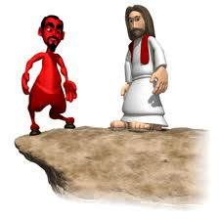
C. Did the Devil Make You Do It?
Satan will attempt to make his options to you attractive… but he tells only half the truth.
Satan will never warn you of the harmful consequences of sin.

Slide 13
The Basic Needs of People
Physical needs.
Security needs.
Social needs.
Self-respect needs.
Achievement needs.
Spiritual needs.

Slide 14
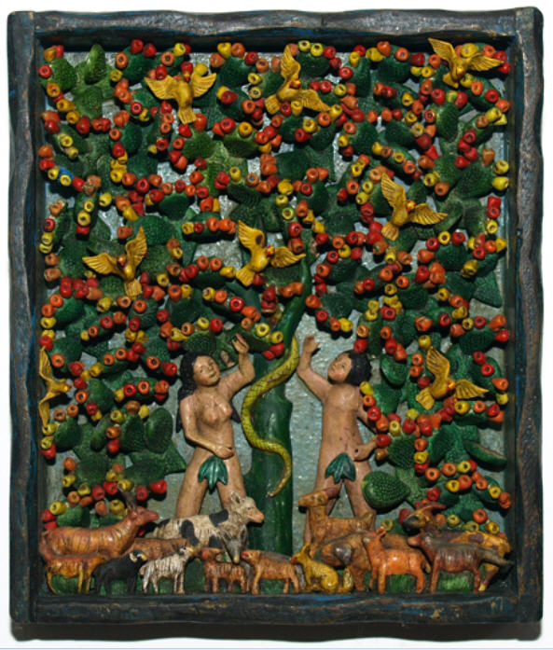
D. How Do the Needs in Your Life Fit in With Temptation?
Satan will tempt you in an area where you have a need that has not been filled recently.
Satan will appeal to a desire of yours and try to get you to believe that it is a real need.

Slide 15
Needs vs. Desires
Need — something we are required to have in order to experience and maintain life to its full potential.
Dictionary Definition
need n.
  A condition or situation in which something is required or wanted: crops in need of water; a need for affection.
  Something required or wanted; a requisite
  Necessity; obligation: There is no need for you to go.
  A condition of poverty or misfortune: The family is in dire need.

Slide 16

E. How Do Your Desires Fit in With Temptation?
Some of our desires are closely related to our needs.
Satan will do everything in his power to make you a slave to the wrong desires.

Slide 17
Needs vs. Desires
Desire-something we want to have, but do not necessarily need to have.
Dictionary Definition
de·sire To wish or long for; want.
  To express a wish for; request.
  n.
  A wish or longing.
  A request or petition.
  The object of longing: My greatest desire is to go back home.
  Sexual appetite; passion.

Slide 18

Personal Application study guide project 2
Learn how to identify your temptations
Learn how to identify what Satan is trying to get you to meet in your life… a need or desire.

Slide 19
The Process of Overcoming Temptation
Chapter 2

Slide 20

Key Biblical Truth:
I need to memorize and
Use a Biblical pattern of
Responding to temptation.
Key Verse:
Ephesians 6:13 NLT
“Use every piece of God’s
Armor to resist the enemy
In the time of evil, so that
After the battle you will
Be standing firm.”

Slide 21

A. Where Do You Stand?
It is time to stop “sitting on the fence” and make a firm decision.
If you want to be successful in overcoming temptation you must be fully committed to following God’s way.

Slide 22

B. Was That a Temptation??!?
Satan will not announce, “This is a temptation.”
Satan will say, “Do you want or need something? Here’s an easy way to get it.”

Slide 23
B. Was That a Temptation??!?
God has promised to speak to you through your conscience and tell you when Satan is trying to get you to sin.

Slide 24

Ask Yourself These Questions…
“If I do this thing, will I break one of God’s laws?”
“If I do this thing, will it help me draw closer to God?”

Slide 25

C. What are the Steps to Overcoming Temptation?
Realize you are being tempted.
Say, “NO,” to the temptation.
Begin to talk to God… pray!
Ask yourself, “What need is Satan trying to get me to meet?”
Look for God’s way out of the temptation.
Set goals that help fill your needs God’s way.

Slide 26

For Personal Application…
Memorize the six steps to overcoming temptation.
Begin to put them into practice in your daily life.
Keep a list of temptations that you encounter daily to help build an awareness of your temptations.

Slide 27
How to Prepare for Temptation
Chapter 3

Slide 28
Key Biblical Truth:
As a Christian, I need to prepare myself so I can successfully overcome every temptation.
Key verse: 1 Corinthians 10:13 New Life Bible
“You have never been tempted to sin in any different way than other people. God is faithful. He will not allow you to be tempted more than you can take. But when you are tempted, He will make a way for you to keep from falling into sin.”

Slide 29
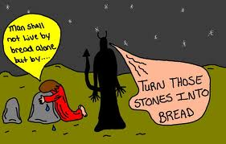
Draw Close to God
Read the Bible and pray if you want to be ready for any temptation Satan may place in front of you.
Learn Jesus’ way of responding to temptation.

Slide 30
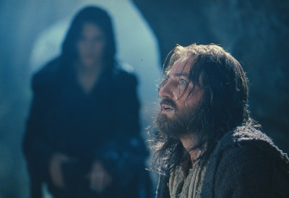
B. Fill Your Needs in God’s Ways
Identify your major temptations.
Identify the need Satan is trying to get you to fill.
Discover God’s way of fulfilling your needs.
Make a commitment to fulfill your needs God’s way.

Slide 31

C. Let God Determine Appropriate Desires
Discover what God likes.
Get rid of old, sinful desires.
Use Biblical values to measure your desires.

Slide 32
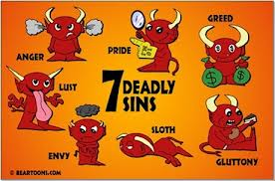
D. Some Temptations Can Be Prevented
Avoid things you know are sin.
Discipline your thought life.
Quickly obey God when He speaks to you.
Spend time with Christians.

Slide 33

D. Some Temptations Can Be Prevented
Be consistent in resisting temptation.
Make sure that God is the real leader of your life.

Slide 34

E. Be aware of Satan’s strategies
He may disguise himself to look spiritual
He may fall back and wait for another opportunity.

Slide 35
Preparing for Temptation
Discuss Project 8
Decide if this project helped prepare you for this temptation. What areas of your life need additional preparation for your success in overcoming this temptation?

Slide 36
Understanding Failure and Handling it Gods Way
Chapter 4

Slide 37
Key Biblical Truth:
I need to learn to respond to my failures in a way that will help me draw closer to God.
Key verse: Hebrews 4:15-16 New Living Translation
“This High Priest of ours understands our weaknesses, for he faced all of the same temptations we do, yet he did not sin. So let us come boldly to the throne of our gracious God. There we will receive his mercy, and we will find grace to help us when we need it.”

Slide 38
What Happens When You Give In to Temptation?
You sin.
You hurt yourself and others.
You will fill the need temporarily, but never permanently.
Following Satan’s way increases the need or the intensity of the desire.

Slide 39

What Happens When You Give In to Temptation?
Giving in once will lead you into greater frustration.
Giving in once makes it easier to give in the next time.
Giving in to one temptation will lead you into greater temptations.
Your failure can make it easier for others to give in to the same temptation.

Slide 40

What Happens When You Give In to Temptation?
9 Giving in leads to rationalizing what is right and wrong.
10. You may feel GUILT!
11. God will come looking for you.
12. Your attitude toward God might change.

Slide 41
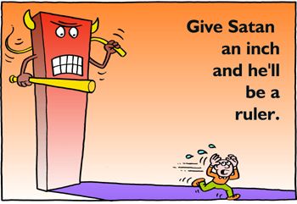
Why Do People Give in to Temptation?
You’re not prepared for the temptation.
You are trying to live the Christian life on your own.
You give up trying to do it God’s way.
You are deceived by Satan.

Slide 42
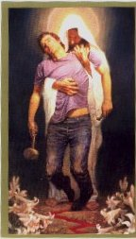
Why Did I Give In to that Temptation?
You do not take Satan and his temptations seriously.
You might think it’s ok because God is always willing to forgive.
You’ve allowed your desires to get out of control.
You are sincere but still give in to temptation.

Slide 43

What Should I Do After I Give In to Temptation?
Admit your failure.
Identify the need or desire and make plans to fulfill it God’s way.
Evaluate your commitment to Christ.
Claim the promises of God for power.
Don’t go on a guilt trip.

Slide 44

Personal Application
Examine your failures.
Look for ways to learn
from your failures so
that you may be
better prepared for
temptation.

Slide 45

In Conclusion…
Yes you will fail from time to time, just as all Christians do.
But remember to call on God for the strength and the wisdom to resist every temptation Satan sends!

Slide 46

Temptation
Scriptures

Slide 47
James 1:13-14
And remember, no one who wants to do wrong should ever say, “God is tempting me.” God is never tempted to do wrong, and he never tempts anyone else either. ¹⁴ Temptation comes from the lure of our own evil desires.

Slide 48
Hebrews 4:14-15
That is why we have a great High Priest who has gone to heaven, Jesus the Son of God. Let us cling to him and never stop trusting him. ¹⁵ This High Priest of ours understands our weaknesses, for he faced all of the same temptations we do, yet he did not sin.

Slide 49
James 4:1-3
What is causing the quarrels and fights among you? Isn’t it the whole army of evil desires at war within you? ² You want what you don’t have, so you scheme and kill to get it. You are jealous for what others have, and you can’t possess it, so you fight and quarrel to take it away from them. And yet the reason you don’t have what you want is that you don’t ask God for it. ³ And even when you do ask, you don’t get it because your whole motive is wrong—you want only what will give you pleasure.

Slide 50
2 Timothy 2:22
Run from anything that stimulates youthful lust. Follow anything that makes you want to do right. Pursue faith and love and peace, and enjoy the companionship of those who call on the Lord with pure hearts.

Slide 51
Psalm 37:3-4
    Trust in the Lord and do good.
    Then you will live safely in the land and prosper.
    ⁴ Take delight in the Lord,
and he will give you your heart’s desires.

Slide 52
James 4:7-8
    So humble yourselves before God. Resist the Devil, and he will flee from you. ⁸ Draw close to God, and God will draw close to you. Wash your hands, you sinners; purify your hearts, you hypocrites.

Slide 53
Ephesians 6:10
    A final word: Be strong with the Lord’s mighty power. ¹¹ Put on all of God’s armor so that you will be able to stand firm against all strategies and tricks of the Devil.

Slide 54
1 Peter 4:1-2
    So then, since Christ suffered physical pain, you must arm yourselves with the same attitude he had, and be ready to suffer, too. For if you are willing to suffer for Christ, you have decided to stop sinning. ² And you won’t spend the rest of your life chasing after evil desires, but you will be anxious to do the will of God.

Slide 55
Psalm 1:1-2
    Oh, the joys of those
    who do not follow the advice of the wicked,
    or stand around with sinners,
    or join in with scoffers.
    ² But they delight in doing everything the Lord wants;
    day and night they think about his law.

Slide 56
Ephesians 4:21-24
    Since you have heard all about him and have learned the truth that is in Jesus, ²² throw off your old evil nature and your former way of life, which is rotten through and through, full of lust and deception. ²³ Instead, there must be a spiritual renewal of your thoughts and attitudes. ²⁴ You must display a new nature because you are a new person, created in God’s likeness—righteous, holy, and true.

Slide 57
Colossians 3:5
    So put to death the sinful, earthly things lurking within you. Have nothing to do with sexual sin, impurity, lust, and shameful desires. Don’t be greedy for the good things of this life, for that is idolatry.

Slide 58
Galatians 5:16
    So I advise you to live according to your new life in the Holy Spirit. Then you won’t be doing what your sinful nature craves.

Slide 59

Temptation
This PowerPoint is designed to be used with the Group Studies for New Christians Course Temptation, by Dave Batty.
This PowerPoint resource was developed by the
Teen Challenge Farm, London, Ontario
Edited by Global Teen Challenge, 2013

