Slide 1



Helping Students with Personal Application Goals
By Dave Batty

Slide 2
How much experience have you had in helping students set personal application goals in Teen Challenge classes?
Give yourself a score of a number between 0 and 10.

Slide 3

Personal Application Goals—the engine

Slide 4
Setting Personal Application Goals is a difficult task
For Students
For Teachers
But Very Important

Slide 5
Satan’s greatest lie
-----Only believe!

Slide 6
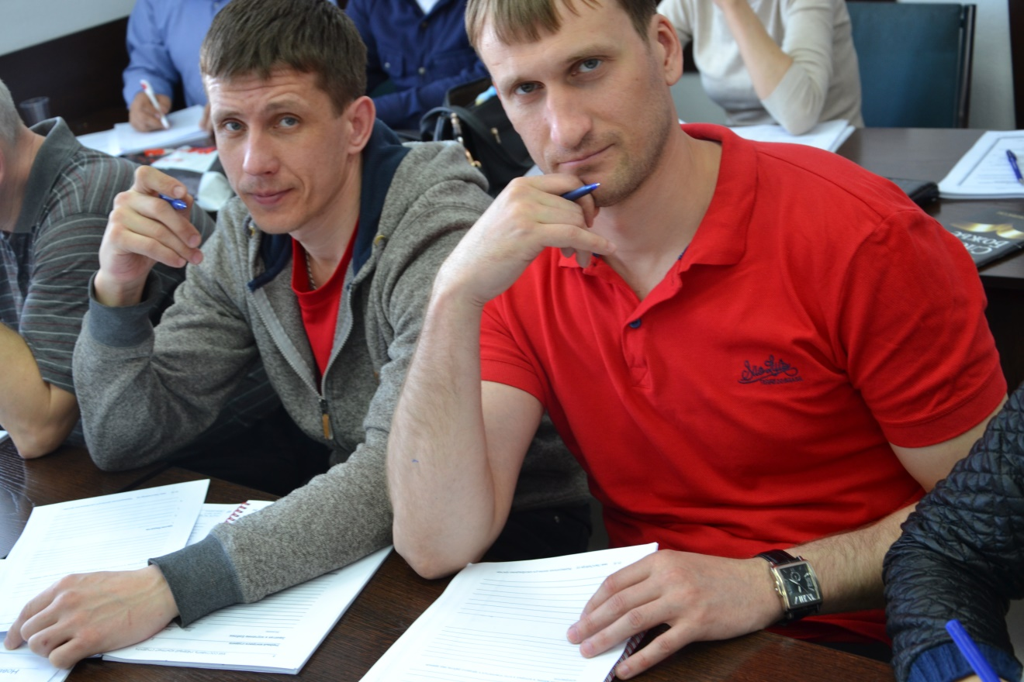
Difference between being a believer and a follower of Jesus

Slide 7

A. God’s view of personal application
Matthew 7:24-27
James 1:22-25
Galatians 3:1-3
Ezekiel 33:30-32

Slide 8
A. God’s view of personal application
Matthew 7:24-27
Hebrew model of education vs. Greek model
Know the truth
Understand how the truth relates to my life
Do it—Put it into action—today!
—consistently

Slide 9
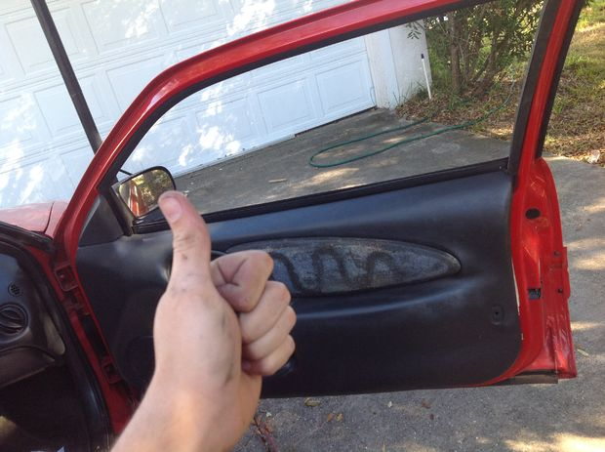
A Biblical approach to learning
Step 1 Step 2 Step 3
Windows

Slide 10

Teen Challenge is a Great Commission ministry—focused on making disciples

Slide 11

Learning how to set personal application goals that can be implemented in 2-3 days is a
basic life skill for a Christian disciple.
These goals focus on
small action steps
of applying God’s truth
in your life.

Slide 12
“A journey of a thousand miles begins with a single step.”
- Chinese Proverb

Slide 13
B. Where do we use Personal Application Goals?
Character Qualities Step 6
Scripture Memorization Class
Book Reports
Sunday Sermon Personalization Class
Group Studies for New Christians classes
Others Uses ( Bible study, Projects)

Slide 14
C. Samples of good personal application goals
Proverbs 4:23 NIV
Above all else, guard your heart,
for everything you do flows from it.
Tonight if I hear any unwholesome talk going on, in order to guard my heart, I will try and change the direction of the conversation. If I can't change the direction of the conversation, I will excuse myself from the situation.

Slide 15

C. Samples of good personal application goals

Slide 16
Romans 12:10 NIV
Be devoted to one another in brotherly love. Honor one another above yourselves.
This week I will practice humility by being last during all events (meals, getting in the van), realizing how this is preferring my brothers to myself.

Slide 17

I will write a letter to my mother and ask her to forgive me for what I have done to hurt her in the past.

Slide 18
Goal for a teacher
Romans 8:28
And we know that in all things God works for the good of those who love him, who have been called according to his purpose.
When I feel like I have done a lousy job of teaching, I will sit down and list what I learned from teaching this lesson.

Slide 19
C. Personal application goals are a tool.
--a _means__, not the __end__
goals are a _means__ to the practical application of Biblical truth
--the desired __end__
  a closer personal relationship with God.
  Men and women of wisdom, holiness, and integrity
  Not simply to be __drug__ free

Slide 20
D. Marks of a good Personal Application Goal
Is it Simple?
Is it Specific?
Is it Meaningful?
Is it Practical?
Can it be measured?
Does it help you grow?

Slide 21
Goal based on Romans 12:16
For the next 3 meals, I will sit next to someone I don't usually spend time with or that I do not like in order to get to know them better.
For the next 3 meals, I will sit next to a new student in the program in order to get to know them better.

Slide 22


Good idea
versus
a good goal

Slide 23

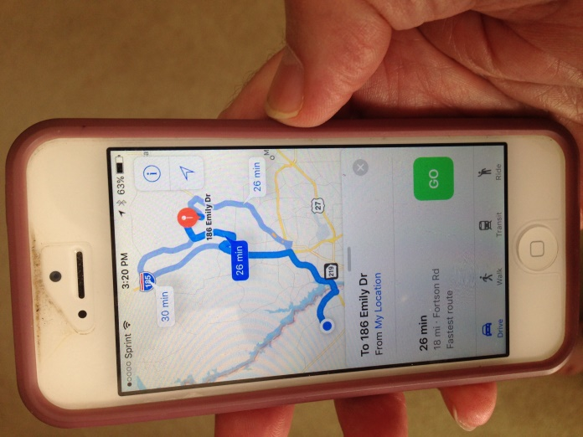

Slide 24
Goal for Character Qualities class--Gratefulness
I will thank 3 people tonight for how they have helped me since
I have been in the program.

Slide 25
2 Corinthians 5:17
I will make a list of 10 “old things” that have gone or need to go & make a list of at least 10 “new things” that have come or need to come. I will read this list daily for a week.

Slide 26
Activity—Evaluate this goal
1 Corinthians 10:13 NIV
No temptation has overtaken you except what is common to mankind. And God is faithful; he will not let you be tempted beyond what you can bear. But when you are tempted, he will also provide a way out so that you can endure it.
Goal: When tempted, realize it is Satan.

Slide 27
Matthew 28:19-20
Therefore go and make disciples of all nations, baptizing them in the name of the Father and of the Son and of the Holy Spirit, 20 and teaching them to obey everything I have commanded you. And surely I am with you always, to the very end of the age.”
Student Goal: I want to win the world to Jesus.

Slide 28
E. What should be the focus of the personal application goal?
1. Where am I today?
2. Where does God want me to be?
(in regard to this area of my life?)
3. What is one step I can take today to begin moving in the right direction?
4. How can this step be measured?

Slide 29
Hebrew model of education
Matthew 7:24-27
Know the truth
Understand how the truth relates to my life
Do it—Put it into action—today!
—consistently
The student’s goal can focus on any one of these three steps.

Slide 30
Are they having problems understanding how God’s truth relates to their life?
Do they see the problem in their life?
Do they see how God’s truth speaks to this problem in their life?
Do they see the steps of action that God’s truth is calling for them to take?

Slide 31
If they correctly understand God’s truth, and see how it relates to their life, then their goal should focus on the personal application—the doing of it.
What are the action steps they will take to actually put this biblical truth into practice in their life?

Slide 32
F. How can you become skilled at writing good personal application goals?
James 1:2 NIV
Consider it pure joy, my brothers, whenever you face trials of many kinds.
Philippians 4:13 NIV
I can do everything through him who gives me strength.

Slide 33
F. How can you as a teacher help students set good personal application goals?
1. What problems do your students have in setting personal application goals?

Slide 34
2. The problem of goals being too general
Ask the question
What is one thing I can do today that will help me move toward my goal?

Slide 35
We are not trying to go the whole distance in one step.
We want to take
One step in a positive direction.

Slide 36
3. What should be the focus of the personal application goal?
1. Where am I today?
2. Where does God want me to be?
(in regard to this area of my life?)
3. What is one step I can take today to begin moving in the right direction?
4. How can this step be measured?

Slide 37
F. Short term vs long term goals
Daily personal application goals
Intermediate steps
Long Range Goals
What is the value I want to develop?

Slide 38
I press on toward the goal to win the prize for which God has called me (Philippians 3:14 NIV)

Slide 39

3. Different Kinds of Goals
God related goal
Reaction goal
(If this happens- then I will do…)
Attitude goal
Behavior goal
Knowledge goal
Interpersonal relationship goal
Self-image goal
Personal health goal
Discussion goal

Slide 40
4. What will be your action steps to help students in your program write better personal application goals?

Slide 41
H. Setting good personal application goals is only one step to becoming a successful Christian—a successful disciple.
What is most important?
1. Put it into action!
Not just one time
Make it a part of your daily lifestyle
This is the path to life transformation
This is the heart of Christian discipleship!

Slide 42
G. Ideas for Good Goals
Involve another person in the goal
Positive Steps- It’s not enough to stop a behavior, take steps in moving toward the new behavior
Set a specific time when you will do goal

Slide 43
Helps in setting Goals
Read questions listed with CQ in Manual
Scripture verse- Look it up in “Life Application Bible”, Other translations may give insights
Refer to SMC Manual “Marks of a good Personal Application Goal”
Refer to Successful Christian Living Student Manual pages 14 -17
Teach a “Goals Class” to staff & students

Slide 44
Developing good Personal Application goals is a skill that will be useful to the student for a lifetime

Slide 45
D. Marks of a good Personal Application Goal
Is it Simple?
Is it Specific?
Is it Meaningful?
Is it Practical?
Can it be measured?
Does it help you grow?

Slide 46
Personal Application Goals—the engine

Slide 47
A Biblical approach to learning
Step 1 Step 2 Step 3
Windows

Slide 48
Contact information
Global Teen Challenge
706-576-6555
www.GlobalTC.org
www.iTeenChallenge.org

