Slide 1
Introduction to the Bible Reading Class & Personal Reading Class & Sunday Sermon Personalization Class

Slide 2
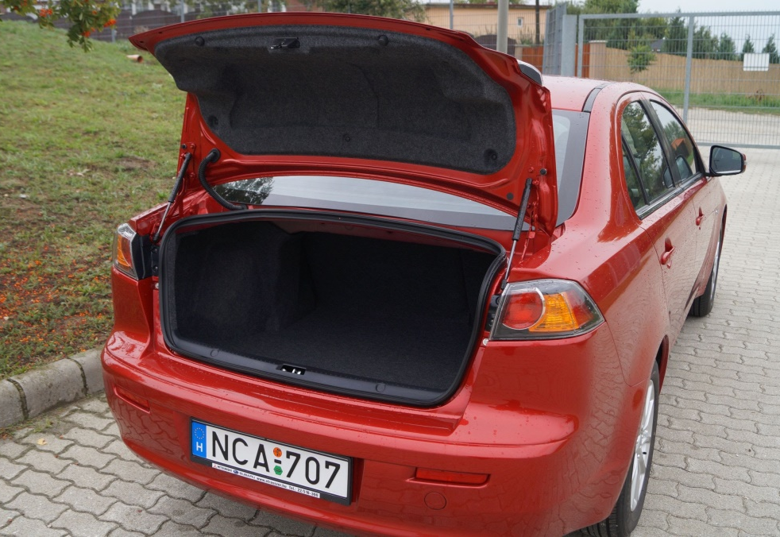
Bible Reading Class & Personal Reading Class

Slide 3
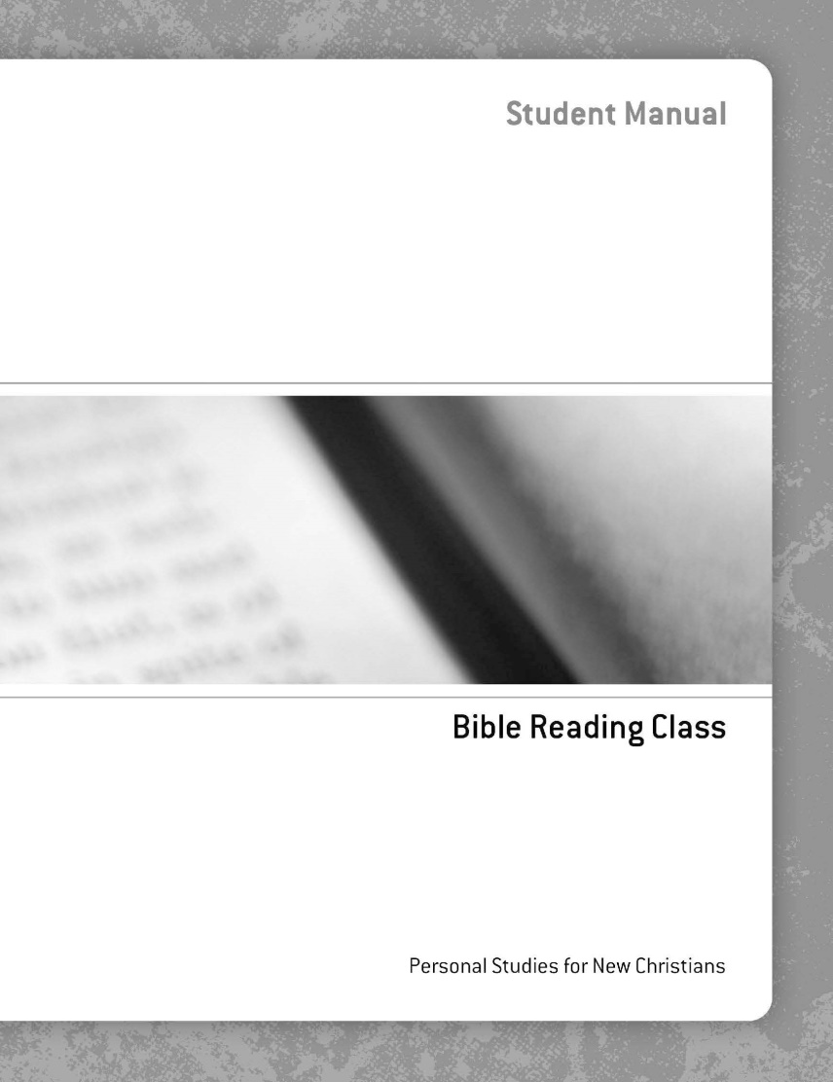

Slide 4
Teaching the value of systematic reading of books in the Bible.

Slide 5
Page 6 Instructions

Slide 6
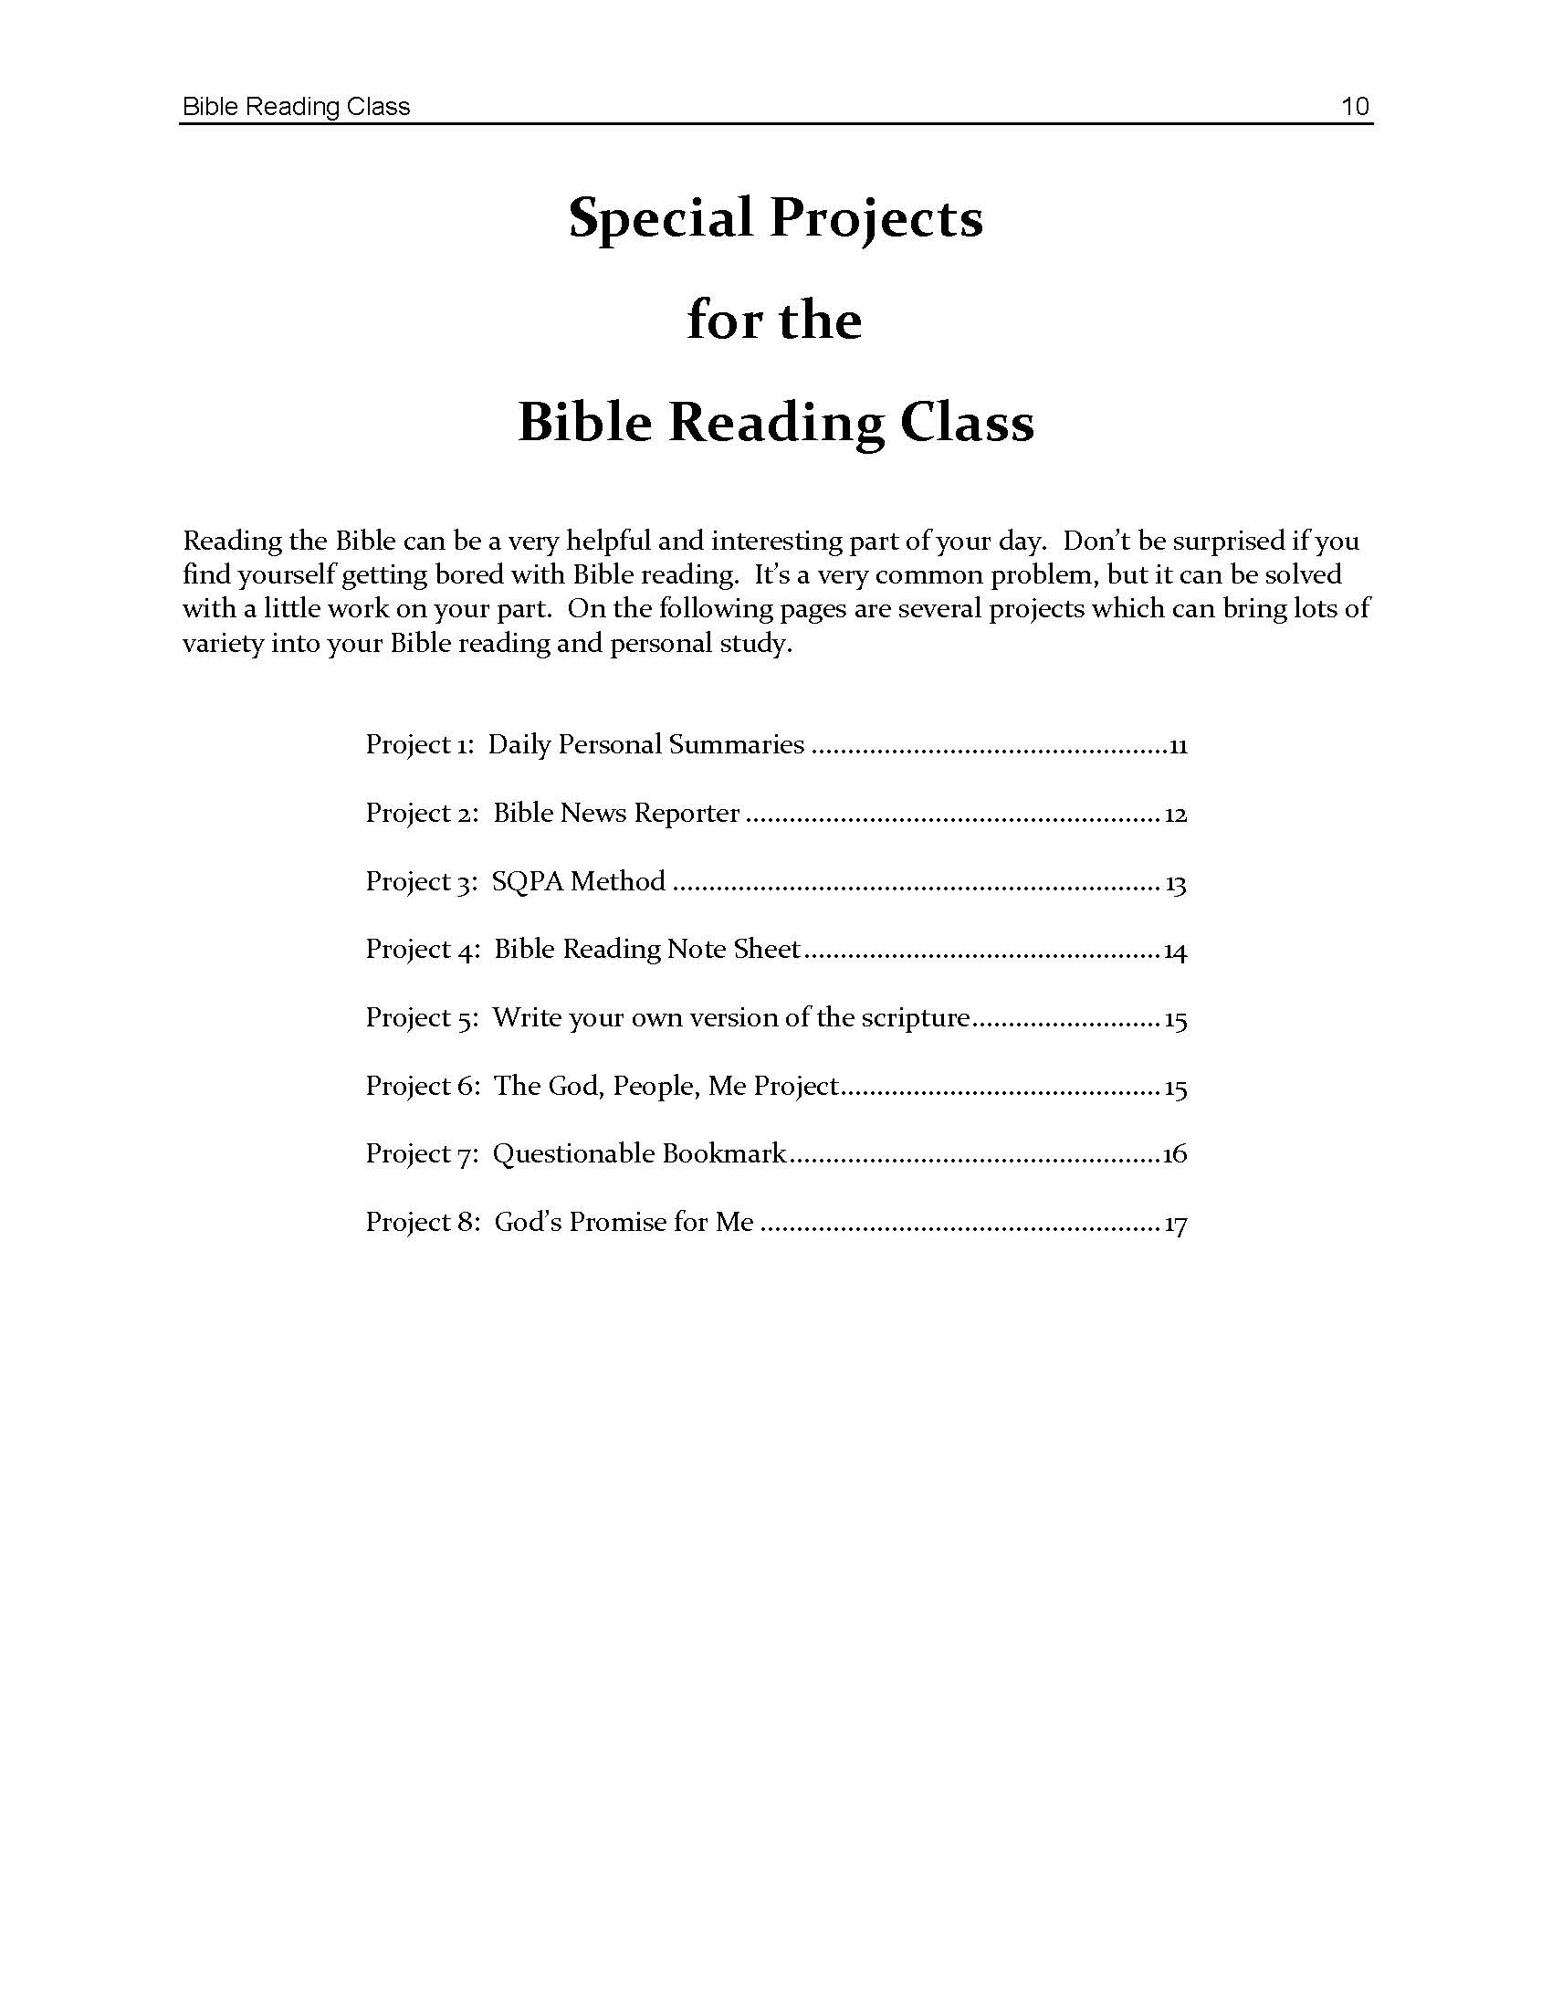
Special Projects Pages 9 - 18

Slide 7
Pages 19 - 27 Bible Reading Record Sheets

Slide 11
Page 4

Slide 12
Page 5 Daily activities

Slide 13
Instructions for Daily Personal Summaries Page 6

Slide 17
Page 8 Book Report

Slide 18
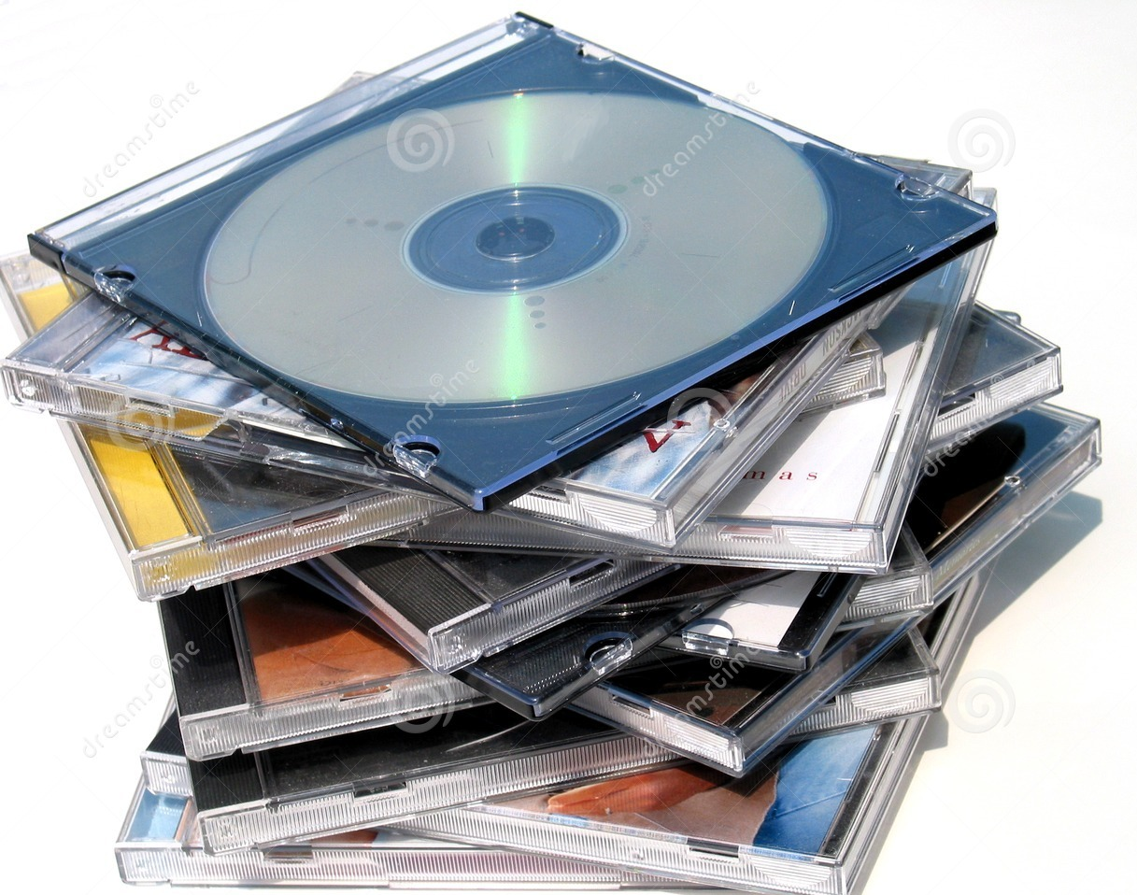
Page 11
Special instructions for audio and video recordings

Slide 19
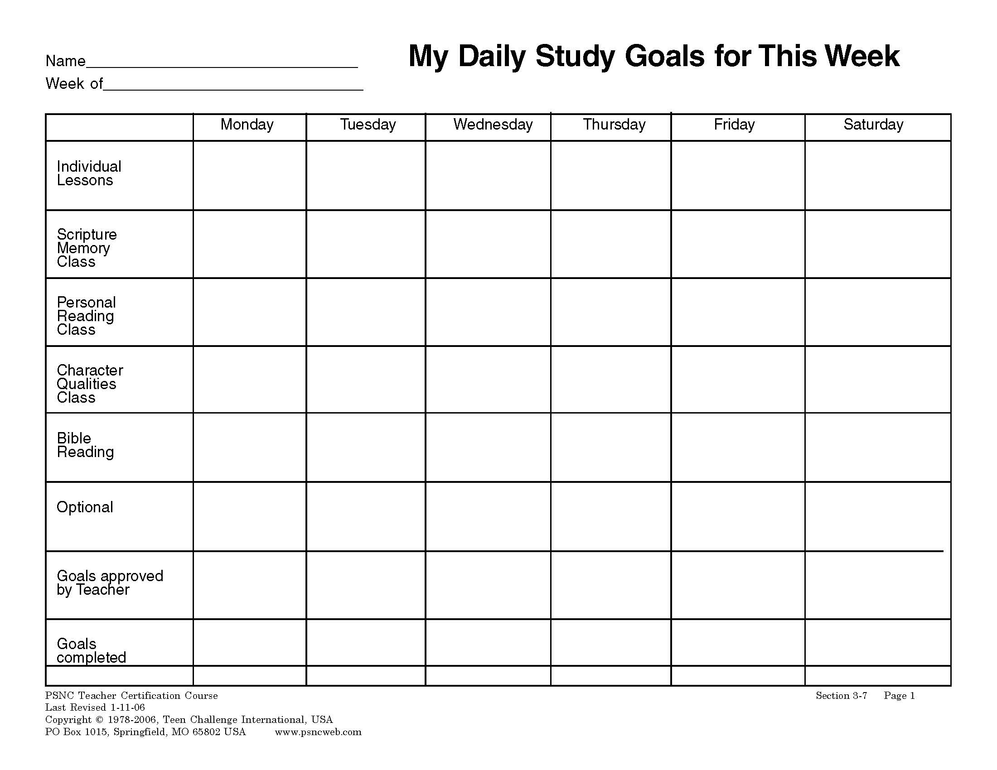

Slide 21
Bible Reading Class & Personal Reading Class

Slide 23
Sunday Sermon Personalization Class

Slide 28
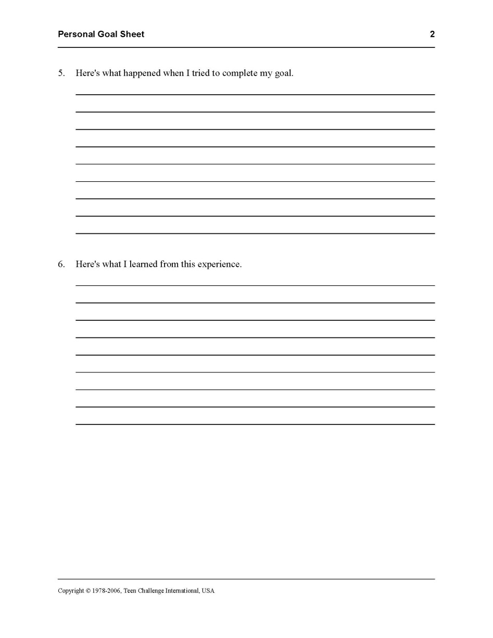

Slide 31
Questions for discussion

Slide 32
CONTACT INFORMATION
Global Teen Challenge
www.GlobalTC.org
www.iTeenChallenge.org

