Slide 1
Scripture Memorization Class
By David Batty

Slide 2
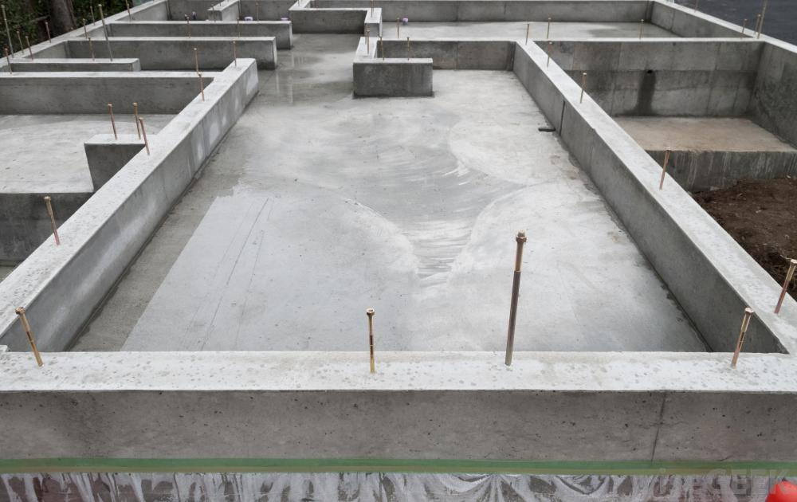
The role of memorizing scripture in the context of:
Christian discipleship
Renewing your mind

Slide 3
Floor of the car

Slide 5
CLASS OBJECTIVES
1. I will memorize verses from the Bible
2. I will discover what God is teaching me in each verse I memorize.
3. I will determine at least 3 ways that I can apply the truths of each verse in my daily living experiences.
4. I will begin to practice these Biblical principles in my daily living.
5. I will begin to think about what these verses say when I encounter difficult situations in my daily experiences.

Slide 6
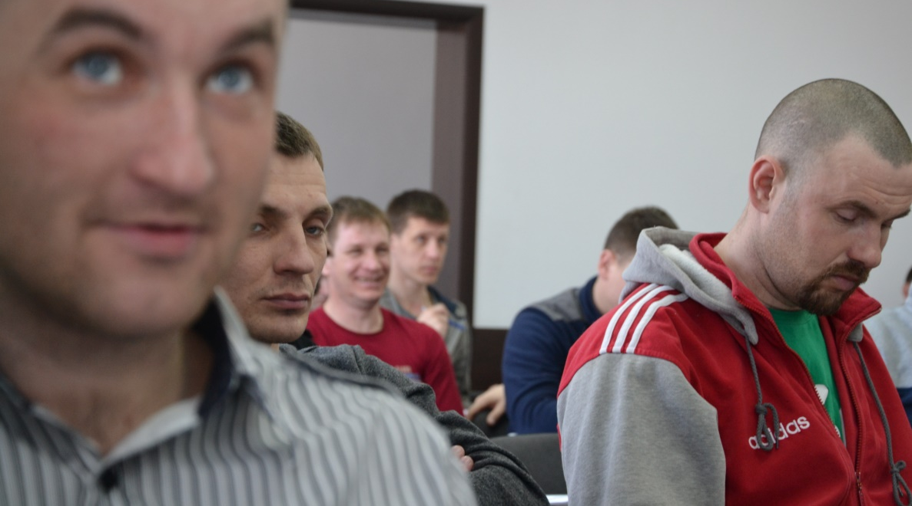
CLASS OBJECTIVES
6. I will begin to replace distracting thoughts about my past life (and temptations) with thoughts about these Biblical principles.

Slide 7
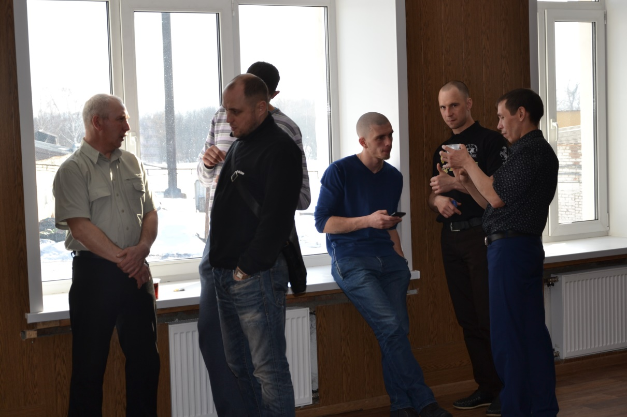
CLASS OBJECTIVES
7. I will use these verses as starting points in personal conversations with others here.

Slide 8
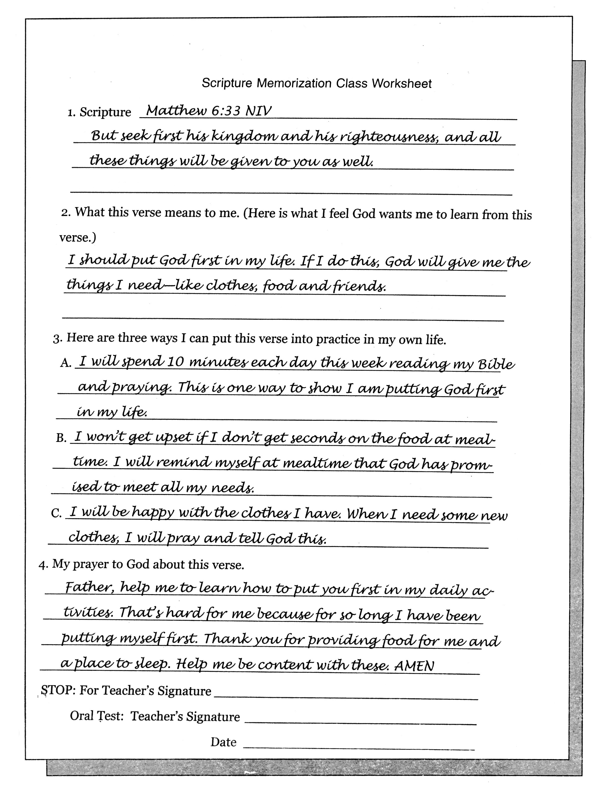

Slide 9
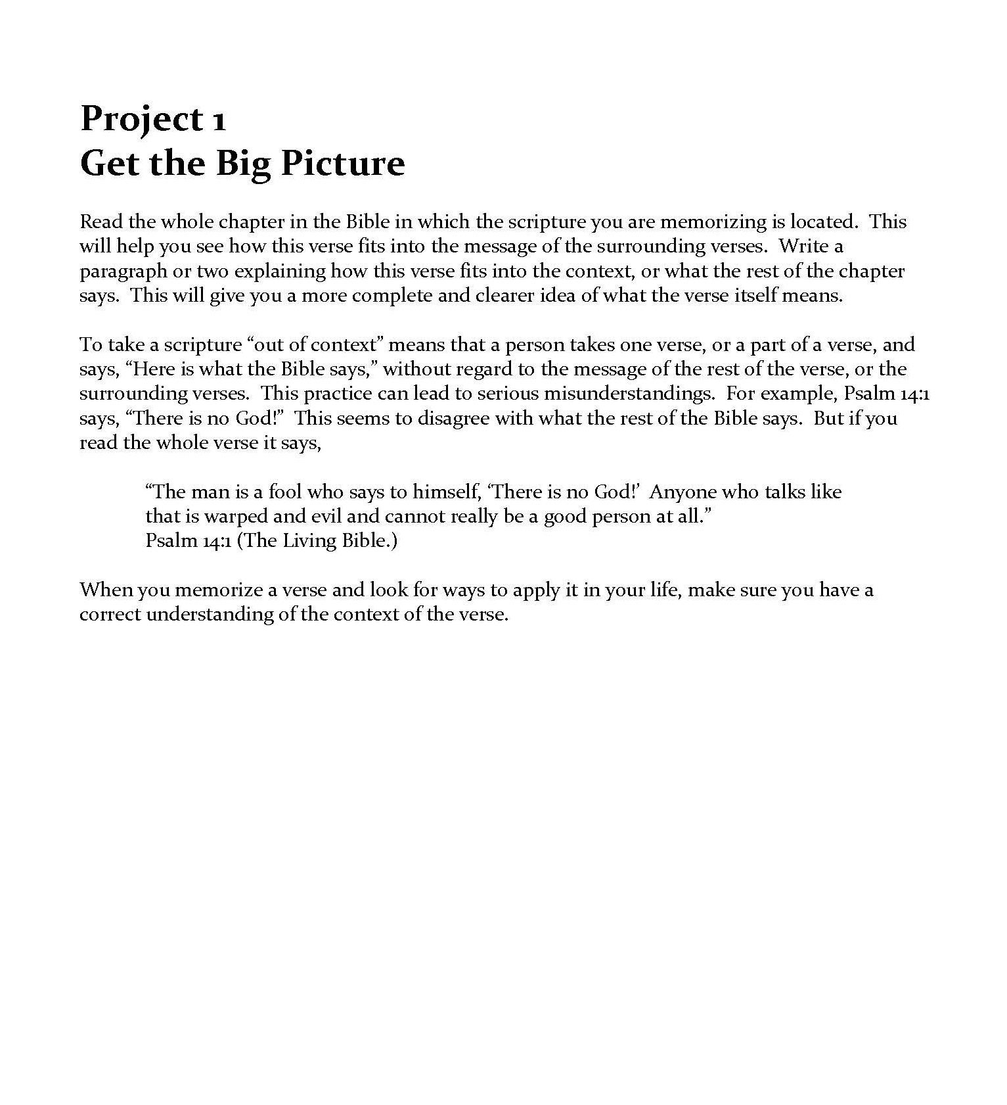
Part 3 Special Projects

Slide 10
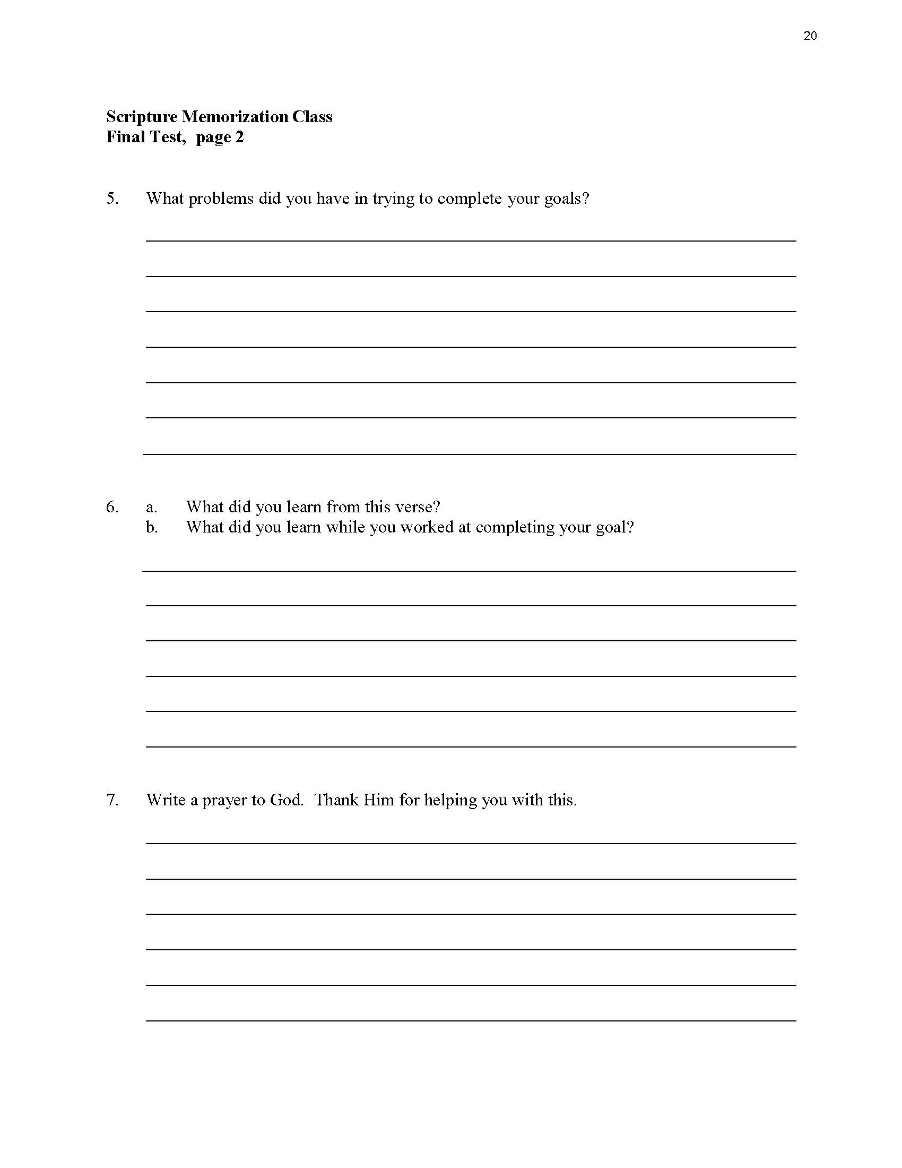

Slide 11
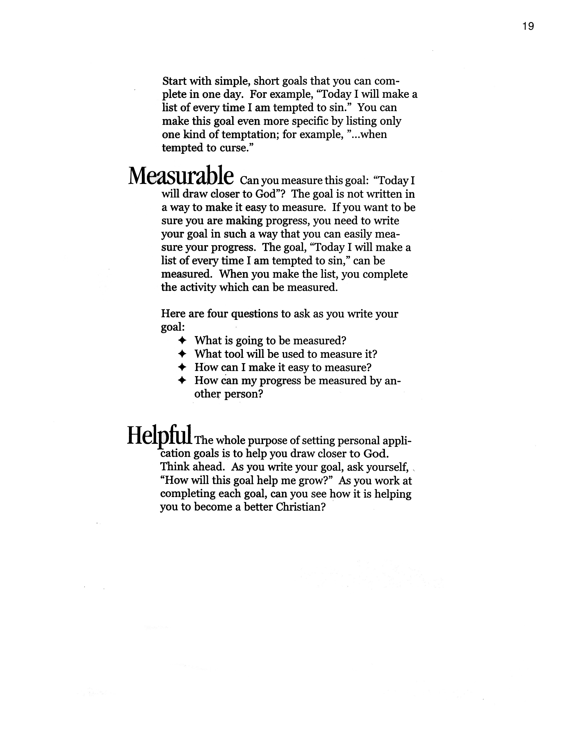

Slide 12
Floor of the car

Slide 13
Questions for discussion

Slide 14
Contact information
Global Teen Challenge
706-576-6555
www.GlobalTC.org
www.iTeenChallenge.org

