Slide 1
200 Project series

Slide 2
All the lessons & projects

Slide 3
200, 300, & 400 Projects

Slide 4
Is it necessary to have all these projects?

Slide 6
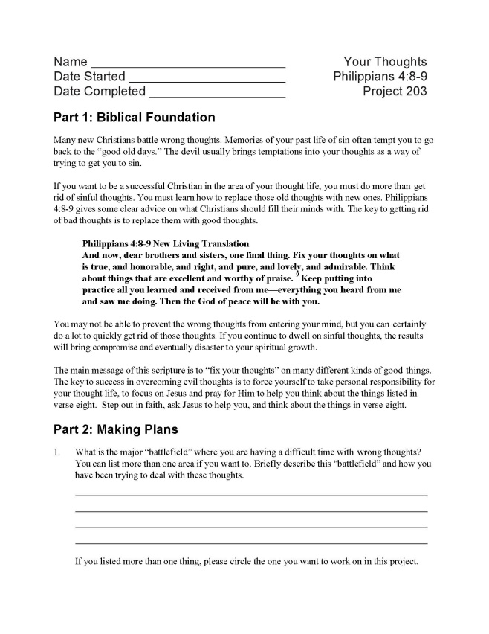
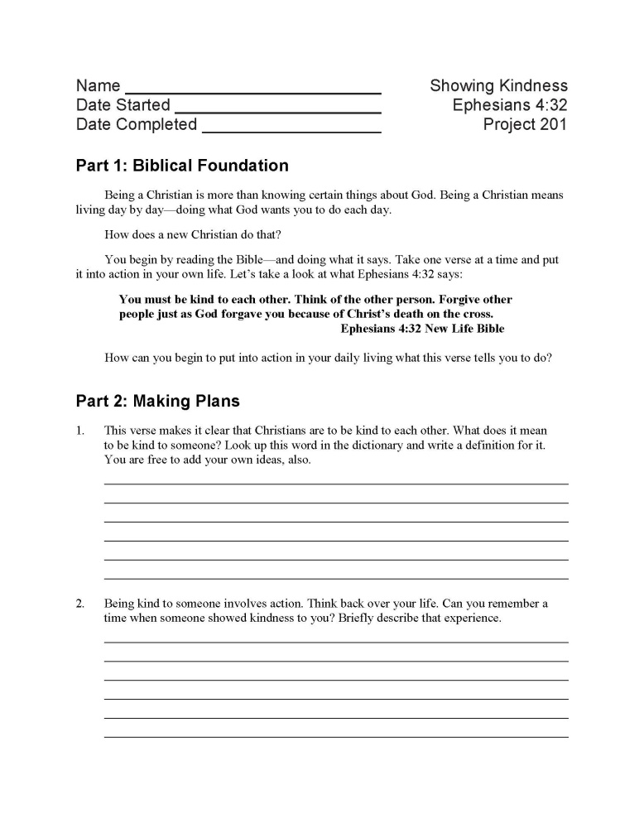
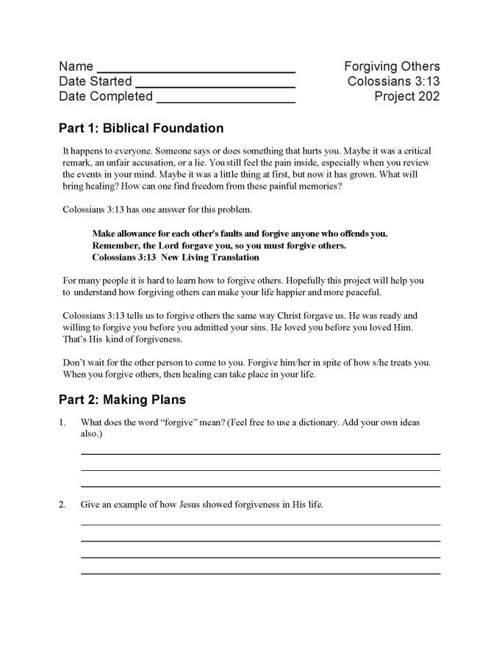
Purpose of the 200 series projects:
To take a specific biblical principle and scripture and apply it in your life this week.

Slide 7
Project 201: Showing Kindness
Jesus showed kindness wherever He went. As believers, it is our goal that the same would be said of us. Students will discover the benefits of showing kindness, and learn useful tips on how to exhibit random acts of kindness to others everyday. Ephesians 4:32 is a key biblical text.

Slide 8
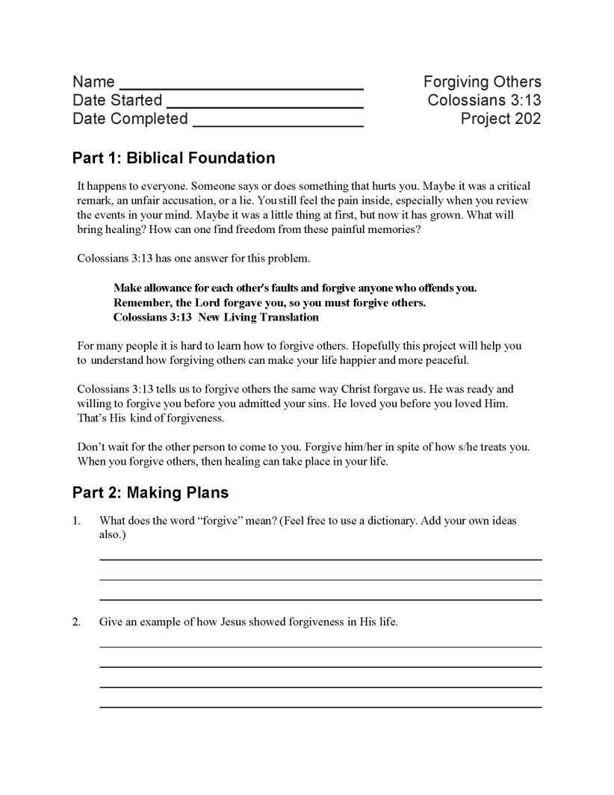
Project 202: Forgiving Others
As Christians it sometimes seems easier to receive forgiveness than to extend it. Yet it is God’s desire for believers to offer the same grace and compassion to others that He has given freely to each of us. Your students can uncover the joy found only through releasing those who have hurt or betrayed them. Once they do, students will be ready to experience the feeling of complete freedom that’s awaiting them. Colossians 3:13 is a key biblical text.

Slide 9
Project 203: Your Thoughts
A person’s thoughts can be a snare that entraps them; however, with the healing power of Christ, everyone can experience the full liberation of their mind. Through this lesson, individuals will encounter the One who sets people free from the bondage of lust, anger, and bitterness. Consider this course for any small group or personal study. A good deal of this study is spent exploring and applying principles identified in Philippians 4:8-9.

Slide 10
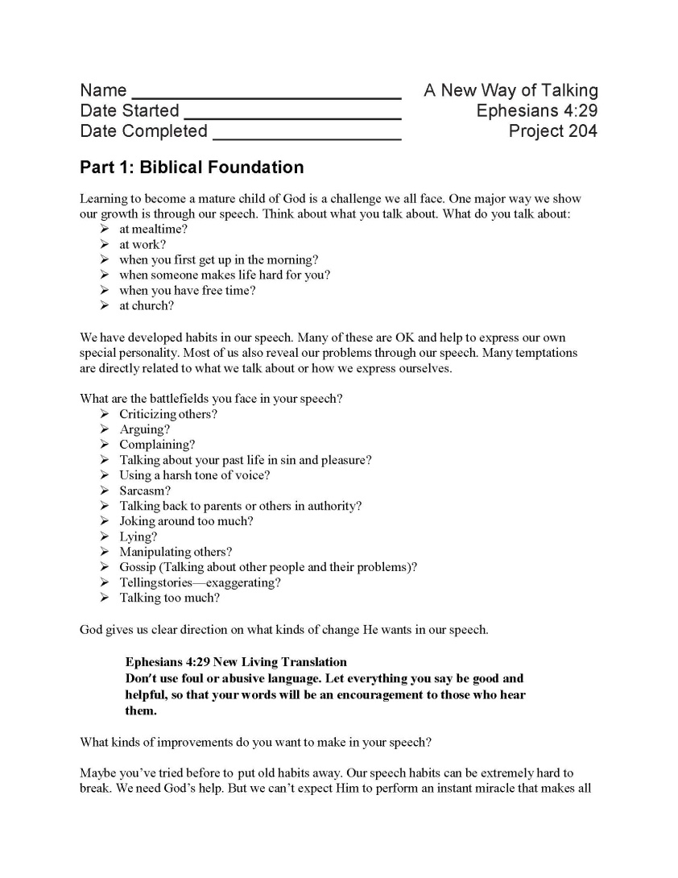
Project 204: A New Way of Talking
Your students can learn how to use their words to lift up and encourage, rather than tear themselves or others down. All believers are called to let their words be a source of life and not death; use this lesson to teach your students how to accomplish this in their own lives. The key biblical text is Ephesians 4:29.

Slide 11
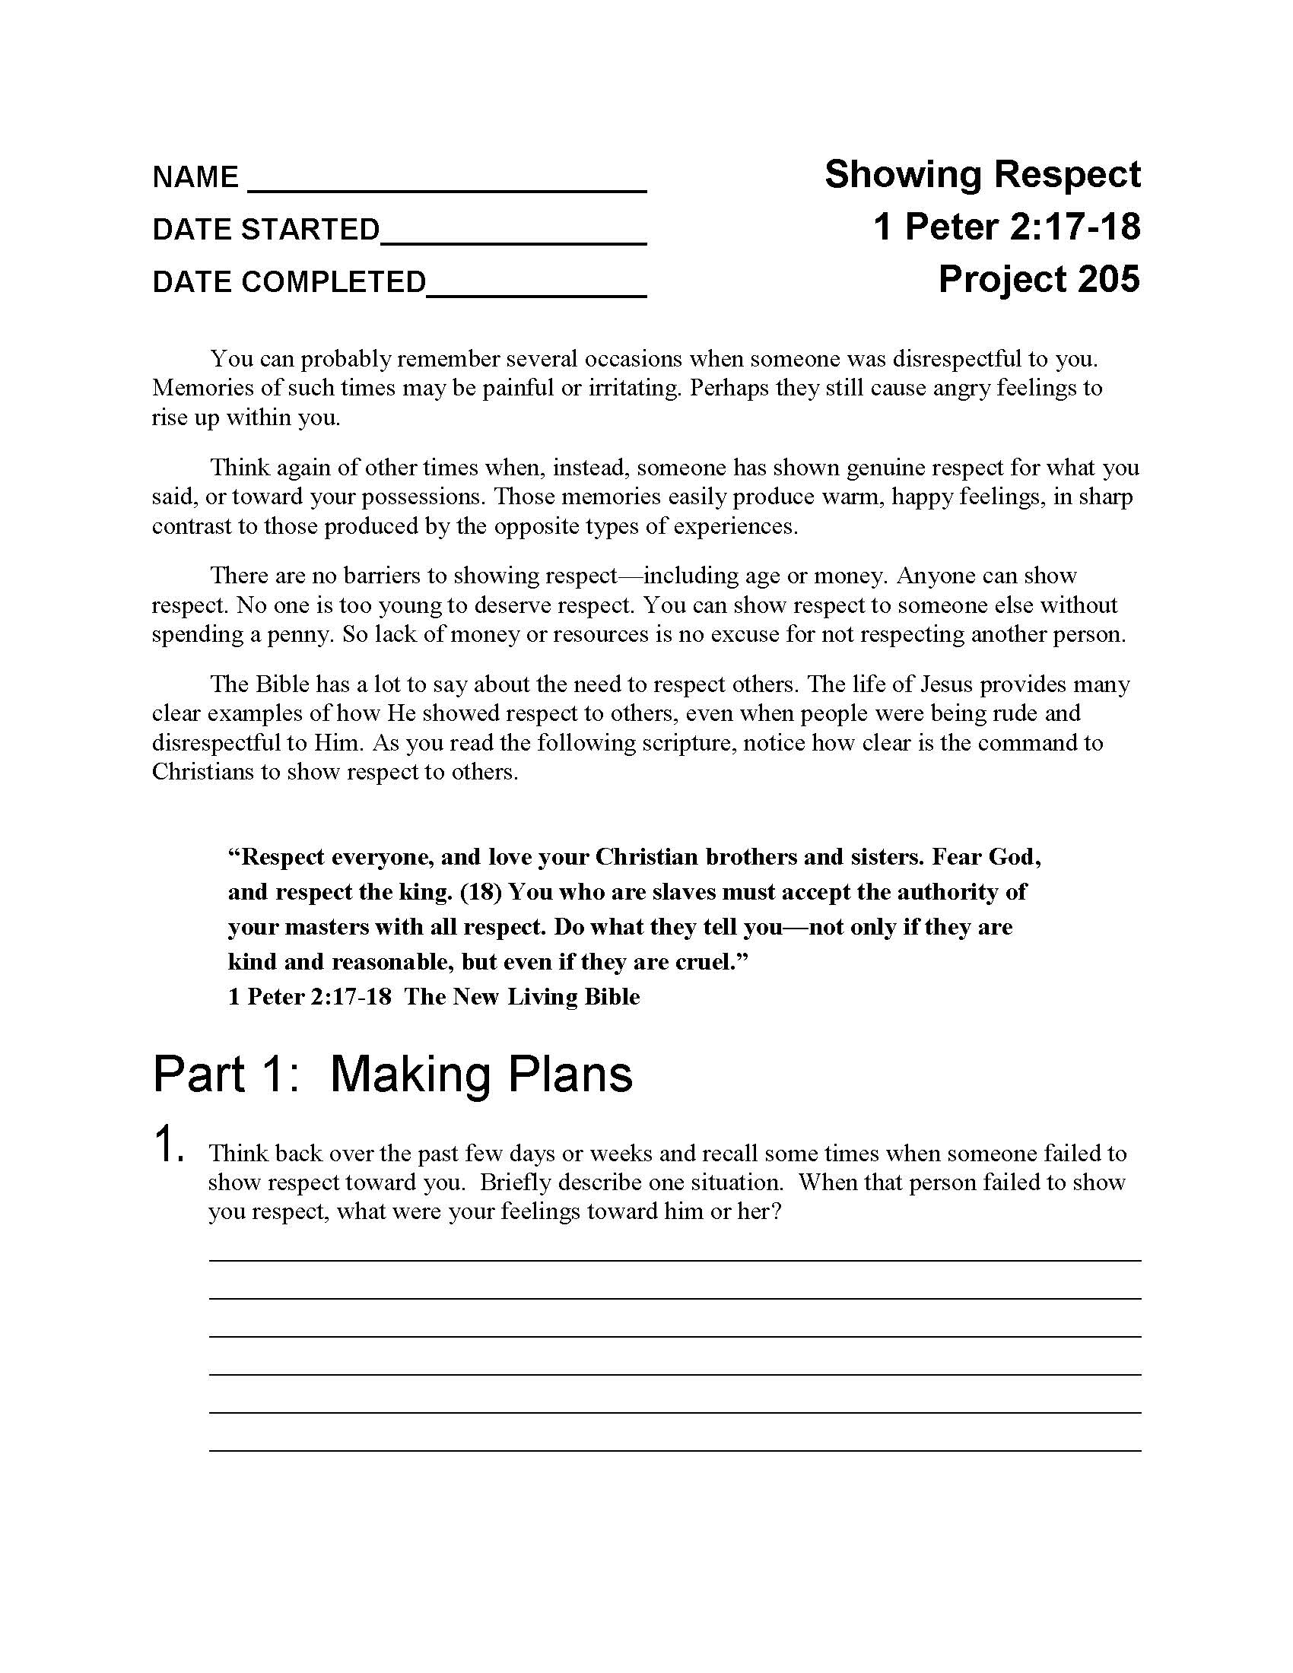
Project 205: Showing Respect
To whom should Christians show respect -- their families, their leaders, their peers? Students will learn how to treat everyone around them with dignity and respect, and in turn how to elicit respect from others

Slide 12
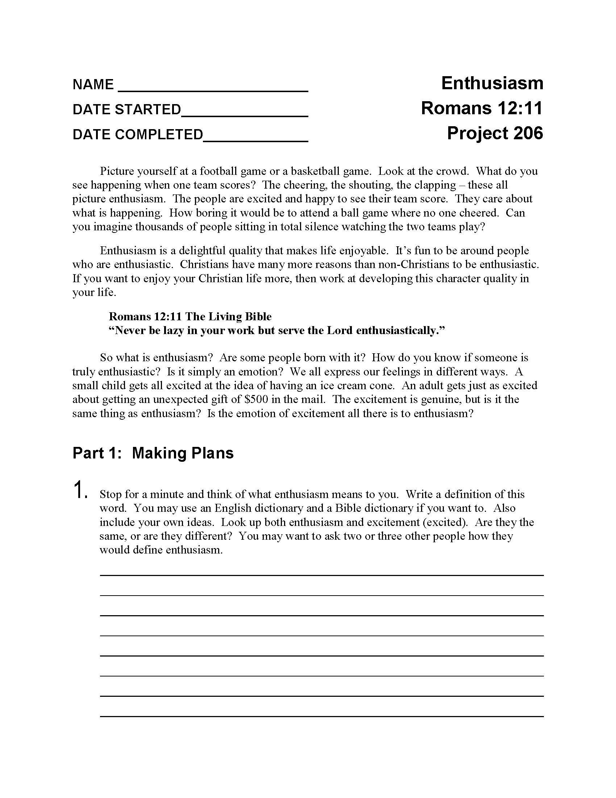
Project 206: Enthusiasm
There is no joy like that found in living the full Christian life. Through this study, individuals will experience the excitement and enthusiasm of being born again, and learn how to share that same joy with those around them.

Slide 13
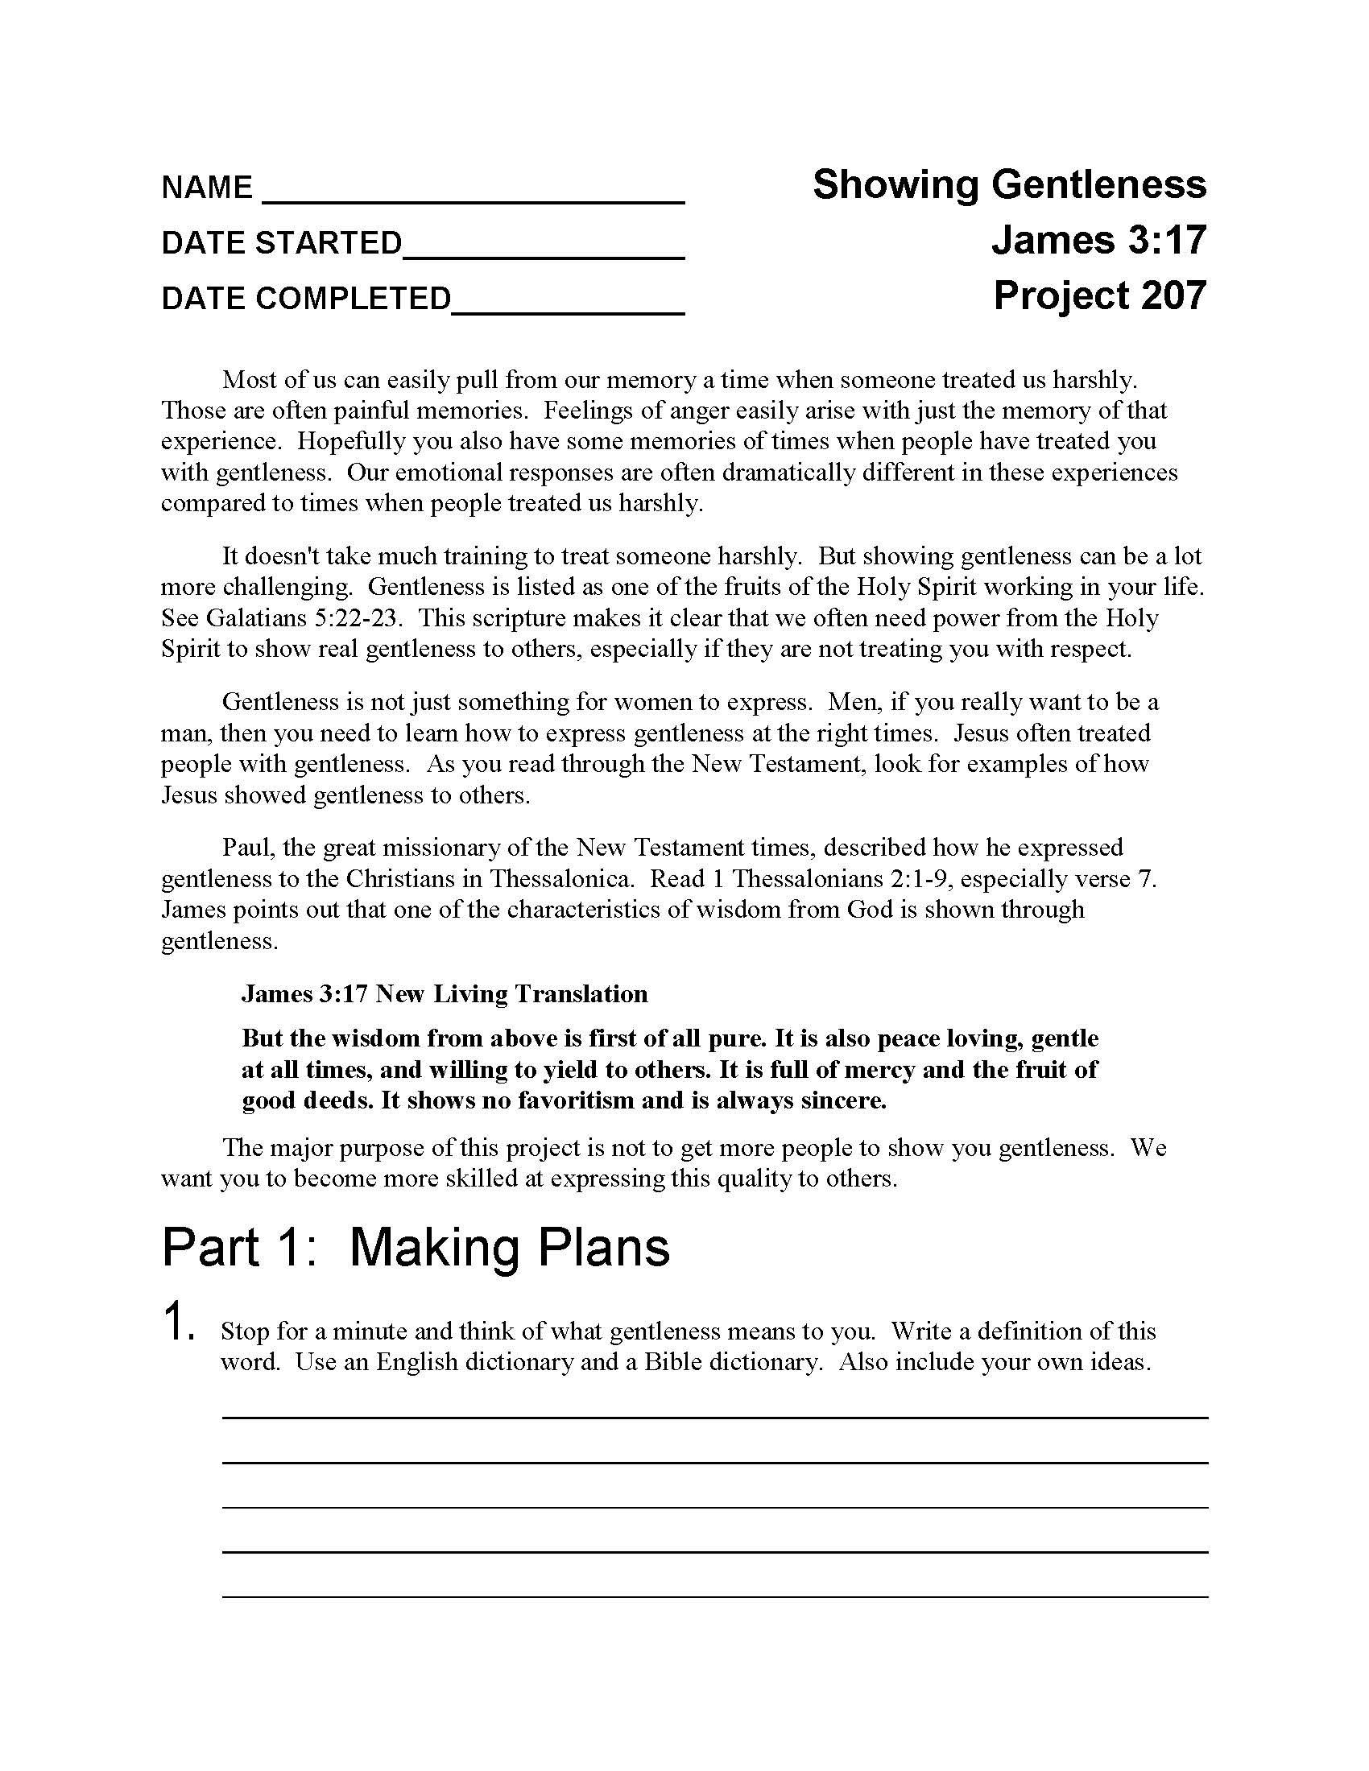
Project 207: Showing Gentleness
There is a gentleness that every Christian should exhibit in their lives when dealing with others. Students will learn how to do this, as well as learn the difference between being gentle and being a pushover.

Slide 14
300 Project Series

Slide 15
300 Series
These are special projects dealing with specific issues or problems in their lives.
Not all of these will be used by every student.
Some of these projects can be used at any point in the program.

Slide 16
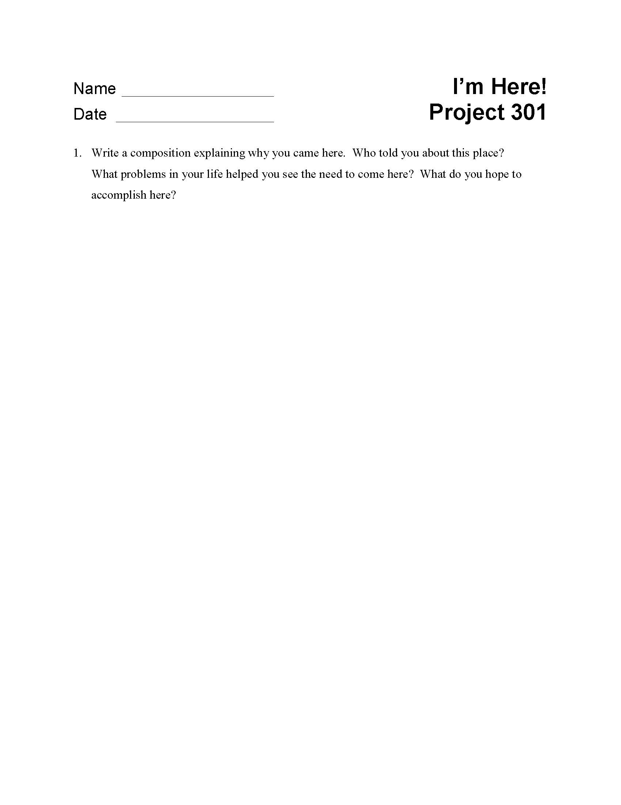
Project 301: I’m Here!
Included is a pack of 50 one-page exercises.

Slide 17
Project 302: New Hope for Life
God is a God of second chances. This study is for students who have left the program, have become freshly aware of their need for help, and have returned.

Slide 18
Project 303: Go See the Judge
Knowing how to behave in court can be an uncertain matter for anyone; knowing how to behave when you’re a new Christian can be even harder. Go See the Judge will equip students to have a godly attitude even when appearing before a court of law.

Slide 19
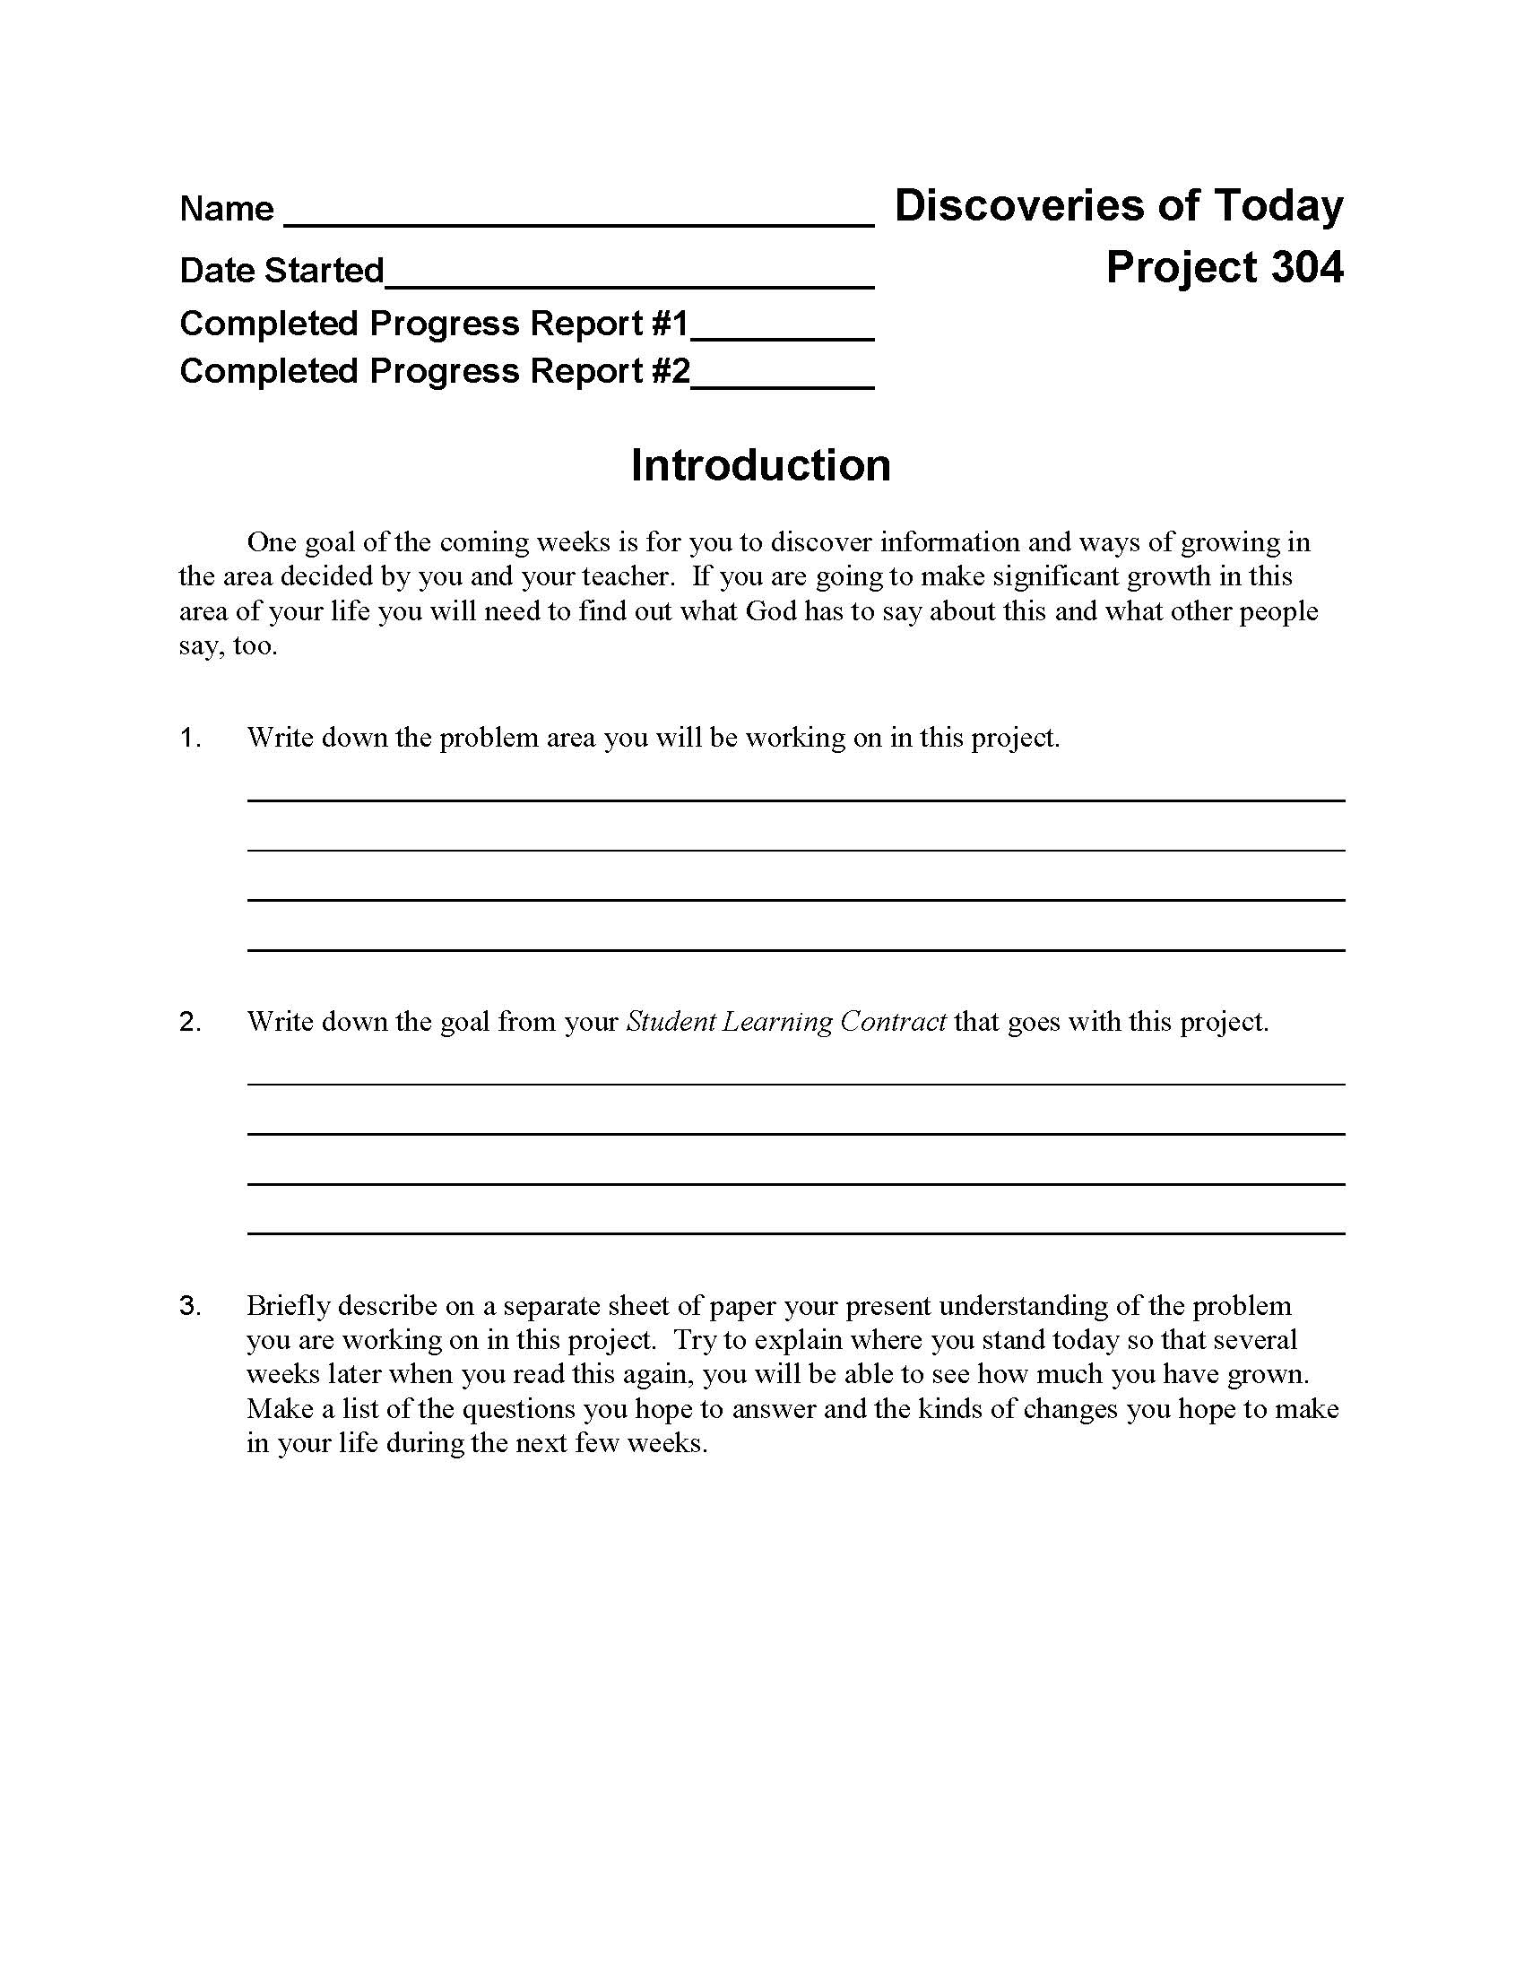
Project 304: Discoveries of Today
Students will discover how to overcome thoughts that tempt and entice. They will also learn to be equipped with verses and practical applications as they continue to discover God’s personal direction for their daily lives.

Slide 20
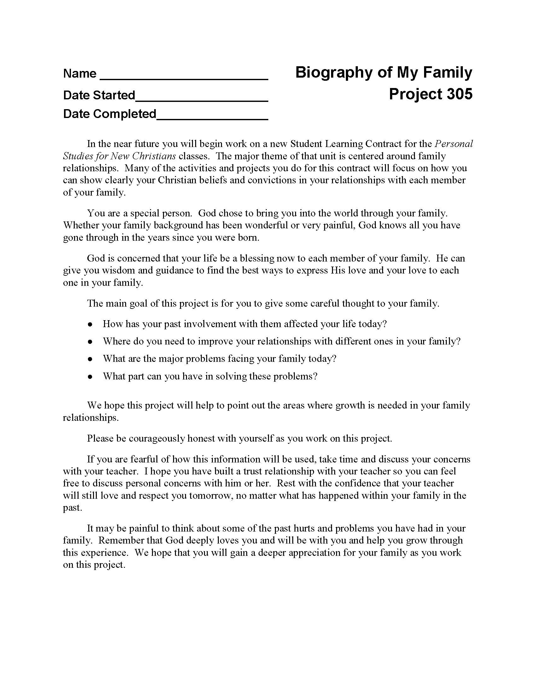
Project 305: Biography of My Family
This lesson is a wonderful aid to anyone who desires to delve deeper into study of their family heritage. By looking at the structure of their family dynamic, individuals will be able to assess where they are, where they’ve been, and where they are going.

Slide 21
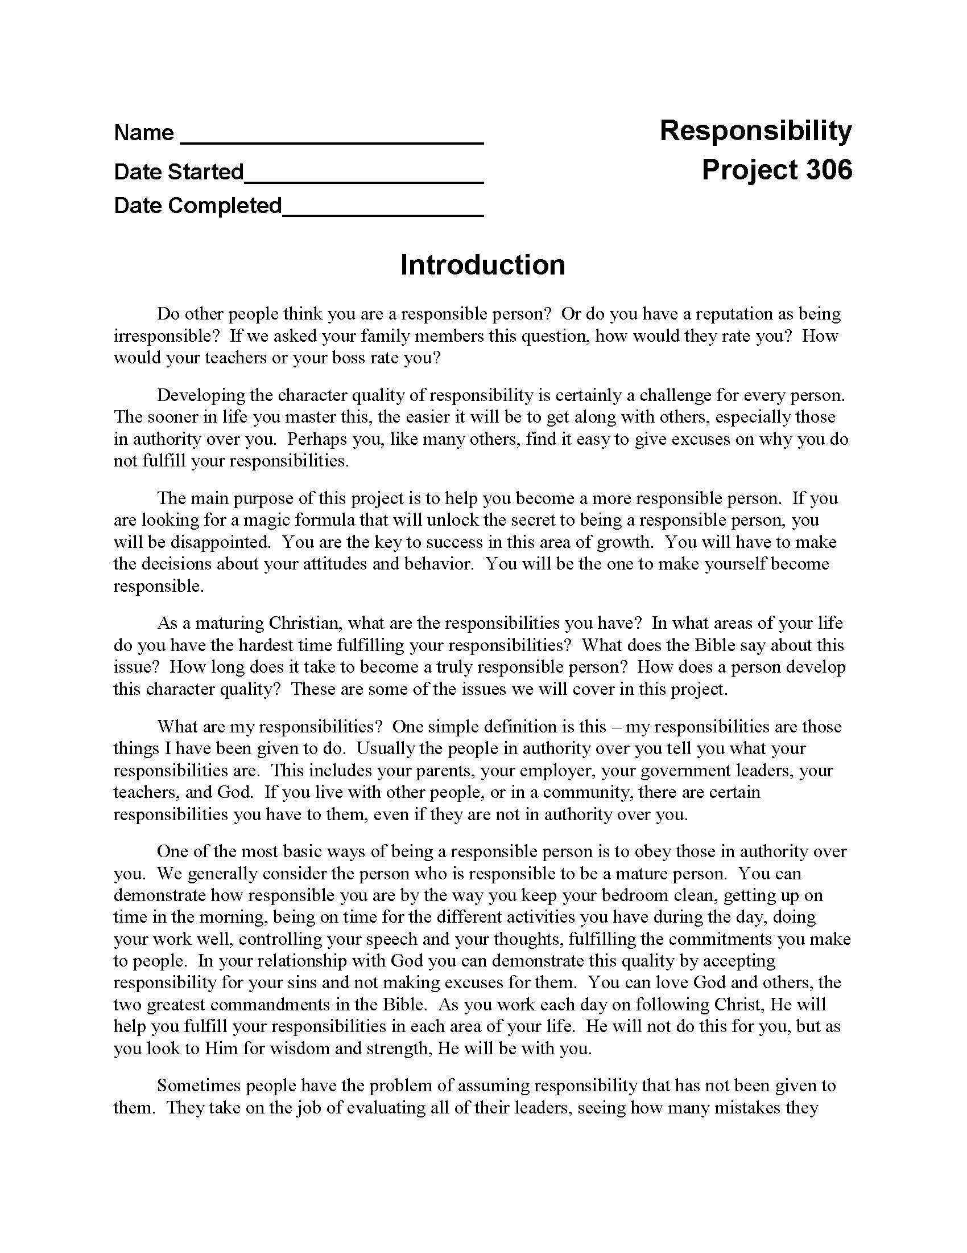
Project 306:
Responsibility
Would your students describe themselves as responsible? What would their family, friends, or co-workers say? This project will help them towards becoming a more dependable and responsible person.

Slide 22
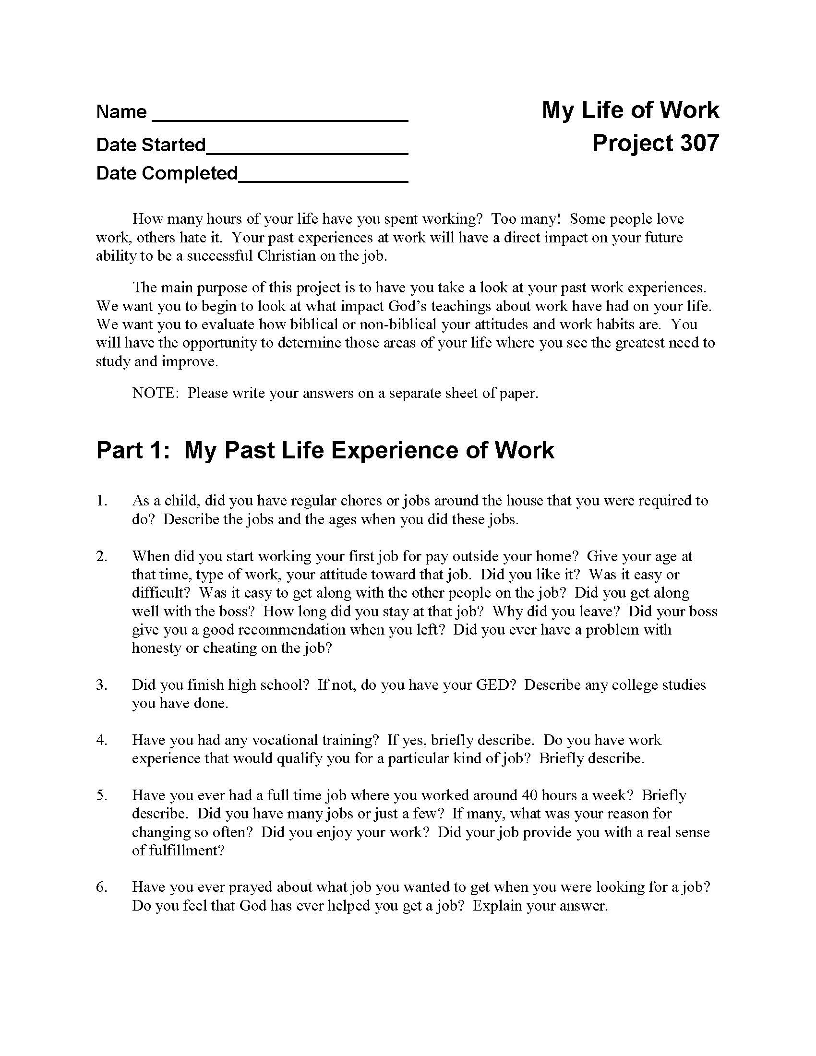
Project 307: My Life of Work
The habits one develops towards working can shape other areas of one’s life. As a Christian worker, your students must evaluate their working habits, both positive and negative, in order to reshape the productivity of their work in the Kingdom of God.

Slide 23
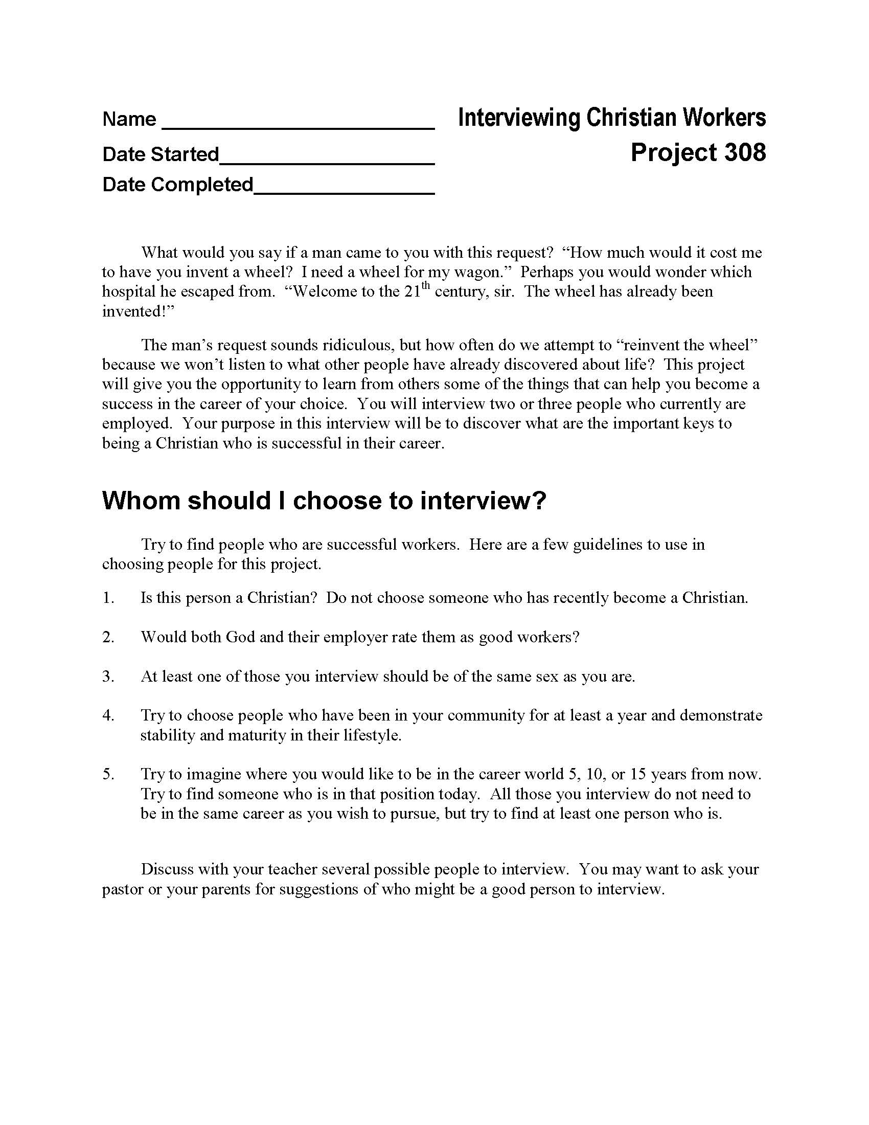
Project 308: Interviewing Christian Workers
Students may find it helpful to talk with someone in an occupation in which they are interested, to get a better understanding of the day-to-day dynamics, the difficulties they experience and how they address them in ways that honor God. This lesson guides students as they conduct interviews with those who hold jobs they themselves aspire to hold one day.

Slide 24
Project 309: Sometimes I Feel Like Leaving
Everyone desires to be successful; nobody ever sets out on a project with the hopes of failing miserably. So why, then, do students sometimes feel like giving up before the task is finished? If your students identify with this struggle, and have ever wanted to quit when things get tough, then this course is definitely for them! Teach them to succeed in achieving their goals, while mastering the art of perseverance and determination.

Slide 25
Project 401: God’s Expression of Love
In a culture that values pleasure over purity, the quest for sexual integrity is often looked upon with mockery or disdain. However, for those who are looking for a better way to live their lives, and are sick of falling into the trap of gray areas, there is God’s Expressions of Love. The Church is crying out for help, and topics discussed in this lesson -- lust, masturbation, and premarital sex -- are all the more pertinent today.

Slide 26
200, 300, & 400 Projects

Slide 27
Questions for discussion

Slide 28
CONTACT INFORMATION
Global Teen Challenge
www.GlobalTC.org
www.iTeenChallenge.org

