Slide 1
Successful Christian Living
Developed by TC Farm London Ontario Canada
Edited by Global Teen Challenge

Slide 2
Successful Christian Living 5th edition By Dave Batty
This PowerPoint is designed to be used with the Group Studies for New Christians Course, Successful Christian Living , by Dave Batty.
Other Materials available include:
Teacher's Manual
Student Manual
Study Guide
Exam
Course Certificate
For Information on obtaining these materials see iteenchallenge.org

Slide 3
Successful Christian Living
Assignments:
Quizzes: Verses to Memorize To be done with:
1. 1 Corinthians 10:29 New Life Version Lesson 2 (see verse on this slide)
2. John 16:13 Lesson 4
Study Guide Projects:
Project # To be done before or with:
1 Lesson 1
2 Lesson 2
3 Lesson 3 or 4
4 Lesson 3
5 Lesson 4
6 Lesson 4
Test: Lesson 5
1 Corinthians 10:29 (NLV)
How the other person feels is important. We are not free to do things that will hurt another person.

Slide 4
Lesson 1 – Who am I?
Key Biblical Truth
I need to listen to God when He speaks to me through my conscience.
Key Verse: Proverbs 20:27 The Living Bible
“A man’s conscience is the Lord’s searchlight exposing his hidden motives.”

Slide 5
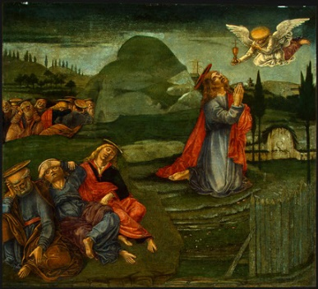
Lesson 1 - Intro
What is your view of success?
Take a few minutes to discuss these questions:
1. How does the world measure success?
2. In what areas of your life would the world consider you to be a success?
3. How are your views of success similar or different from those views
held by non-Christians who live near you?
4. How have your views of true success changed over the past 5 years?

Slide 6
A: What God Says About Me
I am a child of God.
I am loved – God loves me!
I am valuable. I’m worth more to Him than all the riches of the world.
I am a purchased person. Jesus purchased my freedom.

Slide 7
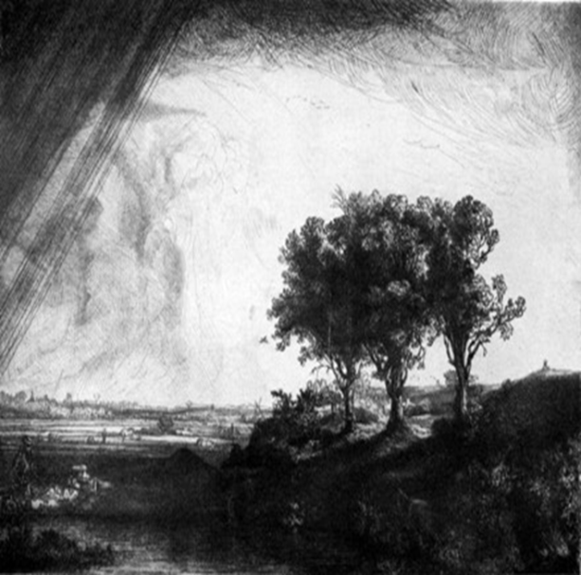
A: What God Says About Me
I am a servant (a follower) of Jesus Christ.
I am a friend of God.
I am still growing (so please be patient with me).

Slide 8
B: I Have a Physical Body
The physical body we have is a miracle.
Sin affects our physical body.

Slide 9
C: I Have a Personality
Four important things have a big influence on your personality.

Slide 10
C: I Have a Personality
My thoughts.
My feelings.
My decisions.
My conscience.
What about false guilt?

Slide 11
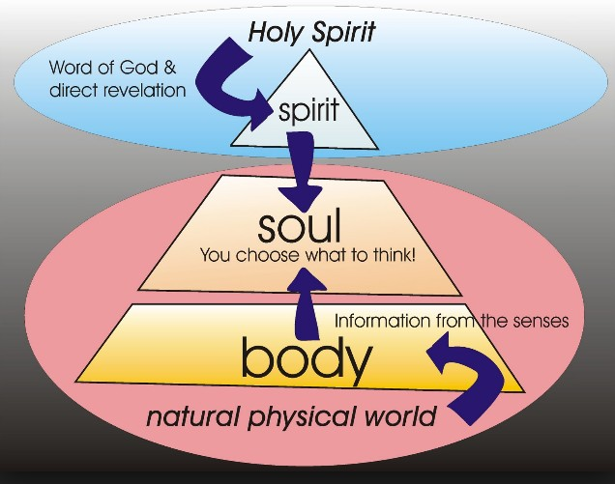
D: I have a spirit
God comes and lives in our spirit when we become a Christian.
Our spirit will live on for all eternity, but our physical body will die.

Slide 12
Five Steps to Becoming a Successful Christian

Slide 13
A. Five Steps to Becoming a Successful Christian
Step 1. Become a Christian
Let God speak to you through the Bible.
You understand His Word with your mind.
You respond with your feelings.
You choose with your will.

Slide 14
A. Five Steps to Becoming a Successful Christian
Step 2. Change the way you think.
An attitude is a pattern or habit of thinking.
We can change our attitudes by memorizing scripture and asking the Holy Spirit for help.

Slide 15
Lesson 1 - Personal Application
How can I learn to listen to God when He speaks to me through my conscience.
What are some ways I can become more sensitive to the Holy Spirit.

Slide 16
Lesson 2 – Set New Goals
Key Biblical Truth
In my daily Bible study, I need to set goals to use in situations where I get uptight today.
Key Verse: Proverbs 16:9 New Living Translation
“We can make our plans, but the LORD determines our steps.”

Slide 17
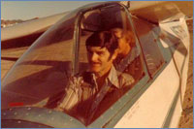
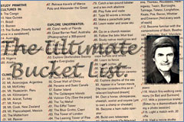
Lesson Two - Intro
One rainy afternoon, an inspired 15-year old boy named John Goddard sat down at his kitchen table in Los Angeles and wrote three words at the top of a yellow pad, "My Life List." Under that heading he wrote down 127 goals. These were not simple or easy goals. They included climbing the world's major mountains, exploring from source to mouth the
longest rivers of the world, piloting the
world's fastest aircraft, running a mile
in five minutes and reading the entire
Encyclopedia Britannica.
John Goddard

Slide 18
A. Five Steps to Becoming a Successful Christian
Step 3. Set new goals.
Find out what God wants you to do. You can do this by studying the Bible.
Ephesians 2:10 New Living Translation
For we are God’s masterpiece. He has created us anew in Christ Jesus, so that we can do the good things he planned for us long ago.
Jeremiah 29:11 New International Version
“For I know the plans I have for you,” declares the LORD, “plans to prosper you and not to harm you, plans to give you hope and a future.”

Slide 19
A. Five Steps to Becoming a Successful Christian
Step 3. Set new goals.
Different kinds of goals.
1. Educational goals
2. Job goals
3. Spiritual goals
4. Bible reading and memorizing goals
5. Character goals (personal development, courage, patience, love,
kindness)
6. Attitude goals
7. Scripture application goals
8. Relationship goals
9. Boundary goals

Slide 20
A. Five Steps to Becoming a Successful Christian
Step 3. Set new goals.
c. How can you start setting goals? 1. Look at the problems in your daily life.
2. Ask yourself, “What is God trying to teach me to do today in this area of my life?”
3. Find one area of your life where you want to grow today.
4. Relate your Bible study to this area where you want to grow.
5. List the things you can finish today.
6. Evaluate the results.

Slide 21
A. Five Steps to Becoming a Successful Christian
Step 3. Set new goals.
Marks of a good daily goal
1. It is simple.
2. It is specific.
3. It is meaningful.
4. It is practical.
5. It can be measured.
6. It helps me.

Slide 22
Lesson 2 - Personal Application
Setting Long-Range Life Goals
Make a list of some long-range goals for your life. Pray seriously about these long-range goals.

Slide 23
Lesson 3 – Manage Your Emotions
Key Biblical Truth
I need to discover how God wants me to express my emotions.
Key Verse: 1 Corinthians 10:29 New Life Bible
How the other person feels is important. We are not free to do things that will hurt another person.

Slide 24
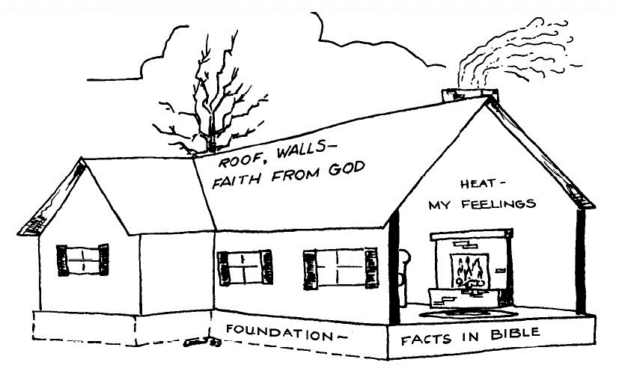
Lesson 3 - Intro

Slide 25
Lesson 3 - Intro
The foundation of the house represents the facts in the Bible that tell us how to
become a Christian. The walls, roof, windows, etc., represent the faith that God gives us to become a Christian. He gives us the power to really change our lives.
We can see the difference. Our feelings can be compared to the heat in the house.
Our feelings help us enjoy each day, just as the heat makes you feel good on a cold, winter day.

Slide 26
Basic facts about our emotions
A. Emotions are important to Christians.
B. God created us with emotions. He wants us to learn how to express our emotions in ways that will please Him.
C. Our emotions change, sometimes rapidly. This is normal. And it’s OK—at least some of the time!
D. Our emotions should not be the foundation of our relationship with God.
Some days you may feel the presence of God near you. Other days you may feel that God has left you alone.
E. Successful Christians learn to be sensitive and aware of their own emotions, and the feelings of other people, as well.

Slide 27
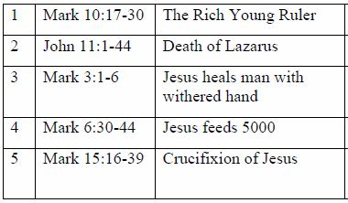
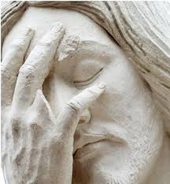
Small group activity How did Jesus express His emotions?
Divide into small groups. Choose one of the following passages. Read the verses and identify the emotion(s) Jesus expressed in that situation. Why did Jesus express this emotion?

Slide 28
A. Five Steps to Becoming a Successful Christian
Step 4. Learn how to manage your emotions. You have to learn how to use your emotions in such a way as to make your life enjoyable and pleasing to God.
You learn to manage your feelings by developing attitudes based on scripture.
When you have “wrong feelings”, release them through prayer to God.
Learn to be sensitive to the feelings of other people.

Slide 29
A. Five Steps to Becoming a Successful Christian
Step 5. Share with others what Christ has done in your life.
Share your love first.
Look for those who have real needs.
Look for those who want help.
Do not preach or argue.

Slide 30
B. How to Get Started in Using the Five Steps
Choose a meaningful section of scripture.
Take time to memorize Scripture. Try to spend extra time on Sunday memorizing Scripture.
Spend time meditating on God’s word.

Slide 31
B. How to Get Started in Using the Five Steps
Think about God’s Word when you are doing things that do not require all your attention.
Get the help of one or two friends.

Slide 32
Lesson 3 - Personal Application
A. Honestly express your emotions
Learn how to put your feelings into words—to God and to others. It is important to be honest about your emotions. Truly spiritual people do not deny their feelings. They are honest about them and express their emotions in ways that please God.
B. Learning to be sensitive to others
Learn to be more sensitive to the feelings of others. Choose one person you want to be more sensitive toward. Write down 1 or 2 things you can do in the next few days to show more concern and sensitivity toward that person.

Slide 33
Lesson 4 - The Holy Spirit

Slide 34
Lesson 4 - The Holy Spirit
Key Biblical Truth
I need to let the Holy Spirit be my teacher so I can be a successful, happy Christian.
Key Verse: John 16:13 New Life Bible
The Holy Spirit is coming. He will lead you into all truth. He will not speak His Own words, He will speak what He hears. He will tell you of things to come.

Slide 35
Lesson 4 – Intro The Holy Spirit in my life
Question 1: Think back to what you knew about God six months ago. At that time, what were your ideas or beliefs about the Holy Spirit?
Question 2: Explain how your ideas and beliefs about the Holy Spirit have changed in the last 6 months.

Slide 36
A. Who is the Holy Spirit?
The Holy Spirit is a person.
The Holy Spirit is God.
The Holy Spirit is equal with God the Father and Jesus.

Slide 37
B. What Does the Holy Spirit Do In Your Life When You Become a Christian?
He convicts you of sin.
He draws you to Christ.
He comes and lives in your spirit.

Slide 38
C. What Does the Holy Spirit Do In Your Life After You Become a Christian?
The Holy Spirit helps you become a successful Christian.
The Holy Spirit will help you understand God’s truth.
The Holy Spirit will help you resist temptations.
The Holy Spirit produces His fruit in your life.

Slide 39
C. What Does the Holy Spirit Do In Your Life After You Become a Christian?
You can experience the baptism of the Holy Spirit.
What is the baptism of the Holy Spirit?
The baptism of the Holy Spirit is a spiritual gift given by God to His children.
It’s available to all of God’s children.
God gives His children this gift to build their spiritual life.
In the book of Acts, the first physical evidence of a person receiving the baptism of the Holy Spirit was they spoke in a language they had never learned.

Slide 40
C. What Does the Holy Spirit Do In Your Life After You Become a Christian?
You can experience the baptism of the Holy Spirit.
b. What will you do with this gift if God gives it to you?
You will receive power to testify about Christ and His saving power to non-Christians.
The baptism of the Holy Spirit will help you to develop a closer relationship with God.
This gift will help you develop a more teachable attitude.

Slide 41
C. What Does the Holy Spirit Do In Your Life After You Become a Christian?
You can experience the baptism of the Holy Spirit.
c. How can you receive the baptism of the Holy Spirit?
1. Draw closer to God, tell Him. He will listen.
2. If you want to be more effective in witnessing to non-Christians, tell God.
3. If you want more spiritual power in your life, ask God for help. Draw closer to God. He loves to shower His gifts on those who are keeping their priorities straight.

Slide 42
C. What Does the Holy Spirit Do In Your Life After You Become a Christian?
He gives the gifts of the Holy Spirit.
God’s idea of ministry is not simply to be a preacher or missionary.
God wants every one of His children to work for Him right where they are.

Slide 43
C. What Does the Holy Spirit Do In Your Life After You Become a Christian?
He gives the gifts of the Holy Spirit.
Some of the gifts of the Holy Spirit are to be used in public ministry and others are to be used in our daily living and work.

Slide 44
C. What Does the Holy Spirit Do In Your Life After You Become a Christian?
He gives the gifts of the Holy Spirit.
Ephesians 4:11-13 New Living Translation (NLT)
11 Now these are the gifts Christ gave to the church: the apostles, the prophets, the evangelists, and the pastors and teachers. 12 Their responsibility is to equip God’s people to do his work and build up the church, the body of Christ. 13 This will continue until we all come to such unity in our faith and knowledge of God’s Son that we will be mature in the Lord, measuring up to the full and complete standard of Christ.

Slide 45
C. What Does the Holy Spirit Do In Your Life After You Become a Christian?
He gives the gifts of the Holy Spirit.
God wants you to use the gift to bring glory to God, not yourself.

Slide 46
Lesson 4 - Personal Application
Is there a situation or problem in your life today where you need the Holy Spirit to help you find the truth? Briefly describe it.

Slide 47
Successful Christian Living 5th edition By Dave Batty
This PowerPoint is designed to be used with the Group Studies for New Christians Course, Successful Christian Living , by Dave Batty.
This PowerPoint resource was developed by
The Teen Challenge Farm, London, Ontario
Edited by Global Teen Challenge, 2018
For Information on obtaining these materials see iteenchallenge.org
Globaltc.org

