Slide 2
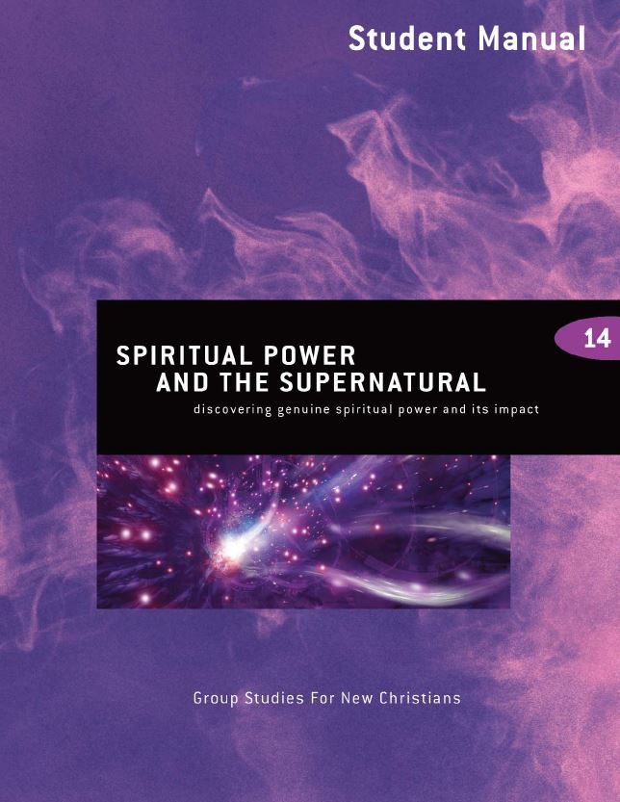
Spiritual Power and the Supernatural
5th edition
By David Batty
This PowerPoint is designed to be used with the
Group Studies for New Christians Course,
Spiritual Power and the Supernatural
Other materials available include:
Teacher’s Manual
Student Manual
Study Guide
Exam
Course Certificate
For Information on obtaining these materials see iteenchallenge.org

Slide 3
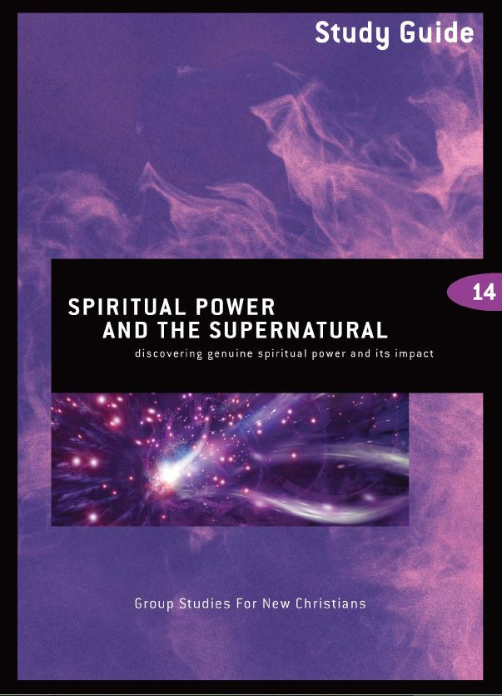
Spiritual Power and the Supernatural
Quizzes: Verses to Memorize To be done with:
1. 2 Peter 1:3 Lesson 2
2. James 1:2-4 Lesson 4
Study Guide Projects:
Project # To be done before or with:
1 Lesson 1
2 Lesson 2
3 Lesson 3 or optional
4 Lesson 2 5 Lesson 3 6 Lesson 4
Test: Lesson 5

Slide 4
Chapter 1 God’s Role in Our World
Lesson 1
God’s supernatural power

Slide 5
Lesson 1 God’s supernatural power
Key Biblical Truth
God is all-powerful. He is very interested in our world. In the past and today He shows His love and concern for us in many ways.
Key Verse Luke 1:37 NIV
For nothing is impossible with God.

Slide 6
Lesson warm up activity:
Skit “Who is the real God?”
See Teacher’s Manual for script for this illustration.

Slide 7
A. What do people today think about God?
Many people have never taken the time to get to know God personally. So it is not surprising that many times they have some wrong ideas about what kind of a God He is. God is not sitting up in heaven with a big stick waiting to punish us every time we step out of line.
He is not a mean angry God. He is a God of love and patience. Certainly He is sad when we sin. But He doesn’t go through each day looking for opportunities to punish you each time you fall short of being perfect. If God had no patience or mercy, we would all be dead.

Slide 8
B. The God of creation

Slide 9
What makes something supernatural?
God normally operates inside the laws of nature. Sometimes God chooses to set aside these laws and do something supernatural—above and beyond the natural. We call these miracles. They are done by God’s power, not human power. When you look at any of the miracles in the Bible, or in modern times, you can know that it is God’s power that has made that miracle—that supernatural event possible.
Spiritual Power and the Supernatural Student Manual, page 6

Slide 10
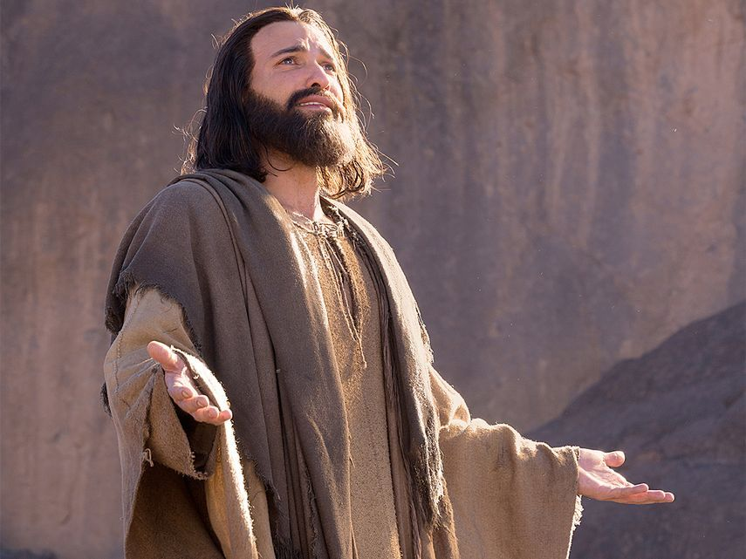
C. How was God involved with people in Bible times?
Jesus provided the most personal example of how God is involved in our world.

Slide 11
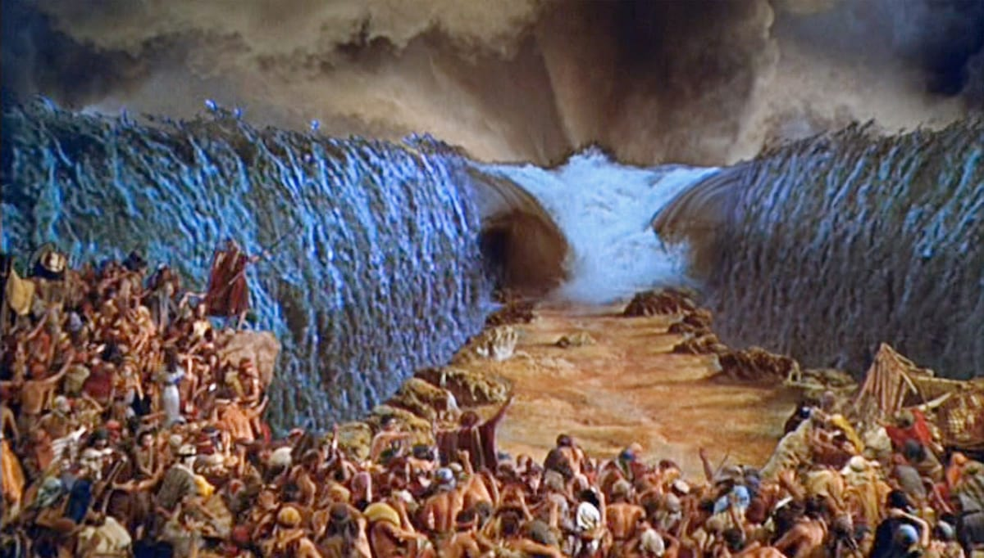
D. How does God use His supernatural powers?

Slide 12
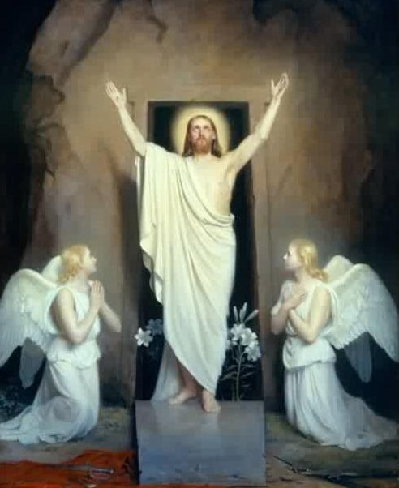
D. How does God use His supernatural powers?
1. The greatest supernatural event of all time.
The resurrection of Jesus.

Slide 13
D. How does God use His supernatural powers?
2. We need spiritual power to continue being a Christian.
Don’t expect God to perform a miracle in your life every time a problem comes up.
Each of these tests and problems provide an opportunity for them to develop character and inward strength.

Slide 14
E. What is God’s plan for the future?

Slide 15
Personal Application
Don’t be afraid to trust God.
Look at the laws of nature in action.
Get to know God better. Get to know who He is, not just what miracles He has done.
Do not depend on miracles to motivate you to serve God. Choose to follow Him because He is God. Let love be your motive, not miracles.

Slide 16
Chapter 2 The Characteristics of True Spiritual Power

Slide 17
Lesson 2 God’s supernatural power
Key Biblical Truth
I need to discover the characteristics of true spiritual power.
Key Verses
Philippians 4:13 New Life Bible I can do all things because Christ gives me the strength.
2 Peter 1:3-4 New Living Translation
3 By his divine power, God has given us everything we need for living a godly life. We have received all of this by coming to know him, the one who called us to himself by means of his marvelous glory and excellence. 4 And because of his glory and excellence, he has given us great and precious promises. These are the promises that enable you to share his divine nature and escape the world’s corruption caused by human desires.

Slide 18
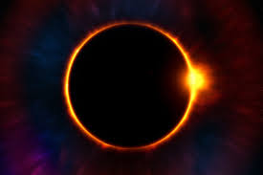
Lesson Warm-up: The Laws of Nature
Share some of your experiences where you observed the laws of nature in action. These experiences can be a reminder to us of God’s present influence in our world today.

Slide 19
A. The reality of being spiritually weak
Study Guide Project 4, “My Need for God’s Spiritual Power in My Life,” Discuss Paul’s weaknesses described in 2 Corinthians 12:9-10.
1. Read 2 Corinthians 12:1-10. Write a brief summary of the main point Paul makes here about his weaknesses.
2. Think about your life. What are some of the areas in your life where you are weak and need God’s power to help you? Choose one of these weaknesses in your life and write down what it is and how you would like God to help you.

Slide 20
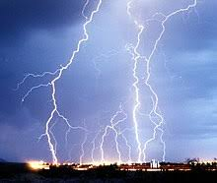
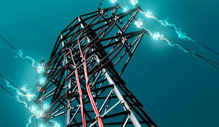
B. What is true spiritual power?
What exactly is electricity? We use it everyday even though we may not understand it.
The same can be said for spiritual power. We may not understand it, but we need it everyday.

Slide 21
C. What does it mean to be spiritually strong?
1. You have made a deep commitment to live for Jesus.
2. You make your decisions after looking at what the Bible tells you to do.
3. Prayer is an important part of your life.
4. You are learning how to listen to God through your spirit.
5. You love God more than other people or things.
6. You have learned how to overcome temptations to sin.
7. Your life shows the “fruit of the Holy Spirit”.

Slide 22
D. Don’t try to imitate God’s power
Acts 19:13b, 15-16 New International Version
They would say, “In the name of Jesus, whom Paul preaches, I command you to come out.” The evil spirit answered them, “Jesus I know and Paul I know about, but who are you?” Then the man who had the evil spirit jumped on them and overpowered them all. He gave them such a beating that they ran out of the house naked and bleeding.

Slide 23
E. Four keys to the life of spiritual power
1. Belief—agreeing with the facts. Accepting in your mind that it is true.
2. Trust—to place your confidence in someone or something. To depend on someone.
3. Hope—to expect something to happen in the future.
4. Faith—a power from God, which always leads to action.

Slide 24
The relationship between these 4 keys to spiritual power
Faith, belief, hope and trust overlap each other, and work together in our lives.
Faith
Trust
Belief
Hope

Slide 25
To better understand these keys we will treat them as though they are completely separate.
Faith
Trust
Belief
Hope

Slide 26
E. Four keys to the life of spiritual power
1. Belief—agreeing with the facts. Accepting in your mind that it is true.
2. Trust—to place your confidence in someone or something. To depend on someone.
3. Hope—to expect something to happen in the future.
4. Faith—a power from God, which always leads to action.

Slide 27
The absence of…
The absence of belief in your life will lead to fear and doubt.
The absence of trust is suspicion.
The absence of hope is despair, anxiety, worry and depression.
The absence of faith is powerlessness.

Slide 28
The presence of…
The presence of belief enables you to face each day with the confidence that God’s word is true. His promises are for you.
The presence of trust enables you to have confidence that God will help you each day, you can rely on Him.
The presence of hope enables you to have joyful anticipation that God will do what He has promised to do.
The presence of faith in your life means that God’s power is at work in your life and He will do His work through you, giving you the power to do all that He wants you to do.

Slide 29
G. Where we can use spiritual power in our lives
1. Becoming a Christian (salvation) Ephesians 2:8-9
2. To keep on being a Christian 2 Peter 1:3
3. To do God’s will Psalm 32:8
4. To have power over sins 1 John 5:4-6.
5. To go through trials and problems James 1:2-5

Slide 30
G. Where we can use spiritual power in our lives
6. Healing James 5:15
7. To overcome temptations 1 Corinthians 10:13
8. To obey God’s laws Psalm 119:11
9. For present needs. You cannot store up faith for future needs Philippians 4:6-7

Slide 31
Conclusion
There is a danger for new Christians to get so involved in trying to come up with the perfect definition for spiritual power that they miss the whole purpose of it… At this point in your life the most important thing is to begin to grow spiritually and use God’s power in your life to fight the battles that are sure to come.

Slide 32
Personal Application – Study Guide Project 4
Look at Study Guide Project 4 and look at the answers you put down for questions 2 and 3.
Divide into groups of 2 and discuss your answers with each other. Then pray for each other.

Slide 33
Chapter 3 How to get spiritual power

Slide 34
Lesson 3 How to get spiritual power
Key Biblical Truth
As a Christian, I need to discover specific situations in my daily life today where I can use the spiritual power that God wants to develop in me.
Key Verse
James 1:2-3 New Life Bible
My Christian brothers, you should be happy when you have all kinds of tests. You know these prove your faith. It helps you to not give up.

Slide 35
Warm up Activity: Study Guide Project 5 - Evaluation of spiritual power in my life
Is this a strong point in my relationship with God or a weak point?
1. You have made a deep commitment to live for Jesus.
2. You make your decisions after looking at what the Bible tells you to do.
3. Prayer is an important part of your life.
4. You are learning how to listen to God through your spirit.
5. You love God more than other people or things.
6. You have learned how to overcome temptations to sin.
7. Your life shows the “fruit of the Holy Spirit.”

Slide 36
A. Don’t seek to be a spiritual superstar specializing in miracles
Shadrach, Meshach, and Abednego
See Daniel 3:16-18

Slide 37
B. It takes time and work to develop spiritual power

Slide 38
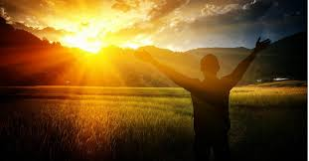
C. Basic steps to developing spiritual power
1. Become a Christian
2. Draw closer to God
3. Obedience
4. Prepare yourself to receive God’s spiritual power
5. Prayer
6. Learn from your tests and problems
7. Fasting
8. Praise and worship

Slide 39
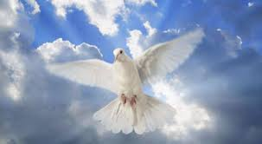
Baptism of the Holy Spirit and spiritual power
Matthew 3:11 NIV “I baptize you with water for repentance. But after me comes one who is more powerful than I, whose sandals I am not worthy to carry. He will baptize you with the Holy Spirit and fire.”
Acts 1:8 NIV But you will receive power when the Holy Spirit comes on you; and you will be my witnesses in Jerusalem, and in all Judea and Samaria, and to the ends of the earth.”
Luke 24:49 NIV “I am going to send you what my Father has promised; but stay in the city until you have been clothed with power from on high.”

Slide 40
Personal Application – Areas of temptation
Identify one or two major areas of temptation you are currently facing.
Write this down on a paper with the understanding that you will not have to turn this paper in to the teacher.
Reflect on the depth of your commitment to overcome this temptation and respond in ways that agree with what God says in the Bible.
List one or two things you can do this week to successfully resist this temptation.

Slide 41
Chapter 4 True spiritual power vs. the counterfeits

Slide 42
Lesson 4 True spiritual power vs. the counterfeits
Key Biblical Truth
I need to discover the difference between God’s power and Satan’s power and human power. I must choose which power to rely on as I go through each situation I face.
Key Verse
Romans 8:2 New Life Bible
The power of the Holy Spirit has made me free from the power of sin and death. This power is mine because I belong to Jesus Christ.

Slide 43
Warm up Activity: God’s power vs. Satan’s power
Questions for discussion:
A. Do you believe Satan has any real power?
B. How would you compare the power of Satan to the power of God?
C. Does God use His supernatural power as much today as He did during Bible times?
D. Think for a minute about the temptations you face in your life. What do these temptations tell you about the power of Satan?

Slide 44
A. God’s power vs. Satan’s power vs. human power
Are Satan’s powers real?
Is God’s power real?
The difference between God’s power and Satan’s power.
God’s power illustrated in the Bible - Study Guide Project 6
The power within you.

Slide 45
B. Satan wants to confuse you with counterfeit experiences
1. Satan has a counterfeit substitute for every good thing God has for your life
True wholesome expressions of sexual love are turned into lust, prostitution, pornography, and homosexuality.
Wholesome satisfaction for doing an excellent job is turned into selfish pride and a haughty attitude.
A natural desire to achieve adequate food, clothing, and shelter is turned into greed to get as much as you can with no regard to how this affects others around.

Slide 46
Faith vs. presumption
Faith—a power from God that always leads to action.
Presumption -- is assuming you know what God wants you to do without really hearing from God. The actions that follow “presumption” involve taking steps that you assume to be what God wants you to do even though God did not tell you to take those actions.

Slide 47
C. Errors in faith teachings today
1. Is there a difference between faith and belief?
1. Belief—agreeing with the facts. Accepting in your mind that it is true.
2. Trust—to place your confidence in someone or something. To depend on someone.
3. Hope—to expect something to happen in the future.
4. Faith—a power from God, which always leads to action.

Slide 48
C. Errors in faith teachings today
1. Is there a difference between faith and belief?
2. Faith words are locked into knowledge of God’s Word
3. What is faith action?
4. Doubt and Negative Confessions
5. Is using medicine wrong?
6. Is God bound to the words in the Bible?

Slide 49
Conclusion
To become all that God wants you to be, you need His help, you need His power, and you need His wisdom. God is ready to give these to you. You must learn to use His power the way He wants it used in your life. You must walk in obedience to Him. If you will fix your eyes on Jesus, and seek to follow Him every day, you will experience His power working in your life. God will use you to be a blessing to many other people in both small ways and large ways.

Slide 50
Personal Application
Focus your attention on God’s power, not Satan’s power. Realize your need to rely on God’s power for the spiritual battles you face.
Write down one or two areas of your life where you need to rely more on God’s power. In groups of two or three, share these briefly and pray for one another.

Slide 51
Spiritual Power and the Supernatural
This PowerPoint is designed to be used with the
Group Studies for New Christians Course,
Spiritual Power and the Supernatural by David Batty
This PowerPoint resource was developed
by Global Teen Challenge, 2018
globaltc.org gtc@globaltc.org

