Slide 1
Personal Relationships with Others
Developed by TC Farm London Ontario Canada
Edited by Global Teen Challenge

Slide 2
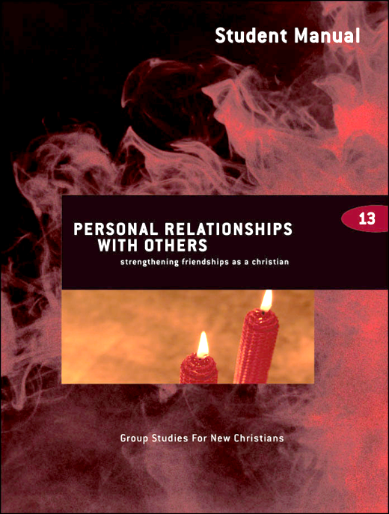
Personal Relationships with Others 5th edition By Dave Batty
This PowerPoint is designed to be used with the Group Studies for New Christians Course, Personal Relationships with Others, by Dave Batty.
Other Materials available include:
Teacher's Manual
Student Manual
Study Guide
Exam
Course Certificate
For Information on obtaining these materials see iteenchallenge.org or contact us at
gtc@globaltc.org

Slide 3
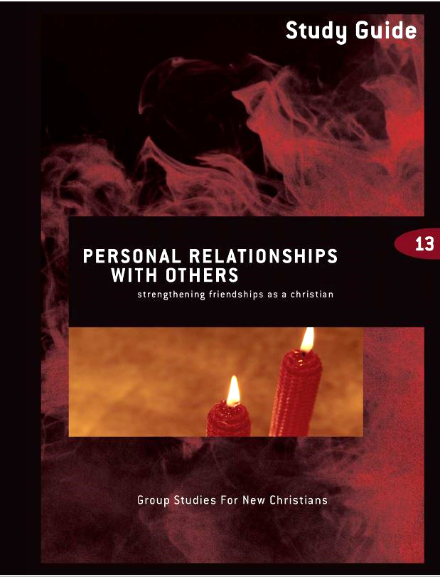
Personal Relationships with Others
Quizzes: Verses to Memorize To be done with:
1. Philippians 4:8 Lesson 2
2. Matthew 19:5 Lesson 4
Study Guide Projects:
Project # To be done before or with:
1 Lesson 1
2 Lesson 2
3 Lesson 3
4 Lesson 4
5 Lesson 4
6 Lesson 4
Test: Lesson 5

Slide 4
Chapter 1
What kind of a friend am I?

Slide 5
Key Biblical Truth: I need to take an honest look at how relationships have affected my life to this point. Key Verse: Proverbs 13:20 NLT “Walk with the wise and become wise; associate with fools and get into trouble.”
What kind of a friend am I?

Slide 6
Lesson warm-up
1. Tell a story about a friendship that has been a positive part of your life.
2. How have your friendships changed now that you have given your life to Jesus Christ?

Slide 7
What kind of a friend am I?
A. Your personal history of relationships
1. Your family relationships
a. How dysfunctional is your family?
b. Was abuse part of your family history?
c. What are your family traditions on relationships?

Slide 8
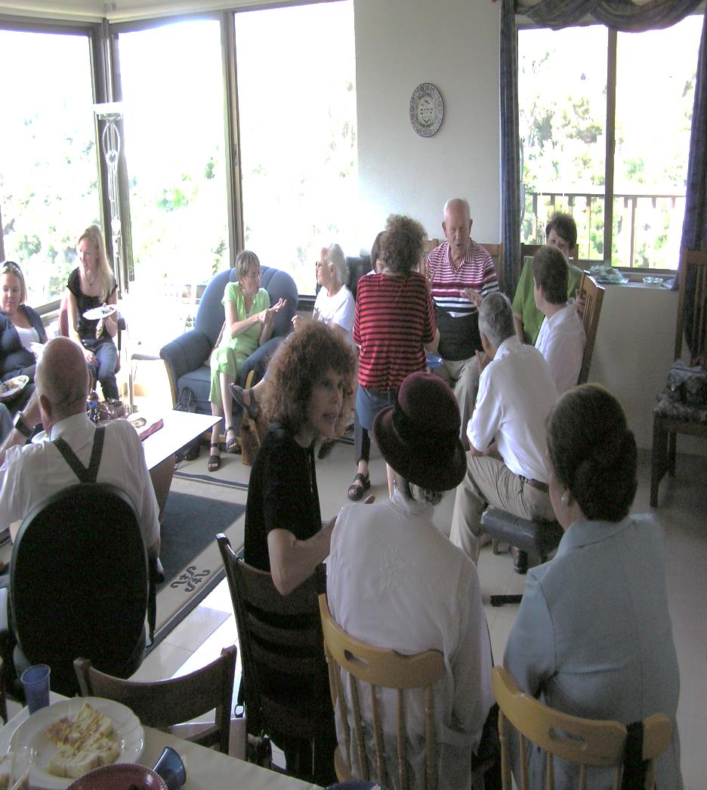
Your personal history of relationships
2. Your friends
a. Have your friends been good or bad for you?
b. Have you been involved in toxic relationships?
c. What kind of problems have you experienced with friends?

Slide 9
Your personal history of relationships
3. Fantasy relationships
- If you have been deeply hurt by other people, retreating into fantasy relationships can feel a lot less painful.
- But fantasy relationships will never really satisfy, because God created you with a built-in need to have real relationships with real people.

Slide 10
What kind of friend are you to others?
1. Are you a safe friend?
2. Are you a “relationship junkie?”
3. Are you an enabler?

Slide 11
How well do you understand God’s view of healthy relationships?
1. God’s priority for relationships in your life
2. God’s plan for your early lessons on relationships

Slide 12
How well do you understand God’s view of healthy relationships?
3. The world’s view vs. God’s view

Slide 13
How well do you understand God’s view of healthy relationships?
4. The wisdom of Proverbs for you today
5. Learn from the examples of people in the Bible
6. How did Jesus relate to other people?

Slide 14
Personal Application
Identify 6 examples of relationships with other people from the life of Jesus.
What lessons you can apply to your own life today from these examples?

Slide 15
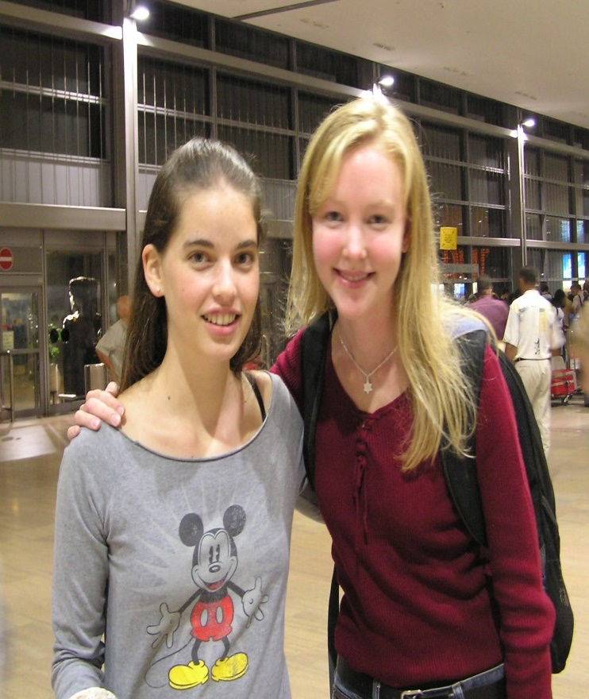
Chapter Two
Four types of friendships

Slide 16
Key Biblical Truth: The first step in building secure relationships is to develop practical ways of fulfilling my responsibilities as a friend. Key Verse: 1 Corinthians 13:7 TLB “If you love someone you will be loyal to him no matter what the cost. You will always believe in him, always expect the best of him, and always stand your ground in defending him.”
Four types of friendships

Slide 17
Lesson Warm-up
Think about people who have been your best friends, and what made them such good friends.
You may want to refer to your answers to Project 1, Question 1 in your Study Guide for this course.

Slide 18
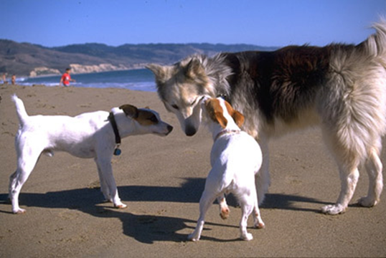
A. Acquaintances
Description: You see the person occasionally. You know his or her name.
Your freedoms: You are free to ask general questions…”What is your name? Where do you live? Work? Where do you go to school?”

Slide 19
3. Your responsibilities…I have a personal goal to try to add value to any person that I know more than ten minutes…
A. Acquaintances

Slide 20
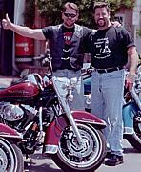
B. Casual Friends
1. Description: a friendship based on common interests and activities. You have certain common interests that make it easy to have a casual friendship.

Slide 21
B. Casual Friends
2. Your freedoms: You are free to ask specific questions.
You may ask for their opinions on a particular subject or ask them about their goals in life.

Slide 22
B. Casual Friendship
3. Your responsibilities…
You must look for the good points in him/her.
Listen carefully, and ask questions that relate to the interests of your friend.

Slide 23
C. Close Friends
1. Description: This friendship is based on similar life goals. The number of close friends one might have may range from five to fifteen.

Slide 24
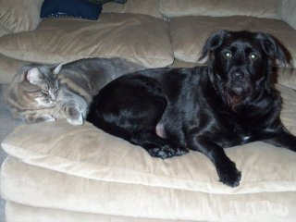
C. Close Friends
2. Your freedoms: You are free to suggest projects that will help both of you. Do not be pushy in trying to give advice.

Slide 25
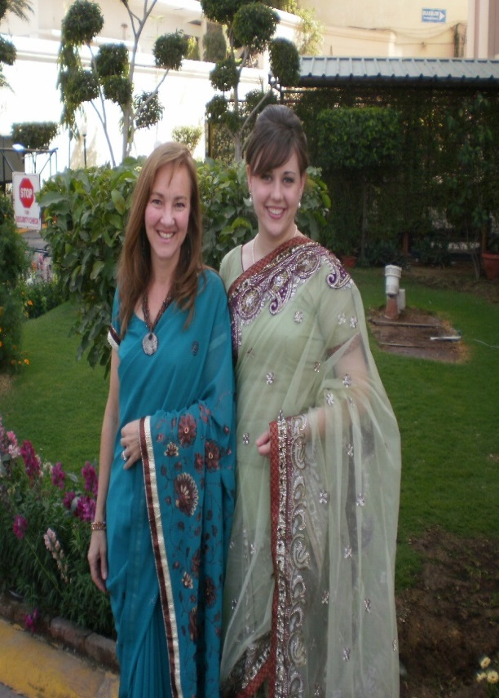
C. Close Friends
3. Your Responsibilities:
Encourage him/her.
Design projects to help each other.
Your friendship should stand through the good times and the bad times.

Slide 26
D. Intimate Friendship
1. Description: A very special friendship. You may have only 1 or 2 intimate friends your whole life. It is a friendship based on a commitment to develop each other’s character.

Slide 27
D. Intimate Friendship
2. Your Freedoms: You have the freedom to correct (not criticize) each other. Focus your correction on their “blind spot” – a problem they do not realize they have.

Slide 28
D. Intimate Friendship
3. Your Responsibilities:
You must be openly honest. You must speak the truth in love.
Give positive advice. Don’t criticize.

Slide 29
personal application
Make a list of the things that make it hard to develop friendships with people you now live with or with people at the church you attend.
Then write down one thing you can do to be a better friend to someone.

Slide 30
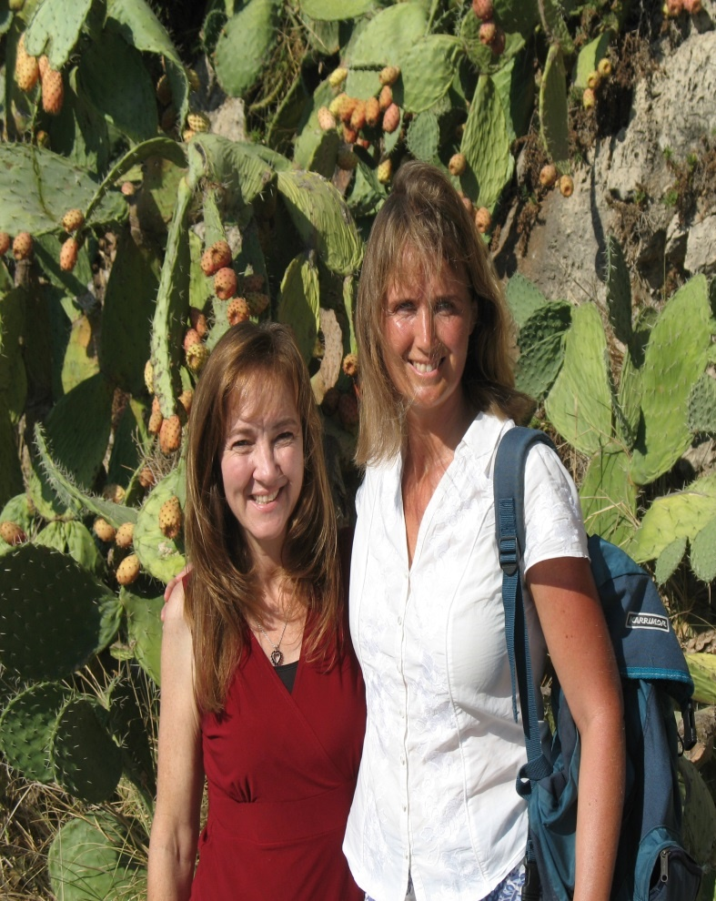
Chapter 3
How do I build great friendships?

Slide 31
How do I build great friendships?
Key Biblical Truth:
As a Christian I need to develop a set of personal standards to guide me in my relationships with others.
Key Verse: Philippians 4:1 The Message
My dear, dear friends! I love you so much. I do want the very best for you. You make me feel such joy, fill me with such pride. Don’t waver. Stay on track, steady in God.

Slide 32
A. Start with yourself
1. What healing is needed in your life?
2. How strong is your commitment to Jesus?
3. How mature are you?
4. Learn how to genuinely care for others.

Slide 33
B. What boundaries do I need in my relationships?
1. What is a boundary?
a. Physical boundaries
b. Mental boundaries
c. Emotional boundaries
d. Spiritual boundaries

Slide 34
2. How can I use boundaries in my life?
a. What boundaries do I need in my life?
b. What if I still fail?
c. Where does God want me to start?

Slide 35
3. So where do I start?

Slide 36
C. How do I choose safe people to be my friends?
How do I determine if someone is not safe?
Why do I attract unsafe people?
How can I choose safe friends?

Slide 37
C. How do I choose safe people to be my friends? (cont.)
4. What should I do if I am in a relationship with an unsafe person?
Be honest with yourself
Breaking off a relationship
After you have broken off an unsafe relationship
What if the unsafe person is a relative?
What about those who were my friends before I became a Christian?

Slide 38
Chapter 4: Sex and the Christian Life

Slide 39
Sex and the Christian Life
Key Biblical Truth
I need to carefully follow God’s pattern for successful living as a single or married person.
Key Verse:
Ephesians 5:15, 17 New Living Translation
15 So be careful how you live. Don’t live like fools, but like those who are wise.
17 Don’t act thoughtlessly, but understand what the Lord wants you to do.

Slide 40
Lesson Warm-up
Rate your level of interest in each question, with “10” being high interest down to “0” indicating no interest in that issue. You can give more than one question a score of 10.
What is God’s plan for single people?
What should you do if you are in love with someone who is not a Christian?
What if you have been sexually active as a single person?
How does your sex life before you get married affect you after you are married?
What makes a date a successful one?
What about dating others who are not Christians?
How do you find a life partner?
What makes a Christian marriage special?
How can you restore your marriage?
What about common law marriages?

Slide 41
A. Sex and the single person
1. What does your culture tell you about sex?
2. What is your family history regarding sexual relationships?

Slide 42
A. Sex and the single person
3. What is sexual freedom?
a. A definition that meets God’s standard
Sexual freedom—it is not the freedom to do whatever you want with your girlfriend or wife (boyfriend or husband).
Sexual freedom is the power to do what is the right thing to do with your girlfriend or wife (boyfriend or husband). You get this power and understanding from God and His Word—the Bible.

Slide 43
A. Sex and the single person
3. What is sexual freedom?
a. A definition that meets God’s standard
b. What about my sexual identity?
4. What is God’s standard for single people?
5. Make a commitment to live in sexual purity.

Slide 44
B. Dating/Choosing the person I will marry
1. What is the purpose of dating?

Slide 45
2. When is a person ready to start dating?
a. When you know the benefits and dangers of dating.
b. When you have personally worked out a set of standards. (Your rules for dating)
c. When you have made an agreement with God to never lower your standards.

Slide 46
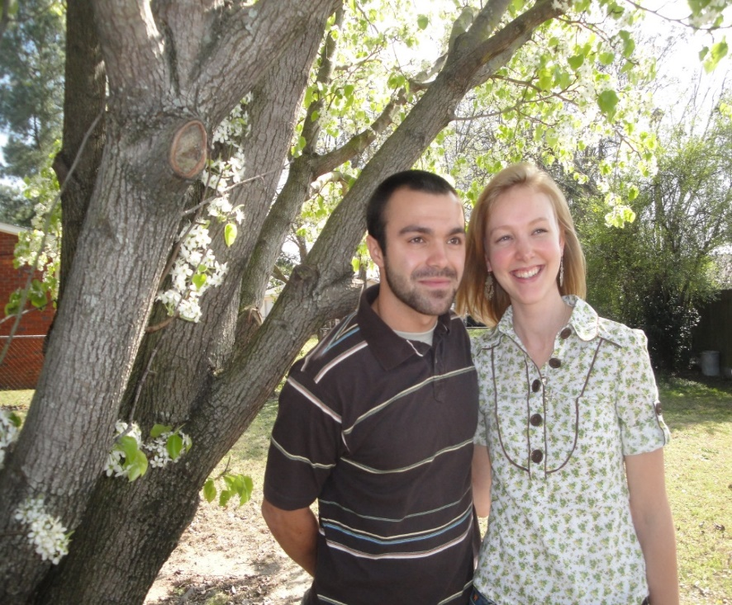
2. When is a person ready to start dating?
d. When you know how to develop a friendship based on something other than sexual attraction.
e. When you are secure in your personal character and committed to exercising self-control in your relationship with the person you plan to date – when you are a safe friend.

Slide 47
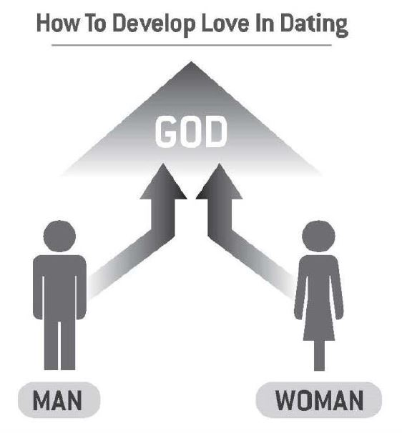
3. What are some of the benefits of dating?
The best way to develop a closer relationship with your friend is for both of you to draw closer to God.
The illustration shows that as you both put God first in your life, you will move closer to God—and to each other.

Slide 48
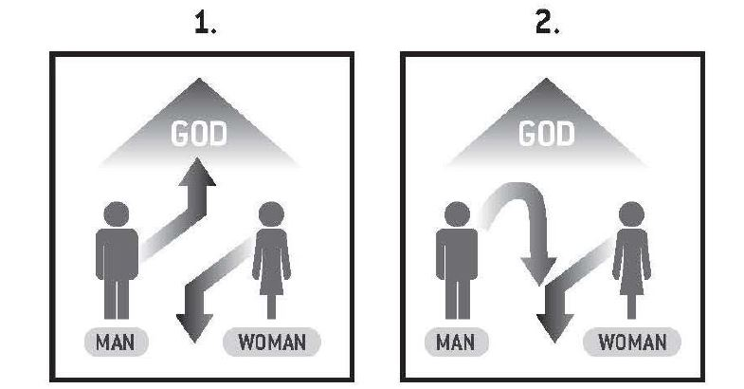
4. What are some of the dangers of dating?

Slide 49
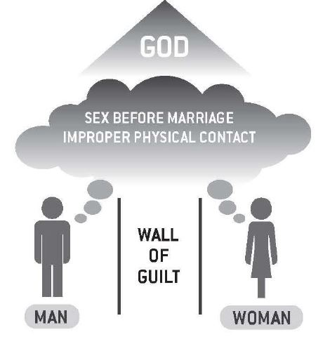
How to destroy Agape Love experimenting with sex.

Slide 50
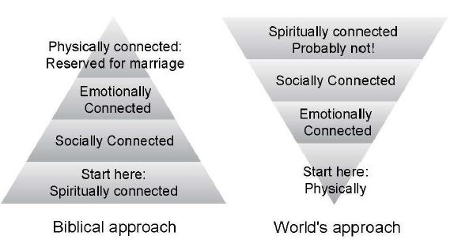
Biblical approach to building relationships

Slide 51
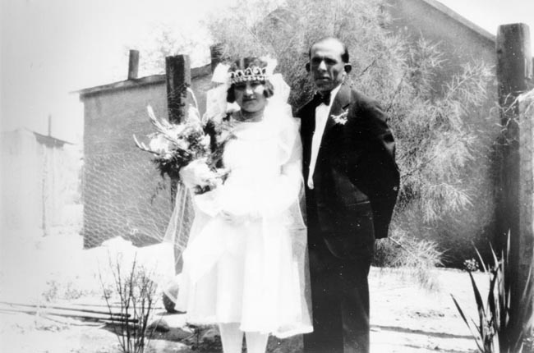
C. Marriage

Slide 52
1. How can you prepare yourself for a successful marriage?
a. You must have a growing personal relationship with Jesus.
b. You must learn to accept yourself.
c. You must learn to be obedient to all authority.

Slide 53
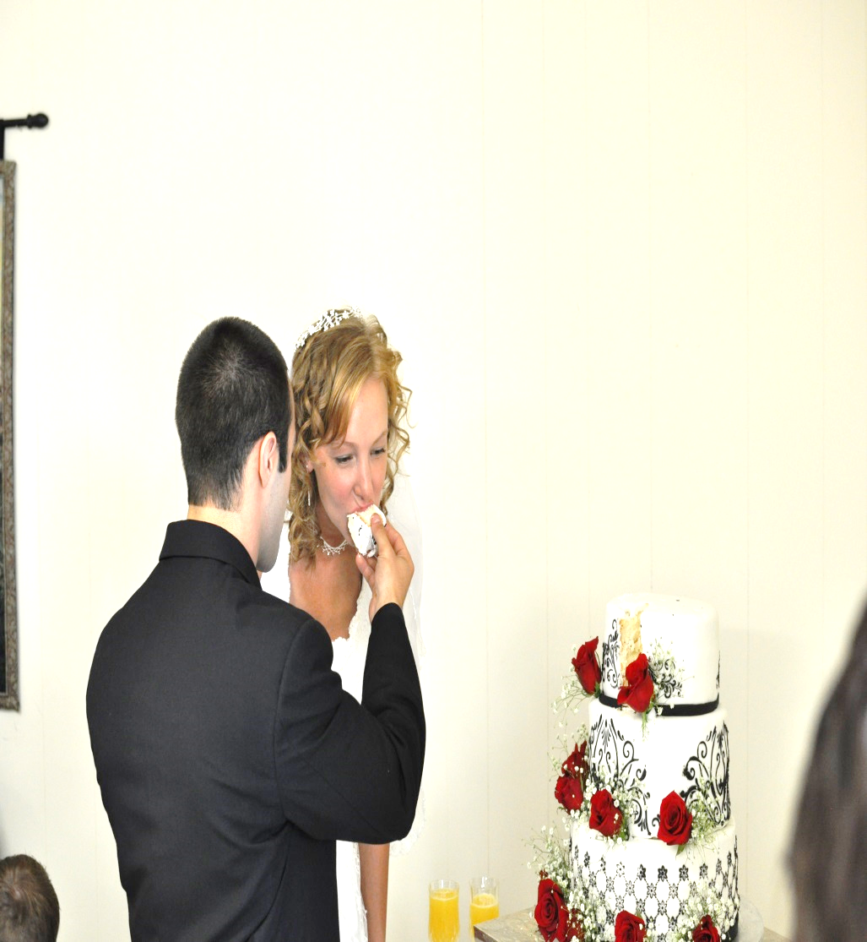
1. How can you prepare yourself for a successful marriage?
d. You must have a clear conscience.
e. You must have a Biblical pattern for expressing your anger. You must give your personal rights to God.

Slide 54
1. How can you prepare yourself for a successful marriage?
f. You must develop the positive inward quality of self-control, especially in your sexual behavior.
g. You must develop good communication skills and learn how to be open and honest in your communication with your marriage partner.

Slide 55
1. How can you prepare yourself for a successful marriage?
h. You must decide what your life goals are.
i. Men – you must be able to support a family financially. You need to be free of large debts.

Slide 56
2. What is God’s pattern for a successful marriage?
a. leaving
1. physical leaving
2. leaving your parents emotionally
3. leaving your “single” way of thinking
b. being joined to your wife/husband
c. becoming one: physically, emotionally, and spiritually.

Slide 57
Personal Application
1. Learn to develop a Biblical attitude toward sex.
2. For those who are married, list ways of developing and expressing love in your marriage. Learn the importance of being open and honest with your husband or wife.
3. Plan a date. What would it look like now that you are a Christian? Include not only what you will do, but also the boundaries you will not cross on a date.

Slide 58
Conclusion
God created you with a desire and need for love, companionship, sharing your life with others. As you focus on developing a close relationship with Jesus, He will lead you in developing many friendships that will make your life rich and complete.

Slide 59
Personal Relationships with Others 5th edition By Dave Batty
This PowerPoint is designed to be used with the Group Studies for New Christians Course, Personal Relationships with Others, by Dave Batty.
Other Materials available include:
Teacher's Manual
Student Manual
Study Guide
Exam
Course Certificate
For Information on obtaining these materials see iteenchallenge.org or contact us at
gtc@globaltc.org

