Slide 1

Overcoming the Stronghold of Pornography
By David Batty

Slide 2
A. Current cultural views of pornography

Slide 3
B. Teen Challenge survey on Pornography & Lusting 1997
Of the 461 who participated in this survey,
74% reported they had been sexually active outside of marriage before coming to TC

Slide 5
Before coming to TC,
87% of the men viewed pornography.
42% viewed it at least 1 time a week.

Slide 10
C. Why do people find pornography such an attraction?
What are the benefits of viewing pornography?

Slide 11

Excellent resource

Slide 12

D. The problem of delusion
We find it very easy to compartmentalize our lives.

Slide 13

Who needs to know about your secret sins of the past?

Slide 14
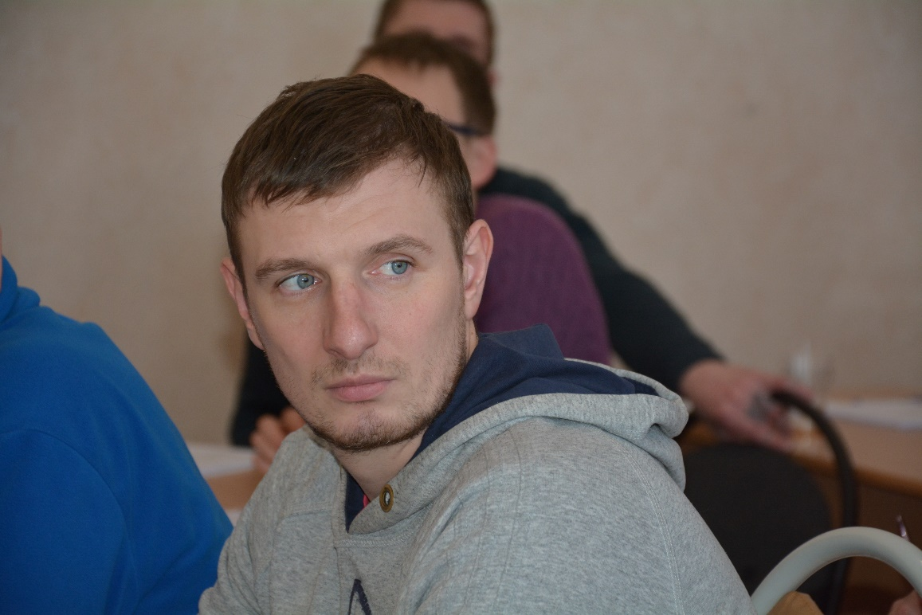
E. A great need for our students to renew their mind

Slide 15
Part 2: Teaching students on overcoming battles with pornography/lusting

Slide 16
Comments on issues or problems the students felt needed to be addressed more
at Teen Challenge to help them overcome temptations to lust or view pornography.
From the 1997 Survey of TC students on pornography & lusting

Slide 17
B. We do not need a course on the evils of lusting and pornography

Slide 18
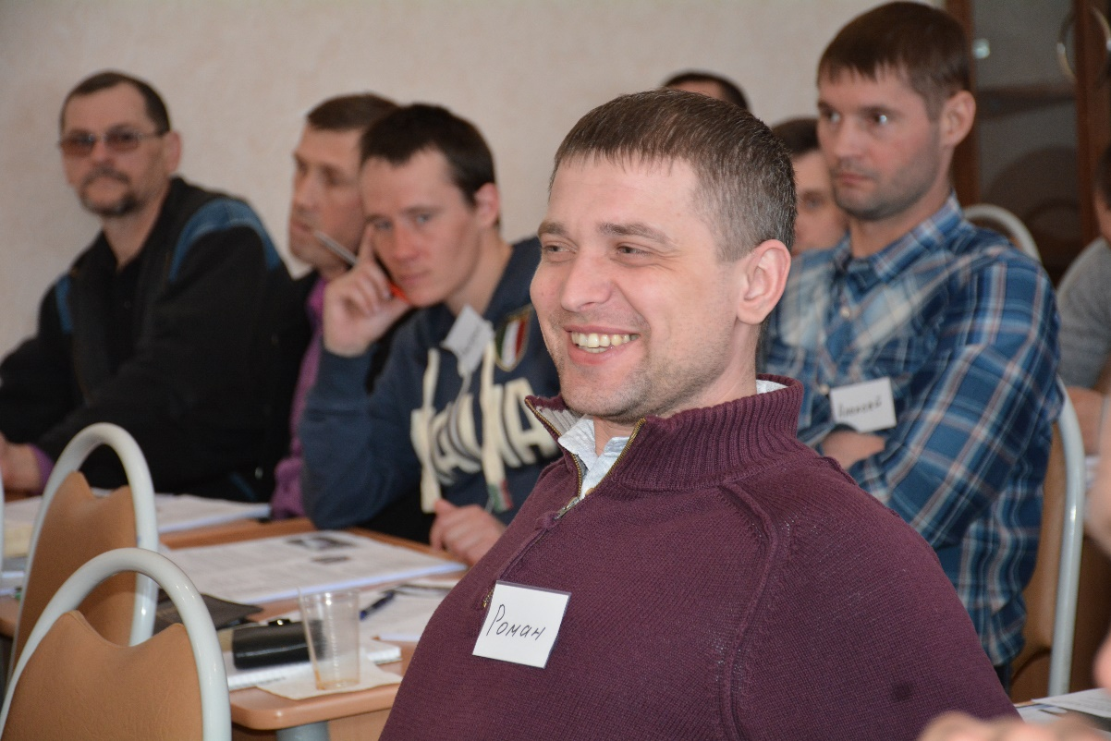
C. The role of effective discipleship training in achieving success in this area of living

Slide 19
Temptation (GSNC course)

Slide 21
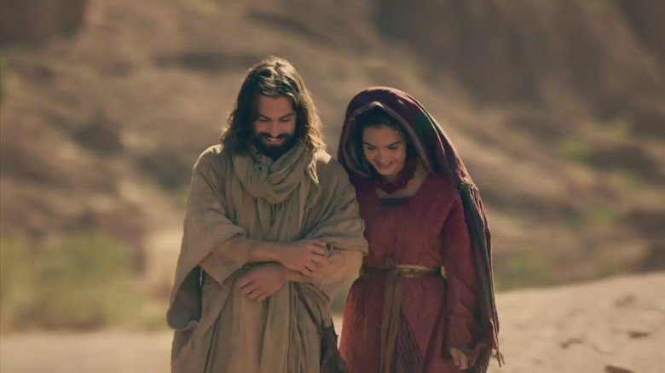
D. Seeing the fulfilled life from
God’s point of view
Seeing sex from God’s point of view

Slide 22
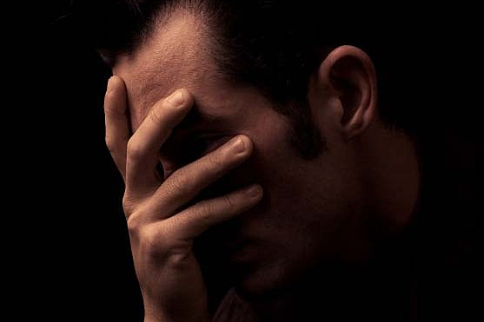
1. The failure of seeing God’s truth about dealing with lustful thoughts

Slide 23
E. Teach them how to respond to old memories (or new thoughts)
1. Thank you God for giving me a sound mind
2 Timothy 1:7

Slide 24
2. Understanding what part of my thoughts are right and wrong
Right thought Wrong thought
Right feeling Wrong feeling
Right person Wrong person
Right time Wrong time

Slide 25
3. What to do when I feel weak
2 Corinthians 12:9

Slide 26

F. Identify triggers

Slide 27

G. Develop substitute behaviors

Slide 28
H. A closer look at renewing the mind

Slide 29
Questions for discussion

Slide 30
Contact information
Global Teen Challenge
706-576-6555
www.GlobalTC.org
www.iTeenChallenge.org

