Slide 1


Obedience to Man
By Dave Batty

Slide 2

Obedience to Man
5th edition
By Dave Batty
This PowerPoint is designed to be used with the Group Studies for New Christians Course, Obedience to Man, by Dave Batty.
Other Materials available include:
Teacher's Manual
Student Manual
Study Guide
Exam
Course Certificate
For Information on obtaining these materials see iteenchallenge.org

Slide 3

Obedience to Man
Quizzes: Verses to Memorize To be done with:
1. Romans 13:1-2 Lesson 2
2. Ephesians 6:1 and 3 Lesson 4
Study Guide Projects:
Project # To be done before or with:
1 Lesson 1
2 Lesson 2
3 Lesson 2
4 Lesson 3
5 Lesson 3
6 Lesson 4
7 Lesson 4 (List 10 results)
8 Lesson 5
Test: Lesson 5

Slide 4
Basic Truths for Obeying
Your Leaders
Chapter 1

Slide 5
Basic Truths for Obeying Your Leaders
Key Biblical Truth
  I need to develop practical ways of showing my leaders I want to obey them.
Key Verse: 2 Corinthians 9:7 (New Life Bible)
  Each man should give as he has decided in his heart. He should not give, wishing he could keep it. Or he should not give if he feels he has to give. God loves a man who gives because he wants to give.

Slide 6
Your Opinion… Agree/Disagree?
All governments are under God.
The authorities are God’s servants, sent for your good.
Government workers need to be paid. They are serving God in what they do.
Pay taxes-so that an orderly way of life
can be maintained.
5. If you are irresponsible to the state then you are irresponsible to God.

Slide 7
Your Opinion… Agree/Disagree?
6. The authorities do not strike fear in people who are doing right, but in those who are doing wrong.

Slide 8
God’s Opinion…
Be a good citizen. All governments are under God. Insofar as there is peace and order, it’s God’s order. So live responsibly as a citizen.
Romans 13:1 The Message(MSG)
2. The authorities are God’s servants, sent for your good. But if you are doing wrong, of course you should be afraid, for they have the power to punish you. They are God’s servants, sent for the very purpose of punishing those who do what is wrong.
Romans 13:4 New Living Translation (NLT)

Slide 9
God’s Opinion…
Pay your taxes, too, for these same reasons. For government workers need to be paid. They are serving God in what they do. Romans 13:6 New Living Translation (NLT)
4. ⁶⁻⁷ That’s also why you pay taxes—so that an orderly way of life can be maintained. Fulfill your obligations as a citizen. Pay your taxes, pay your bills, respect your leaders Romans 13:7 The Message (MSG)

Slide 10
God’s Opinion…
If you’re irresponsible to the state, then you’re irresponsible with God, and God will hold you responsible.
Romans 13:2 The Message (MSG)
6. For the authorities do not strike fear in people who are doing right, but in those who are doing wrong. Would you like to live without fear of the authorities? Do what is right, and they will honor you.
Romans 13:3 New Living Translation (NLT

Slide 11
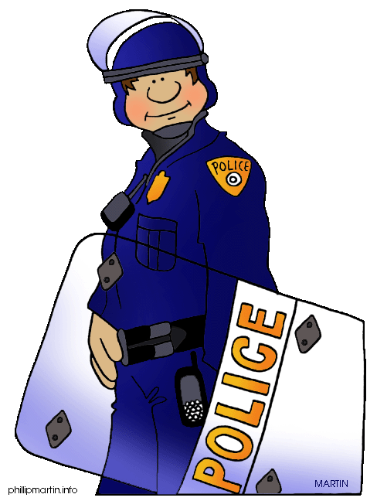
Basic Truths for Obeying Your Leaders
What have been your life experiences with your leaders?
The issue of disobedience
Conflict with leaders
The habit of disobedience
How does God fit into your life?

Slide 12
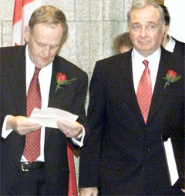
Which Leaders Should You Obey?
Government leaders
Parents
Employer
Spiritual leaders – pastor
Leaders where you presently live

Slide 13
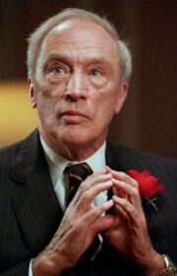
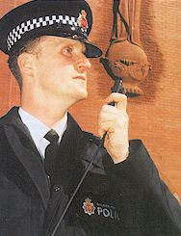
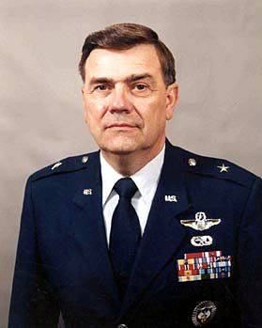
Develop Obedient Attitudes
Respectful attitude
Submissive Attitude
Grateful attitude (Thankful attitude)
Quiet attitude

Slide 14

Obedience to Man is Based on Love
God told you to love others as you love yourself
Jesus told you to love others the same way He loves you
If you don’t love your leaders, you will not be able to obey them

Slide 15

Guidelines to Help You Obey Your Leaders With Love
Learn to respect the person in authority even though s/he has faults
God uses leaders to guide you and protect you
What if you don’t trust your leaders?

Slide 16

Personal Application
List four ways you can show your leaders that you want to obey them.
Choose one of these four ways and put it into practice.
Study guide project 2 can be used to help you record your experience.

Slide 17
Three Levels of Obedience
Chapter 2

Slide 18
Basic truths for obeying your leaders
Key Biblical Truth
  Christians need to develop mature ways of obeying their leaders.
Key Verse: Ephesians 6:1 (New Life Bible)
  Children, as Christians, obey your parents. This is the right thing to do.

Slide 19
Introduction – Lesson Warm-up
What are some names for people who do not obey the rules?
Outlaw
Rebel
inmate
non-conformist
Other names?

Slide 20

Three Levels of Obedience
One: Obey because you were told to do it

Slide 21
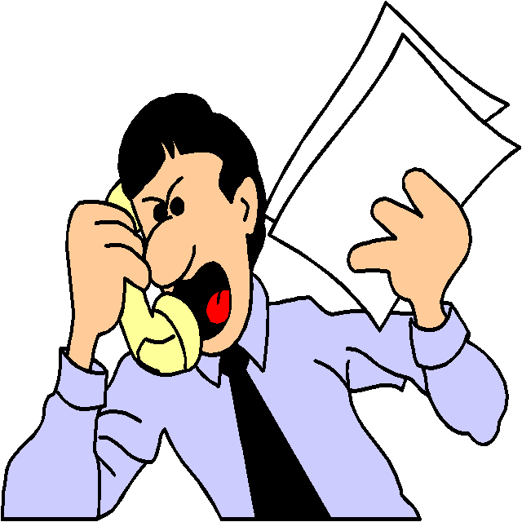
Level One: Obey
-Because you were told to do it.
Don’t complain.
Don’t talk back or argue with your leader.
Do the job the best you can.
Learn to enjoy obeying.

Slide 22
Three Levels of Obedience
Two: Obey and Discover
the Main Reason Why
Your Leader Told You
to Do It

Slide 23

Level Two: … Discover the Main Reason Why…
Put yourself in his position and look at it from his point of view.
Ask why – but be careful in the “when” and “how”.

Slide 24
Level Two: … Discover the Main Reason Why…
Try to discover the main reason why God wants you to do this.
Ask your leader what goals he has for himself and you.
Why ask why? Cuz you will learn to obey on your own without being told!

Slide 25

Three Levels of Obedience
Three:
Obey On Your Own – because
It’s the right thing to do

Slide 26
Level Three: Obey On Your Own
Obey on your own because it is the right thing to do.
You will need the help of the Holy Spirit.
The person who obeys on his own in all areas of his life mirrors the life of Jesus.

Slide 27
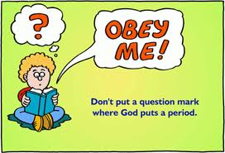
Personal Application
Make a commitment to develop an obedient lifestyle.
Pray and ask God for strength and wisdom to master all three levels of obedient lifestyle.

Slide 28
How Should You Respond When Talking to Your Leaders?
Chapter 3

Slide 29
Basic Truths for Obeying
Your Leaders
Key Biblical Truth
  I need to develop practical ways of showing respect when responding to my leaders.
Key Verse: Matthew 7:1 (New Life Bible)
  Do not say what is wrong in other people’s lives. Then other people will not say what is wrong in your life.

Slide 30
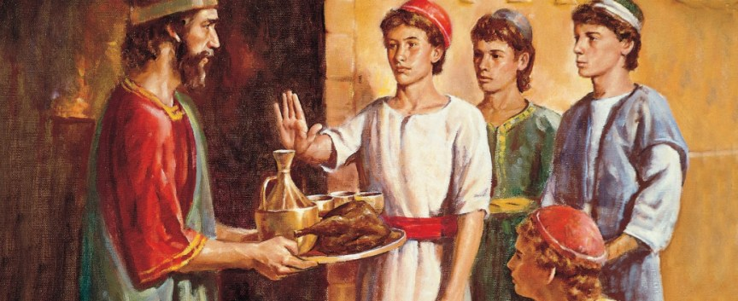
Lesson Warm-up
Prepare to give a skit acting out Daniel chapter 1. You may add to the script what is not given in the scripture, but do not change the pattern that Daniel used in working out an arrangement with his leaders.

Slide 31
How Should You Respond When Talking to Your Leaders?
Do not condemn or criticize your leaders.
Base your response on your opinion.
Say it in a way to help your leader reach his or her goals.

Slide 32

How Should You Respond When Talking to Your Leaders?
Set goals on how you will respond when a particular problem comes up.
Set deadlines on when you will talk to your leader.
Look to God for the power to do this right

Slide 33
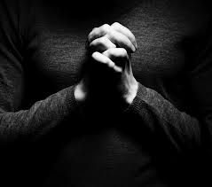
Personal Application
Review the six guidelines presented in today’s lesson.
Focus your attention on at least one of the guidelines each time you talk with one of your leaders.

Slide 34
What Should You do When
Your Leader Tells You to do Something Wrong?
Chapter 4

Slide 35
Basic Truths for Obeying
Your Leaders
Key Biblical Truth
  I need to carefully think about the results of obeying or disobeying my leaders in each daily experience.
Key Verse: Ephesians 6:1 and 3 (New Living Translation
¹ Children, obey your parents because you belong to the Lord, for this is the right thing to do. ³ If you honor your father and mother, “things will go well for you, and you will have a long life on the earth.”

Slide 36
Lesson Warm-up
Imagine for a few minutes that you are the person in authority. Write down how you would respond in these two situations.
1. Your teenage daughter has refused to clean up her bedroom. You clearly told her this morning to do it, but the room is still a mess. How will you react to her disobedience?
2. Your teenage son is assigned to do the dishes every Tuesday night. This week you are having guests over for dinner on Tuesday so there are lots of extra dirty dishes. Your son finishes all the dishes by himself without the help of an automatic dishwasher. How will you respond to his obedience?

Slide 37
What Should You Do When Your Leader Tells You to Do Something Wrong?
A: Carefully assess
what you have been
told to do

Slide 38
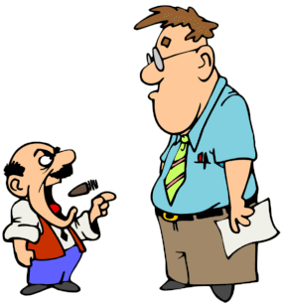
A: Carefully assess what you have been told to do
Find out if you correctly heard what your leader told you to do.
Determine if what you have been told to do is actually a sin.
If it is a sin, determine what sin it is.

Slide 39
What Should You Do When Your Leader Tells You to Do Something Wrong?
B: Discover the Main
Reason Why the Leader
Told You to Do It

Slide 40
B: Discover the Main Reason…
Is the main reason for your good?
Is the main reason to get you to sin?
Is the leader testing you to see what you will do?
Is the leader joking?

Slide 41
What Should You Do When Your Leader Tells You to Do Something Wrong?
C: If the Main Reason
is Not Sin, You Have
the Responsibility to
Obey

Slide 42

C: If the Main Reason is Not Sin… Responsibility to Obey
Find another way to do it so you will not have to sin.
Talk to your leader.
Give God time to change your leader’s mind.

Slide 43
What Should You Do When Your Leader Tells You to Do Something Wrong?
D: If the Main Reason
is Sin, You Have the
Responsibility to Disobey
Your Leader

Slide 44
D: If the Main Reason is Sin… Responsibility to Disobey
Talk to your leader.
Give God time to change your leader’s mind.
Be willing to suffer the consequences of doing right.
Get out of an abusive situation

Slide 45








Results of Obeying Your Leaders

Slide 46

Results of Obeying Your Leaders
How does obedience affect my relationship with others?
1. God
2. My parents and family
3. My children
(present and future ones)
4. My friends
5. Those I work with
6.Other people living around me

Slide 47

Results of Obeying Your Leaders
2. How does God view obedience?
1. Genesis 24
2. 1Kings 17:8-23
3. Proverbs 2:1-2
4. Proverbs 6:20-24
5. Proverbs 13:13
6. Proverbs 28:7

Slide 48
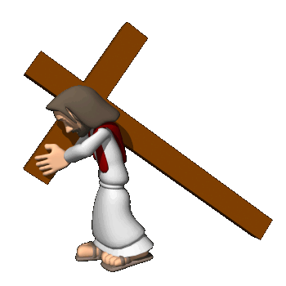
Results of Obeying Your Leaders
2. How does God view obedience?
7. Romans 13:1-6
8. Ephesians 6:1-3
9. Ephesians 6:5-8
10. Hebrews 5:8-9,
Hebrews 13:17
11. Peter 2:13-17

Slide 49
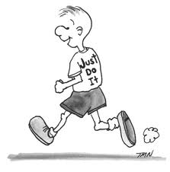
Results of Obeying Your Leaders
God promises to bless us if we obey our leaders.
The more you develop self-discipline, the easier it will become for you to resist temptations to sin.

Slide 50

Results of Obeying Your Leaders
As you obey your leaders, and continue to grow, you can learn to trust your leaders the way God wants you to trust them.

Slide 51
Results of Disobeying Your Leaders
DIS-

Slide 52
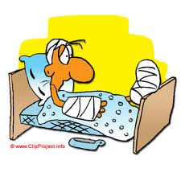
Results of Disobeying Your Leaders
1. What are the consequences of disobedience?
Natural consequences
Discipline
Punishment
Revenge

Slide 53

Results of Disobeying Your Leaders
2. How does disobedience affect my relationship with others?
God
My parents and family
My children(present and
future ones)
My friends
Those I work with
Other people living around me

Slide 54

Results of Disobeying Your Leaders
3. How does God view disobedience?
Genesis 39
1 Samuel 13 & 14
Proverbs 13:13
Proverbs 5:12-24
Proverbs 15:9-10
Acts 5:17-41
Romans 13:1-6
2 Corinthians 10:6
1 Peter 2:13-17

Slide 55
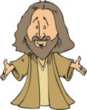
Results of Disobeying Your Leaders
4. THE NEED FOR DISCIPLINE AND PUNISHMENT TODAY
We all face situations-almost everyday
where we are faced with a
decision-will I obey or disobey?
So when you are disciplined or
punished, God is giving you an
opportunity to change-to grow.
The choice is yours. How will you respond?

Slide 56

Personal Application
Practice discovering the main reason why your leader tells you to do something.
Developing this skill is key to responding in a way that will bring glory to God.

Slide 57
Conclusion
As you work at putting the three levels of obedience into your life, you can be sure it will take you down a path that leads to greater peace. This is also the path to better relationships with others.
Don’t settle for less than God’s best for you.

Slide 58
Obedience to Man
Scriptures

Slide 59
Matthew 22:37-40
Jesus replied, “ ‘You must love the Lord your God with all your heart, all your soul, and all your mind.’ ³⁸ This is the first and greatest commandment. ³⁹ A second is equally important: ‘Love your neighbor as yourself.’ ⁴⁰ All the other commandments and all the demands of the prophets are based on these two commandments.”

Slide 60
John 13:34-35
So now I am giving you a new commandment: Love each other. Just as I have loved you, you should love each other. ³⁵ Your love for one another will prove to the world that you are my disciples.”

Slide 61
John 14:21
Those who obey my commandments are the ones who love me. And because they love me, my Father will love them, and I will love them. And I will reveal myself to each one of them.”

Slide 62
Romans 13:1-7
Obey the government, for God is the one who put it there. All governments have been placed in power by God. ² So those who refuse to obey the laws of the land are refusing to obey God, and punishment will follow. ³ For the authorities do not frighten people who are doing right, but they frighten those who do wrong. So do what they say, and you will get along well.

Slide 63
Romans 13:1-7
The authorities are sent by God to help you. But if you are doing something wrong, of course you should be afraid, for you will be punished. The authorities are established by God for that very purpose, to punish those who do wrong. ⁵ So you must obey the government for two reasons: to keep from being punished and to keep a clear conscience.
⁶

Slide 64
Romans 13:1-7
Pay your taxes, too, for these same reasons. For government workers need to be paid so they can keep on doing the work God intended them to do. ⁷ Give to everyone what you owe them: Pay your taxes and import duties, and give respect and honor to all to whom it is due.

Slide 65
Ephesians 6:1-3
Children, obey your parents because you belong to the Lord, for this is the right thing to do. ² “Honor your father and mother.” This is the first of the Ten Commandments that ends with a promise. ³ And this is the promise: If you honor your father and mother, “you will live a long life, full of blessing.”

Slide 66
1 Peter 2:17
Show respect for everyone. Love your Christian brothers and sisters. Fear God. Show respect for the king.

Slide 67
Colossians 3:22-23
Work hard and cheerfully at whatever you do, as though you were working for the Lord rather than for people. ²⁴ Remember that the Lord will give you an inheritance as your reward, and the Master you are serving is Christ.

Slide 68
Proverbs 6:20-23
My son, obey your father’s commands, and don’t neglect your mother’s teaching. ²¹ Keep their words always in your heart. Tie them around your neck. ²² Wherever you walk, their counsel can lead you. When you sleep, they will protect you. When you wake up in the morning, they will advise you. ²³ For these commands and this teaching are a lamp to light the way ahead of you. The correction of discipline is the way to life.

Slide 69
Proverbs 13:13
People who despise advice will find themselves in trouble; those who respect it will succeed.

Slide 70
Proverbs 28:7
Young people who obey the law are wise; those who seek out worthless companions bring shame to their parents.

Slide 71
Hebrews 5:8-9
So even though Jesus was God’s Son, he learned obedience from the things he suffered. ⁹ In this way, God qualified him as a perfect High Priest, and he became the source of eternal salvation for all those who obey him.

Slide 72
1 Peter 2:13-17
For the Lord’s sake, accept all authority—the king as head of state, ¹⁴ and the officials he has appointed. For the king has sent them to punish all who do wrong and to honor those who do right.
¹⁵ It is God’s will that your good lives should silence those who make foolish accusations against you. ¹⁶ You are not slaves; you are free. But your freedom is not an excuse to do evil. You are free to live as God’s slaves. ¹⁷ Show respect for everyone. Love your Christian brothers and sisters. Fear God. Show respect for the king.

Slide 73
Proverbs 5:12-14
… and you will say, “How I hated discipline! If only I had not demanded my own way! ¹³ Oh, why didn’t I listen to my teachers? Why didn’t I pay attention to those who gave me instruction? ¹⁴ I have come to the brink of utter ruin, and now I must face public disgrace.”

Slide 74
Proverbs 15:9-10
The Lord despises the way of the wicked, but he loves those who pursue godliness.
¹⁰ Whoever abandons the right path will be severely punished; whoever hates correction will die.

Slide 75

Obedience to Man
5th edition
By Dave Batty
This PowerPoint is designed to be used with the Group Studies for New Christians Course, Obedience to Man, by Dave Batty.
This PowerPoint resource was developed by the
Teen Challenge Farm, London, Ontario
Edited by Global Teen Challenge, 2018
For Information on obtaining these materials see iteenchallenge.org

Slide 76
Obedience to Man
This PowerPoint is designed to be used with the Group Studies for New Christians Course, Obedience to Man, by Dave Batty.
This PowerPoint resource was developed by the
Teen Challenge Farm, London, Ontario
Edited by Global Teen Challenge, 2018
gtc@globaltc.org

