Slide 1
Obedience to God By David Batty
Global Teen Challenge
Iteenchallenge.org 01/2018

Slide 2
Obedience to God
5th edition
By David Batty
This PowerPoint is designed to be used with the
Group Studies for New Christians Course,
Obedience to God, by David Batty
Other materials available include:
Teacher’s Manual
Student Manual
Study Guide
Exam
Course Certificate
For Information on obtaining these materials see iteenchallenge.org
Iteenchallenge.org 01/2018

Slide 3
Obedience to God
Quizzes: Verses to Memorize To be done with:
1. Mark 12:30 Lesson 2
2. John 13:34-35 Lesson 4
Study Guide Projects:
Project # To be done before or with:
1 Lesson 1
2 Lesson 2
3 Lesson 4
4 Lesson 3 or 4
Test: Lesson 5

Slide 4
Memory Verses
Mark 12:30 (New Living Translation)
And you must love the Lord your God with all your heart, all your soul, all your mind, and all your strength.
John 13:34-35 (New Living Translation)
So now I am giving you a new commandment: Love each other. Just as I have loved you, you should love each other. Your love for one another will prove to the world that you are my disciples.
Iteenchallenge.org 01/2018

Slide 5
Chapter 1 Love and Obedience
Iteenchallenge.org 01/2018

Slide 6
Love and Obedience
Key Biblical Truths
The best way to obey God is to express my love to God in meaningful ways in my daily life.
Key Verse
You must love the Lord your God with all your heart and with all your soul and with all your mind and with all your strength. This is the first law.
Mark 12:30 (New Life Bible)
Iteenchallenge.org 01/2018

Slide 7
Love and Obedience
“Deals I’ve Made With
God…”
Iteenchallenge.org 01/2018
Notes:
Lesson Warm Up 1

Slide 8
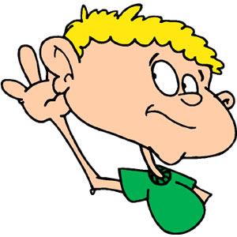
Love and Obedience
“When God told me to do…”
Iteenchallenge.org 01/2018
Notes:
Lesson Warm Up 2

Slide 9
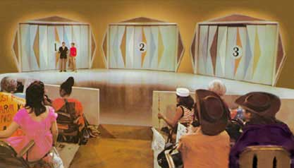
Love and Obedience
“Let’s Trade Your Salvation”
“Fun in the Son” by Isaac Air Freight
Iteenchallenge.org 01/2018
Notes:
Lesson Warm Up 3

Slide 10
A. The Need For New Relationships
What relationships do you value the most today?
How do we grow new relationships?
God wants to be your father
Iteenchallenge.org 01/2018

Slide 11
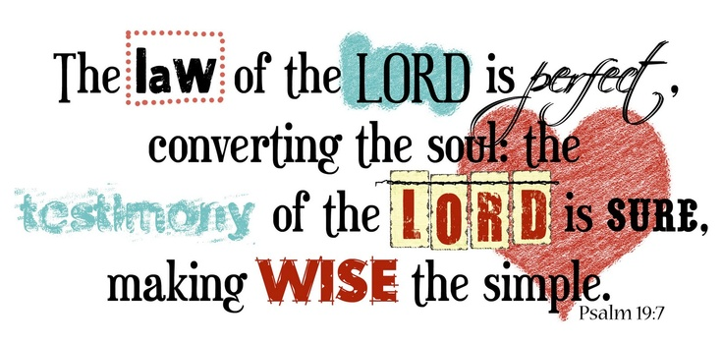
B. What place does obeying God’s laws have in a healthy relationship with God?
1. God’s laws
Iteenchallenge.org 01/2018

Slide 12
2. God’s Greatest Laws
Matthew 22:35-40
One of them, an expert in religious law, tried to trap him with this question:
“Teacher, which is the most important commandment in the law of Moses?”
Iteenchallenge.org 01/2018

Slide 13
Jesus replied, “‘You must love the Lord your God with all your heart, all your soul, and all your mind.’
This is the first and greatest commandment.
A second is equally important: ‘Love your neighbor as yourself.’
The entire law and all the demands of the prophets are based on these two commandments.”
Iteenchallenge.org 01/2018

Slide 14
C. Why Obey God?
God is love.
God loves you.
God has commanded us to love Him.

Slide 15
D. How do I obey God’s greatest law?
How do I get started in loving God?
Obey God’s laws
Obey the principles behind God’s laws
Give God your personal rights
Do what God wants you to do
Iteenchallenge.org 01/2018

Slide 16
D. How do I obey God’s greatest law?
What if I don’t have the power to obey God?
2 Timothy 1:7
2 Corinthians 12:9
You must want to obey God’s laws
Iteenchallenge.org 01/2018

Slide 17
D. How do I obey God’s greatest law?
What if I don’t feel any love for God?
Describe love
What is the greatest commandment of the Bible and for whom?
“Feelings” vs. “Actions and Thoughts”
Whether we feel love or not, we need to continue to walk in obedience to God and His laws.
Iteenchallenge.org 01/2018

Slide 18
E. What place do motives have in obedience to God?
Define motive
It’s personal: You and God
Love is the highest motive for obeying God
Other possible motives
Iteenchallenge.org 01/2018

Slide 19
Personal Application
Discover some practical ways of showing love to God.
Have love be your main motive for obeying God.
Make a firm commitment to obeying God.
Iteenchallenge.org 01/2018

Slide 20
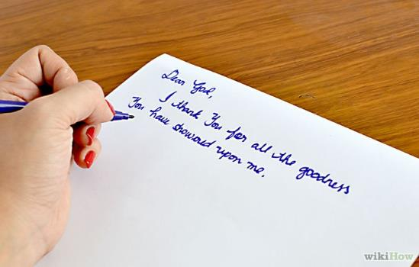
Personal Application Activity
Write a prayer to God:
Thank Him for being a loving leader
Express your love and desire to obey God and His laws
Talk to God about your motives for obeying Him.
Pair off and read your prayer to a partner
Look for ways to express your love and obedience
Explain how Study Guide Project 1 fits in with this.
Notes:
Personal Application Activity

Slide 21
Chapter 2 Attitude and Obedience
Iteenchallenge.org 01/2018

Slide 22
Attitude and Obedience
Key Biblical Truths
Christians need to develop obedient attitudes to use when obeying God and His laws.
Key Verse
Your attitude should be the kind that was shown us by Jesus Christ.
Philippians 2:5 (The Living Bible)
Iteenchallenge.org 01/2018

Slide 23
Attitude and Obedience
“My motive in obeying God…”
Iteenchallenge.org 01/2018
Notes:
Lesson Warm Up Activity

Slide 24
Attitude and Obedience
Motives and Attitudes
Iteenchallenge.org 01/2018
Notes:
Lesson Warm Up Activity

Slide 25
What is an attitude?
A pattern of thinking.
An opinion.
The way you think.
A habit of thinking.
A point of view.
Thoughts I have learned.
A mental position with regard to a fact or state (Webster’s Seventh New Collegiate Dictionary)
Iteenchallenge.org 01/2018
Notes:
Lesson Warm Up Activity

Slide 26
A. Check for Attitudes that Make it Easy to Disobey God
Condemning attitude
Rebellious attitude
Ungrateful attitude
Lazy attitude
Resentful attitude
Stubborn attitude

Slide 27
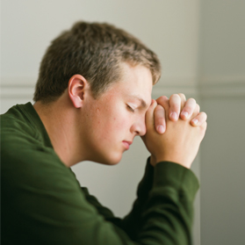
B. Develop obedient attitudes
Reverent attitude
Servant attitude
Grateful attitude
Quiet attitude
Iteenchallenge.org

Slide 28
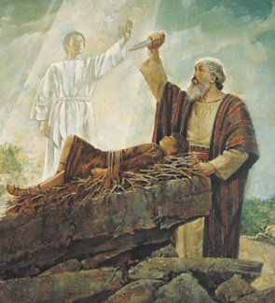
Abraham’s Obedient Attitude
Genesis 22:1-19
Hebrews 11:17-19
Which obedient attitudes did Abraham use in his situation?
Iteenchallenge.org 01/2018

Slide 29
Expressing Obedient Attitudes
How to develop and express these attitudes.
How these attitudes affect your relationship with God and your behavior.
Iteenchallenge.org 01/2018

Slide 30
What is a Reverent Attitude?
Respect mixed with love.
Admiration: “I admire God. I look to God with respect. I honor Him.”
Iteenchallenge.org 01/2018

Slide 31
How Do You Develop a Reverent Attitude?
Understand that God is working in your life through your leaders.
Recognize that God is using your leaders to make you into the person God wants you to be.
Look on your leaders as “God’s hands,” guiding and directing you.
Iteenchallenge.org 01/2018

Slide 32
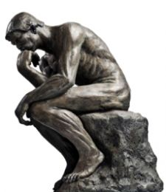
Think about it….
“How do I express a reverent attitude?”
“How does this reverent attitude affect my relationship with God?”
“How does this reverent attitude affect my behavior?”
Iteenchallenge.org 01/2018

Slide 33
What is a Servant Attitude?
Understanding that you are not your own boss.
Recognizing that you are actually serving God when you are working for your leaders.
This means you are working for God’s approval in everything you do, especially in obeying God and your leaders.
Iteenchallenge.org 01/2018

Slide 34
How Do You Develop a Servant Attitude?
Willingly submit yourself to God and your leaders and obey them.
Place yourself under God’s protection.
Look for ways of making someone else successful, especially your leaders. Become excited about this and find real happiness in doing this.
Don’t try to do God’s job. Don’t try to take on His responsibilities.
Iteenchallenge.org 01/2018

Slide 35
Think about it….
“How do I express a servant attitude?”
“How does this servant attitude affect my relationship with God?”
“How does this servant attitude affect my behavior?”
Iteenchallenge.org 01/2018

Slide 36
What is a Grateful Attitude?
Being thankful for having God as your leader.
Being genuinely happy and appreciating what God is doing to make you into the person He wants you to be.
Iteenchallenge.org 01/2018

Slide 37
How Do You Develop a Grateful Attitude?
Learn to be happy to have God as your boss. Thank God every day that you are His child.
Show genuine appreciation to God every day. Thank Him whenever He uses other people to advise or correct you.
Give all your expectations to God. Make a list of all the things you expect Him to do for you. Then pray and give all these expectations to God.
Iteenchallenge.org 01/2018

Slide 38
Think about it….
“How do I express a grateful attitude?”
“How does this grateful attitude affect my relationship with God?”
“How does this grateful attitude affect my behavior?”
Iteenchallenge.org 01/2018

Slide 39
What is a Quiet Attitude?
Learning to be quiet in what I say.. In how much I say and how loud I say it.
Learning to be quiet on the inside as well as the outside.
Learning to be at peace with God.
Iteenchallenge.org 01/2018

Slide 40
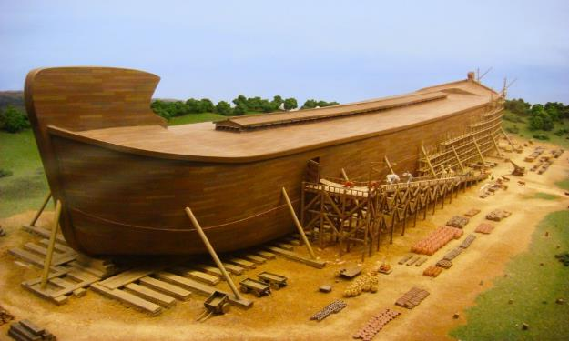
How Do You Develop a Quiet Attitude?
Learn to obey God without demanding to know His reasons. Be willing to obey simply because you were told to do it.
Place your trust in God, that He will be able to work through your leaders to do in your life what He wants.
Trust God to do this even if your leaders make mistakes and do wrong things.
Iteenchallenge.org 01/2018

Slide 41
How Do You Develop a Quiet Attitude?
Do not argue with God.
Do not demand an explanation as to why you should do something before you will obey.
Iteenchallenge.org 01/2018

Slide 42
Think about it….
“How do I express a quiet attitude?”
“How does this quiet attitude affect my relationship with God?”
“How does this quiet attitude affect my behavior?”
Iteenchallenge.org 01/2018

Slide 43
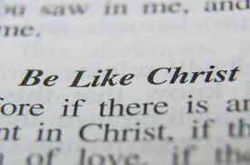
Becoming more like Christ
Need for balance
Developing obedient attitudes & getting rid of disobedient attitudes
Intelligent Obedience:
A choice
A wise person loves to obey God and His laws.
Iteenchallenge.org 01/2018

Slide 44
Personal Application
Do a personal evaluation of your life.
Rate yourself on the attitudes that make it easy to disobey God.
Make a firm commitment to obeying God.
Iteenchallenge.org 01/2018
Notes:
Personal Application

Slide 45
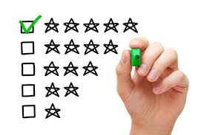
Personal Application Activity
Rate yourself on the attitudes that make it easy to disobey God. (Student Manual pg14-15)
Write down on a scale of 1-5 how strong each disobedient attitude is in your life.
(1:the attitude is very small, no problem at all; 5:the attitude is a very strong one in your life)
Write down at least one thing you can do to build a strong obedient attitude
Write down one thing you can do to help get rid of one of the disobedient attitudes in your life.
Iteenchallenge.org 01/2018
Notes:
Personal Application Activity

Slide 46
Chapter 3 Which Laws Do I Obey??
Iteenchallenge.org 01/2018

Slide 47
Laws To Obey
Key Biblical Truths
Obeying God’s laws is the most important thing I can do today.
Key Verse
But the one who keeps looking into God’s perfect Law and does not forget it will do what it says and be happy as he does it. God’s Word makes men free.
James 1:25 (New Life Bible)
Iteenchallenge.org 01/2018

Slide 48
Laws to Obey
Do Christians have to obey all of God’s laws that are in the New Testament?
Do Christians have to obey all of God’s laws that are in the Old Testament?
If Christians do not have to obey all of God’s laws, how do you decide which laws to obey and which ones to ignore?
Iteenchallenge.org 01/2018
Notes:
Lesson Warm Up Activity

Slide 49
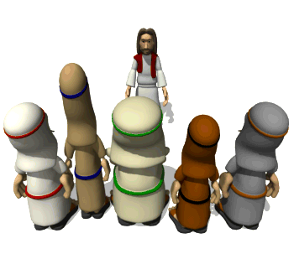
A. Four Basic Categories of God’s Laws
Health Laws
Civil Government Laws for the nation of Israel
Religions Laws
Moral Laws
Iteenchallenge.org 01/2018
Notes:
Lesson Warm Up Activity

Slide 50
“These four groups seem relatively simple, but in reality, some laws could easily fit into two categories. The last group—moral laws—is also a problem. In reality, every law in the Bible has a moral issue tied to it. These four categories are man-made. You won’t find a verse in the Bible that breaks these laws into these four categories.”
Quote from Student Manual page 21
Iteenchallenge.org 01/2018

Slide 51
Health Laws
Exodus
Leviticus
Numbers
Deuteronomy
Iteenchallenge.org 01/2018

Slide 52
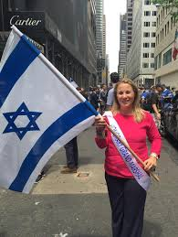
Civil Government Laws for the nation of Israel
Exodus
Leviticus
Numbers
Deuteronomy
Iteenchallenge.org 01/2018

Slide 53
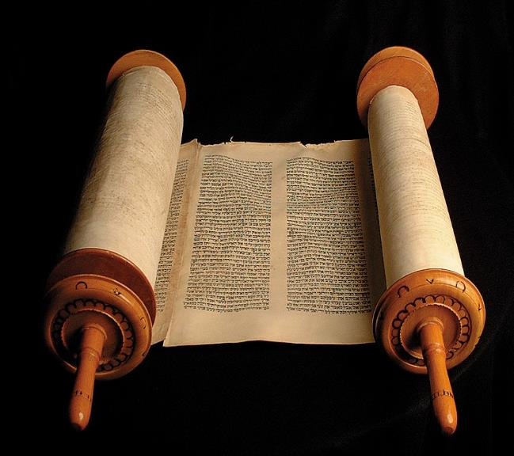
Religious Laws
Old Testament Laws
Training and duties of priests and Levites
Different types of food and animal sacrifices
Religious holidays
Iteenchallenge.org 01/2018

Slide 54
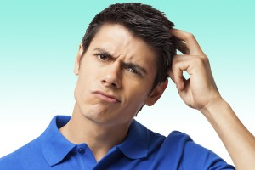
Which of God’s laws in the Old and New Testament should Christians obey today?
Iteenchallenge.org 01/2018

Slide 55
B. The Debate over which laws need to be obeyed today…
A Controversial Issue…
How to make the
right decisions in this
area of your life.
Iteenchallenge.org 01/2018

Slide 56
Position 1: “Christians today need to obey all the Old Testament laws.”
“A variation of this position is that Christians are required to obey some of the Old Testament laws, but not all of them. This puts us into a very difficult place of having to decide which laws to obey and which ones to ignore.”
Quote from the Student Manual page 23.
Iteenchallenge.org 01/2018

Slide 57
Position 1: “Christians today need to obey all the Old Testament laws.”
Matthew 5:17-19
Acts 15:28-29
Iteenchallenge.org 01/2018

Slide 58
Position 2: “Christians need to obey God’s Law in the New Testament.”
Matthew 5 – 7
Mark 12:30-31
John 13:34
Romans 13:1-2
Ephesians 6:1-3
Iteenchallenge.org 01/2018

Slide 59
Position 3: “A place to start for new Christians.”
Learning how to obey God - NOT how to get around obeying His laws
Obeying God is one of the best ways to show that “I love Him.”

Slide 60
C. Obey the principles behind God’s laws
You can choose to look at every law in the Bible and ask:
What does this law tell me about God?
Why did God give this law to His people?
What was He trying to teach them with this law?
What is the lesson or principle of this law that I can apply to my relationship with God today?
Iteenchallenge.org 01/2018

Slide 61
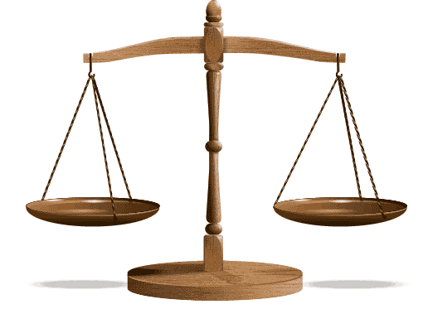
The spirit of the law vs. the letter of the law
“Intelligent obedience means that we take a close look at the laws God has given us to discover the main reason why He made each law.”
Iteenchallenge.org 01/2018

Slide 62
D. What is “God’s will?”
Become a Christian
Stop sinning
Start doing what is right
Give time for Christian work
Respond to problems and tests the way God wants you to
Learn to respond like God does
Learn to be sensitive to the needs of others
Share with others what Christ has done for you
Iteenchallenge.org 01/2018

Slide 63
Personal Convictions
What is a “Personal Conviction”?
The Holy Spirit many times deals with people about particular things He does not want them to do. These personal convictions are an important part of God’s will for that person.
A “personal boundary” that God has given that person. *God will never give a personal conviction that allows for something prohibited by one of God’s laws.
Provide a tighter boundary for that person than the laws of the Bible.
Iteenchallenge.org 01/2018

Slide 64
Personal Interests
What’s the difference?
Personal interests are personal choices that people make regarding their own lifestyle.
It’s a personal choice, not a conviction that God has established for that person.
Iteenchallenge.org 01/2018

Slide 65
Personal Application
Identify one of God’s laws that relates to an area of your life where you need to grow.
Take time to find out the principle behind each of God’s laws.
Iteenchallenge.org 01/2018
Notes:
Personal Application

Slide 66
Chapter 4 Results of obeying God
Iteenchallenge.org 01/2018

Slide 67
Results of obeying and disobeying God
Key Biblical Truths
I need to carefully think about the results of obeying and disobeying God in each daily experience.
Key Verse
Despise God’s word and find yourself in trouble. Obey it and succeed. Proverbs 13:13 (The Living Bible)
Iteenchallenge.org 01/2018

Slide 68
Results of obeying and disobeying God
“If I were God…”
Iteenchallenge.org 01/2018
Notes:
Lesson Warm Up Activity

Slide 69
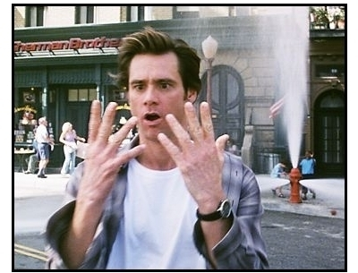
“If I were God…”
Here is how I would…
Reward people who obey me.
Punish sinners (non-Christians) who disobey me.
Punish Christians who disobey me.
Convince people to obey me.
Iteenchallenge.org 01/2018
Notes:
Lesson Warm Up Activity

Slide 70
A. Results of obeying and disobeying God
Make two lists:
List of results for obeying God
List results for disobeying God
*Include the scripture verse for each result you list.
Iteenchallenge.org 01/2018

Slide 71
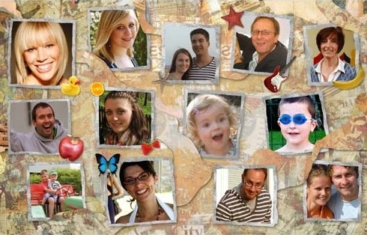
Results of obeying God
How does obedience to God affect my relationships to these people?
God
Myself
My parents and my family
My Children
My friends
Those I work with
Other people, including people I don’t even know.
Iteenchallenge.org 01/2018

Slide 72
Results of disobeying God
How does disobedience to God affect my relationships to these people?
God
Myself
My parents and my family
My Children
My friends
Those I work with
Other people, including people I don’t even know.
Iteenchallenge.org 01/2018

Slide 73
Chapter 5 Results of disobeying God
Iteenchallenge.org 01/2018

Slide 74
Results of disobeying God
What can I learn from the disobedience of others?
Adam and Eve
King David and Bathsheba
We should not follow in their steps, or we, too, will experience the tragic consequences of sin.
There is no such thing as “safe” sin –
Every act of disobedience opens us up to
destructive consequences.
Iteenchallenge.org 01/2018

Slide 75
B. Four key words related to disobedience
Natural Consequence
Discipline
Punishment
Revenge
Iteenchallenge.org 01/2018

Slide 76
C. What is God’s attitude toward people who disobey His Laws?
God is sad when we sin.
God hates sin.
God is patient with sinners and disobedient Christians.
God is a God of justice.
God is a God of mercy.
Iteenchallenge.org 01/2018

Slide 77
The relationship between God’s mercy and His justice
If a person sins and refuses to admit it or confess it, God will respond with what discipline he or she deserves.
If a person sins and admits it or confesses it to God, then God often responds with His mercy. Often, a “lighter sentence” for the disobedient action.
Iteenchallenge.org 01/2018

Slide 78
Conclusion
Choosing to obey God is clearly the best choice you can make. The blessings of God are promised to you when you obey, and the warnings for disobedience are also clearly stated.
Galatians 6:7-8 New Living Translation
Don‟t be misled. Remember that you can‟t ignore God and get away with it. You will always reap what you sow! 8Those who live only to satisfy their own sinful desires will harvest the consequences of decay and death. But those who live to please the Spirit will harvest everlasting life from the Spirit.

Slide 79
Personal Application
Write a prayer to God, thanking Him for being a God who is patient, loving, merciful, and just.
Seek His help and strength to obey Him today and each day following.
Iteenchallenge.org 01/2018
Notes:
Personal Application

Slide 80
Obedience to God
5th edition
By David Batty
This PowerPoint is designed to be used with the
Group Studies for New Christians Course,
Obedience to God, by David Batty
Other materials available include:
Teacher’s Manual
Student Manual
Study Guide
Exam
Course Certificate
For Information on obtaining these materials see iteenchallenge.org gtc@globaltc.org
Iteenchallenge.org 01/2018

Slide 81
Obedience to God
Developed by TC Farm London Ontario Canada
Edited by Global Teen Challenge

