Slide 1
The Ultimate Purpose of Leadership Fulfilling the Great Commission as a Leader by EQUIP Ministries founded by John Maxwell
1

Slide 2
The Ultimate Purpose of Leadership Fulfilling the Great Commission as a Leader
“...so that all nations might believe and obey Him."
(Romans 16:26b)

Slide 3
The Ultimate Purpose of Leadership Fulfilling the Great Commission as a Leader
As you continue your leadership journey, it is essential to understand why God desires for you to deepen your leadership skills. Is it just for your personal growth? Is it just for
the growth of your local church? Or is there a larger purpose – a purpose beyond your own life, your church and even your community? The answer is YES!
The ultimate purpose for your personal leadership development is to be more effective in your role of advancing the growth of His kingdom around the world!

Slide 4
The Ultimate Purpose of Leadership Fulfilling the Great Commission as a Leader
God and His Plan for the People of the World
Principle #1 – _____ Is the Center of _____ Things.
"… all things were created by Him and for Him." (Colossians 1:16)
"… it was fitting that God, for whom and through whom everything exists." (Hebrews 2:10)
Principle #2 –God Desires for _____ the People in the World to _____ Him through Jesus Christ.
God
all
all
know

Slide 5
The Ultimate Purpose of Leadership Fulfilling the Great Commission as a Leader
Old Testament Illustrations
"I will bless those who bless you, and whoever curses you I will curse; and all peoples on earth will be blessed through you." (Genesis 12:3)
"… so that all the peoples of the earth may know that the Lord is God and that there is no other." (I Kings 8:60)
"May God be gracious to us and bless us … that your ways may be known on earth, your salvation among all nations." (Psalm 67:1-2)

Slide 6
The Ultimate Purpose of Leadership Fulfilling the Great Commission as a Leader
New Testament Illustrations
"But the angel said to them, 'Do not be afraid. I bring you good news of great joy that will be for all the people. Today in the town of David a Savior has been born to you; He is Christ the Lord.'" (Luke 2:10)
"Therefore go and make disciples of all nations …" (Matthew28:18)
"… so that all nations might believe and obey Him." (Romans 16:26b)
"He is the atoning sacrifice for our sins, and not only for ours but also for the sins of the whole world." (1 John 2:2)

Slide 7
The Ultimate Purpose of Leadership Fulfilling the Great Commission as a Leader
all
Principle #3 – God Desires ____ the People of the World to _______ Him.
"And they sang a new song: 'You are worthy to take the scroll and to open its seals, because You were slain, and with Your blood You purchased men for God from every tribe and language and people and nation.'" (Revelation 5:9-10)
worship

Slide 8
The Ultimate Purpose of Leadership Fulfilling the Great Commission as a Leader
"Missions is not the ultimate goal of the Church. Worship is. Missions exists because worship doesn't. Worship is ultimate, not missions, because God is ultimate, not man.
When this age is over, and the countless millions of the redeemed fall on their faces before the throne of God, missions will be no more. It is a temporary necessity. But worship abides forever …" – John Piper, Let the Nations Be Glad
QUESTION: In light of the above truth, how should this affect our priorities as a leader?

Slide 9
The Ultimate Purpose of Leadership Fulfilling the Great Commission as a Leader
The People of the World
Reality #1 – People must first _____ of God before they can know Him through Jesus Christ and worship Him.
"How can they believe in the one of whom they have not heard?" (Romans 10:14)
hear

Slide 10
The Ultimate Purpose of Leadership Fulfilling the Great Commission as a Leader
portion
Reality #2 – Only a _______ of the world is hearing of Christ today.
The world population is ___ billion… and growing.
___ billion live in areas where there is access to the Gospel.
___ billion live in areas where there is little or no access to the Gospel.
6.3
4.7
1.6

Slide 11
The Ultimate Purpose of Leadership Fulfilling the Great Commission as a Leader
see
Reality #3 – How we ____ the world determines how we feel about the world (our motivation) and how we respond to its needs (our action).
"When Jesus landed and saw a large crowd, He had compassion on them …" (Mark 6:34)
QUESTION: How does God see the people of the world?

Slide 12
The Ultimate Purpose of Leadership Fulfilling the Great Commission as a Leader
Perspective #1 – Peoples (Ethnos)
"Therefore go and make disciples of all nations …" (Matthew 28:19)
The historical perspective focused on __________.
A more accurate perspective focuses on ________ or ethnic groups.
Perspective #2 – Reached or Unreached
"Therefore go and make disciples of all nations …" (Matthew 28:19)
Some measure ___________ ("saved" or "lost"). This is God’s part.
Some measure ___________ ("reached" or "unreached"). This is our part.
"It has always been my ambition to preach the gospel where Christ was not known…“ (Romans 15:20)
countries
peoples
response
accessibility

Slide 13
The Ultimate Purpose of Leadership Fulfilling the Great Commission as a Leader
"Although all people equally need the Gospel, the Gospel is not equally accessible to all people.“
Dr. Larry D. Reesor

Slide 14
The Ultimate Purpose of Leadership Fulfilling the Great Commission as a Leader
Perspective #3 – Potential Worshippers
______________ Worshippers
"At the name of Jesus every knee will bow, in heaven, on earth and under the earth, and every tongue confess that Jesus Christ is Lord, to the glory of God the Father.“ (Philippians 2:10-11)
__________ Worshippers
"After these things I looked, and behold, a great multitude, which no one could count from every nation and all tribes and peoples and tongues, standing before the throne and before the Lamb, clothed in white robes and palm branches were in their hands …“ (Revelation 7:9)
Involuntary
Voluntary

Slide 15
The Ultimate Purpose of Leadership Fulfilling the Great Commission as a Leader
God wants all people to be VOLUNTARY worshippers!
QUESTION:
What is your ministry doing right now to reach the unreached?

Slide 16
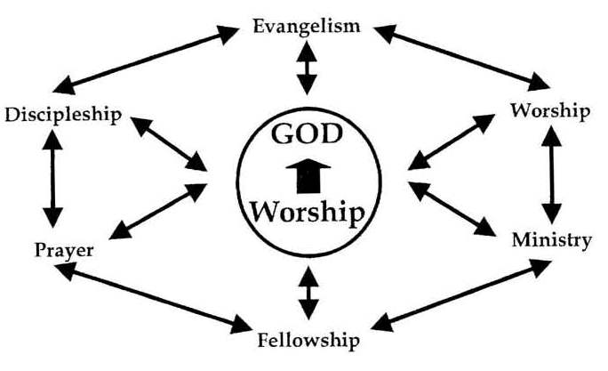
The Ultimate Purpose of Leadership Fulfilling the Great Commission as a Leader
The Church Is God's Instrument of Mission
As the Body of Christ, the Church is responsible for the Great Commission. The primary physical expression of that universal body is the local church.
The Pattern of Ministry (Acts 2:41-47)

Slide 17
The Ultimate Purpose of Leadership Fulfilling the Great Commission as a Leader
The Process of Growth (Acts 1:8)
"But you will receive power when the Holy Spirit comes on you; and you will be My witnesses in Jerusalem, and in all Judea and Samaria, and to the ends of the earth." ( Acts 1:8)
___________ Acts 2-7
The Church functioned well, but only in its own community and culture.
___________ and ___________(Acts 8:1)
The Church spread beyond its community to other cultures only after it encountered persecution.
_____ of the ______ (Acts 13)
The church at Antioch was the first local church God used to intentionally send out cross-cultural "missionaries."
Jerusalem
Judea
Samaria
Ends
Earth

Slide 18
The Ultimate Purpose of Leadership Fulfilling the Great Commission as a Leader
The local church is called to fulfill the pattern of ministry lived out in Acts 2 while at the same time reproducing that ministry beyond its Jerusalem to its Judea, Samaria and to the ends of the earth!

Slide 19
The Ultimate Purpose of Leadership Fulfilling the Great Commission as a Leader
"Personalization" – Helping Every Believer Discover Their Role
Paul's Picture of the Church – ________
(Romans 12:4-8, I Corinthians 12)
"Just as each of us has one body with many members, and these members do not all have the same function, so in Christ we who are many form one body, and each member belongs to all the others." (Romans 12:4-5)
A Body

Slide 20
The Ultimate Purpose of Leadership Fulfilling the Great Commission as a Leader
Unity
Principle #1 – _______ – Every member of the Church is a part of one Body.
Principle #2 – _________ – Every member has been uniquely gifted by God.
Principle #3 – _____________ – In order for the Body to function effectively, every member must fulfill his/her personal, unique place of ministry and mission.
Diversity
Partnership

Slide 21
The Ultimate Purpose of Leadership Fulfilling the Great Commission as a Leader
Helping Every Believer Discover Where They Fit
Every believer should discover their:
S – Spiritual Gifts (I Corinthians 7:7)
H – Heart/Passion (Philippians 2:13, Revelation 17:17)
A – Abilities (Exodus 36:2)
P – Personality (Psalm 139-:13-16)
E – Experiences in Life (Romans 8:28)
(This list is referenced in The Purpose Driven Church, by Rick Warren)

Slide 22
The Ultimate Purpose of Leadership Fulfilling the Great Commission as a Leader
God longs for every believer to be engaged in His global, redemptive mission and He has designed you, as a pastor or church leader, to help people discover their unique place of service!
QUESTION: How are you equipping Christians in the Church to serve – and fulfill the Great Commission?

Slide 23
The Ultimate Purpose of Leadership Fulfilling the Great Commission as a Leader
ASSESSMENT: How effective is your congregation at fulfilling the basic ministry functions of a local church (Acts 2:41-47)?
Evangelism –
Discipleship –
Prayer –
Ministry –
Fellowship –
Worship –

Slide 24
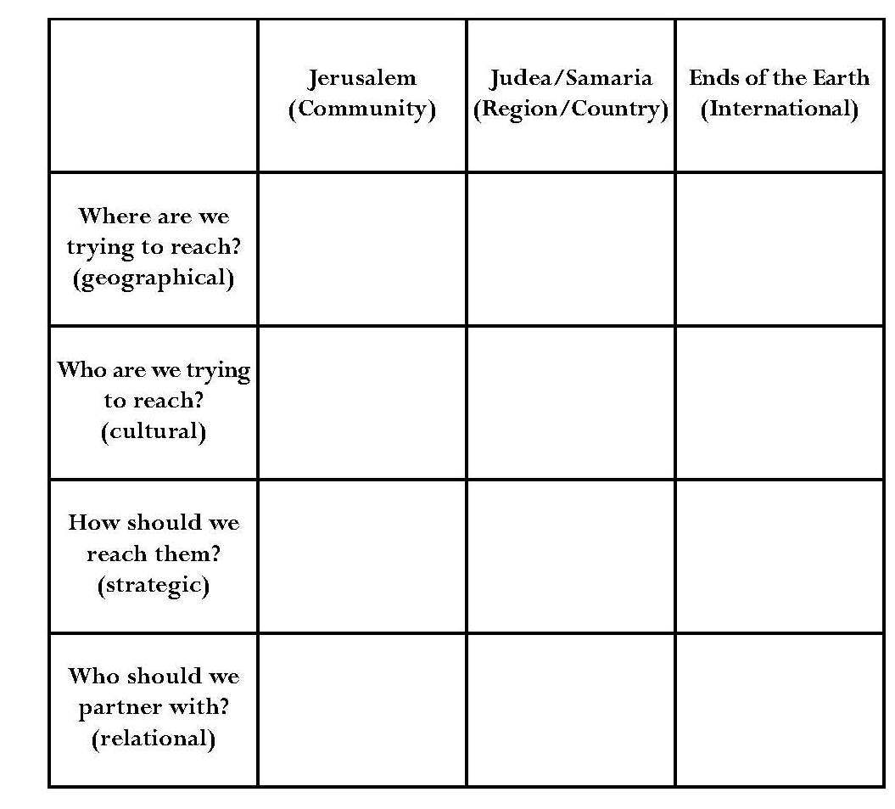
The Ultimate Purpose of Leadership Fulfilling the Great Commission as a Leader
APPLICATION: Based on Acts 1:8, invest some time in developing a global growth plan for your local church.

Slide 25
The Ultimate Purpose of Leadership Fulfilling the Great Commission as a Leader
Conclusion: These are exciting days in the Kingdom of God. The Holy Spirit is moving across the world as never before, yet there is so much more to do.
God has ordained His Church to be His instrument to communicate the message of redemption to the people of the world.
The Church will not be effective in fulfilling its role in God's global plan without effective leadership. Our prayer is that you will be the leader God desires you to be so you can lead God's Church to be the army of God He intends for it to be. May we do it so that all peoples may worship Him!

Slide 26
For more information about this course and other training resources: Contact Global Teen Challenge at GTC@Globaltc.org Or visit our training website at iTeenChallenge.org

