Slide 1
Teamwork Makes the Dream Work The Characteristics of a Great Team by EQUIP Ministries founded by John Maxwell
1

Slide 2
Teamwork Makes the Dream Work The Characteristics of a Great Team
“Now there are varieties of gifts, but the same Spirit. And there are varieties of ministries, and the same Lord…For even as the body is one and yet has many members, and all the members of the body, though they are many, are one body, so also is Christ.”
I Corinthians 12:4-5, 12

Slide 3
Teamwork Makes the Dream Work The Characteristics of a Great Team
Great Teams Possess
_______________________
_______________________
_______________________
A common goal (vision)
Diverse skills contribution
Strong coaching communication

Slide 4
Teamwork Makes the Dream Work The Characteristics of a Great Team
What Makes an Effective Team?
An effective team ________________________________.
The foundation of a successful team is relationship. Why?
_________________________: People go the “first mile” because of a sense of duty. They go the “second mile” because of relationship.
_________________________: Leaders always touch a heart before they ask for a hand.
_________________________: Good leaders always “host” the conversation and relationships of their life. They initiate as a host rather than wait for others to serves, as a guest.
Cares for one another
The 2nd Mile Principle
The Connection Principle
The Host Principle

Slide 5
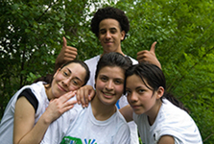
Teamwork Makes the Dream Work The Characteristics of a Great Team
EVALUATION
As a team, do we care for one another?

Slide 6
Teamwork Makes the Dream Work The Characteristics of a Great Team
What Makes an Effective Team?
An effective team ________________________________.
What are YOUR teams top three priorities?
knows and practices what is important

Slide 7
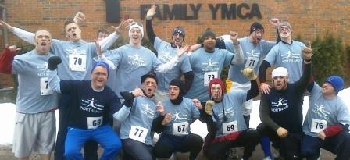
Teamwork Makes the Dream Work The Characteristics of a Great Team
EVALUATION
As a team, do we know and act on what is important?

Slide 8
Teamwork Makes the Dream Work The Characteristics of a Great Team
What Makes an Effective Team?
An effective team ________________________________.
Why is growing together, as a staff so important?
The __________ growth determines the organization’s growth.
Life and society are constantly _______________.
A leader cannot lead a follower _________ where they have personally grown.
The leadership team must stay on the __________________:
Leaders must __________ to stay in front.
Grows together
leaders
changing
beyond
same page
change

Slide 9
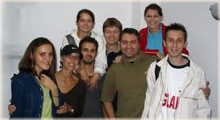
Teamwork Makes the Dream Work The Characteristics of a Great Team
EVALUATION
As a team, are we growing together?

Slide 10
Teamwork Makes the Dream Work The Characteristics of a Great Team
What Makes an Effective Team?
An effective team ________________________________.
The right “chemistry” happens on a team when…
___________ are strong
___________ are similar
___________ is evident
___________ are clear
___________ are complimentary
Has chemistry that fits
Relationships
Desire
Trust
Roles
Abilities

Slide 11
Teamwork Makes the Dream Work The Characteristics of a Great Team
The right “chemistry” happens on a team when…
___________ are appreciated
___________ is high
___________ are frequent
___________ are pure
___________ are received by all
EVALUATION
As a team, do we have the right chemistry?
Players
Morale
Wins
Motives
Benefits

Slide 12
Teamwork Makes the Dream Work The Characteristics of a Great Team
What Makes an Effective Team?
An effective team ________________________________.
The truth in a nutshell: individualism wins trophies, but teamwork wins championships.
A Code of Cooperation…
…carry your load. …see the big picture.
…respect other team members. …give up your rights.
…understand their value. …represent the team’s position, not yours.
…look for ways to add value to them. …privately and publicly affirm one another.
…come together ready to contribute. …accept responsibility for the team’s standings.
Places individual rights below the team

Slide 13
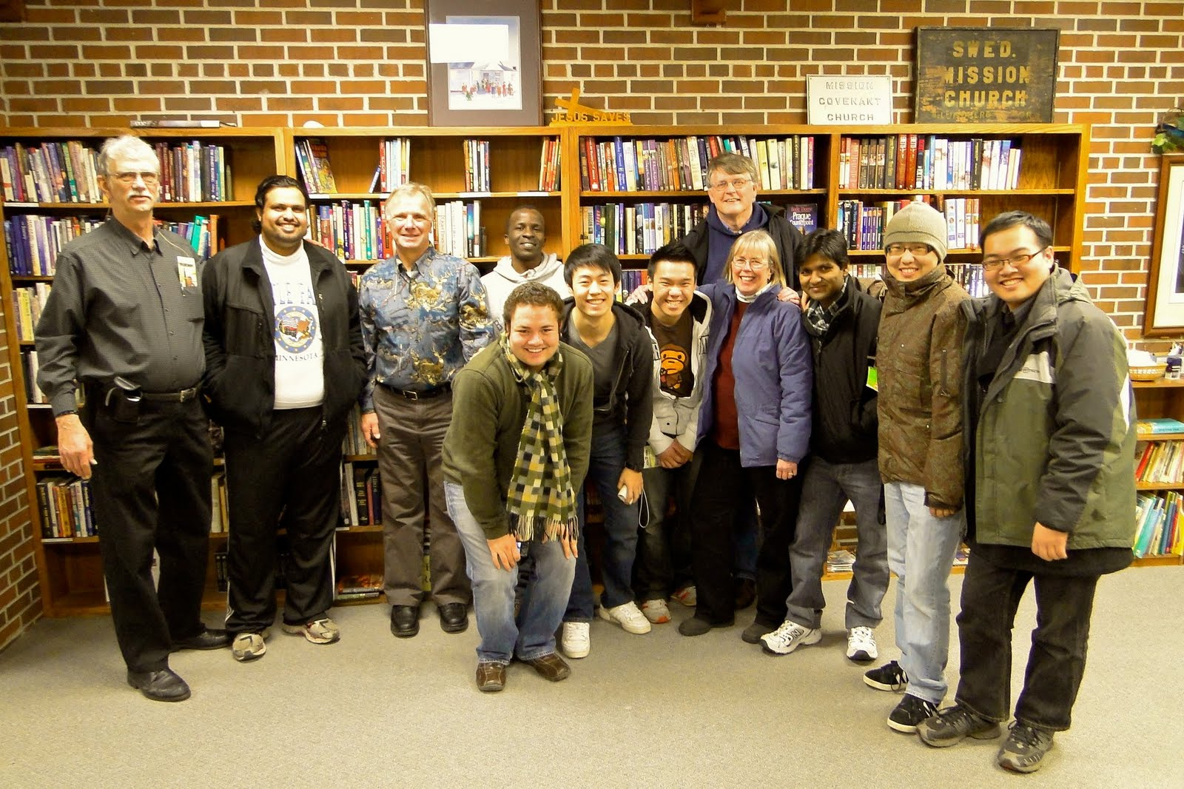
Teamwork Makes the Dream Work The Characteristics of a Great Team
EVALUATION
As a team, do we place the team’s interest above our own?

Slide 14
Teamwork Makes the Dream Work The Characteristics of a Great Team
What Makes an Effective Team?
An effective team ________________________________.
The “Niche Principle”: people who occupy a special place on the team feel special and perform in a special way. Team niches humanize teamwork. (Philip VanAuken)
List your team members and identify their roles.
What is your unique role on the team?
Realizes everyone plays a special role

Slide 15
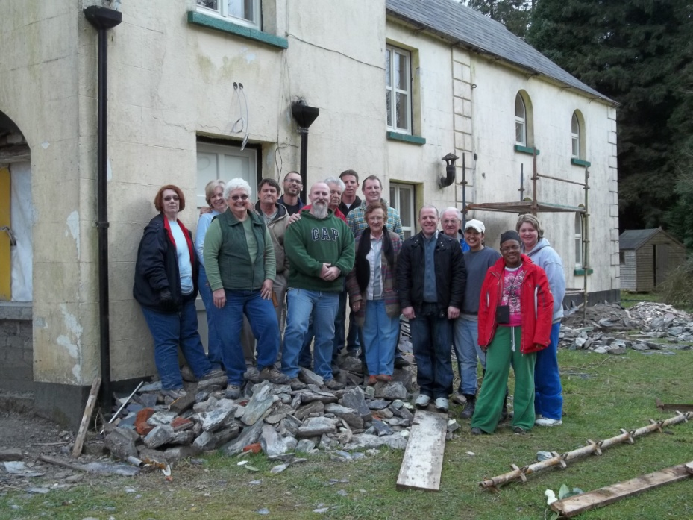
Teamwork Makes the Dream Work The Characteristics of a Great Team
EVALUATION
As a team, do we understand and appreciate the role of others?

Slide 16
Teamwork Makes the Dream Work The Characteristics of a Great Team
What Makes an Effective Team?
An effective team ________________________________.
In ministry, a BENCH represents…
Support Players A Place for Rest
Special Role Players A Place for Encouragement
A Place for Strategy A Place for Assistance
Has a strong bench

Slide 17
Teamwork Makes the Dream Work The Characteristics of a Great Team
What areas should be on “our scoreboard”? (i.e. conversions, giving, etc.)
EVALUATION
As a team, do we score well in these areas?

Slide 18
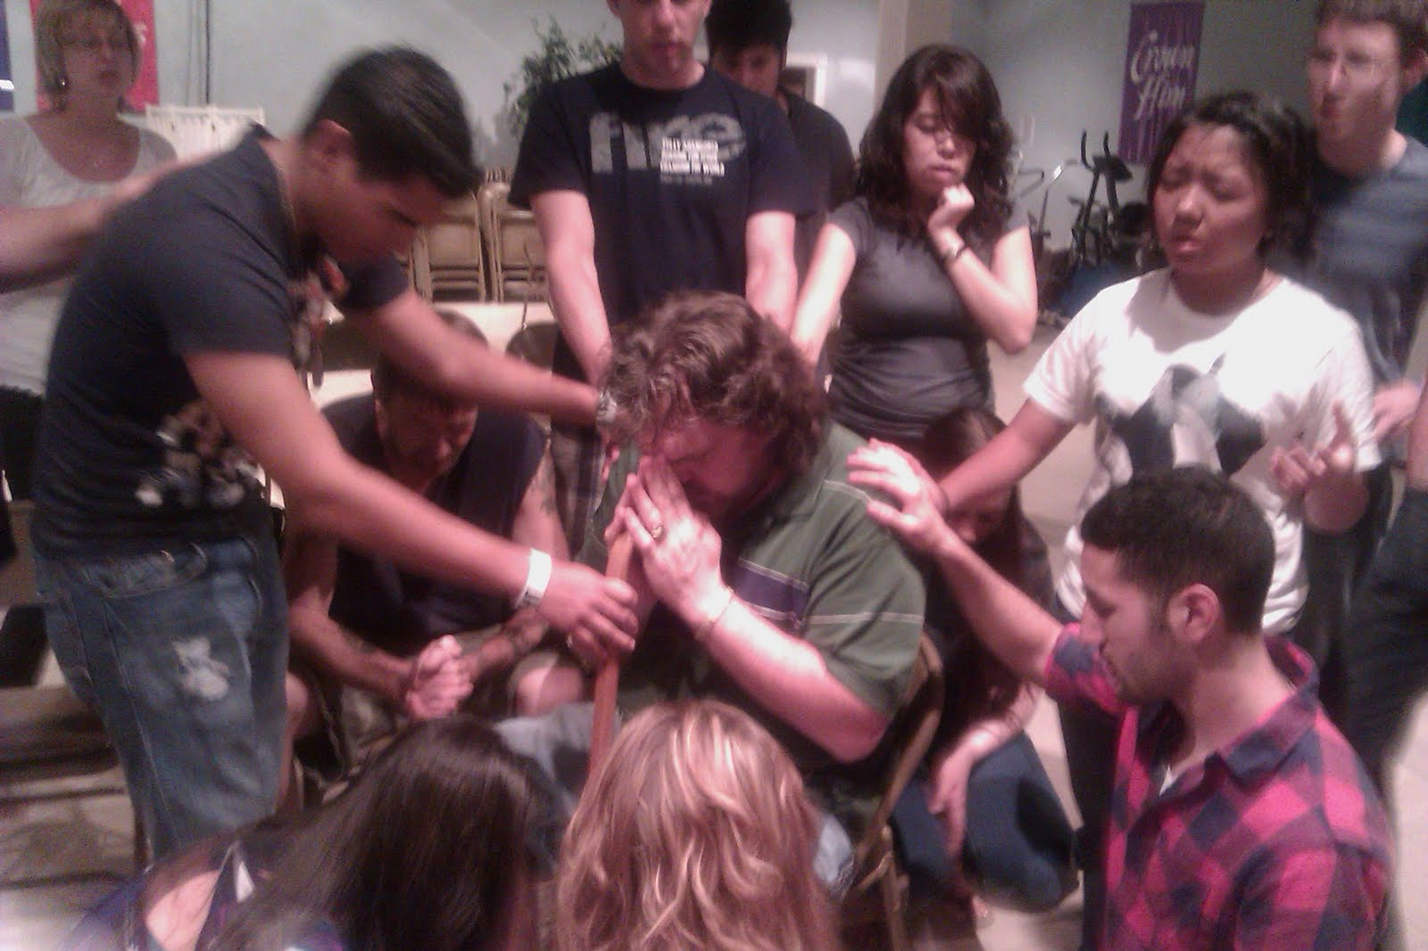
Teamwork Makes the Dream Work The Characteristics of a Great Team
EVALUATION
As a team, are we developing a strong bench?

Slide 19
Teamwork Makes the Dream Work The Characteristics of a Great Team
What Makes an Effective Team?
An effective team ________________________________.
The team knows where it stands because there is a scoreboard that everyone can see. Players glance at the scoreboard continually during a game. When the game is over, at least they know if they have won or lost.
(Many ministries do not enjoy this luxury!)
Knows exactly where the team stands

Slide 20
Teamwork Makes the Dream Work The Characteristics of a Great Team
What Makes an Effective Team?
An effective team ________________________________.
There is no success without sacrifice. If I succeed without sacrifice, then it is because someone who went before me made the sacrifice. If I sacrifice and do not see success, then someone who follows will reap success from my sacrifice.
What blessings have we received that we did not pay for?
What sacrifice will we give so that the next generation will have success?
Pays the price

Slide 21
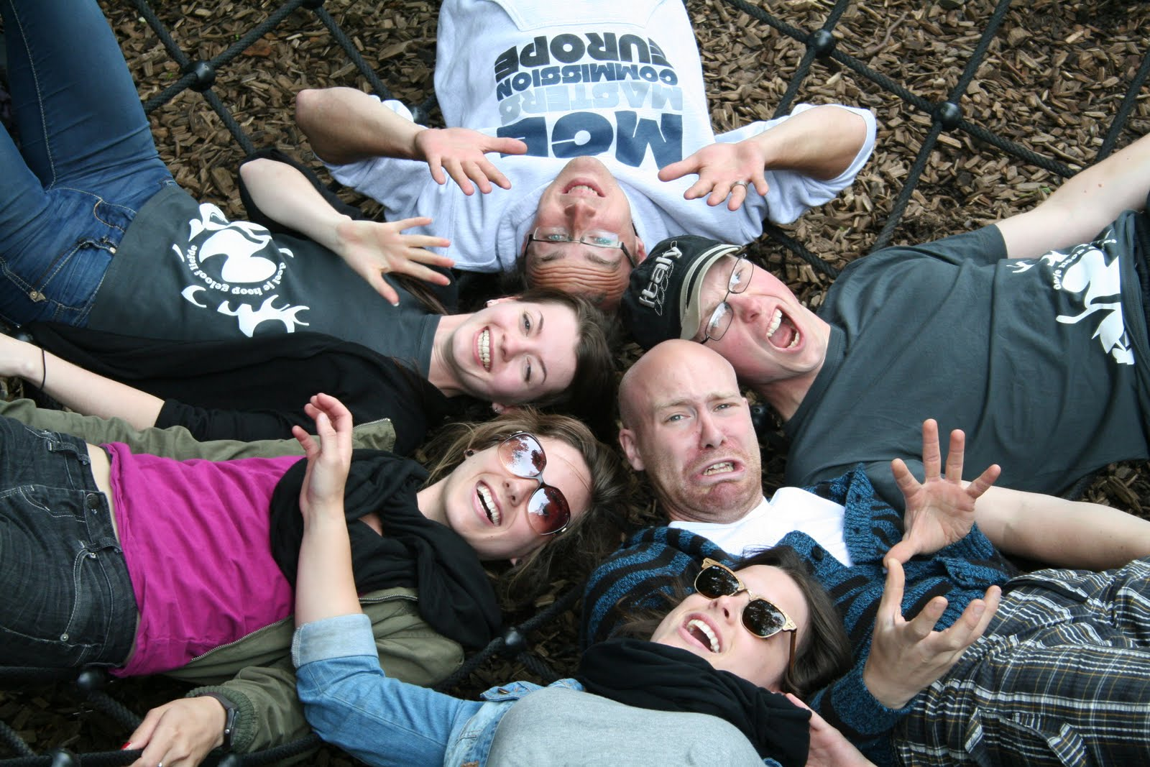
Teamwork Makes the Dream Work The Characteristics of a Great Team
EVALUATION
As a team, is our sacrifice sufficient to provide success to the next generation?

Slide 22
Teamwork Makes the Dream Work The Characteristics of a Great Team
What Makes an Effective Team?
An effective team ____________________________________.
SAYS YES TO THE RIGHT QUESTIONS

Slide 23
Teamwork Makes the Dream Work The Characteristics of a Great Team
TEN QUESTIONS THE TEAM SHOULD ASK:
Do we _______________ each other?
Respect and trust go hand in hand.
Do we have _______ for each other?
Are you honestly interested in the welfare of your colleagues?
Do team members feel free to ____________ openly?
In an environment of open and free communication, a team can achieve anything.
respect and trust
concern
communicate

Slide 24
Teamwork Makes the Dream Work The Characteristics of a Great Team
TEN QUESTIONS THE TEAM SHOULD ASK:
Do we __________ our team’s goals?
Without a clear focus on team goals, even the best teams will drift.
Do we have a ____________ to those goals?
Belief in goals should be concrete, not abstract.
Do we make good use of each member’s _______?
Do members feel they are making a worthwhile contribution?
Do we handle _______successfully?
Success is judged by how conflict is handled within the team as a whole.
understand
commitment
abilities
conflict

Slide 25
Teamwork Makes the Dream Work The Characteristics of a Great Team
TEN QUESTIONS THE TEAM SHOULD ASK:
Does _________ participate?
The very word “team” implies that everyone participates.
Do we respect our individual __________?
Do you respect team members with whom you are not always in agreement?
Do we _____ being members of this team?
True success depends on enjoying what you do and that includes enjoying your team.
everyone
differences
enjoy

Slide 26
Teamwork Makes the Dream Work The Characteristics of a Great Team
So Where Do I Begin?
The kind of people you recruit should be determined by the goals you believe God has given you. Look for appropriate gifts in people for each position. In each person look for:
G GIFTED MEMBERS
Look for specific gifts and abilities in other lay leaders that are crucial to achieve your goals.
I INFLUENTIAL PEOPLE
Look for lay leaders who have influence with others.
F FAITHFUL WORKERS
Look for lay leaders who are already faithful to Christian commitments they have made.
T TEACHABLE SPIRIT
Look for lay leaders who are willing to learn and be flexible with teammates.
S SERVANT’S HEART
Look for lay leaders who want to serve others, not gain recognition.

Slide 27
Teamwork Makes the Dream Work The Characteristics of a Great Team
TAKE AN EVALUATION OF TEAMWORK: No Somewhat Yes
An effective team cares for one another. 1 2 3 4 5
An effective team knows what is important. 1 2 3 4 5
An effective team grows together. 1 2 3 4 5
An effective team has a “team fit”. 1 2 3 4 5
An effective team places individual rights below 1 2 3 4 5
the team’s best interest.
An effective team realizes that everyone plays a 1 2 3 4 5
special role.
An effective team has a strong bench. 1 2 3 4 5
An effective team knows exactly where it stands. 1 2 3 4 5
An effective team pays the price. 1 2 3 4 5
An effective team says “yes” to the right questions. 1 2 3 4 5

Slide 28
Teamwork Makes the Dream Work The Characteristics of a Great Team
“Now there are varieties of gifts, but the same Spirit. And there are varieties of ministries, and the same Lord…For even as the body is one and yet has many members, and all the members of the body, though they are many, are one body, so also is Christ.”
I Corinthians 12:4-5, 12
Next Session: The Wisest Investment You’ll Ever Make

Slide 29
For more information about this course and other training resources: Contact Global Teen Challenge at GTC@Globaltc.org Or visit our training website at iTeenChallenge.org

