Slide 1



Love and Accepting Myself
Global Teen Challenge

Slide 2

Love and Accepting Myself
5th edition By Dave Batty
This PowerPoint is designed to be used with the
Group Studies for New Christians Course,
Love and Accepting Myself.
Other Materials available include:
Teacher's Manual
Student Manual
Study Guide
Exam
Course Certificate
For Information on obtaining these materials see iteenchallenge.org or contact us at
gtc@globaltc.org

Slide 3

Class Assignment List
Quizzes: Verses to Memorize To be done with:
1- 1 John 4:7-8 Lesson 2
2- Galatians 6:4 New Life Bible Lesson 4
Study Guide Projects:
Project# To be done before or with:
1 Lesson 1
2 Lesson 2
3 Lesson 3
4 Lesson 4
5 Lesson 5
6 Used in class with Lesson 4
Test: Date Lesson 5

Slide 4
Chapter 1:What is Love?

Slide 5
Key Biblical Truth
As a Christian, I need to discover practical ways of showing my love in each thing I do today.
Lesson 1 Love -- What and How?
Key Verse: 1 John 4:7 New Life Bible
Dear friends, let us love each other, because love comes from God. Those who love are God’s children and they know God.

Slide 6

Lesson 1 Warm-up
How does our culture describe love?

Slide 7
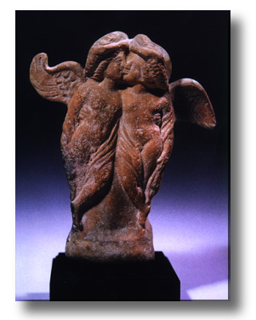
What is Love?
Eros
  Suggests sensual desire and sexual drive.
  It goes no deeper than the physical part of a person.

Slide 8
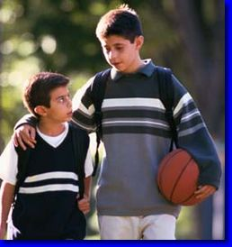
What is Love?
Phileo
  The love for friends and relatives.
  Goes no deeper than the emotional level.

Slide 9
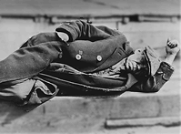
What is Love?
Agape
  God’s love; the purest, deepest kind of love.
  Not just emotion but also an act of one’s will.
  You love others, not because they are worthy, but because you want to.

Slide 10

How Does God Show Agape Love?
God loves us unconditionally!
God has shown us that he loves us.
God loves us as much as Himself.
We do not need to fear God (but we do need to deeply respect him).
God disciplines us because he loves us.
God’s love never fails.

Slide 11
How Can I Show Love?
Who does God want us to love?
  We are commanded to love God.
    The Holy Spirit gives us the love we need.
    We respond to God’s love.
  We are commanded to love our neighbor.
    This fulfills God’s laws.
    This shows our relationship to God.

Slide 12
How Can I Show Love?
Who does God want us to love?
  We are commanded to love our enemies.
  God expects us to love ourselves.

Slide 13

How Can I Show Love?
It takes God’s help to love others.
  We cannot love some people in our own strength.
  Some people are easier to love than others.

Slide 14

How Can I Show Love?
We can love with God’s love.
  God is love, therefore everything in 1 Corinthians chapter 13 applies to God.
  This kind of love brings us to God.
  This love is given to us by the Holy Spirit when we receive Christ.

Slide 15
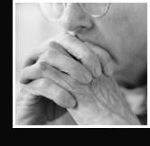
How Can I Show Love?
We love by faith.
  Everything about the Christian life is based on faith.
  This principle is based on a command and a promise.
    God commands us to love.
    God promises to hear and answer when we pray according to his will.

Slide 16

How Can I Show Love?
We love by faith.
  It involves a union of love and faith.
  Make a list of people you do not like, and begin to love them by faith using 1 Corinthians 13 as a guide.
  Loving by faith is a growing process which never stops.
  Loving by faith motivates us to witness to others.

Slide 17
Personal Application
Write down one way you want to show God that you love Him.
Choose one of the 5 descriptions of love from Study Guide Project 1 and make a goal to show love to someone in the next 24 hours using that expression of love.

Slide 18
Key Biblical Truth
I need to develop ways of overcoming those things which hinder me from showing love to others.
Lesson 2 Love Hindered
Key Verse: 1 Corinthians 13:5 New Life Bible
Love does not do the wrong thing. Love never thinks of itself. Love does not get angry. Love does not remember the suffering that comes from being hurt by someone.

Slide 19

Lesson 2 Warm-up
Share the results of your efforts to put your goal of showing love to one person into action . Share even if it didn’t turn out the way you had anticipated.
One of the key issues we will be talking about today is what hinders us from showing love to others.

Slide 20
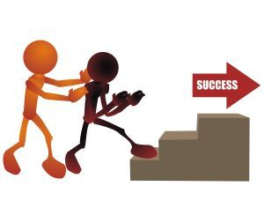
What hinders me from showing love?
It’s not easy to love some people. That’s life! Some of us have a hard time showing love to other people. We have been raised in a place where toughness, not love, was the way you earned friendships. For some of us, our old habits of using others will be hard to break.
Take some time and think about the way you show
love to others. How well are they able to see you
showing love? Remember, 1 Corinthians 13 gives a
very practical list of different ways to show others
that we love them.

Slide 21
How Important is Love?
Love is one of the most important things in life.
The two greatest laws in the Bible speak of love.

Slide 22
Mark 12:30-31 NIV
Love the Lord your God with all your heart and with all your soul and with all your mind and with all your strength.’
The second is this: ‘Love your neighbor as yourself.’ There is no commandment greater than these.”

Slide 23
John 13:34-35 NIV
“A new command I give you: Love one another. As I have loved you, so you must love one another. By this all men will know that you are my disciples, if you love one another.”
So from God’s point of view, of all the laws that He gave us, love is at the top of these laws.

Slide 24
How Important is Love?
3. Obedience is more important than love.
1 Samuel 15:22 New Living Translation
But Samuel replied, “What is more pleasing to the LORD: your burnt offerings and sacrifices or your obedience to his voice? Obedience is far better than sacrifice. Listening to him is much better than offering the fat of rams.”

Slide 25
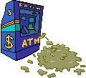
What Are We Not to Love?
Do not love sin.
Do not love money.
Satan.

Slide 26
Personal Application
Write down one way you want to show God that they love Him. Pick one of the 6 descriptions of love from Study Guide Project 2, and make a goal to show love to someone in the next 24 hours, using that expression of love. You may use the personal goal that you already wrote for that part in Project 2, or you can write a new goal.
Complete this assignment before your next class session. You must choose someone that you will have personal contact with in the next 24 hours. Simply thinking loving thoughts won’t do! You must have a goal that expresses some action—a loving action. You can choose a friend, a family member, a roommate, a leader, or even a stranger.

Slide 27
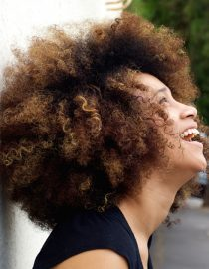
CHAPTER 2: ACCEPTING MYSELF

Slide 28
Key Biblical Truth
As a Christian, I need to clearly know why I should accept myself as God accepts me.
Lesson 3 Why Accept Myself
Key Verse: Ephesians 2:10 New Life Bible
We are His work. He has made us to belong to Christ Jesus so we can work for Him. He planned that we should do this.

Slide 29

Lesson 3 Warm-up
Turn to Study Guide Project 4, “A close look at me.”
Read the first two questions and take a good look at yourself in a big mirror. Then sit down and immediately answer all the rest of the questions on Project 4.

Slide 30
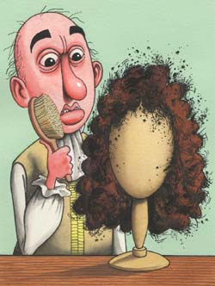
What Does It Mean to Accept Myself?
There are four key areas which relate to accepting myself:
  My physical appearance.
  My abilities.
  My parents.
  My environment.

Slide 31

What Does It Mean to Accept Myself?
Accepting myself means that I am able to say to God,
“I really appreciate the way You made me.
That includes my physical appearance, my abilities, my parents, and where I grew up.
Thank you God.”

Slide 32
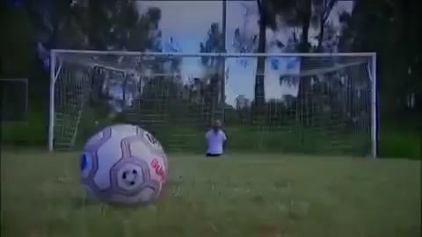
Video: Nick Vujicic

Slide 33

Why Should I Accept Myself?
God planned exactly how I would look.
God made me for a very special reason (job, or ministry).
God is not finished making me yet.

Slide 34
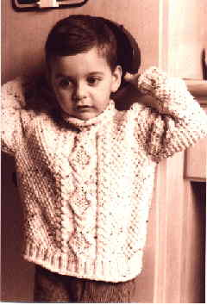
Why Should I Accept Myself?
My outward appearance is only a “frame” around my inward beauty.
God is more concerned with inward beauty than with outward appearances
God will help me when I feel inferior.

Slide 35
Personal Application
Make a commitment to accept God’s reasons for accepting myself.
A. Rate yourself on how hard it is for you to accept the way God made you.
B. Look at Point B. “Why should I accept myself?” Pick at least one of these points that is most helpful to you, and make a commitment to embrace that truth in your life today.
C. Select a scripture that focuses on that truth. Write that verse on a card and keep it in a prominent place—in your Bible, on the refrigerator, or next to your bed, etc., and read it several times a day and meditate on it.
D. Write a prayer to God on the challenges you face in trying to accept yourself.

Slide 36
Key Biblical Truth
I need to show by my actions that I accept myself as God accepts me.
Lesson 4 How Can I Accept Myself
Key Verse: Galatians 6:4 New Life Bible
Everyone should look at himself and see how he does his own work. Then he can be happy in what he has done. He should not compare himself with his neighbor.

Slide 37
Lesson 4 Warm-up
Explain the answers to these two questions:
A. What does it mean to accept myself?
B. Why should I accept myself?

Slide 38
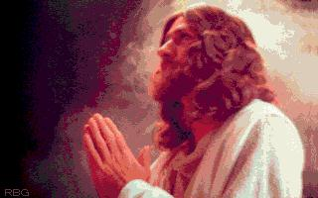
How Can I Accept Myself?
Take a good look at myself.
Thank God for making me the way I am.
Work on developing positive inward qualities.

Slide 39
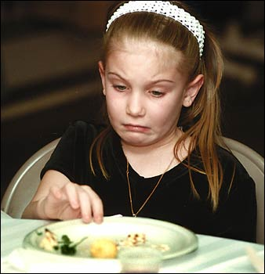
Why Don’t I Accept Myself?
When I am bitter about my past.
When I criticize myself
Not understanding why God made me the way He did.
Comparing myself with others.

Slide 40
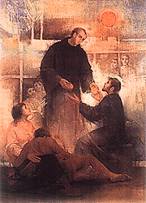
What Are the Benefits of Accepting Myself?
A new freedom to love. To love God, others, and even myself.
It will be easier to accept others the way they are.

Slide 41

What Are the Benefits of Accepting Myself?
An inner peace, joy and happiness.
A new openness. I can be myself. I don’t have to put up a front.

Slide 42
Personal Application
Turn to Project 6 Healing Old Memories
This activity may be for the chapel or a prayer room. The main purpose of this project is to help you look to the Lord who is most able to help you put to rest hurts and resentments from the past.
We will each pray privately regarding the different items listed on this project.
The sample prayer simply gives you an idea of how you can pray in a meaningful way regarding these issues. Skip over the items listed that do not apply to your own past. You are free to add other issues not listed on this project.
You will not be graded on this project, it is only between themselves and the Lord. This is not a time for self-pity. This project should be completed with an honest look at your lives, but also with a clear element of hope. God can help you resolve these hurts, if you will allow Him to help.

Slide 43
Love and Accepting Myself
5th edition By Dave Batty
This PowerPoint is designed to be used with the
Group Studies for New Christians Course,
Love and Accepting Myself.
Other Materials available include:
Teacher's Manual
Student Manual
Study Guide
Exam
Course Certificate
For Information on obtaining these materials see iteenchallenge.org or contact us at
gtc@globaltc.org

