Slide 1

Introduction to Counseling in Teen Challenge
By Dave Batty
Teen Challenge Staff Training Course T603.02
iTeenChallenge.org

Slide 2


1. The reality of working in
Teen Challenge
People come with lots of problems

Slide 3

1. The reality of working in
Teen Challenge
Many have deep damage from their past

Slide 4


1. The reality of working in
Teen Challenge
Trauma

Slide 5
1. The reality of working in
Teen Challenge
90% of women have background of sexual abuse
Most TC staff are not trained as professional counselors

Slide 6

2. Teen Challenge is first of all a Christian discipleship ministry before being a counseling ministry

Slide 7
3. Don’t promise quick solutions

Slide 8
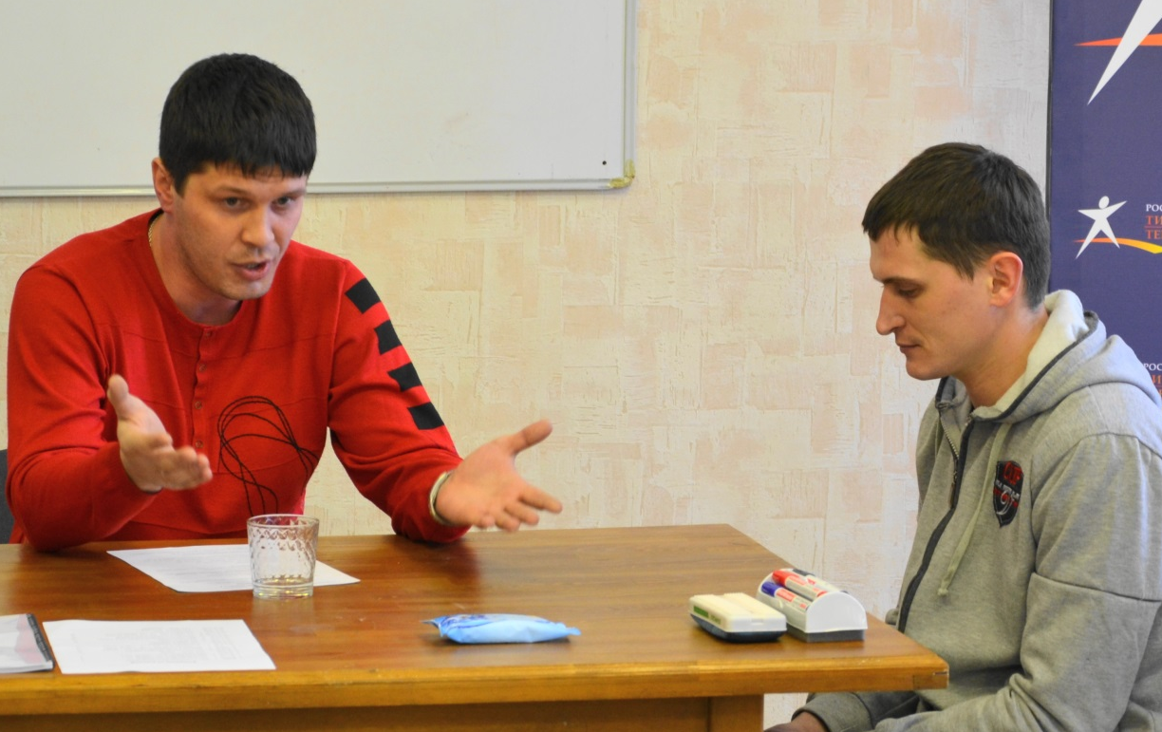
4. Don’t make decisions for the person you are counseling
Instead, give:
  ideas
  Alternatives
  Information

Slide 9
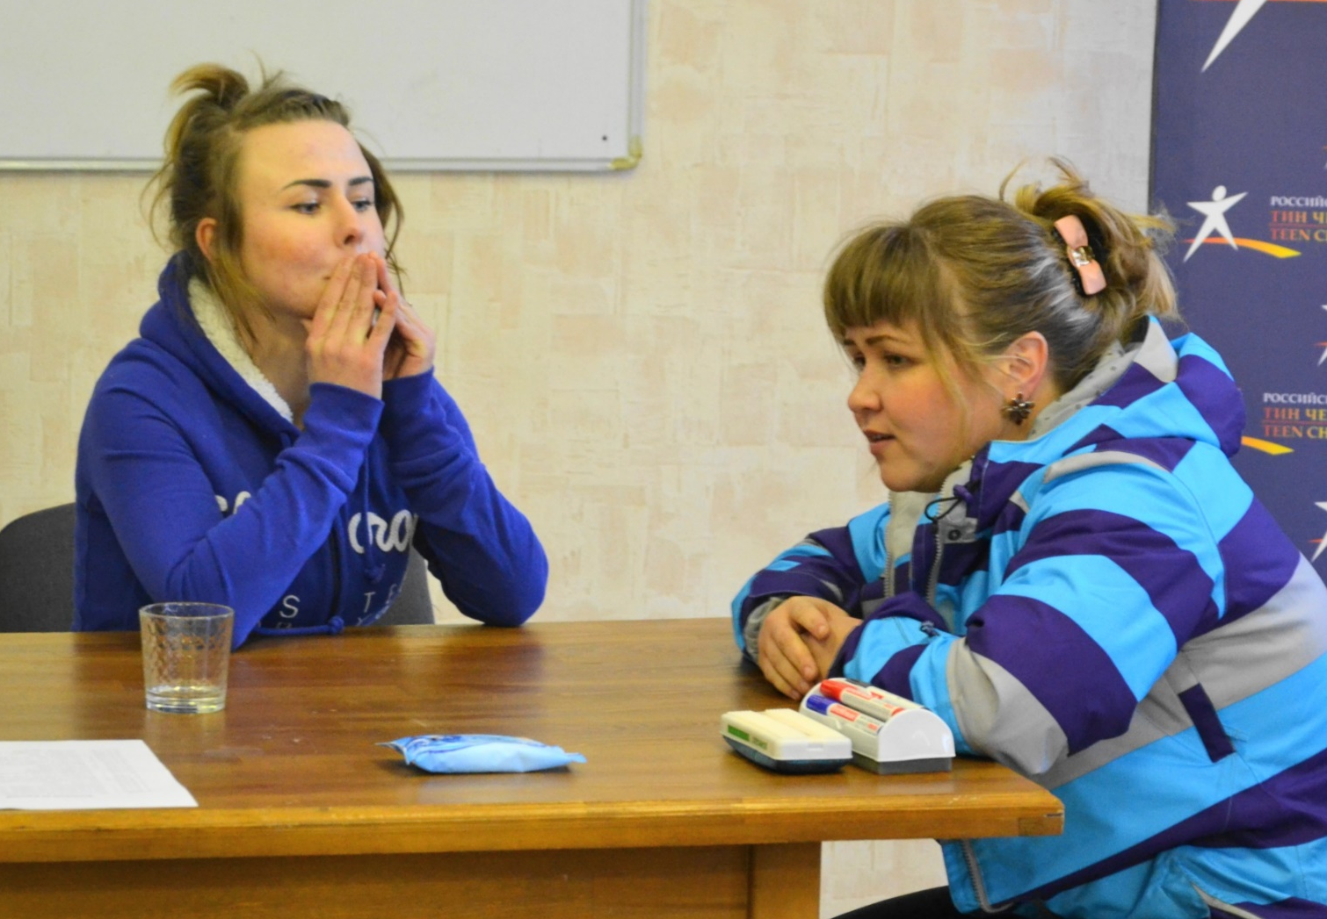
5.
Listen!

Slide 10

6. Help break down false beliefs
I’m fine!

Slide 11
7. Don’t allow students to become dependent on you
--“You are the only one who can help me!”

Slide 12
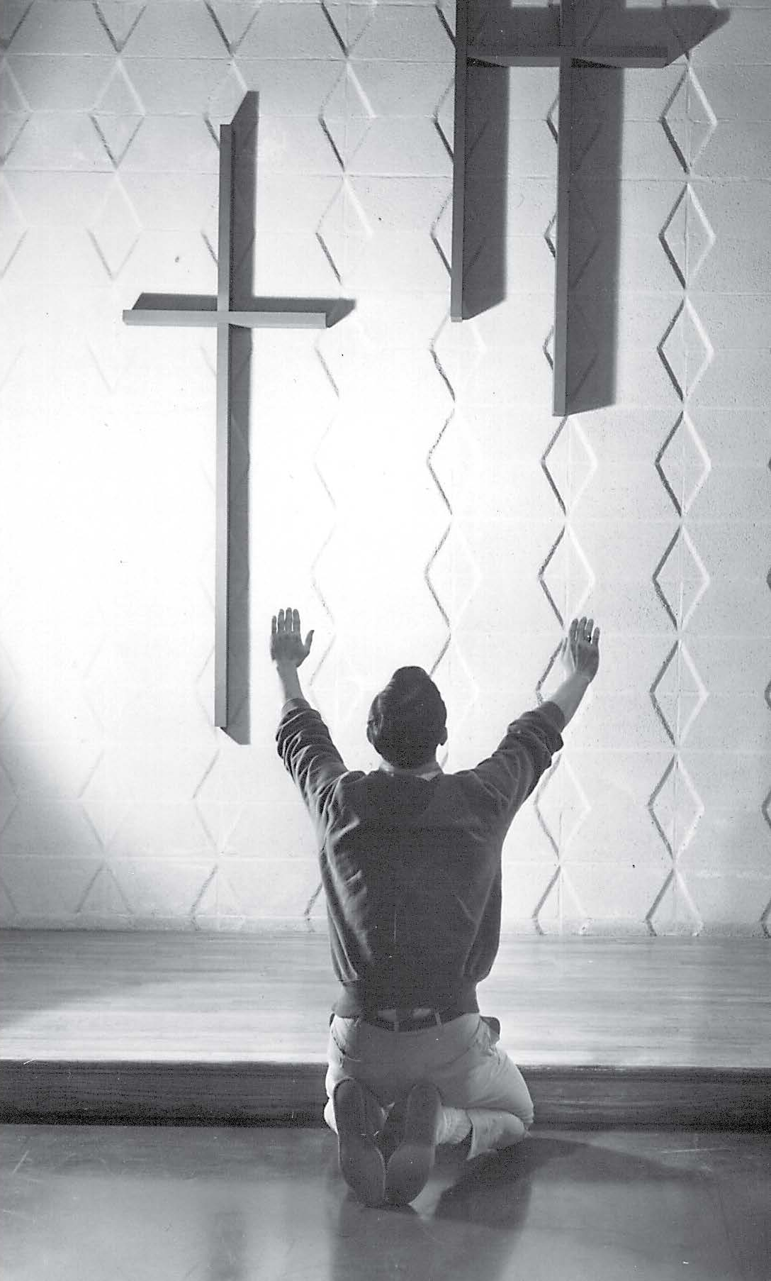
8. Point them to Jesus as the real source of help
Hebrews 12:1-2

Slide 13

9. Help them identify root problems

Slide 14

10. Help them develop problem solving skills
James 1:2-5

Slide 15
11. Help them learn how to “put off” and “put on” in their life so they can become all that Jesus wants them to be.
Colossians 3:1-17
2 Peter 1:3-11

Slide 16
Questions for discussion

Slide 17
Contact information
Global Teen Challenge
www.GlobalTC.org
www.iTeenChallenge.org

