Slide 1
An Introduction to Christian Character Development
By Dave Batty

Slide 2
What impresses you?
We should not be overly impressed with the spiritual gifts that other people have. God alone decides who gets which gifts.
When we look at other people, we should be impressed with their Christian character—this is their gift to God.

Slide 3
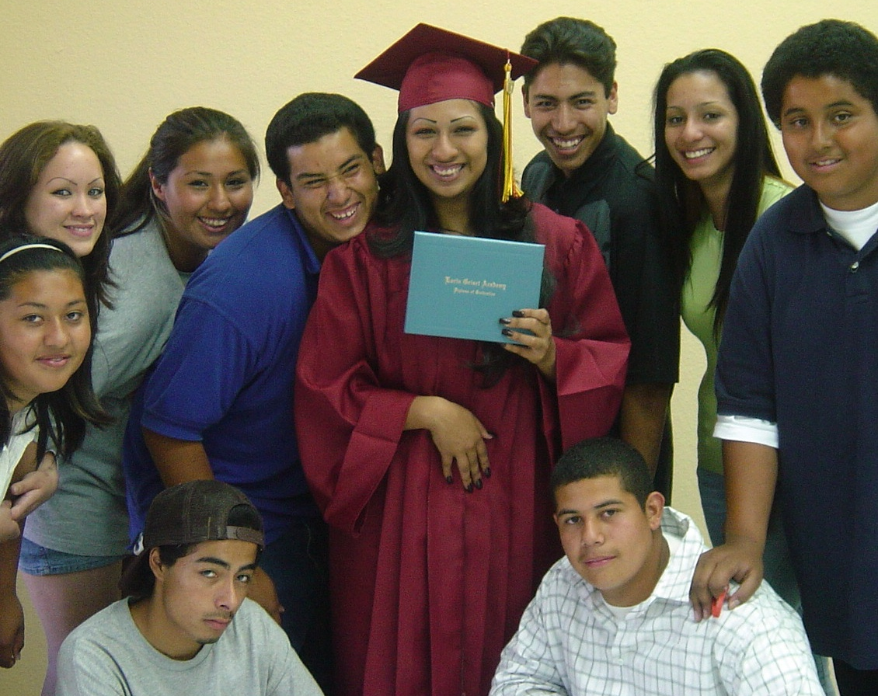
A. What is character?
We are not talking about your personality.

Slide 4
A. What is character?
“Character is the will to do what is right, as God defines right, regardless of the cost. Men and women of character are willing to recognize there is a standard of right and wrong outside of us that we need to submit ourselves to. We must be proactive and intentional in our pursuit of character and God will use our character to guide us.”
--Quote by Andy Stanley

Slide 5
Another definition of character
An absolute system of right and wrong, combined with a will to do what is right.

Slide 6
Two essential elements of character
1. Determining what is right and wrong
If you are going to develop Christian character in your life, then you must build on a set of beliefs based on what God says is right and wrong.
This standard of right and wrong is not based on my own opinions —it must be based on God’s truth.

Slide 7
2. Choosing to do what is right
Our will has a great part in determining our character.
It is not enough to believe something is right.
We must choose to make that belief a part of our lifestyle.
We must be fully committed to doing the right thing, no matter how hard it may be.

Slide 8
The strength of your character is revealed in the presence of problems.
How do you respond when you are under pressure?
Look at your choices and they reveal your character.

Slide 9
B. What are specific examples of Christian character for us to develop?
Alertness
Attentiveness
Availability
Cautiousness
Compassion
Contentment
Courage
Creativity
Decisiveness
Deference
Dependability
Determination
Diligence
Discernment
Discretion
Endurance
Enthusiasm
Fairness
Faith
Flexibility
Forgiveness
Generosity
Gentleness
Gratefulness
Hospitality
Humility
Initiative
Joyfulness
Love
Loyalty
Meekness
Neatness
Obedience
Patience
Persuasiveness
Punctuality
Responsibility
Resourcefulness
Reverence
Security
Self-control
Sensitivity
Sincerity
Thoroughness
Thriftiness
Tolerance
Truthfulness
Virtue
Wisdom
From the Character Qualities Class in the PSNC

Slide 10
C. How does a person develop their character?
“Your character is the sum total of all your habits.”
Quote by Rick Warren in The Purpose Driven Life
Can we change our character?
Paul Boyko

Slide 11
C. How does a person develop their character?
2 Corinthians 5:17 New Living Translation
This means that anyone who belongs to Christ has become a new person. The old life is gone; a new life has begun!
Becoming a disciple of Jesus is where the real opportunity lies to change our character.
Superficial changes, or
Radical changes
Hebrews 5:11-14

Slide 12
God wants us to use our character to direct us in our responses to every situation we face each day.
We honor God when we use His truth as the standard for our decisions on a daily basis.

Slide 13
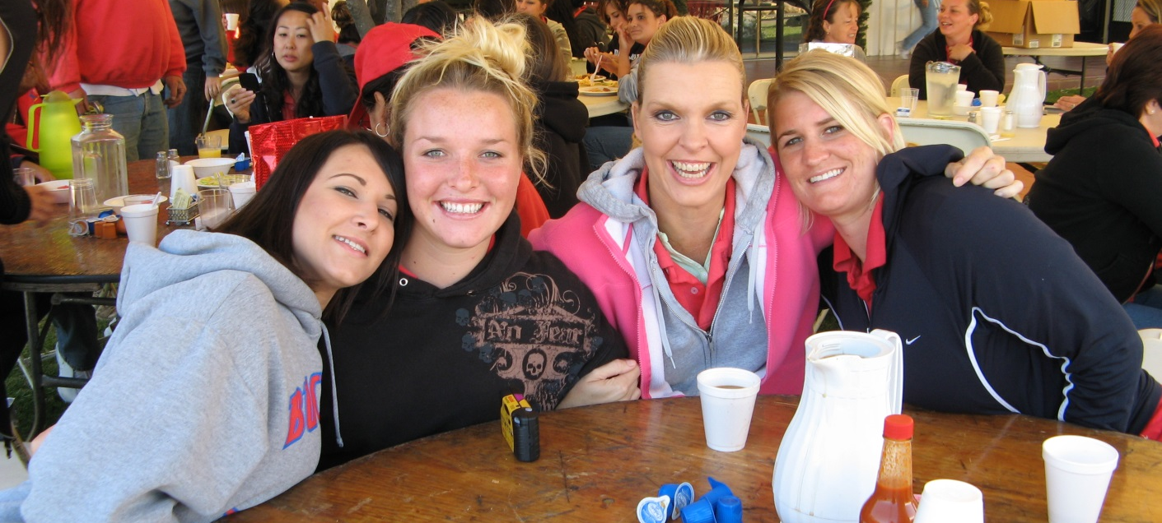
D. In developing Christian disciples, we need to give high priority to helping our students develop Christian character in their lives.
Godly character formation does not happen by chance, or by just being present in Teen Challenge.

Slide 14
1. Character formation takes place because of a very intentional process where we seek to put out of our lives ungodly character traits and plant and grow godly character traits.

Slide 15
2. As a discipler, we must first model Christian character in our lives 24-7.

Slide 16
How do we teach character development?
not simply preaching
not simply teaching
not simply counseling

Slide 17
3. Developing Christian character starts in our mind.
We must choose to think the right thoughts.
Thoughts >> Actions >> Attitudes >> Character
Notes:
Right thoughts lead to right actions. Right actions lead to right attitudes. Right attitudes, applied consistently over time produce Godly character.

Slide 18
4. Character is developed one small step at a time, especially as I face problems in my daily activities.
How did Jesus help his disciples develop Christian character in their lives?

Slide 19
Character is not developed by a single prayer or action.
It is developed through a consistent application of biblical principles.
My character is who I am at the very depths of my soul.

Slide 20
E. How do we take these from simply being “an assignment” to becoming part of our whole lifestyle?

Slide 21
13. Patience Opposite Quality — Restlessness
PATIENCE — Learning how to wait to fulfill personal goals. Increasing the time you can wait between achievement and reward. Learning to accept difficult situations as from God without giving Him a deadline to remove them.
1. Do you buy things before you have the money to pay for them?
2. Is your primary concern to remove a problem or to see God’s purpose in allowing it to exist in the first place?
Romans 5:3-4 The Living Bible

