Slide 1
Title Layout
Subtitle

Slide 2
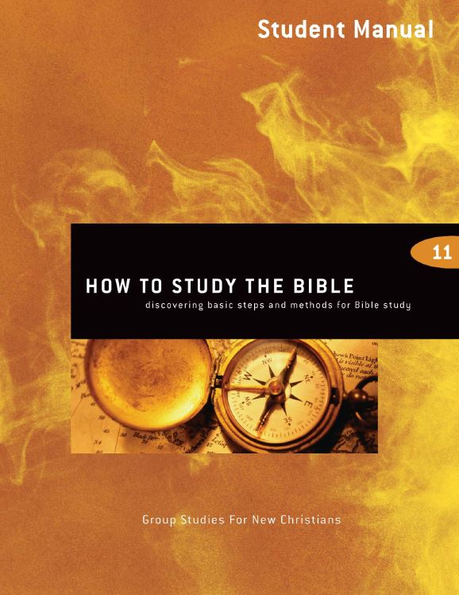
How to Study the Bible
5th edition
By David Batty
This PowerPoint is designed to be used with the
Group Studies for New Christians Course,
How to Study the Bible
Other materials available include:
Teacher’s Manual
Student Manual
Study Guide
Exam
Course Certificate
For Information on obtaining these materials see iteenchallenge.org

Slide 3
How to Study the Bible
Quizzes: Verses to Memorize To be done with:
1. Mark 4:24 The Living Bible Lesson 2
2. 2 Corinthians 8:11 Good News Bible Lesson 4
Study Guide Projects:
Project # To be done before or with:
1 Lesson 1
2 Lesson 2
3 Lesson 3
4 Lesson 3 5 Lesson 4 or 5 6 Optional
SQPA Bible Study Lesson 4
Test: Lesson 5

Slide 4
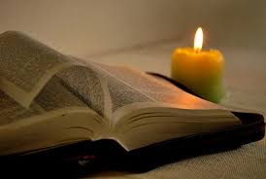
Chapter 1 Getting started with the basics of Bible study

Slide 5
Lesson 1 Getting started with the basics of Bible study
Key Biblical Truth
I need to use my personal Bible study as a tool in my daily life situations to help me grow closer to God.
Key Verse Psalms 119:105 The Living Bible
Your words are a flashlight to light the path ahead of me, and keep me from stumbling.

Slide 6
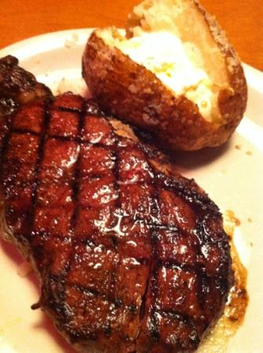
Lesson Warm-up
To enjoy this steak, you have to …
Learn how to prepare it first.
This course is designed to help you learn how to take God’s Word and get spiritual food that will help you grow and become a successful Christian.

Slide 7
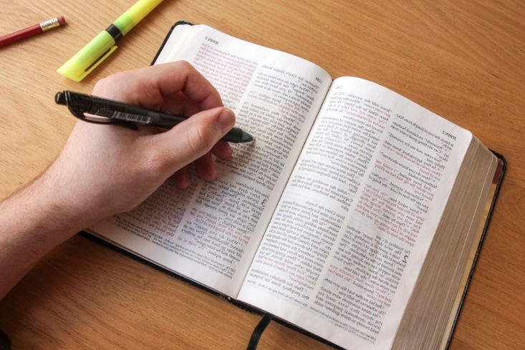
Introduction
When we talk about “studying the Bible,” we are using the word “study” in a very general way. We are talking about any time you read, memorize, think about, or do research on any part of the Bible. This could mean spending one minute or 5 hours in the Bible.

Slide 8
A. Why is it important to study the Bible?
Here are several reasons some new Christians gave in response to this question.
a. To find answers to the questions I have.
b. To get to know God better.
c. Because they are curious to see what the Bible says.
d. To find out what God expects you to do in life.
e. For inspiration and enjoyment (some people like to read).
f. To learn to be a better Christian.

Slide 9
2. Why should I study the Bible?
What are the reasons you should study the Bible? Take a minute and list 2 or 3 of the main reasons why you want to study the Bible.
1.
2.
3.

Slide 10
3. What are the benefits of studying the Bible?
Psalm 119:9 (NIV) How can a young person stay on the path of purity? By living according to your word.
Psalm 119:11 (NIV) I have hidden your word in my heart that I might not sin against you.
Psalm 119:105 (NIV) Your word is a lamp for my feet, a light on my path.
John 17:17 (NIV) Sanctify them by the truth; your word is truth.

Slide 11
Pattern for Christian Growth
Point A: Where you are today
Point B: Where God wants you to be
Point C: Long range goals
Point D: Tools to use in growing
Point E: Daily life situations

Slide 12
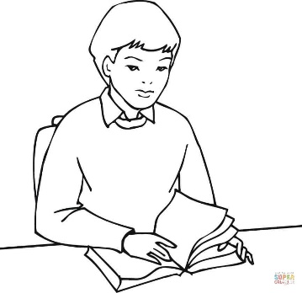
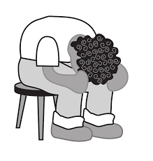

Slide 13
B. Preparing yourself for Bible study
When should I study the Bible?
Study the Bible every day
Pick a time when you are not sleepy
Try to spend extra time on Sunday
Share with someone else what you have learned

Slide 14
B. Preparing yourself for Bible study
2. How should I study the Bible?
Have an open mind
Prayerfully
With an attitude to obey

Slide 15
B. Preparing yourself for Bible study
3. What materials do I need for Bible study?
The Bible
Use a notebook for your notes
With an attitude to obey

Slide 16
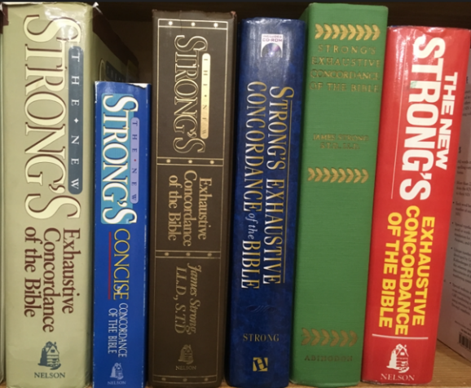
B. Preparing yourself for Bible study
4. Other tools for Bible study
Concordance
Bible atlas
Bible dictionary
Computer programs, websites and Apps (see next slide)

Slide 17
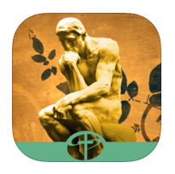
Websites and Apps Today there are an abundance of free tools available online. Here are just a few.
Websites
biblestudytools.com
Biblegateway.com
Blueletterbible.org
You Version – Bible.com
Apps
You Version
Blue Letter Bible
Olive Tree Bible
And-Bible
The Apologetics Study Bible for Students
Bible.is

Slide 18
Personal Application
List 2 or 3 areas in their life where they want to grow.
Put these areas of interest for growth on a sheet of paper and use it as a book mark for where you are reading for your personal devotions. As you read the Bible each day, read this list and see if any of the verses speak to these needs.
Write down what it says that will help you to grow.

Slide 19
Chapter 2 Making Bible study relevant to my life

Slide 20
Lesson 2 Making Bible study relevant to my life
Key Biblical Truth
The most important part of personal Bible study is putting in action (doing) in my life today the teachings of the verse.
Key Verse Mark 4:24 The Living Bible
“And be sure to put into practice what you hear. The more you do this, the more you will understand what I tell you.”

Slide 21
Lesson Warm-up
To enjoy this steak, you have to …
Learn how to prepare it first.
This course is designed to help you learn how to take God’s Word and get spiritual food that will help you grow and become a successful Christian.

Slide 22
A. Three basic steps of Bible study
1. Get the facts (What does it say?) Observe
2. Get the meaning (What does it mean?) Interpret
3. Apply it to your life (How can I use this in my daily living?) Personal Application

Slide 23
1. Get the facts (What does it say?) Observe
In getting the facts, you need to find the answers to these 6 basic questions:
1. Who are the people involved?
2. What is happening?
3. Where do the events take place?
4. When do these things take place?
5. Why do these things happen?
6. How do these things happen?

Slide 24
2. Get the meaning (What does it mean?) Interpret
1. Get a clear definition of each word.
2. Make a list of each thing the verse talks about.
3. See how this scripture relates to other verses in the chapter of the Bible you are studying.
4. Check other verses in the Bible that talk about the same subject. Use the concordance or marginal reference in the Bible to help you with this.
5. Personalize the verses. a. Write the verses in your own words. Write your own translation. b. Write the verses to yourself, using “I, me, my.”
6. Re-live the scripture, putting yourself in the shoes of each person mentioned in the scripture.
7. How does this scripture relate to my daily living?

Slide 25
3. Apply it to your life (How can I use this in my daily living?) Personal Application
1. Ask the Holy Spirit to help you.
2. Look for ways to apply what you study.
3. Make a decision to apply what you have learned.
4. Set goals. Write them down. Make them simple enough and clear enough so you can later evaluate your goals to see if you reached them.
5. Test your goals. See how well the Bible principles work for you.
6. Evaluate the results in your life. Check to see how well you did. You may need to revise your goals.
7. Share with others how you have applied the scripture to your life. Encourage them and show them how to do the same.

Slide 26
B. Life-to-Life Learning Bible Study Pattern
1. List stress situations —situations where I find it easy to get uptight, frustrated, angry, irritated, discouraged, or when I feel under pressure.
2. Ask God this question: —“God, what are you trying to teach me to do today?”
3. Find one area in my daily life where I want to grow —use 1 Corinthians 13:4-8 to identify possible areas where I need to grow.
4. Relate this to my Bible study —what does the Bible have to say about this area of my life where I want to grow?
5. List things I can finish today —in other words, set goals —choose one goal and do it today
6. Evaluate the results —later the same day or the next day, review what happened when you tried to reach the goal you set.

Slide 27
Discuss Project 2, “My Stress Situations”
Share your personal examples from Project 2, “My Stress Situations,” in the Study Guide.
Take one or two of the examples and follow through the steps of Bible study given in the Life-to-Life Learning Bible Study pattern.

Slide 28
Personal Application
Use the Life-to-Life Learning Bible Study Pattern.
Project 4 in the Study Guide will help you put this into practice.

Slide 29
Chapter 3 Personal and group Bible study

Slide 30
Lesson 3 Memorizing Scripture
Key Biblical Truth
Memorizing a verse makes it easier to apply its teachings to my daily life situations today.
Key Verse James 1:25 New Life Bible
But the one who keeps looking into God’s perfect law and does not forget it will do what it says and be happy as he does it. God’s Word makes men free.

Slide 31
Lesson Warm-up
Share your favorite scripture
Since we are going to discuss memorizing scripture today, what is your favorite scripture. Briefly explain why that scripture has been so meaningful to you.

Slide 32
A. Personal devotions (Personal Bible study)
1. What are personal devotions?
2. Planning your personal devotions
a. Choose a time and place
b. Read the Bible and take notes.
c. Pray

Slide 33
3. Goals of your personal devotions
a. God should get something out of it
Here are a few things you can give to God:
(l) Your love (2) Your attention (3) Your praise (4) Your worship
b. You should get strength and help from it.

Slide 34
B. Group Bible study and family devotions
1. What are family devotions and group Bible study?
a. Family devotions
Family devotions are similar to personal devotions. Here your whole family gets together and reads the Bible, discusses it, and has prayer.
b. Group Bible study
Group Bible study is any group of people who come together on a regular basis to read the Bible and discuss it, and have prayer.

Slide 35
2. Planning your family devotions time
a. Choose a time when the whole family can be together
b. Read the Bible
c. Discussion
d. Pray

Slide 36
3. Goals of family devotions (group Bible study)
l) God should receive your praise, worship, and love.
2) Teach your children how to read the Bible and apply it to their lives.
3) Teach your children how to pray.
4) Help each other apply the scripture to your daily lives.
5) Get to know other people better (the ones in your Bible study groups).
6) Hold one another accountable for living according to God’s truth.

Slide 37
Memorizing scripture
1. What does it mean to memorize scriptures?
To memorize is to simply learn the words so you can repeat them from memory. You have the words in your mind, and you can recall (repeat) the words at any time.

Slide 38
2. Why should you memorize scripture?
There are many ways memorizing scripture can help you. Here are just a few benefits.
a. Use it to resist temptation.
b. Use it to help solve your problems.
c. It helps you to have good thoughts.
d. It prepares you to meditate on God’s Word.
e. Use it to prepare you for witnessing.
f. It helps you to learn to think the way God thinks. In Romans 12:1-2, God commands us to renew our minds—to learn to think the way He wants us to think.

Slide 39
3. How can I memorize scripture?
a. Choose the scripture carefully.
b. Write the verse on a small card.
c. Memorize the verse 3 or 4 words at a time.
d. Memorize scripture with other persons.
e. Make a picture of the verse in your mind (or on paper).
f. Keep reviewing.

Slide 40
4. How do I make scripture memorization most helpful in my life?
a. Look for ways to relate this verse to your daily experiences.
b. Apply it to your life!
c. Ask God for a special verse for your life.
d. Memorize sections of scripture.
e. Memorizing scripture helps renew your mind.
f. Meditate on the verses you have memorized.

Slide 41
The value of scripture memorization.
Psalm 119:9, 11 NIV
How can a young man keep his way pure? By living according to your word. (11) I have hidden your word in my heart that I might not sin against you.
Romans 12:2 NIV
Do not conform any longer to the pattern of this world, but be transformed by the renewing of your mind. Then you will be able to test and approve what God’s will is—his good, pleasing and perfect will.

Slide 42
Personal Application
Set a goal of having personal devotions every day. If you are not currently doing personal devotions, make a goal to do this for the next 7 days.

Slide 43
Chapter 4 Bible study methods

Slide 44
Lesson 4 Meditation
Key Biblical Truth
Meditating on God’s Word is one of the best methods of making God’s Word a part of my daily life.
Key Verse Joshua 1:8 New International Version
Do not let this Book of the Law depart from your mouth; meditate on it day and night, so that you may be careful to do everything written in it. Then you will be prosperous and successful.

Slide 45
Lesson Warm-up
Share your favorite scripture
Share a favorite scripture you have memorized. Why doe this scripture have special meaning to you? How has meditating on this scripture helped you to deepen your understanding of God’s Word?

Slide 46
C. Meditation on God’s Word
1. What is meditation?
Webster’s dictionary says meditation is “the act or process of meditating.” Meditating means “to reflect on or muse over; contemplate; ponder.”
Meditation is not concentrating; it is not hard thinking.
Meditating on God’s Word means taking Bible verses through your mind, feelings, and will, and letting His Word become a part of your life. You let God’s truths become a part of your thoughts, attitudes, feelings, and actions.

Slide 47
2. What is the difference between memorizing and meditating?
a. Memorizing is just knowing it. Meditation is making it a part of you.
b. Memorizing is just knowing it off the top of your head. Meditation allows it to sink deeply in your mind so that you can have it as a part of your thoughts.
c. Memorizing is just being able to quote them. Meditation is thinking about it to get an understanding.

Slide 48
3. Why should I meditate on God’s Word? (What are the benefits?)
a. You will have good success. Joshua 1:8
b. Whatever you do will prosper. Psalm 1:2-3
c. Your wisdom and knowledge will increase. Psalm 119:97, 100
d. You will have power over sin and temptation. Psalm 119:9, 11
e. You will become more like God in the way you think, feel, and act.

Slide 49
4. How can I meditate on God’s Word? (Methods)
a. Memorize the scripture
b. Clear your mind of other outside thoughts
c. Focus your attention on just one small part of the verse
d. Take it through your mind
e. Take it through your feelings

Slide 50
4. How can I meditate on God’s Word? (Methods)
f. Take it through your will
g. Mix meditation with prayer
h. The value of repetition
i. Use meditation with the other Bible study methods you do

Slide 51
How to get started in meditating on God’s Word
A. Start with very short period of time.
B. Think about how you would put a verse into action in your daily activities.
C. Try to do this several times each day.
D. Try to coordinate a verse with more and more daily activities so that it will become a regular part of your whole day.
E. One of the main purposes of meditation is to think of ways to apply verses in your daily life.

Slide 52
Bible study methods - A. SQPA Method
1. Summarize (S)
2. Questions (Q)
3. Personal Application (PA)

Slide 53
SQPA - detailed
1. Summarize (S)
a. Take notes on what the scripture is about. Write in your own words what each verse talks about. Do each verse separately.
b. Write down your own opinions about the verses.

Slide 54
SQPA - detailed
2. Questions (Q)
Write down any questions you have about this scripture. You may want to leave space between each question so you can come back later and write in the answers. You may want to include questions about how to apply the teachings of these verses, how did the person in these verses feel when this happened, or “Why” questions.

Slide 55
SQPA - detailed
3. Personal Application (PA)
a. List ways to apply what you have learned from studying this scripture.
b. Pick at least one thing you can apply the same day (or week), and plan how, when, where, and with whom you are going to apply it. Later check up on yourself to see how you did.

Slide 56
Conclusion
In this course we have discussed several different methods of Bible study. Once you have completed a Bible study, take time to meditate on what you have studied. This can help you gain deeper insights into God’s Word and take it deep into your heart.

Slide 57
Personal Application
Meditate on your favorite verse. If you do not have a favorite verse, use one or more verses from Psalm 23.
Sit quietly for 1-3 minutes, with eyes closed, if you wish, and put into practice the meditation strategies discussed in today’s class session.
Look for ideas from God about how to better understand God’s truth in this verse and how it can help you in your life today. You may want to use this time to pray the verse back to God.

Slide 58
How to Study the Bible
5th edition By David Batty
This PowerPoint is designed to be used with the Group Studies for New Christians Course,
How to Study the Bible
Other materials available include:
Teacher’s Manual
Student Manual
Study Guide
Exam
Course Certificate
For Information on obtaining these materials see iteenchallenge.org
Globaltc.org gtc@globaltc.org

