Slide 1
How Can I Train New Christians?
By David Batty

Slide 2
What is the difference between training new Christians (or potential Christians), vs. those who have been a Christian for several years?

Slide 3
1. Follow example of Jesus to speak to people at their level
Connect with their world
Their culture
Their language

Slide 4
2 Timothy 2:24-26 Phillips NT
²⁴⁻²⁶ And the Lord’s servant must not be a man of strife: he must be kind to all, ready and able to teach: he must have patience and the ability gently to correct those who oppose his message. He must always bear in mind the possibility that God will give them a different outlook, and that they may come to know the truth. They may come to their senses and be rescued from the power of the devil by the servant of the Lord and set to work for God’s purposes.

Slide 5
2. What is the background of your students?
A. Their family background How healthy or dysfunctional was it?
B. Any religious background?
C. What is the quality of their educational background? Reading level?
D. Effects of drug use on their learning today

Slide 6
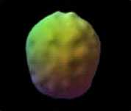
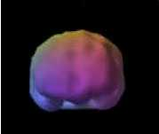
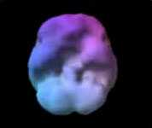
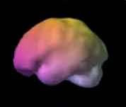
Effects of drugs on the brain
Normal 3D Brain SPECT Studies
Back
Top
Front
Top-down surface view
Bottom
Front-on surface view
Front
Top
Back
Underside surface view
Bottom
Side surface view
Source: Dr. Amen Clinic

Slide 7
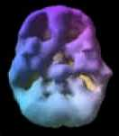
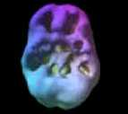
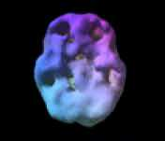
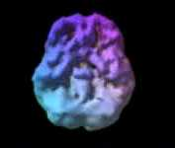
Marijuana
18 yr/o – 3 yr history of
4x week use
16 yr/o – 2 yr history of daily abuse
38 yr/o – 12 yrs of daily use
28 yr/o – 10 yrs of mostly weekend use

Slide 8
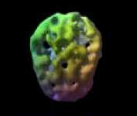
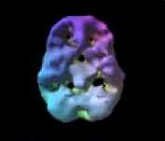
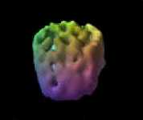
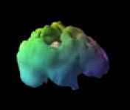
Alcohol
38 yr/o – with 17 yrs of heavy weekend use
Top
Bottom
Front
Right side

Slide 9
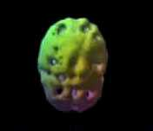
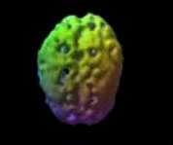
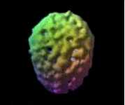
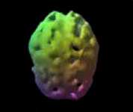
Cocaine & Methamphetamine
52 yr/old – 28 yrs of Heroin & frequent meth use
24 yr/old – 2 yrs of frequent cocaine use
28 yr/old – 8 yrs heavy meth use
36 yr/old – 10 yrs frequent meth use

Slide 10
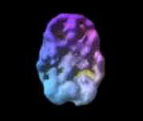
Heavy Nicotine & Caffeine Abuse
45 yr/old – 27 year history of heavy use
3 packs of cigarettes and 3 pots of coffee daily
Underside view
Marked decrease in overall brain activity

Slide 11
Heroin & Methadone
Normal brain
39 yr/old – 25 years of frequent heroin use
40 yr/old – 7 yrs of methadone & heroin 10 years prior

Slide 12
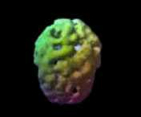
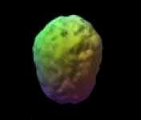
Hope for Healing
Alcohol, Cocaine & Meth
On and Off Drugs
During substance abuse
One year
Drug & alcohol free

Slide 13
2. What is the background of your students?
A. Their family background How healthy or dysfunctional was it?
B. Any religious background?
C. What is the quality of their educational background? Reading level?
D. Effects of drug use on their learning today

Slide 14
3. Teach like the Holy Spirit
One who comes along side to guide us into the truth
Not like a military general—makes all the decisions for those under his command

Slide 15
4. Our Mission
The mission of Teen Challenge is to evangelize and disciple persons with life-controlling problems and initiate the discipleship process to the point where the student can function as a Christian in society, applying spiritually motivated biblical principles in relationships in the family, church, chosen vocation, and community.

Slide 16
Our Mission
Teen Challenge endeavors to help people become
mentally sound
emotionally balanced
socially adjusted
physically well
spiritually alive

Slide 17
5. Balanced training for New Christians
A. Christ-like lifestyle
B. Overcoming Problems
C. Christian Service—ministry

Slide 18
6. What is your approach to teaching?
Is it based on the Bible?
Matthew 7:24-27
What are the two approaches identified here?

Slide 19
The Wise and Foolish Builders
Matt. 7:24 "Therefore everyone who hears these words of mine and puts them into practice is like a wise man who built his house on the rock. 25The rain came down, the streams rose, and the winds blew and beat against that house; yet it did not fall, because it had its foundation on the rock. 26But everyone who hears these words of mine and does not put them into practice is like a foolish man who built his house on sand. 27The rain came down, the streams rose, and the winds blew and beat against that house, and it fell with a great crash."

Slide 20
Two approaches to teaching
1: Greek Focus on knowing the facts
2: Hebrew Focus on Personal Application

Slide 21
A Biblical approach to teaching
Step 1: Know the facts
Step 2: Relate these truths to your life
Step 3: Personal application. Do it!

Slide 22
7. Growth is a process
Focus on the truth and take time to be connected with each student on a personal level.

Slide 23
Questions for discussion

Slide 24
Contact information
Global Teen Challenge
www.GlobalTC.org
www.iTeenChallenge.org

