Slide 1
How Can I Know I’m a Christian?
Global Teen Challenge

Slide 2
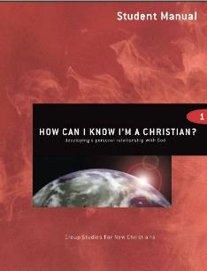
How Can I Know I’m a Christian? 5th edition By Dave Batty
This PowerPoint is designed to be used with the Group Studies for New Christians Course,
How Can I Know I’m a Christian? by Dave Batty.
Other Materials available include:
Teacher's Manual
Student Manual
Study Guide
Exam
Course Certificate
For Information on obtaining these materials see iteenchallenge.org or contact us at gtc@globaltc.org

Slide 3
How Can I Know I’m a Christian Assignment list
Quizzes: Verses to Memorize To be done with:
1. 8 facts on page 5 & 6 in Student Manual Lesson 2
2. Romans 8:16 TLB (page 20 St. Manual) Lesson 3
3. John 1:12 Lesson 4
4. James 1:5-6 Lesson 7
Study Guide Projects:
Project # To be done with or before
1 Lesson 1
2 Lesson 2
3 Lesson 3
4 Lesson 3 or 4
5 Lesson 8
6 Lesson 4
7 Lesson 5
8 Lesson 6
9 & 10 Lesson 7 or 8
11 Lesson 7 12 Lesson 9
Test: Lesson 10

Slide 4
How Does a Person Become a Christian?
Chapter 1

Slide 5
Lesson 1 - Commitment of the Mind Commitment of the Will
Key Biblical Truth
Once I understand the facts from the Bible concerning how to become a Christian, I need to take steps to become a Christian.
Key Verse: John 1:12 (New Life Bible)
“He gave the right and the power to become children of God to those who received Him. He gave this to those who put their trust in His name.”

Slide 6
A. A Commitment of Your Mind
1. You must understand and believe certain facts in the Bible which tell you how to become a Christian.

Slide 7
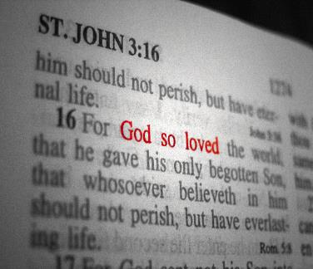
A. A Commitment of Your Mind
2. Here are the facts you need to know and believe to become a Christian
1.God does exist.
Hebrews 11:6
2. The Bible is true.
2 Timothy 3:16
3. I have sinned in disobeying God’s laws.
Romans 3:23

Slide 8
A. A Commitment of Your Mind
2. Here are the facts you need to know and believe to become a Christian
4. God loves me and He sent His only Son, Jesus, to live and die for me.
John 3:16

Slide 9
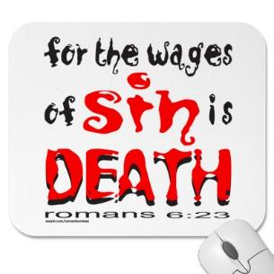
A. A Commitment of Your Mind
2. Here are the facts you need to know and believe to become a Christian
5. Jesus is the only One who can forgive my sins.
Acts 4:12
6. The penalty of sin is death (eternal death)
Romans 6:23

Slide 10
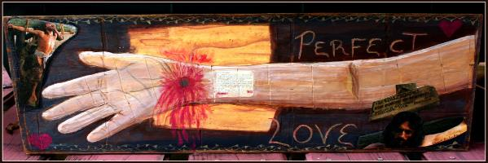
A. A Commitment of Your Mind
2. Here are the facts that you need to know
and believe to become a Christian
7. I can be saved from the penalty of sin by confessing my sins to Jesus and asking Him to forgive me.
1 John 1:9

Slide 11
A. A Commitment of Your Mind
2. Here are the facts that you need to know and believe to become a Christian
8. I can become a Christian by allowing Jesus to be the Leader of my life now.
Romans 10:9-10

Slide 12
B. A Commitment of Your Will
1. You must understand what it means to become a Christian.

Slide 13
B. A Commitment of Your Will
2. You must make a decision to become a Christian.

Slide 14
B. A Commitment of Your Will
3. With the help of God, you must follow through and do what you have decided to do.

Slide 15
Personal Application
Copy the eight facts from page 5 and 6 of the student manual or from the next slide, and respond to each by writing one of these comments next to each fact:
*I believe this
*I don’t believe this
*I’m not sure

Slide 16
8 FACTS YOU NEED TO KNOW AND BELIEVE TO BECOME A CHRISTIAN
1. God does exist. Hebrews 11:6
2. The Bible is true. 2 Timothy 3:16
3. I have sinned in disobeying God’s laws. Romans 3:23
4. God loves me and He sent His only Son, Jesus, to live and die for me. John 3:16
5. Jesus is the only One who can forgive my sins. Acts 4:12
6. The penalty of sin is death (eternal death). Romans 6:23
7. I can be saved from the penalty of sin by confessing my sins to Jesus and asking Him to forgive me. 1 John 1:9
8. I can become a Christian by allowing Jesus to be the Leader of my life now. Romans 10:9-10

Slide 17
Lesson 2 - Commitment of Emotions
Key Biblical Truth
I need to have a clear understanding of how my emotions are involved in becoming a Christian.
Key Verse: James 1:9 (New Life Bible)
“A Christian brother who has few riches of this world should be happy for what he has. He is great in the eyes of God.”

Slide 18
Lesson Warmup - Quiz on Emotions part 1
True False 1. A Christian who is really close to God will feel happy all the time.
True False 2. Holding your anger inside is better than impulsively expressing it (or acting it out).
True False 3. When a Christian gets depressed, there is something wrong with his spiritual life (his relationship with God).
True False 4. New Christians can keep on the spiritual ―high that often follows their conversion if they carefully obey God’s laws.

Slide 19
Lesson Warmup - Quiz on Emotions part 2
On the next four questions, Answer A, B or C, that best describes you and your feelings. Many of the questions have more than one right answer.
5. When someone hurts me or makes me angry, it is hard for me to tell him/her what I am feeling.
A. This is me B. This is me a little C. Not me
6. I am usually very quick to express my feelings (to act them out). A. This is me B. This is me a little C. Not me
7. I am usually hold my feelings inside, and don’t express them. A. This is me B. This is me a little C. Not me
8. It is hard for me to tell God how I feel when I am upset or depressed. A. This is me B. This is me a little C. Not me

Slide 20
Review of Lesson 1
What does it mean to make a commitment of your mind?
What does it mean to make a commitment of your will?

Slide 21
C. A Commitment of Your Emotions
1. How are your feelings involved when you become a Christian?

Slide 22
C. A Commitment of Your Emotions
a. We all respond differently to situations
Did someone promise that you would feel different when you became a Christian? Be careful about believing their promises that you too can feel the same thing.

Slide 23
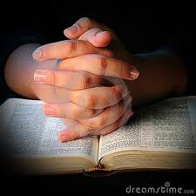
C. A Commitment of Your Emotions
b. Your feelings will change
Each day is a new day where situations may bring joy and peace, or anger and sadness.

Slide 24
C. A Commitment of Your Emotions
c. Your feelings should have third place when you become a Christian.

Slide 25
C. A Commitment of Your Emotions
2. What feelings are involved when you become a Christian?
Excitement, peace, and joy are common emotions people feel when they become a Christian.

Slide 26
C. A Commitment of Your Emotions
3. Learn how Christ wants you to show your feelings each day.
a. Submit your emotions to the leadership of Jesus Christ.

Slide 27
C. A Commitment of Your Emotions
b. Learn how to correctly identify your feelings.
c. Learn how to find emotional release through prayer

Slide 28
C. A Commitment of Your Emotions
d. Learn how to talk about your feelings to others
e. Learn to be more emotionally expressive

Slide 29
C. A Commitment of Your Emotions
f. Watch for “emotionally addicted” Christians.

Slide 30
Personal Application…
Focus on accepting your changing emotions and not depending on them to prove you are a Christian.
*Pray about your emotions
*Keep a diary or journal of your emotions
*Do a Bible study on emotions
*Make a contract with a friend or relative to confront feelings

Slide 31
Where Can I Look to Find Evidence That I’m a Christian?
Chapter 2

Slide 32
Lesson 3 - Evidences: The Bible and The Holy Spirit
Key Biblical Truth:
I need to learn to listen to the Holy Spirit when He speaks to me.
Key Verse: Romans 8:9 New Life Bible
But you are not doing what your sinful old selves want you to do, you are doing what the Holy Spirit tells you to do, if you have God’s Spirit living in you. No one belongs to Christ if he does not have Christ’s Spirit in him.

Slide 33
Where Can I Look to Find Evidence That I’m a Christian?
A. The Bible.
The Bible has the facts which will tell you how to become a Christian.

Slide 34
Where Can I Look to Find Evidence That I’m a Christian?
A. The Bible.
2. You must obey the teachings in the Bible.
3. The facts in the Bible have not changed

Slide 35
Where Can I Look to Find Evidence That I’m a Christian?
B. The Holy Spirit
1. The Holy Spirit will come and live in you
2. The Holy Spirit will be your teacher
3. He will speak to you and tell you that you are a Christian

Slide 36
Where Can I Look to Find Evidence That I’m a Christian?
B. The Holy Spirit
4. How can a person become more sensitive to the voice of the Holy Spirit?

Slide 37
How do I know if God is speaking to me?
1. Check it with the Bible.
2. Talk to God, and try to listen to Him.
3. Ask yourself, “Do I sense peace?”.

Slide 38
How do I know if God is speaking to me?
4. Can I shake off the thought?
5. You may need to seek out the help of an older Christian.

Slide 39
Personal Application…
This personal application project deals with learning to depend on the Holy Spirit more in your daily activities.
1- List the problems you are facing this week, especially those problems that you can’t solve in your own wisdom or strength.
2- Look for verses which relate to these problems and then pray for the Holy Spirit to give you wisdom to know where to begin attacking each problem.

Slide 40
Lesson 4 - Evidences: Changes in Your Life
Key Biblical Truth:
I need to cooperate with God in making changes in my daily life that will help me to draw close to God.
Key Verse: Philippians 1:6 New Life Bible
I am sure that God who began the good work in you will keep on working in you until the day Jesus Christ comes again.

Slide 41
Lesson Warm-up Story of a young man drafted into the Army
{There’s a bittersweet story about a West Virginia mountain boy who was drafted into the Army. The fellow had been raised in a small, secluded church and he and all the other church members worried that exposure to the world would
cause him to lose his faith. They held an all-night prayer vigil on his behalf the night before he left for boot camp. The boy didn’t write home at all during his two year hitch in the service, so it was with considerable interest that the whole
fellowship gathered around him when he returned. “How’d it go?” they asked.
“Were you able to hold onto your faith?” The young man replied enthusiastically,
“You know, I was really scared. But your prayers helped and it turned out just
great. I was in the Army the whole two years and nobody ever found out I was a
Christian!”} This story is from The Mind Changers, by Em Griffin (Tyndale House Publishers, 1976), page 207, used by permission

Slide 42
Where Can I Look to Find Evidence That I’m a Christian?
C. Changes in your life
1. You will have a new understanding of what is right and wrong

Slide 43
Where Can I Look to Find Evidence That I’m a Christian?
C. Changes in your life
2. You will have a new love(interest) for the Bible
3. You will have a desire to be like Jesus.

Slide 44
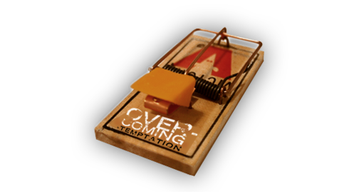
Where Can I Look to Find Evidence That I’m a Christian?
C. Changes in your life
4. You will have more tests, temptations and problems

Slide 45
There are many different ways you will be tested in your daily living.
a. Temptation to sin.
1 Corinthians 10:13
Persecution.
2 Timothy 3:12
The failures of other Christians.
Galatians 6:1-2
Facing the realities of life.
Overcoming the past.

Slide 46
Where Can I Look to find Evidence That I’m a Christian?
5. You will have a love for others
(especially other Christians)
6. You will want to share Jesus Christ with others
7. More changes

Slide 47
Personal Application…
Witnessing Role play
Have a student pretend that he is witnessing to a non-Christian friend. The friend asks, “What changes have taken place in your life since you became a Christian?” Have the student respond to him/her.

Slide 48
My Personal Relationship with Jesus Christ
Chapter 3

Slide 49
Lesson 5 - My Personal Relationship with Jesus Christ
Key Biblical Truth
I need to discover meaningful ways of developing a closer personal relationship with Jesus.
Key Verse: Hebrews 4:16 New Life Bible
Let us go with complete trust to the very place of God’s loving favor. We will receive His loving kindness and have His loving favor to help us whenever we need it.

Slide 50
Lesson Warm-up Characteristics of a good friendship
-Make a list of ten characteristics or qualities that you look for in a close friend.
-Choose the four most important ones and number them in order of priority.

Slide 51
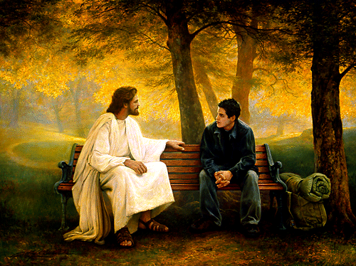
Living the Christian life means becoming “best friends” with Jesus Christ.

Slide 52
A. Why build a personal relationship with Jesus?
1. Why did God create you?
2. What brings true fulfillment in life?

Slide 53
B. What Kind of Relationship can you Develop with Jesus?
1. Don’t look for a mystical experience
2. Do I have to stop being me?

Slide 54
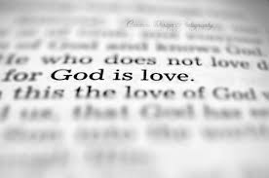
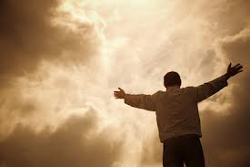
C. How can I learn about God?
Learn about God in the Bible.
Do not assume that God thinks like you do
Knowing about God or knowing God

Slide 55
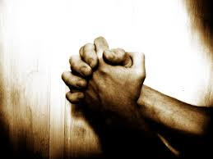
D. What are the basic steps to develop a personal relationship with Jesus?
1. Both people must want this friendship
2. Learn how to communicate with Jesus

Slide 56
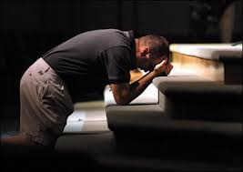
D. What are the basic steps to develop a personal relationship with Jesus?
3. Learn to develop trust and honesty
4. Learn to respect and love him

Slide 57
Personal Application…
Rate yourself on a scale of 1 – 10 as to the quality of your personal relationship with Jesus. (#1 means I hardly know Jesus, #10 means I have a very deep, intimate personal relationship with Jesus.)
Then pair off and share your answers with your partner. Then pray for one another to develop a closer personal relationship with
Jesus.

Slide 58
Lesson 6 - Building a friendship with Jesus
Key Biblical Truth
I need to cooperate with God in making changes in my daily life that will help me to draw closer to God.
Key Verse: Philippians 1:6 New Life Bible
I am sure that God who began the good work in you will keep on working in you until the day Jesus Christ comes again.

Slide 59
Lesson Warm-up How do you build a long distance friendship?
Small Group Activity:
A. You want to develop a friendship with a person in another country. You know you will never be able to see this person, because you cannot travel to that country. How would you go about developing a friendship with this person?
B. Discuss the possibilities and write an action plan of how you would proceed in developing this friendship.
Also list what would be some of the problems you could face in getting to know this person.
C. Report your ideas to the class.

Slide 60
D. What are the basic steps to develop a personal relationship with Jesus?
1. Both people must want this friendship
2. Learn how to communicate with Jesus

Slide 61
D. What are the basic steps to develop a personal relationship with Jesus?
3. Learn to develop trust and honesty
4. Learn to respect and love him

Slide 63
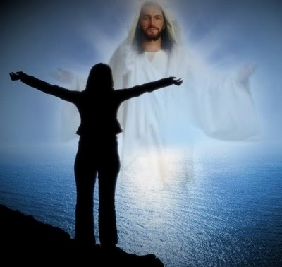
E. What are the results of knowing God personally?
1. Peace
2. Contentment
3. You will feel God’s presence

Slide 64
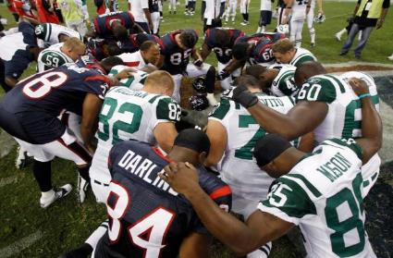
E. What are the results of knowing God personally?
4. You will think more about God
5. You will want to tell others about Jesus

Slide 65
Personal Application…
Evaluation of my uptight spots
Identify one area where you have been getting uptight, angry, or frustrated.
You do not need to tell the class about this. Think about how this situation can be an opportunity for you to draw closer to God.
Write down one way you can express your love to God through this difficult situation.

Slide 66
What Can I do with my Doubts About Being a Christian?
Chapter 4

Slide 67
Lesson 7 - Causes of Doubts
Key Biblical Truth
I need to discover what is happening in my daily life that causes me to have doubts about being a Christian.
Key Verse: James 1:5-6 New Life Bible
If you do not have wisdom, ask God for it. He is always ready to give it to you and will never say you are wrong for asking. (6) You must have faith as you ask Him. You must not doubt. Anyone who doubts is like a wave which is pushed around by the sea.

Slide 68
A. Who Brings Doubt Into Your Mind?
Satan.
Other people.
Yourself.
God (read the story of the encounter between Jesus and the rich, young ruler).

Slide 69
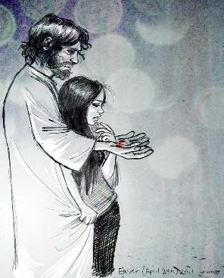
B. What causes these doubts?
KNOWLEDGE GAP
UNDERSTANDING GAP
BEHAVIOR GAP

Slide 70
What causes these doubts? There are many problems that cause a person to doubt he is a Christian. Following are listed some of the problems which cause these doubts:
1. When the good feelings leave.
2. Continuing to fail or sin.
3. Giving Jesus only part of your life.
4. Secretly becoming a Christian.
5. Temptation.

Slide 71
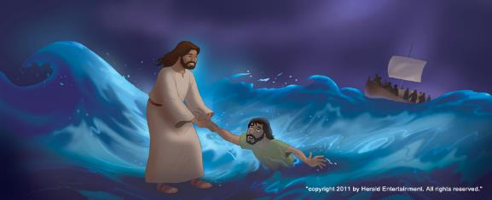
What causes these doubts?
Bitterness toward another person.
When your prayers are not answered.
Unwilling to correct a past mistake or wrong.
Fear.
Pride.

Slide 72
Personal Application…
Evaluation of my doubts
Identify problems in your life that may be causing you to have doubts. List a problem that causes you to feel far from God. Reflect on the category in which you would put this problem:
1. Knowledge gap
2. Understanding gap
3. Behavior gap

Slide 73
Lesson 8 - Getting Rid of Doubts
Key Biblical Truth
I can get rid of my doubts about being a Christian when I develop a pattern for overcoming the problem that causes these doubts.
Key Verse: Philippians 1:6 New Life Bible
I am sure that God who began the good work in you will keep on working in you until the day Jesus Christ comes again.

Slide 74
Lesson Warm-up
Case study: Story of Tim & Bud
Teacher: Read the story of Tim & Bud from the Teacher’s Manual Lesson 8: Warm-up

Slide 75
The story of Thomas
Read: John 20:19-31
What impresses you about this event?
Can they identify with Thomas and his doubts?
What do you think was causing Thomas to have doubts?
What did Jesus say was causing Thomas to have doubts?
What did Thomas say would get rid of his doubts?
How did Jesus help Thomas get rid of his doubts?
Did Jesus go along with Thomas’ plan for getting rid of his doubts?
How did Thomas react to Jesus?
What does Thomas’ reaction tell us about how sincere he was in getting rid of his doubts?

Slide 76
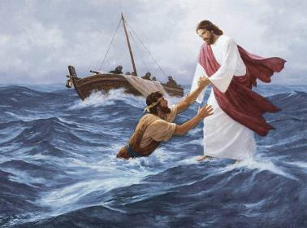
Jesus and Peter walking on water
Read: Matthew 14:22-33
What was causing Peter to have doubts?
Who was bringing these doubts into his mind?
What were the consequences of Peter’s doubts?
-the immediate consequences
-How do you think Peter felt after he got back to the boat and had to face the other disciples?
What did Peter do to get rid of his doubts?
What did Jesus do to help Peter?
Did this help Peter get rid of his doubts, or was this help only to deal with the consequences of his doubts?

Slide 77
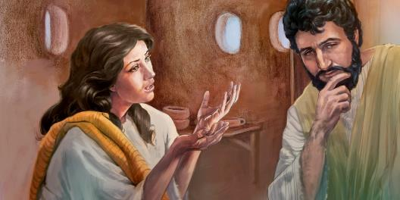
Joseph’s doubts about Mary’s pregnancy
Read: Matthew 1:18-25
What caused Joseph to doubt Mary’s explanation?
Put yourself in Joseph’s shoes. Would you believe your fiancée if she told you that God had made her pregnant?
What action did Joseph decide to take which shows that he did not believe Mary’s explanation for being pregnant?
How did God help Joseph solve this problem?
What was the response of Joseph to the
dream?
Does his response show that he still had
doubts?

Slide 78
C. How Can You Discover What is Causing Your Doubts?
Pray.
Think through the problem.
Bible study.
Spend time with other Christians.

Slide 79
Lesson 9 - Getting Rid of Doubts
Key Biblical Truth
I can get rid of my doubts about being a Christian when I develop a pattern for overcoming the problem that causes these doubts.
Key Verse: Psalm 94:19 The Living Bible
Lord, when doubts fill my mind, when my heart is in turmoil, quiet me and give me renewed hope and cheer.

Slide 80
Lesson Warm-up
If I die tonight:
Answer the following question privately. You do not have to hand this in.
If you were to die tonight, are you confident you would go to heaven?
Briefly explain why you chose this answer.
1. Yes, I feel very secure in my relationship with God, and I am very confident that I would go to heaven.
2. Sometimes I have doubts as to whether or not I would go to heaven.
3. I am not at all sure that I would go to heaven if I died tonight.
4. I don’t want to think about it.

Slide 81
D. How to Get Rid of Doubts
Admit you have the doubt.
Begin to talk to God about it.
Examine your doubts.

Slide 82
D. How to Get Rid of Doubts
Ask God how he wants you to get rid of this doubt.
Set goals that will help you get rid of these doubts God’s way.

Slide 83
Personal Application…
Divide into groups of two and share with each other at least one way this course has helped you know they are a Christian.
Then pray for each other.

Slide 84
Questions for Additional Study..
Why do I need to change this area in my life?
What does God say in the Bible about this issue?
What is my part in bringing about change?
What has God promised to do to help me change here?
How will this change affect my Christian growth?

Slide 85
Questions for Additional Study…
What should I do to make this change a
permanent part of my life?
How will this change affect my relationships with friends (both Christian and non-Christian)?

Slide 86
In Conclusion…
Remember you need God’s help to be a Christian. Whether the doubts come or go, you can stand firm in your love for God and say, “Yes, I know I’m a Christian.”

Slide 87
How Can I Know I’m a Christian? 5th edition By Dave Batty
This PowerPoint is designed to be used with the Group Studies for New Christians Course,
How Can I Know I’m a Christian? by Dave Batty.
This PowerPoint resource was originally developed by The Teen Challenge Farm, London, Ontario
Edited by Global Teen Challenge, 2018 gtc@globaltc.org globaltc.org

