Slide 1
Growing Through Failure By Dave Batty

Slide 2
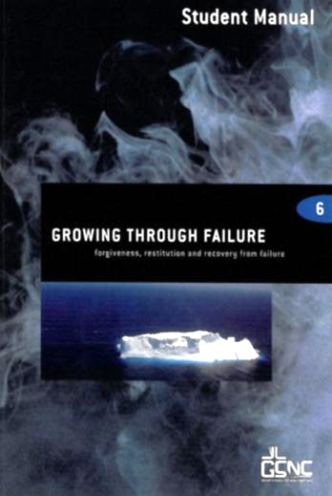
Growing Through Failure 5th edition By Dave Batty
This PowerPoint is designed to be used with the Group Studies for New Life Course,
Growing Through Failure, by Dave Batty.
Other Materials available include:
Teacher's Manual
Student Manual
Study Guide
Exam
Course Certificate
For Information on obtaining these materials see iteenchallenge.org

Slide 3
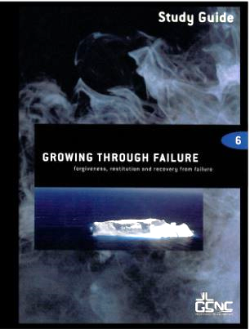
Growing Through Failure
Quizzes: Verses to Memorize To be done with:
Matthew 6:14-15 Lesson 2
Psalm 32:8-9 Lesson 4
Study Guide Projects:
Project # To be done before or with:
1 Lesson 1
2 Lesson 2
3 Lesson 3
4 Lesson 4
Test: Lesson 5
For Information on obtaining these materials see iteenchallenge.org globaltc.org

Slide 4
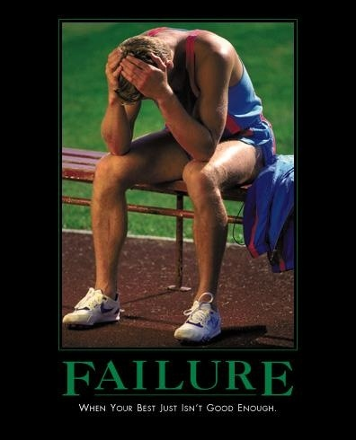
Chapter One: The Causes of My Failure

Slide 5
Key Biblical Truth
I need to discover the root problems in my life when I fail.
Key Verse:
Hebrews 4:16 Phillips New Testament
Let us therefore approach the throne of grace with fullest confidence, that we may receive mercy for our failures and grace to help in the hour of need.

Slide 6
Lesson Warm-up
1. Do successful Christians ever fail?
2. Is it always a sin to fail?
3. Give an example of a big failure that someone made. (This can be your own failure or anyone else’s, for example, a politician.)

Slide 7
Lesson Warm-up
4. Does God always get angry when Christians fail?
5. Have you ever relapsed in your life? (Relapse is having overcome a problem or a sin, then to fall back into doing it again.)
6. How do you rate yourself on being a success or a failure? Give yourself a number between 1 and 10. “One” means you consider yourself a total failure. “Ten” means your life has always been filled with success and no failure.

Slide 8
A. The Different Kinds of Failure
Failure that is not sin
Losing a game
Failing a test
Failing to reach a goal
Mistakes
“The man who makes no mistakes does not usually make anything.”
Edward J. Phelps

Slide 9
A. The Different Kinds of Failure
Failure that is sin
Failing to obey God’s laws (and man’s laws)
If you fail to do the right thing
Every time you give in to a temptation to sin

Slide 10
A. The Different Kinds of Failure
3. Failure that leads to sin

Slide 11
B. What God Does When My Failure is a Sin
God is very sad when you fail Him
God will give you a guilty conscience
God has promised to forgive you

Slide 12
B. What God Does When My Failure is a Sin
God disciplines His children
God gives us a reason to have hope in the future
God is ready to help you grow

Slide 13
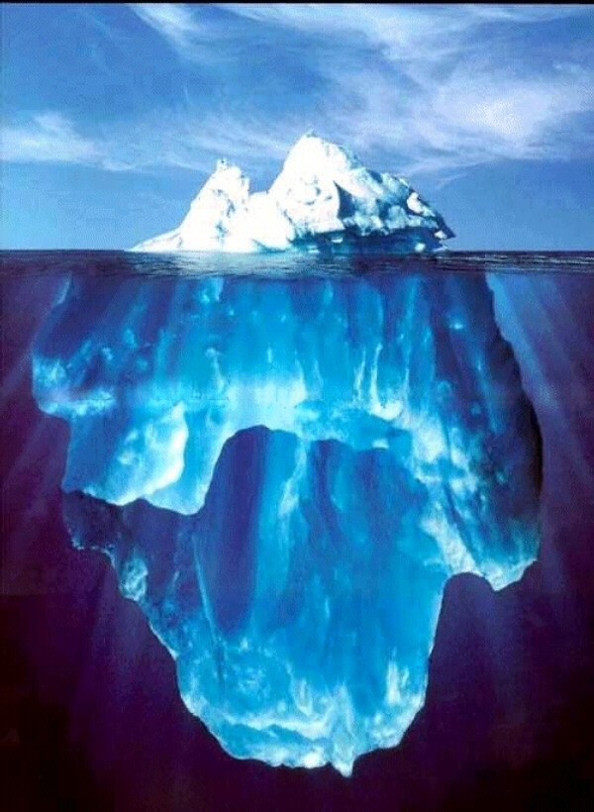
C. Understanding My Problems
Surface Problems
Surface Causes
Root Problems
Root Cause

Slide 14
C. Understanding My Problems

Slide 15
D. Consequences of Failure
Sin leads to death
Guilt
A sense of emptiness
Discipline
Bad habits
Addictions
Memories of past pain and failure
Anger
Broken relationships
More failures

Slide 16
Personal Application
Think about the problems that are currently causing you to fail then write down your answers for the following questions.
1. What is one surface problem that you are interested in overcoming?
2. What do you think is the surface cause (inner attitude) of this problem?
3. Which of the three root problems is most closely related to this?

Slide 17
Personal Application
4. How does the root cause fits in with this problem? Give at least 1 or 2 examples of how you have been “doing things your way,” in dealing with this problem.
5. What is God’s way of dealing with this problem?

Slide 18
Chapter Two
First Steps to Recovery From Failure

Slide 19
Key Biblical Truth
I need God’s help in taking the right steps to recover from failure.
Key Verse:
Psalm 32:8-9 New Living Translation
8The LORD says, “I will guide you along the best pathway for your life. I will advise you and watch over you.
9Do not be like a senseless horse or mule that needs a bit and bridle to keep it under control.”

Slide 20
Lesson review
Understanding My Problems
Surface Problems
Surface Causes
Root Problems
Root Cause

Slide 21
Lesson review C. Understanding My Problems
Hebrews 12:15-17
Isaiah 53:6
Isaiah 55:7

Slide 22
Relapse:
Slipping back into old patterns of failure.
Recovery:
The steps one takes to recover from their failure. Recovery also includes learning what steps to take so you don’t commit the same failure again.

Slide 23
A. Common Ways of Responding to Failure
Getting rid of only the surface problem
Suppress it
Don’t hide anything
Run away from the problem

Slide 24
A. Common Ways of Responding to Failure
Ignore the problem
Make excuses and justify the problem
Respond to the failure God’s way

Slide 25
B. What Should I Do When I Fail?
I should admit that I was wrong
I should ask God to forgive me
I must forgive myself
I must make a decision to stop sinning

Slide 26
B. What Should I Do When I Fail?
Ask forgiveness of those who were offended
Find the cause of the failure
Look for God’s way out of my failure
Let others tell me about my problems
Keep Growing!

Slide 27
C. Asking for Forgiveness… 1. Before I ask…
Admit to myself, and God, that I was wrong
Know clearly what I did wrong
Plan what I will say when I talk to this person

Slide 28
2. Wrong Ways to Ask for Forgiveness
“If I was wrong, please forgive me…”
“I was wrong, but you were wrong…”

Slide 29
2. Wrong Ways to Ask for Forgiveness
"Now that I have confessed what I did wrong, you must forgive me.“
"Now that I have confessed what I did wrong, let’s just forget about it."

Slide 30
3. The Right Way to Ask for Forgiveness
“I was wrong in (tell what you did wrong) . Will you forgive me?”

Slide 31
D. Making Restitution
Restitution: Greek “apokatastis”
Αποκαταστις
Apo:
“Back, again”
Kathistemi:
“To set in order”

Slide 32
D. Making Restitution
A repair of a public roadway
The restoration of estates to rightful owners
A balancing of accounts
Αποκαταστις

Slide 33
1. The Biblical Pattern for Restitution
Matthew 5:23-24
Luke 19:1-10
Galatians 6:1-2

Slide 34
2. Steps in Restitution
Make a commitment with God
Restore your relationship with the person you offended
Make material restoration for what you stole or destroyed

Slide 35
3. The Results of Making Restitution
Inner peace
It may cause you hardship
It reveals you “walk the walk”, not simply “talk the talk” – an excellent opportunity for witness
You may be pardoned

Slide 36
Personal Application
Asking for forgiveness
Memorize the simple pattern for asking forgiveness. Ask God to reveal to you if there is someone you need to go to and ask forgiveness.
Write out what you plan to say to this person then go and ask forgiveness.

Slide 37
Chapter 3
How to grow through my failures

Slide 38
Key Biblical Truth
I need to listen to and obey the Holy Spirit so He can help me grow through my failures.
Key Verse:
John 16:13 New Life Bible
The Holy Spirit is coming. He will lead you into all truth. He will not speak His words. He will speak what He hears. He will tell you of things to come.

Slide 39
A. Overcome the problem
What is my attitude toward failure?
False beliefs and the truth
Discover the causes, results and solutions of each failure
a. How does God want me to respond to this failure?
b. Dealing with the consequences of my failure

Slide 40
Understanding My Failure
The Cause
of my failure
The Result
The Solution
The natural consequence
of my failure
Finding God’s way of growing as a result of my failure
“I am responsible
for my actions”

Slide 41
GROWING THROUGH FAILURE
5
4
I see the problem before I fail, and avoid or solve it.
3
I see the problem before I fail, but I still fail.
2
I see my failure right when it is happening but I still fail.
1
I see the failure after it is past.
I don’t see the problem, I fail, and even then I don’t see it.

Slide 42
Overcome the problem
C. What are the steps to implementing God’s solution to this problem?
Fix your eyes on Jesus
Take steps of faith
Develop a recovery plan

Slide 43
4. Failure Moves Me

Slide 44
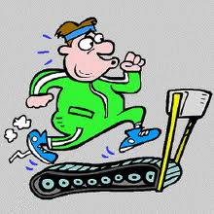
B. Live a healthy lifestyle
I need to discover God’s plan for my life
Develop the disciplines of living for Jesus
Develop boundaries for healthy living

Slide 45
C. Take steps to prevent that failure again
Create a relapse prevention plan
Identify potential triggers
Develop relationships of accountability
Relapse =
Slipping back into old patterns of failure.

Slide 46
Personal Application
Take an honest look at your failures. Pick one area in their life and evaluate where you are at on the chart, “Growing Through Failure.” in the Student Manual.
Write down one or two things you can do to more effectively put into practice God’s way of overcoming this failure.
Find at least one scripture that relates to the solution and explain how this verse will help you grow.

Slide 47
Chapter 4
Relapse

Slide 48
Key Biblical Truth
God has a path to real recovery for everyone who has relapsed.
Key Verse:
1 Corinthians 10:13 New Living Translation “The temptations in your life are no different from what others experience. And God is faithful. He will not allow the temptation to be more than you can stand. When you are tempted, he will show you a way out so that you can endure.”

Slide 49
A. Seven reasons why recovery quickly turns into relapse
Magical thinking
Environmental abstinence vs. real change
Old friends
Old problem solving strategies

Slide 50
A. Seven reasons why recovery quickly turns into relapse
Failure to use God’s power
Unresolved problems
Compartmentalizing my life

Slide 51
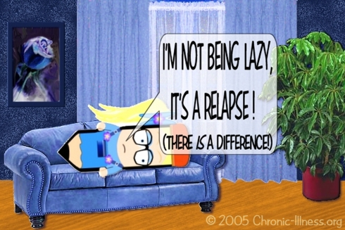
B. What causes relapse?
You can’t relapse if you have never experienced recovery
Failure to deal with problems of the past
Other addictions and life-controlling problems

Slide 52
C. Understanding relapse
What is the path to addiction?
What is recovery?
What is relapse?

Slide 53
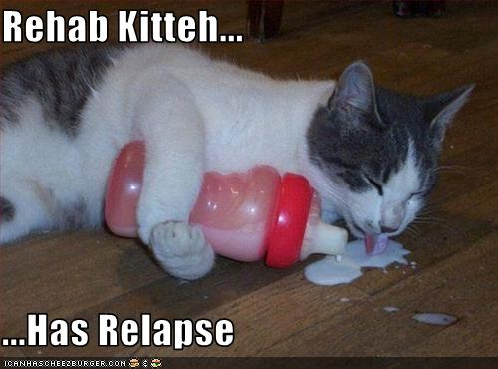
D. What to do if relapse occurs
Stop immediately
Get help
Re-design your recovery strategy
Begin the hard work of recovery
Establish a relationship of accountability
Keep Growing!

Slide 54
Personal Application
Write down 5 things you will do to prevent relapse in your life.
Break up into groups of two and share your answers with each other, and then pray for each other.

Slide 55
Growing Through Failure Scriptures

Slide 56
Romans 13:1-2
Obey the government, for God is the one who put it there. All governments have been placed in power by God. ² So those who refuse to obey the laws of the land are refusing to obey God, and punishment will follow.

Slide 57
James 4:17
Remember, it is sin to know what you ought to do and then not do it.

Slide 58
1 Corinthians 10:13
But remember that the temptations that come into your life are no different from what others experience. And God is faithful. He will keep the temptation from becoming so strong that you can’t stand up against it. When you are tempted, he will show you a way out so that you will not give in to it.

Slide 59
John 16:8
And when he (the Holy Spirit) comes, he will convince the world of its sin, and of God’s righteousness, and of the coming judgment.

Slide 60
1 John 1:9
If we say we have no sin, we are only fooling ourselves and refusing to accept the truth. ⁹ But if we confess our sins to him, he is faithful and just to forgive us and to cleanse us from every wrong.

Slide 61
Hebrews 12:5-11
And have you entirely forgotten the encouraging words God spoke to you, his children? He said,
“My child, don’t ignore it when the Lord disciplines you,
and don’t be discouraged when he corrects you.
⁶ For the Lord disciplines those he loves,
and he punishes those he accepts as his children.”

Slide 62
Hebrews 12:5-11
⁷ As you endure this divine discipline, remember that God is treating you as his own children. Whoever heard of a child who was never disciplined? ⁸ If God doesn’t discipline you as he does all of his children, it means that you are illegitimate and are not really his children after all.

Slide 63
Hebrews 12:5-11
⁹ Since we respect our earthly fathers who disciplined us, should we not all the more cheerfully submit to the discipline of our heavenly Father and live forever? ¹⁰ For our earthly fathers disciplined us for a few years, doing the best they knew how. But God’s discipline is always right and good for us because it means we will share in his holiness.

Slide 64
Hebrews 12:5-11
¹¹ No discipline is enjoyable while it is happening—it is painful! But afterward there will be a quiet harvest of right living for those who are trained in this way.

Slide 65
Colossians 1:20-22
… and by him <Jesus> God reconciled everything to himself. He made peace with everything in heaven and on earth by means of his blood on the cross. ²¹ This includes you who were once so far away from God. You were his enemies, separated from him by your evil thoughts and actions,

Slide 66
Colossians 1:20-22
²² yet now he has brought you back as his friends. He has done this through his death on the cross in his own human body. As a result, he has brought you into the very presence of God, and you are holy and blameless as you stand before him without a single fault.

Slide 67
Hebrews 12:15-17
Look after each other so that none of you will miss out on the special favor of God. Watch out that no bitter root of unbelief rises up among you, for whenever it springs up, many are corrupted by its poison. ¹⁶ Make sure that no one is immoral or godless like Esau. He traded his birthright as the oldest son for a single meal. ¹⁷ And afterward, when he wanted his father’s blessing, he was rejected. It was too late for repentance, even though he wept bitter tears.

Slide 68
Isaiah 53:6
All of us have strayed away like sheep. We have left God’s paths to follow our own. Yet the Lord laid on him the guilt and sins of us all.

Slide 69
Isaiah 55:7
Let the people turn from their wicked deeds. Let them banish from their minds the very thought of doing wrong! Let them turn to the Lord that he may have mercy on them. Yes, turn to our God, for he will abundantly pardon.

Slide 70
Matthew 5:23, 24
“So if you are standing before the altar in the Temple, offering a sacrifice to God, and you suddenly remember that someone has something against you, ²⁴ leave your sacrifice there beside the altar. Go and be reconciled to that person. Then come and offer your sacrifice to God.

Slide 71
Luke 19:1-10
Jesus entered Jericho and made his way through the town. ² There was a man there named Zacchaeus. He was one of the most influential Jews in the Roman tax-collecting business, and he had become very rich. ³ He tried to get a look at Jesus, but he was too short to see over the crowds.

Slide 72
Luke 19:1-10
⁴ So he ran ahead and climbed a sycamore tree beside the road, so he could watch from there. ⁵ When Jesus came by, he looked up at Zacchaeus and called him by name. “Zacchaeus!” he said. “Quick, come down! For I must be a guest in your home today.”

Slide 73
Luke 19:1-10
⁶ Zacchaeus quickly climbed down and took Jesus to his house in great excitement and joy. ⁷ But the crowds were displeased. “He has gone to be the guest of a notorious sinner,” they grumbled.

Slide 74
Luke 19:1-10
⁸ Meanwhile, Zacchaeus stood there and said to the Lord, “I will give half my wealth to the poor, Lord, and if I have overcharged people on their taxes, I will give them back four times as much!”

Slide 75
Luke 19:1-10
⁹ Jesus responded, “Salvation has come to this home today, for this man has shown himself to be a son of Abraham. ¹⁰ And I, the Son of Man, have come to seek and save those like him who are lost.”

Slide 76
Galatians 6:1-2
Dear brothers and sisters, if another Christian is overcome by some sin, you who are godly should gently and humbly help that person back onto the right path. And be careful not to fall into the same temptation yourself. ² Share each other’s troubles and problems, and in this way obey the law of Christ.

Slide 77
Ecclesiastes 12:1-11
I said to myself, “Come now, let’s give pleasure a try. Let’s look for the ‘good things’ in life.” But I found that this, too, was meaningless. ² “It is silly to be laughing all the time,” I said. “What good does it do to seek only pleasure?”

Slide 78
Ecclesiastes 12:1-11
³ After much thought, I decided to cheer myself with wine. While still seeking wisdom, I clutched at foolishness. In this way, I hoped to experience the only happiness most people find during their brief life in this world. ⁴ I also tried to find meaning by building huge homes for myself and by planting beautiful vineyards.

Slide 79
Ecclesiastes 12:1-11
⁵ I made gardens and parks, filling them with all kinds of fruit trees. ⁶ I built reservoirs to collect the water to irrigate my many flourishing groves. ⁷ I bought slaves, both men and women, and others were born into my household. I also owned great herds and flocks, more than any of the kings who lived in Jerusalem before me.

Slide 80
Ecclesiastes 12:1-11
⁸ I collected great sums of silver and gold, the treasure of many kings and provinces. I hired wonderful singers, both men and women, and had many beautiful concubines. I had everything a man could desire!

Slide 81
Ecclesiastes 12:1-11
⁹ So I became greater than any of the kings who ruled in Jerusalem before me. And with it all, I remained clear-eyed so that I could evaluate all these things. ¹⁰ Anything I wanted, I took. I did not restrain myself from any joy. I even found great pleasure in hard work, an additional reward for all my labors.

Slide 82
Ecclesiastes 12:1-11
¹¹ But as I looked at everything I had worked so hard to accomplish, it was all so meaningless. It was like chasing the wind. There was nothing really worthwhile anywhere.

Slide 83
1 John 1:9
If we say we have no sin, we are only fooling ourselves and refusing to accept the truth. ⁹ But if we confess our sins to him, he is faithful and just to forgive us and to cleanse us from every wrong.

Slide 84
James 4:8-10
Draw close to God, and God will draw close to you. Wash your hands, you sinners; purify your hearts, you hypocrites. ⁹ Let there be tears for the wrong things you have done. Let there be sorrow and deep grief. Let there be sadness instead of laughter, and gloom instead of joy. ¹⁰ When you bow down before the Lord and admit your dependence on him, he will lift you up and give you honor.

Slide 85
2 Chronicles 7:14
Then if my people who are called by my name will humble themselves and pray and seek my face and turn from their wicked ways, I will hear from heaven and will forgive their sins and heal their land.

Slide 86
Growing Through Failure 5th edition By Dave Batty
This PowerPoint is designed to be used with the Group Studies for New Life Course,
Growing Through Failure, by Dave Batty.
This PowerPoint resource was developed by the
Teen Challenge Farm, London, Ontario
Edited by Global Teen Challenge
For Information on obtaining these materials see iteenchallenge.org

