Slide 1
Disciplining students in the
Teen Challenge program
3rd Edition
By Dave Batty
&
Dan Batty

Slide 2
What are the most difficult challenges facing Teen Challenge staff today in the area of disciplining students?

Slide 3
How you handle discipline will quickly show the depth of character in your life.
It will also expose your weaknesses.

Slide 4

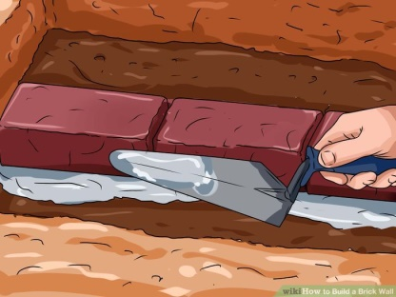
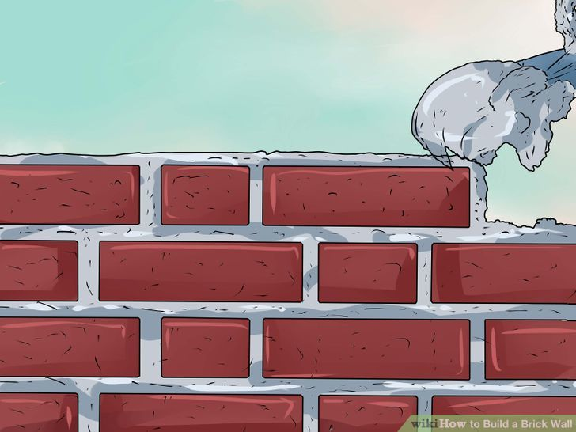
Why do you discipline students?

Slide 5
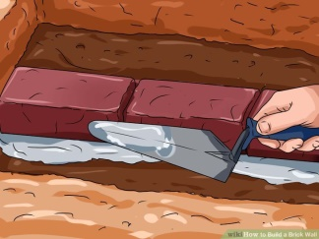
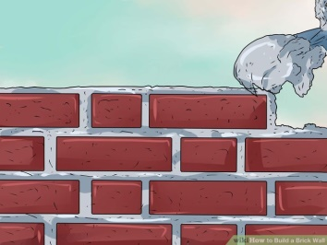

What kind of a ministry are we?
Drug rehabilitation?
Bring people to Jesus?
Make disciples
—followers of Jesus

Slide 6
How does disciplining students fit into our ministry?
We are a Christian discipleship ministry
How can we help this student follow Jesus?
(be obedient)
How can we help this student develop godly character?
(self-discipline)

Slide 7
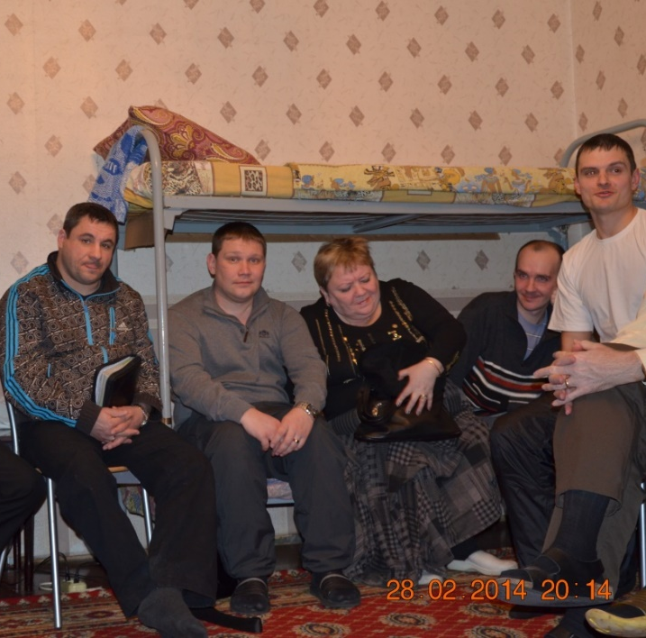
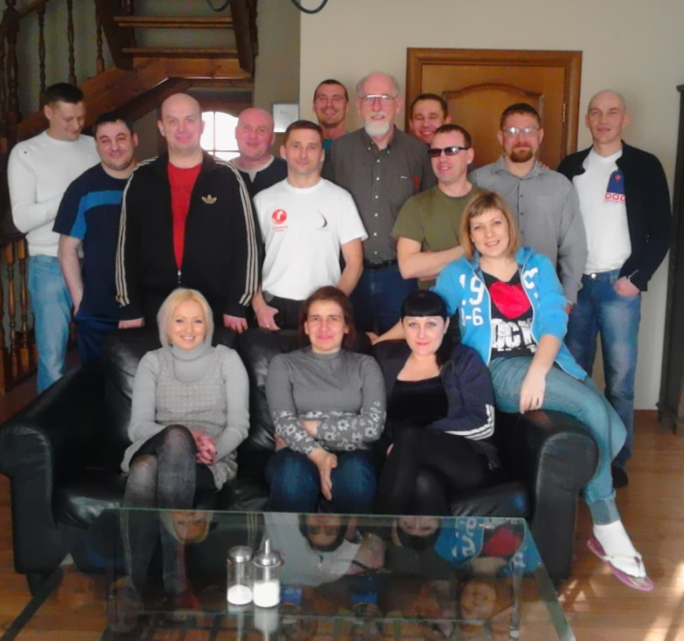
What is our main focus in this training?
Students?
Staff?

Slide 8
Personal Application Ideas
Student Manual page 4
1
2
3
4
5
6
7

Slide 9

Lesson 1
Discipline in your life

Slide 10
  Key Truth:
  Your present view of discipline has been greatly influenced by
  your past experiences.

Slide 11
  Key Verse: Proverbs 22:6
Start children off on the way they should go, and even when they are old they will not turn from it.

Slide 12
Discipline in your life
(Early childhood years 1-12)
1. Were you raised and disciplined by Christian parents?
Yes No_____

Slide 13
2. What was your home setting during your first twelve years?
I was raised by both my biological father and mother.
I was raised in a home with a step parent.
I was raised in a single parent home.
I was raised someone other than my biological parents.

Slide 14
Question 4.
Rate how often you were disciplined
0 100
Rarely Very often

Slide 15
Question 5.
How often were the persons angry at the time they were disciplining you?
0 100
Rarely Very often

Slide 16
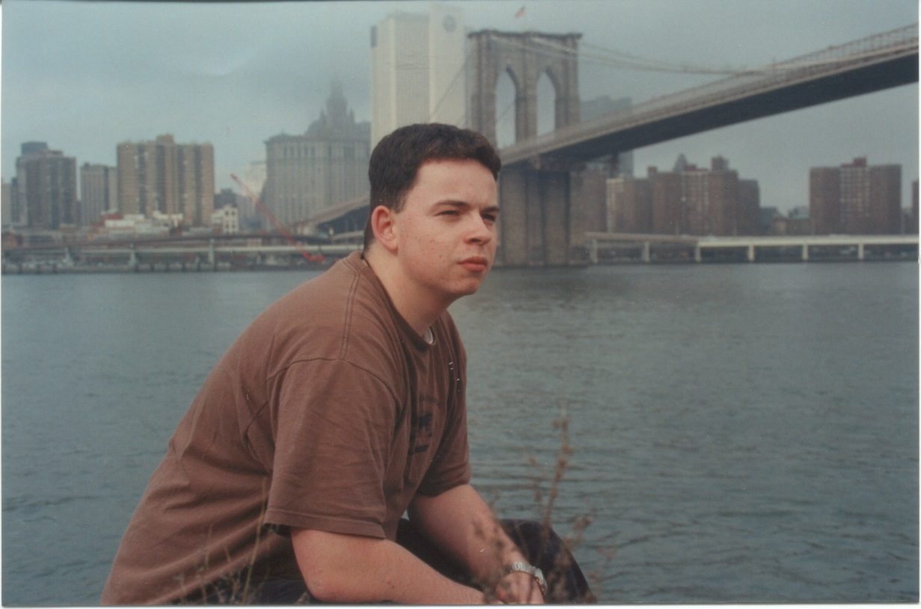
B. What God says about your past experiences

Slide 17
Hebrews 12:11
No discipline seems pleasant at the time, but painful.
Later on, however, it produces a harvest of righteousness and peace for those who have been trained by it.

Slide 18
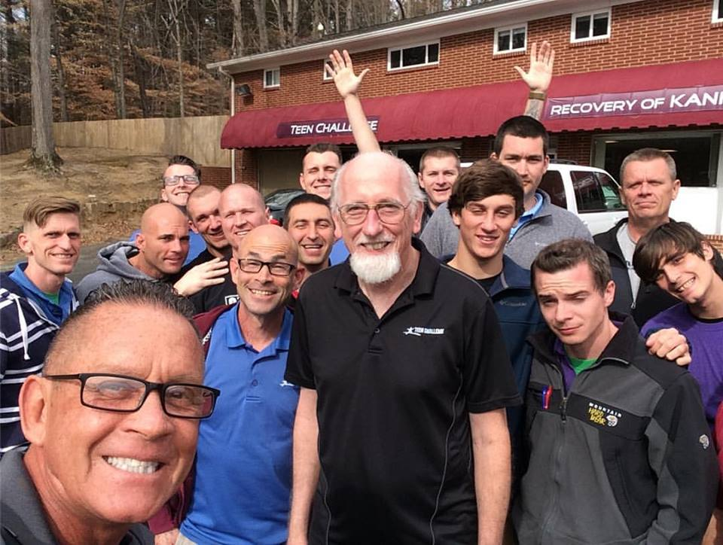
C. Who are the people you will be required to discipline in TC?

Slide 19
Why do you discipline students?

Slide 20
With all the careful attention we give to learning about a student’s background, none of this will replace the need to depend on the Holy Spirit to give us wisdom to minister to each student God’s way.

Slide 22
Lesson 2
Principles of Discipline

Slide 23
Key Truth:
  Understanding God's view of discipline
  will help me live
  a godly lifestyle

Slide 24
Key Verse:
Hebrews 12:11 NIV
No discipline seems pleasant at the time, but painful. Later on, however,
it produces a harvest of righteousness and peace for those who have been trained by it.

Slide 25
What are some Biblical reasons for having discipline?

Slide 26
A. The need for discipline
Proverbs 22:6
Hebrews 12:11
2 Timothy 3:16
Romans 2:5-8
Genesis 2:15-17, 3:1-24

Slide 27
A. The need for discipline
The simple reason why discipline is needed—people have disobeyed
That’s a negative reason.
Positive reason—People need to learn to obey.
This leads to the best life.

Slide 28

B. Three levels of obedience

Slide 29
B. Three levels of obedience
1. Obey because you were told to do it.

Slide 30
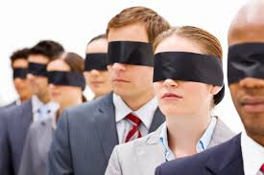
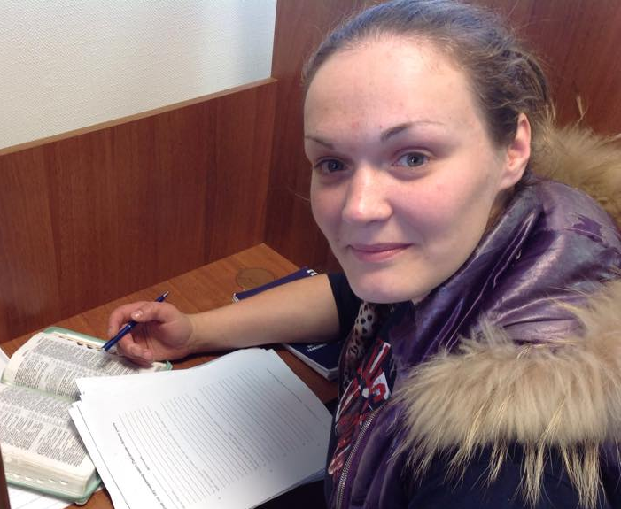
Blind Obedience
Careful obedience

Slide 31
B. Three levels of obedience
Obey because you were told to do it.
Obey and discover the main reason why you were told to do it.

Slide 32
With every rule:
What are the main reasons why we have this rule?
Students are not allowed to leave the
Teen Challenge property alone
(without staff supervision).
Students are not allowed to smoke.

Slide 33
B. Three levels of obedience
Obey because you were told to do it.
Obey and discover the main reason why you were told to do it.
Obey on your own because it is the right thing to do.

Slide 34
It is extremely important that staff function at Level Three

Slide 35
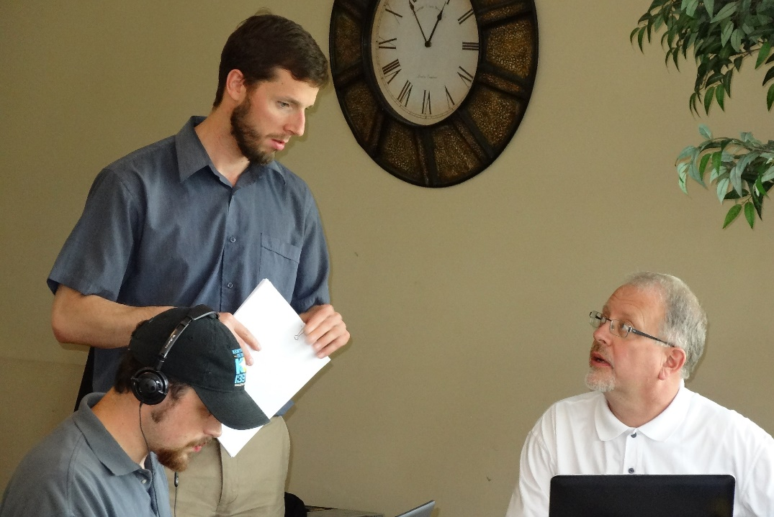
Do the rules you enforce reflect God’s priorities in life?

Slide 36
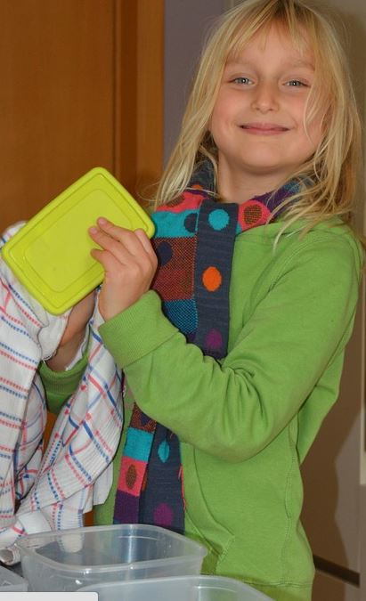
D. Three levels of discipline
Self-discipline
--not self-punishment
--a healthy, mature way
of facing life
--functioning at level 3
of obedience
--it's self-control
--willingly choosing to live
within the rules
2 Corinthians 10:5 Philippians 3:12-14

Slide 37
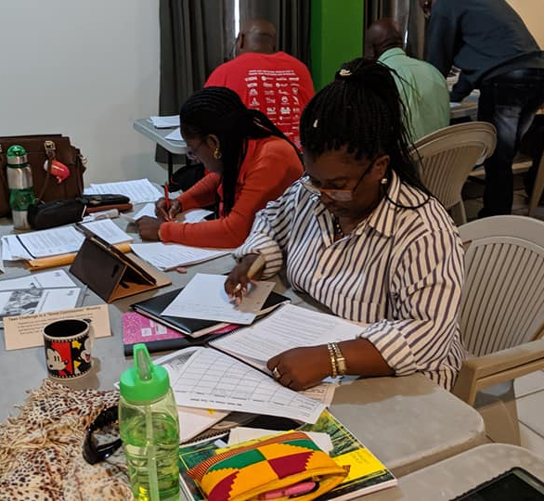
D. Three levels of discipline
Self-discipline
2 Corinthians 10:5
Discipline by others
Romans 13:1-5
Discipline by God
Hebrews 12:5-11

Slide 38
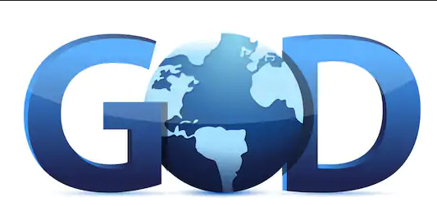
How does God discipline us?

Slide 39
Questions

Slide 40

Lesson 3
Relationships in Discipline

Slide 41
Key Truth
Discipline carries the
greatest potential for
positive growth
in the context of
meaningful relationships.

Slide 42
Hebrews 12:10 NIV
Our fathers disciplined us for a little while as they thought best; but God disciplines us for our good, that we may share in his holiness.

Slide 43
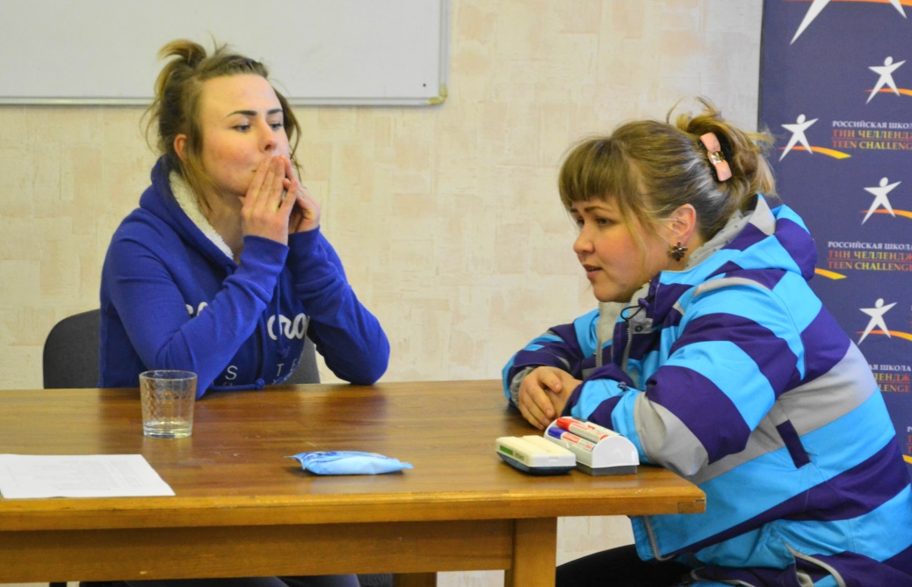
The setting of Discipline
Relationships!

Slide 44
A. Discipline in the context of meaningful relationships
The family
Society
God
Teen Challenge

Slide 45
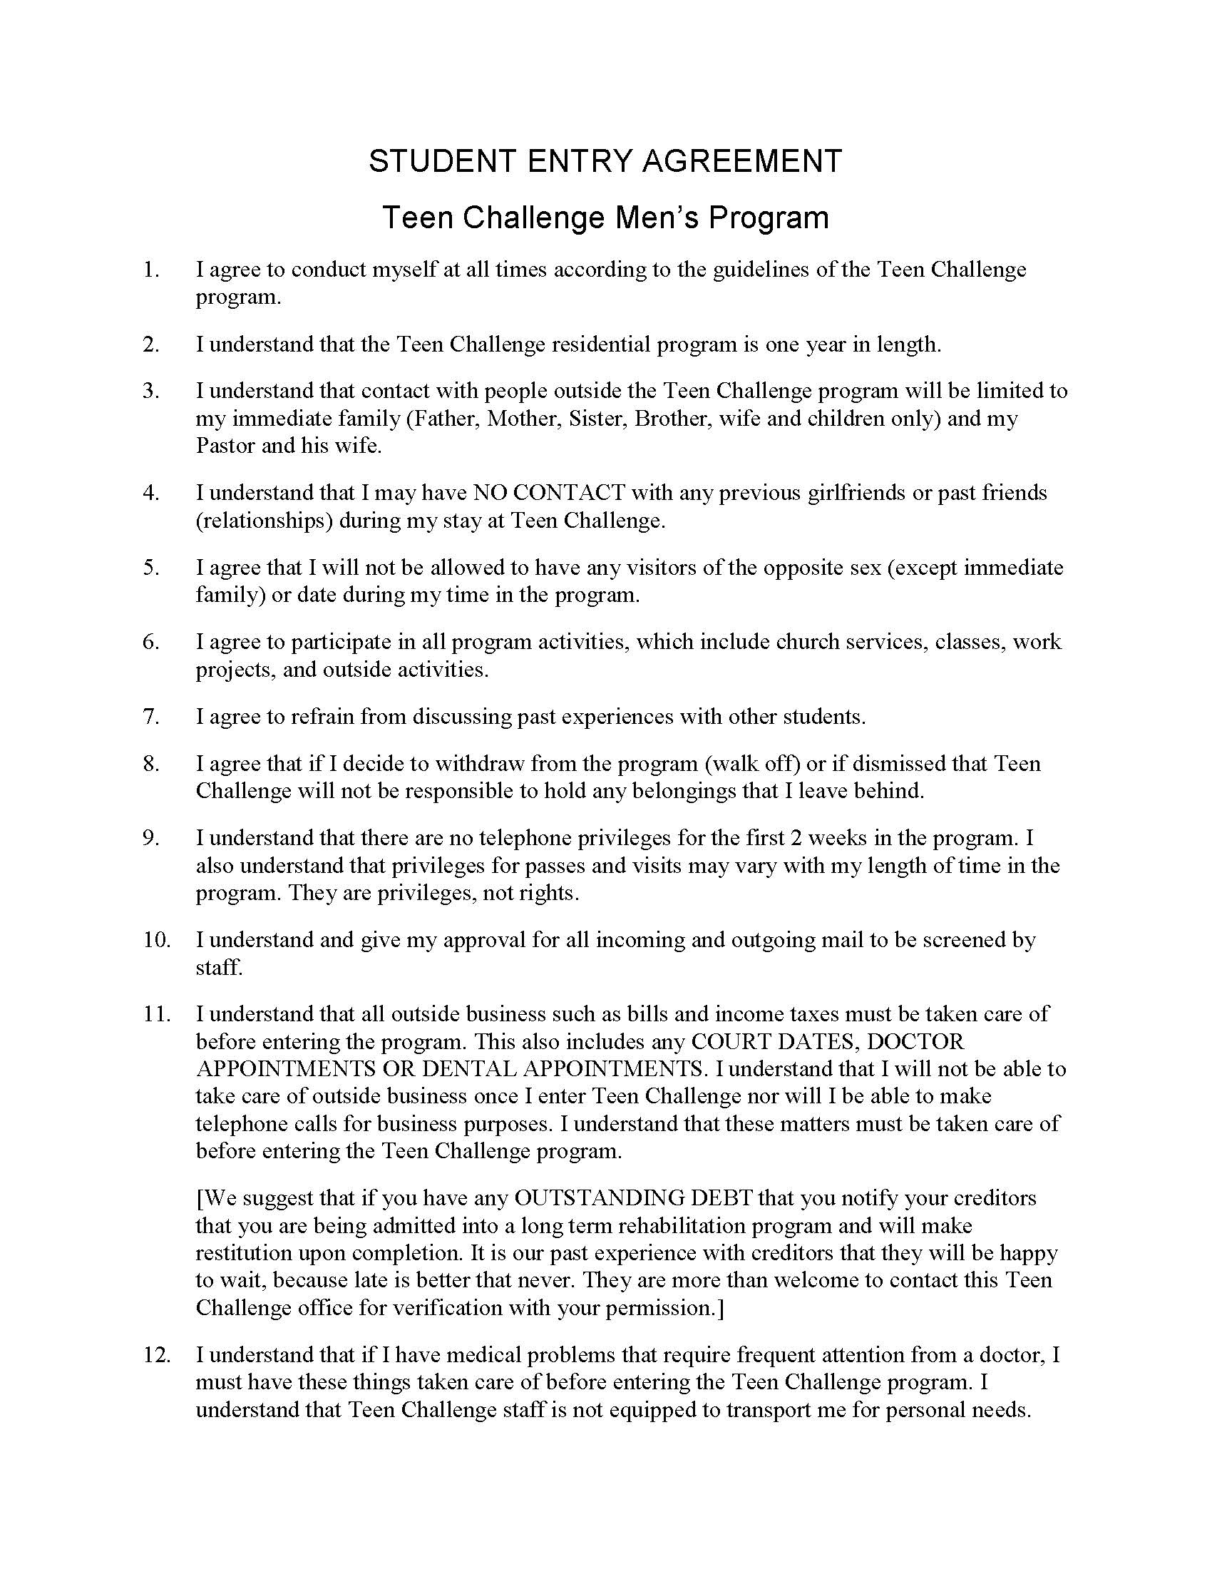
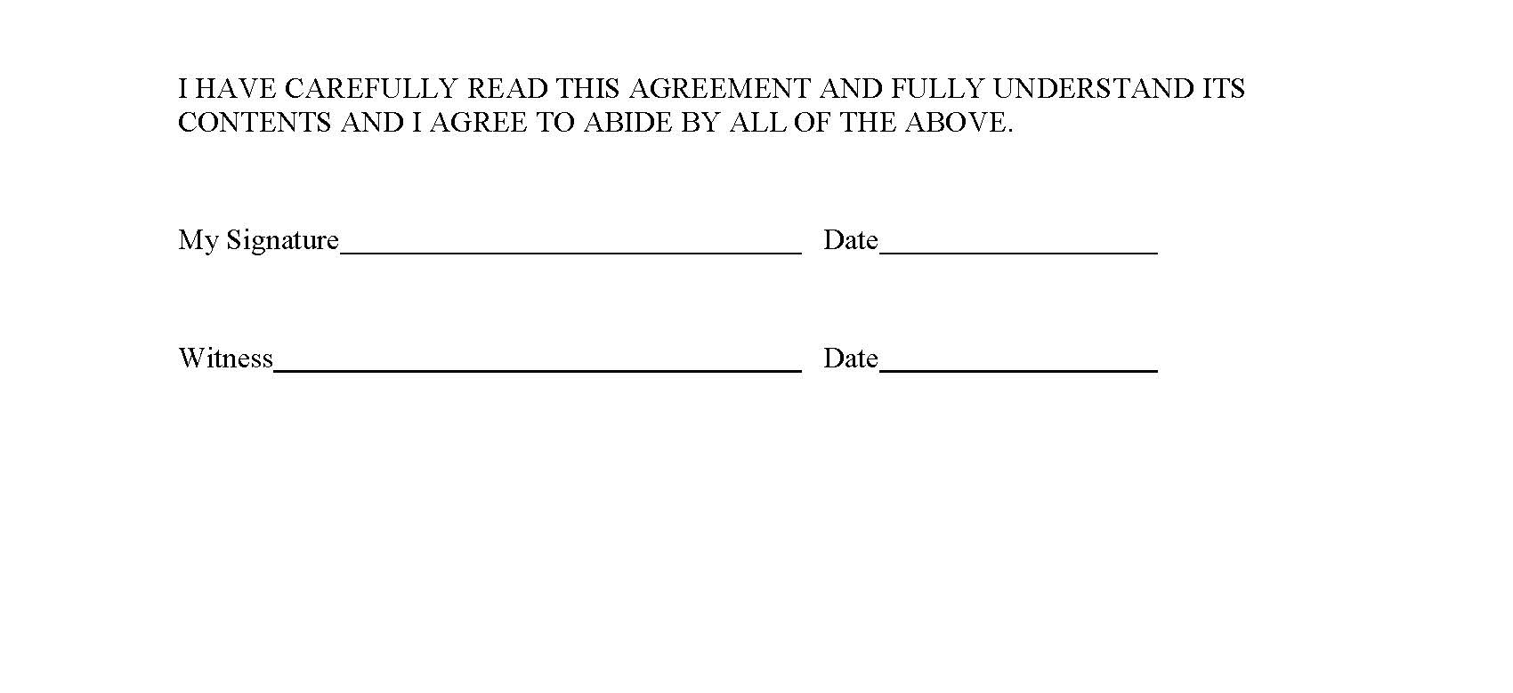
New Student Agreement

Slide 46
Discipline in Teen Challenge
In the Teen Challenge program, damaged relationships are a major problem

Slide 47
B. Discipline in the context of damaged relationships
Delusion --not seeing, not understanding, or not acting in truth.
Denial --a defense mechanism to hide from the painful consequences of facing the truth
Rebellion --"I don't want to submit to your authority."

Slide 48
Project 4
Case Study #2 Just a little respect, please!
Instructions:
1. Take Study Guide Project 4. Read the case study on the top of the page. If you are studying this as a correspondence course, continue and answer all questions at this time.
2. If you are studying this course in a group classroom environment, go ahead and answer all questions before the next session / class. Bring it with you to discuss in the next class.

Slide 50

Lesson 4
The Main Goals of Discipline

Slide 51
When you are disciplining a student in TC, what is your main goal?
Change!

Slide 52
Key Truth:
Change within and in one’s behavior is the goal of discipline.
Key Verse:
2 Peter 3:9b NIV He is patient with you,
not wanting anyone to perish,
but everyone to come to repentance.

Slide 53
A. What is the main goal of discipline?
What kind of change?
You cannot force a student to change
Biblical discipline is designed to bring change from a willing heart.

Slide 54
What kind of change are we looking for?
Change that comes from the heart
Change to want to obey God and those in authority over us.

Slide 55
B. So what motivates a person to want to change?
1. Change motivated by Love
Love is the highest motive for change
2. Change resulting from Learning
3. Change resulting from Pain
    Physical pain

Slide 56

b. Emotional pain
We need to make sure that our methods of discipline are fostering sorrow that leads to repentance, not anger that leads to more rebellion.

Slide 57
B. So what motivates a person to want to change?
1. Change motivated by Love
Love is the highest motive for change
2. Change resulting from Learning
3. Change resulting from Pain
    Physical pain
    Emotional pain
    Spiritual pain

Slide 58
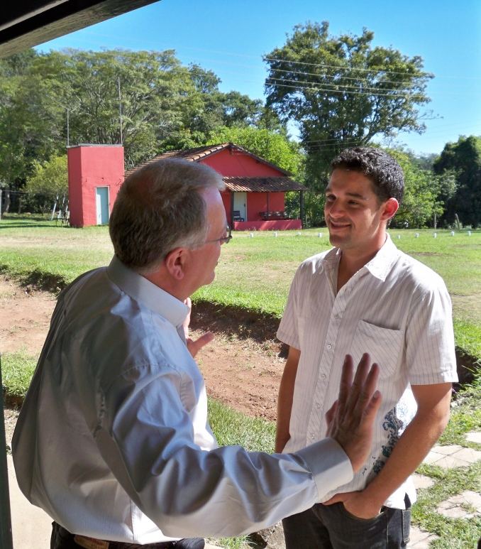
How would you explain spiritual pain to a student in your program?

Slide 59
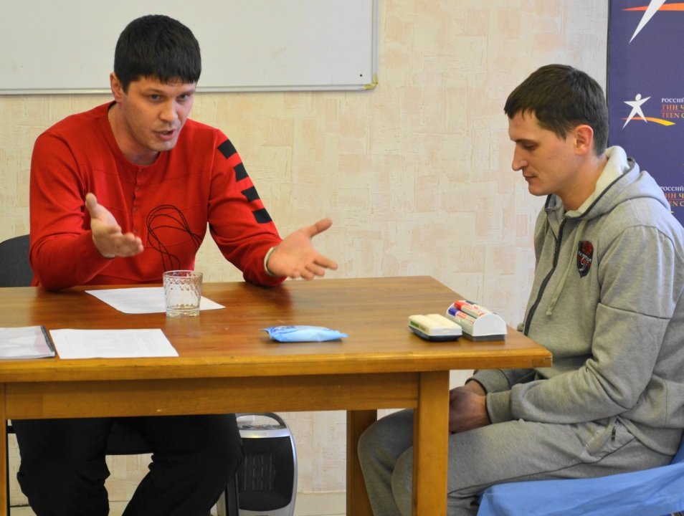
C. What is the purpose of discipline
- punishment or correction?

Slide 60
D. What is redemptive discipline?
To bring healing,
not just punishment
What are we doing to prepare this to be a redemptive experience?

Slide 61

E. Discipline and the Consequences

Slide 62
E. Discipline and the Consequences
Choice Consequences

Slide 63
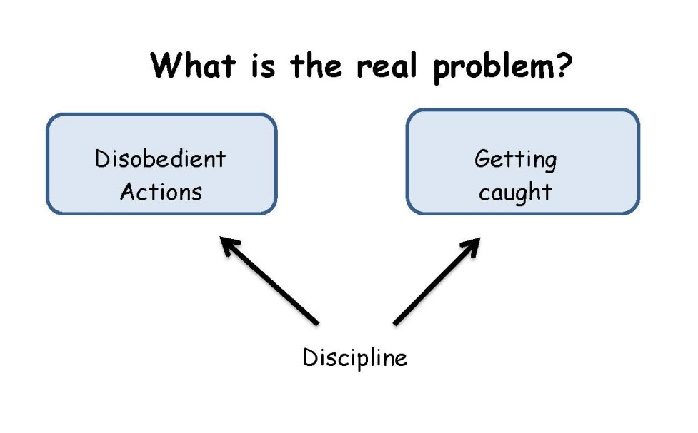
Two perspectives of the problem

Slide 64
F. Attitudes of the staff
The attitudes of the staff are more important than the specific discipline assigned to the student

Slide 65
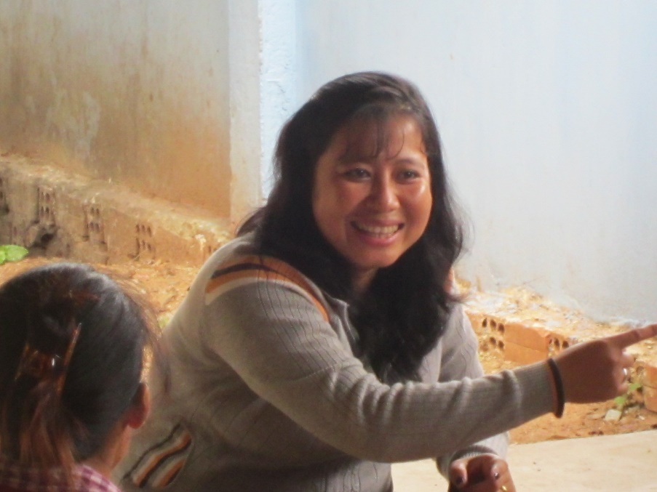
F. Attitudes of the staff
Firm love
Tender heart
Attentive ears

Slide 66
Project 5
Case Study 3 – The Heavy Metal Music

Slide 68

Lesson 5:
The Role of Staff in Discipline

Slide 69
Key Truth:
Teen Challenge staff must demonstrate God's character in the context of discipline.
Key Verses:
Ephesians 4:15 NIV
Instead, speaking the truth in love, we will in all things grow up into him who is the Head, that is, Christ.
1 Corinthians 11:1 NIV
Follow my example, as I follow the example of Christ.

Slide 70
Before we look at
the methods of discipline
we need to look at
the messengers of discipline.

Slide 71
Key areas in the life of the staff
A. Understanding authority
B. The self image of the staff
C. Avoiding the wrong kind of help
D. Understanding cultural differences
E. Communicating with Godly love

Slide 72
A. Understanding authority
The Jesus Style of authority
God commands parents to discipline their children
Leadership by example
1 Corinthians 11:1
Walk in truth
Obey at levels 2 & 3

Slide 73
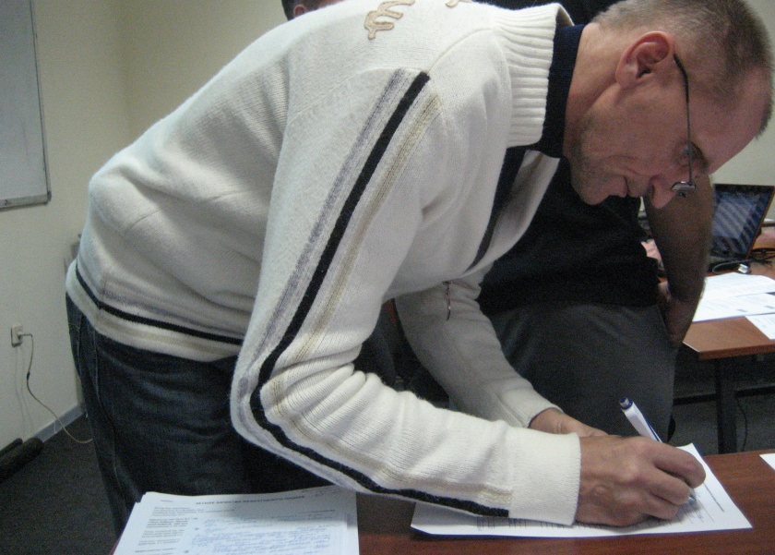
B. The self image of the staff
Do you need to be needed?
Power & a weak self image
The RIGHT to be respected

Slide 74

C. Avoiding the wrong kind of help

Slide 75
1. Enabling
Anything that stands in the way of persons experiencing the natural consequences of their own behavior. Galatians 6:7-8
When helping harms the one you love.

Slide 76
1. Enabling
Rescuing people from their responsibilities and/or consequences.
Giving the person permission to stay sick, and continue with their inappropriate behavior.

Slide 77
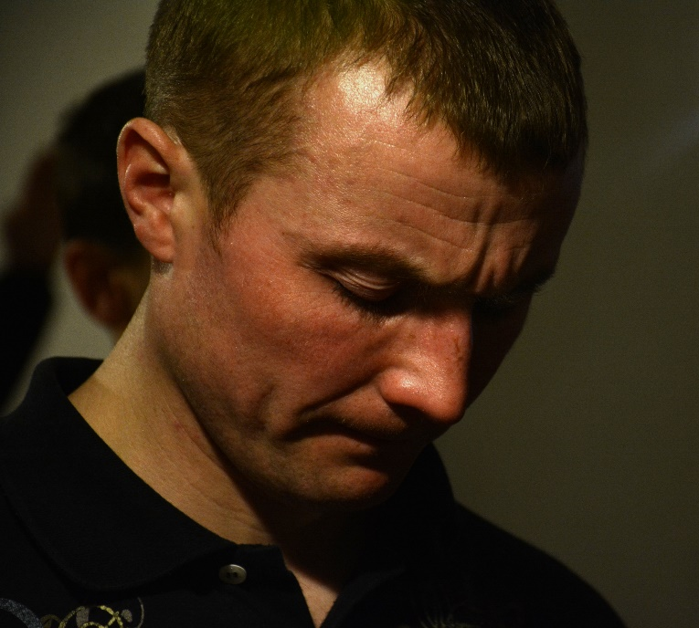
2. Confronting Conflict
We are most useful in confronting conflict when we are not so much trying to change another person as we are trying to help them see themselves more accurately.

Slide 78

D. Understanding cultural differences

Slide 79
E. Communicating with Godly love
1 Peter 4:8
Colossians 4:6
Ephesians 4:15

Slide 80
Project 6
Case Study 4: Kitchen Crew Chief
Question 2
What are the two issues that face the staff as a result of the student's actions and words?

Slide 82
Lesson 6
TC Standards & Policies for Discipline

Slide 83
Key Truth:
Discipline in the TC program is only done within the context of approved policies and procedures.
Key Verse:
2 Timothy 4:5 NIV
But you, keep your head in all situations, endure hardship, . . . discharge all the duties of your ministry.

Slide 84
3 Steps for Standards and Policies
Teen Challenge Accreditation Standards
Local TC Policies & Procedures
How staff implement these policies & procedures

Slide 85
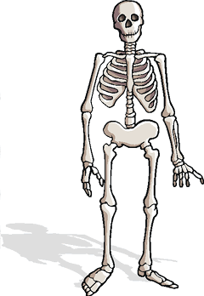
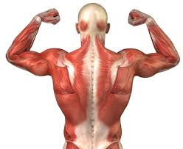
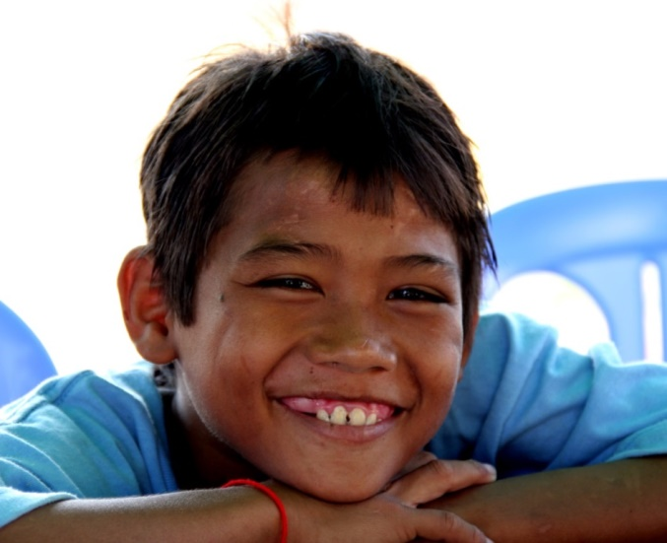
Skeleton
Written Policies & procedures
Muscles/organs
Program activities
Life
God at work in our ministry

Slide 86

Step 1
National Accreditation Standards
These standards provide a list of the important policies that a local Teen Challenge needs to have for their ministry.

Slide 87

Step 2
TC Policies & Procedures
Each local Teen Challenge needs to have a policies & procedures manual which lists the policies staff are to use
in all areas of their ministry. This would include:
The list of rules given to the students.
Policies for the staff on disciplining students
Documenting discipline given to students.

Slide 88
Step 3
Implementing discipline policies
We need to depend on the Holy Spirit to guide us in this process so we can help our students achieve all that God desires for them.

Slide 89


Slide 90
Step 2
Policies and Procedures Manual
Documenting discipline given to students
Policies on discipline

Slide 91
Step 3
Implementing discipline policies

Slide 92
Sample Student Discipline Report
In Student Manual
Instructions for staff -- pages 47-48
Sample discipline report -- pages 45-46

Slide 93
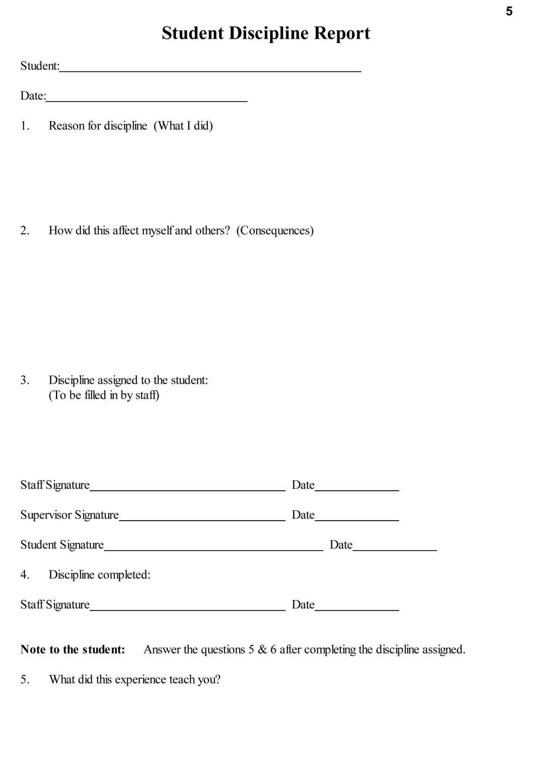
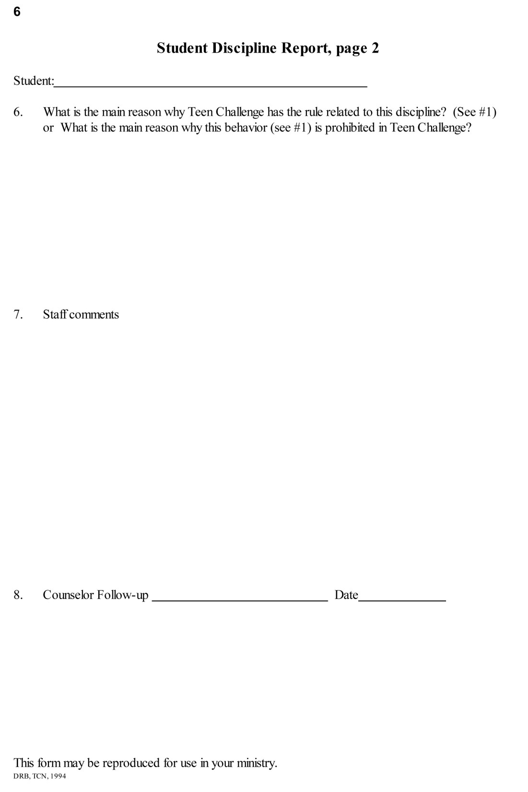

Slide 94
Project 7
Case study #5: The Laundry Lie
Question 1: If you were the staff who caught Jill doing her laundry, what would you do?
Question 2: If you were the program director, what would you do once you found out from the other two staff what Jill had done?

Slide 95
Case study #5: The Laundry Lie
Discipline assigned Jill
1. She was assigned 3 hours of extra work detail--one hour for each staff involved in this case. She had to wash the van inside and out and do yard work for the rest of the time.
2. She had to memorize several verses related to lying and manipulation.
3. On her next scheduled day to do her laundry, she was not allowed to use the washer or dryer, but had to do her laundry by hand.

Slide 97
Lesson 7
Interview with Teen Challenge Program Director

Slide 99
Lesson 8
Methods of Discipline

Slide 100
Key Truth:
With the Lord's help, we need to find the most appropriate discipline for each student.
Key Verse:
Hebrews 12:11 (NIV)
No discipline seems pleasant at the time,
but painful. Later on, however, it produces a harvest of righteousness and peace for those who have been trained by it.

Slide 101
A major concern for all staff
What is the intent behind the discipline?
How will this discipline help this student develop the godly attitudes and behaviors of a growing Christian?

Slide 102
Project 8: Assigning Discipline
Discipline situation #___
How would you discipline?

Slide 103

A. Methods of Discipline
1. Counseling
2. Educational Projects
3. Loss of Privileges
4. Work Detail
5. Major violations

Slide 104

1. Counseling

Slide 105
2. Educational Projects
a. Scripture study
b. Character Qualities study
c. Book study projects
d. Special written projects

Slide 106
3. Loss of Privileges
--phone calls
--visits from family
--mail
--recreation
--shopping trips
--passes
--free time

Slide 107
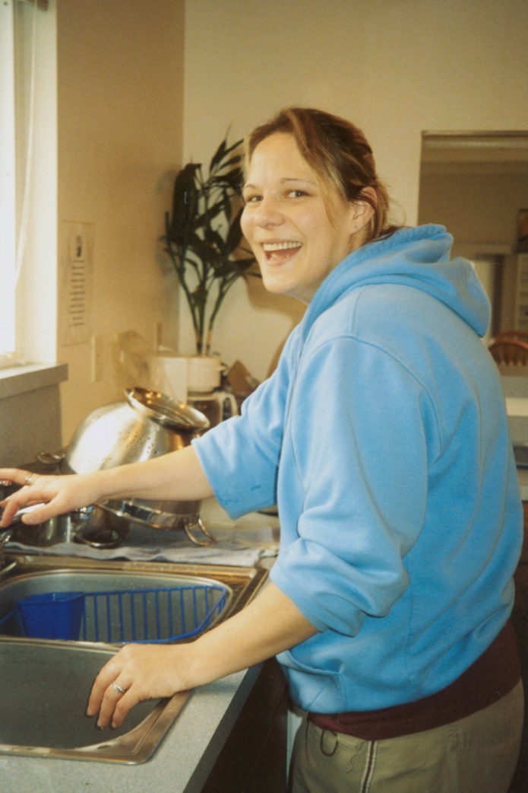
4. Work assignments for discipline

Slide 108
5. Major violations
Probation
Extend time in the program
Start the program over again
Suspension
Dismissal from the program
Transfer to another program

Slide 109

B. Prohibited Disciplinary Procedures
1. No demeaning language
2. No physical contact
3. No lock-downs
4. Do not discipline in public
5. No food deprivation
6. No excessive discipline

Slide 110
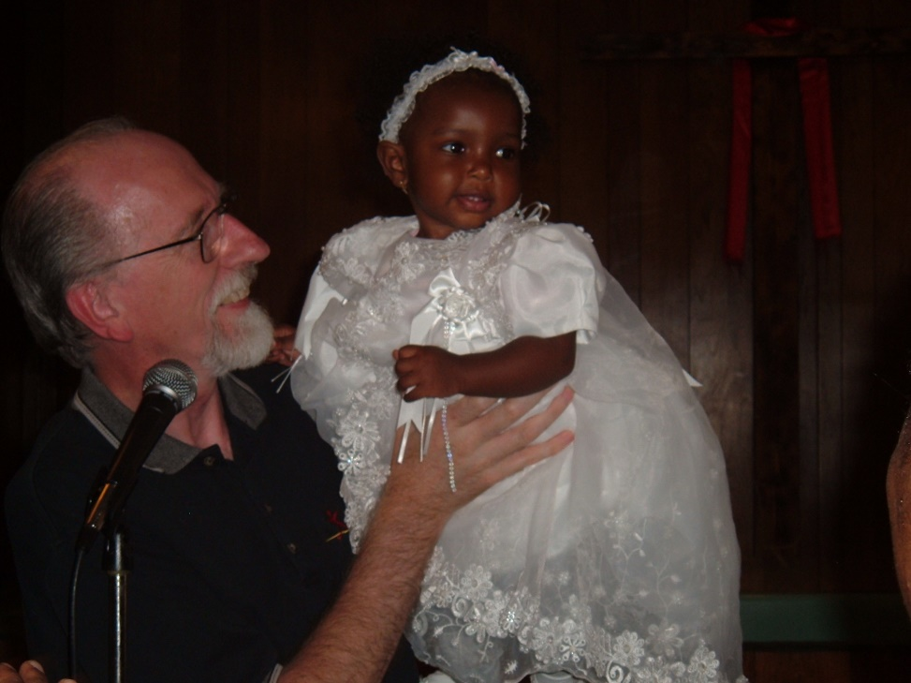
C. Dismissal process
Sometimes there is a family that will be affected by your decision.

Slide 111

Project 9
Case study #6: The Confession

Slide 113
Lesson 9
Making Discipline Effective

Slide 114
Key Truth
Staff must respond in discipline with godly attitudes to help make the discipline effective.
Key Verse:
1 Peter 3:9 (NIV)
Do not repay evil with evil or insult with insult, but with blessing, because to this you were called so that you may inherit a blessing.

Slide 115
A. How to assign appropriate discipline

Slide 116
A. How to assign appropriate discipline
Follow the policies and procedures of the TC center where you work
Ask God for guidance before assigning the discipline
Take time to get to know the student personally
Do not threaten students

Slide 117
Seek to find balance in your discipline
Offer your student a choice
between two disciplines
Tie your discipline to personal character development

Slide 118
Teen Challenge values
Integrity
Honesty
Kindness
Consideration
Sobriety
Diligence
Humility
Responsibility
Respect
Morality
Gratitude
Accountability
Teachable
Cleanliness
Discretion
Source: Teen Challenge North Central Indiana

Slide 119
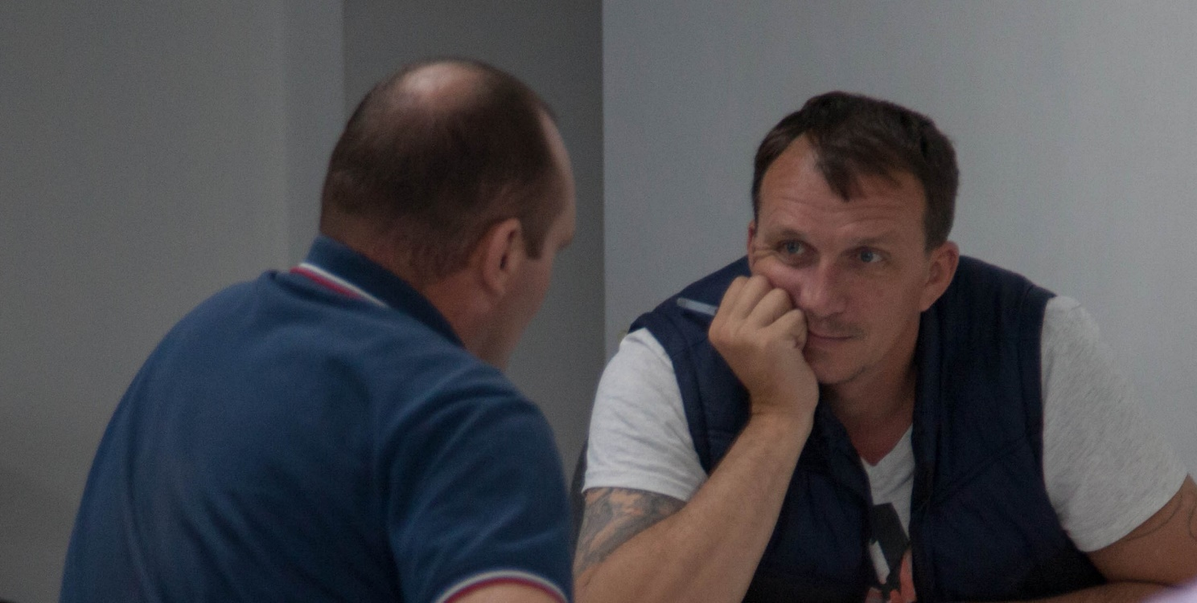
Follow through on the assigned discipline

Slide 121
B. Show love & concern
How can staff show they love the students?
How can staff show they care about the students?

Slide 122
C. Avoid favoritism
How do staff show favoritism to students?
How does the perception of favoritism affect the student's response to discipline?

Slide 123
D. Stay calm during a problem
How easy is it for you right now in life to take disrespectful comments or unjustified criticism?
Proverbs 15:1

Slide 124
E. Be aware you are dealing with difficult people
F. Patience vs. frustration
What situations related to discipline do you think would be most frustrating to you?

Slide 125
G. Confronting conflict
H. Making mercy (grace) an important part of your program.
--Peter walking on the water
--Old Testament Year of Jubilee

Slide 127
Chapter 10
Special Situations in Discipline

Slide 128
Key Truth
Staff need to learn how to rely on the Holy Spirit to direct you when handling discipline situations.
Key Verse:
James 1:5 (NLT)
If you need wisdom, ask our generous God, and he will give it to you. He will not rebuke you for asking.

Slide 129
Training for new staff
Confession vs. denial
Evidence gathering and assessment
Confidentiality

Slide 130
When do you call the police?
When do you discipline the whole program?
Disciplining a student with a background of abuse

Slide 131
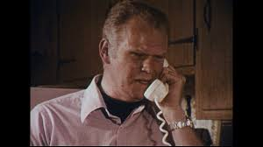
Project 11
Case study #7: The Telephone Call

Slide 132
Questions for discussion

Slide 133

Contact information
Global Teen Challenge
gtc@globaltc.org
www.GlobalTC.org
www.iTeenChallenge.org

