Slide 1

How to Handle Conflict
How to Confront Conflict
in a Caring Way
By Dave Batty

Slide 2
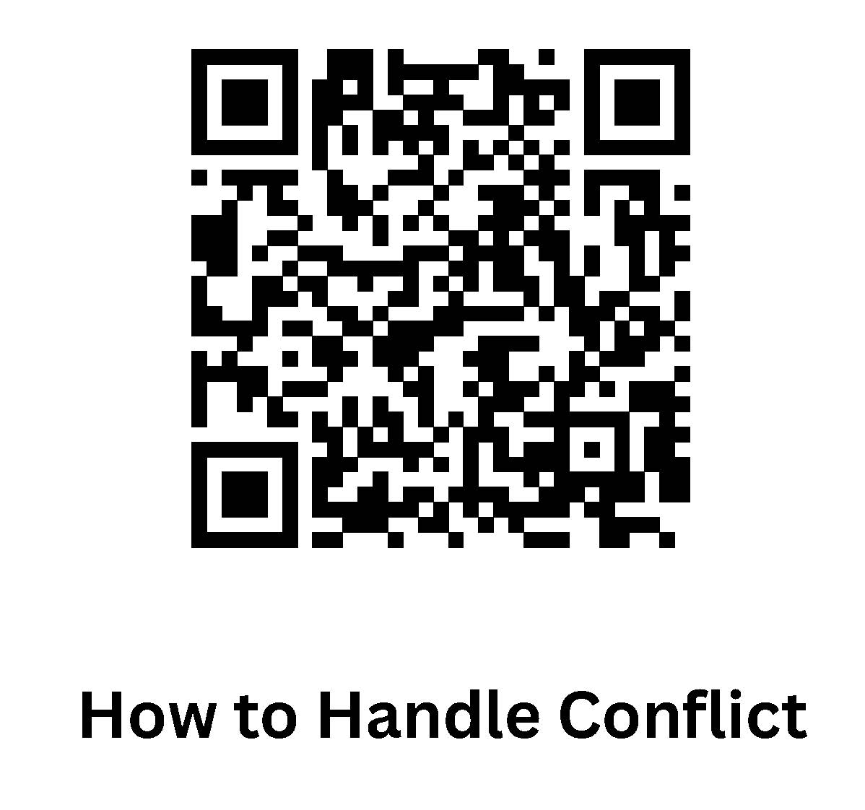
Notes and PowerPoint on iTeenChallenge.org

Slide 3
Three aspects of handling conflict
What is your attitude toward conflict?
What does the Bible say about conflict?
How do you respond to conflict?

Slide 4

How does conflict affect you?
Your life
Your family
Your work

Slide 5
Spiritual Gifts vs Personal Character
Spiritual gifts—God’s gifts to you
Personal character—your gift to God

Slide 7
Reacting or choosing my response?

Slide 8
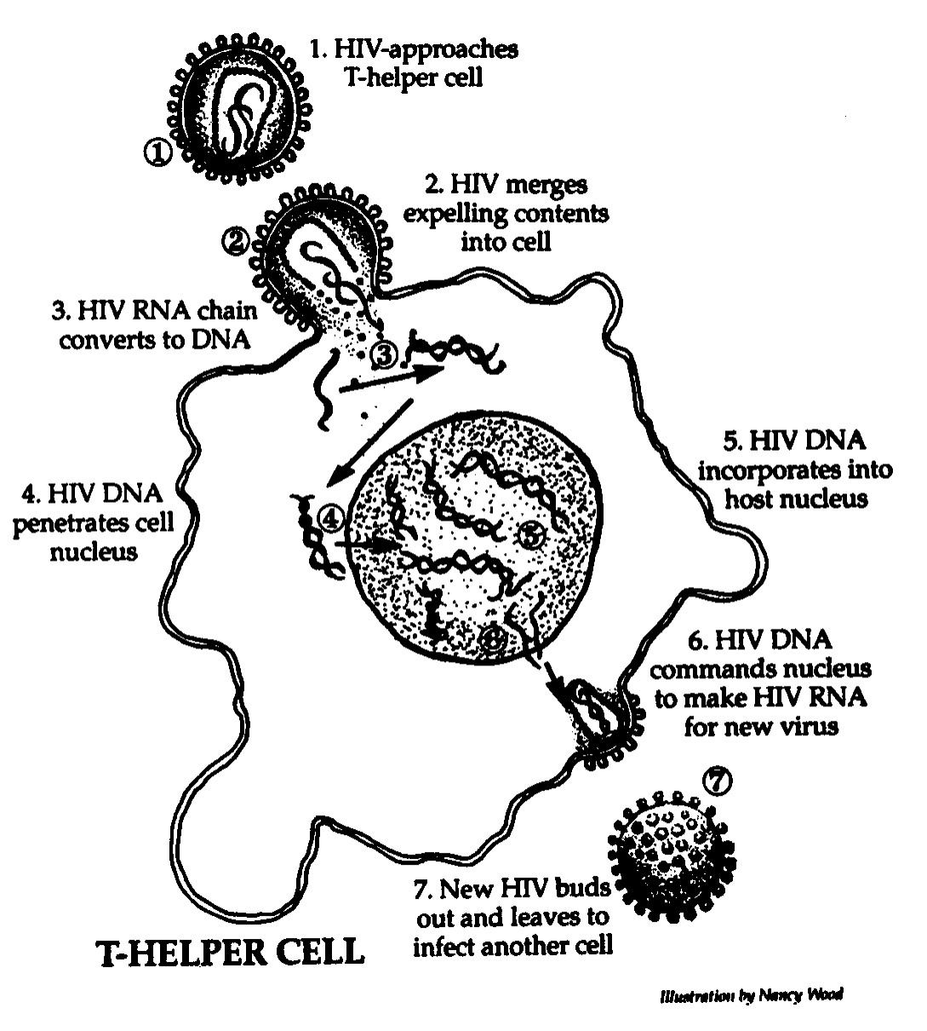
#4

Slide 9
Conflict in our lives
Problems
Issues Conflict
Disagreements

Slide 10
What causes conflict in families?
Cultural background vs God’s standard for living

Slide 11
The Myth of
Hidden Harmony
Deep down, we all agree. There is no conflict, only poor under-standing. If only we understand each other, we’ll agree.
—real cause —misunderstanding?
—real cause —real disagreement?

Slide 12
Key truth
We are most useful in confronting conflict when we are not so much trying to change another person as we are trying to help them see themselves more accurately.

Slide 13
What is your attitude toward conflict?
Conflict is not sin.
When someone causes conflict, they are not necessarily sinning.

Slide 14
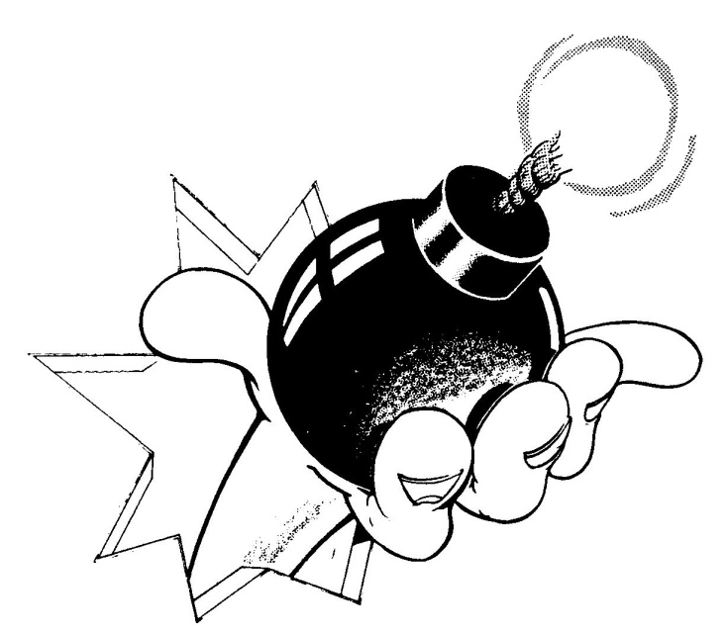
Conflict is Normal
Neutral
Natural
So Accept it!

Slide 15
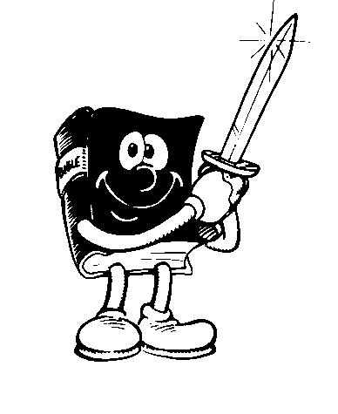
Learn how to accept conflict as a tool of God, not a trick of the devil.

Slide 16
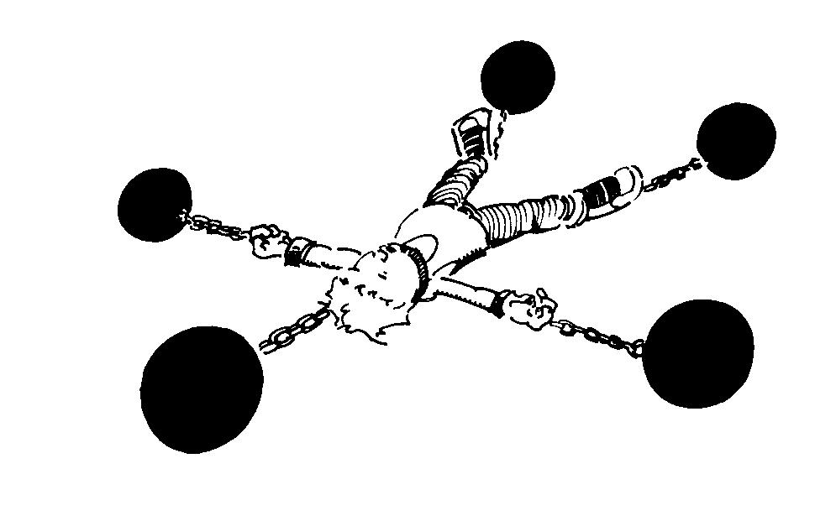
Conflict can be creative tension.

Slide 17
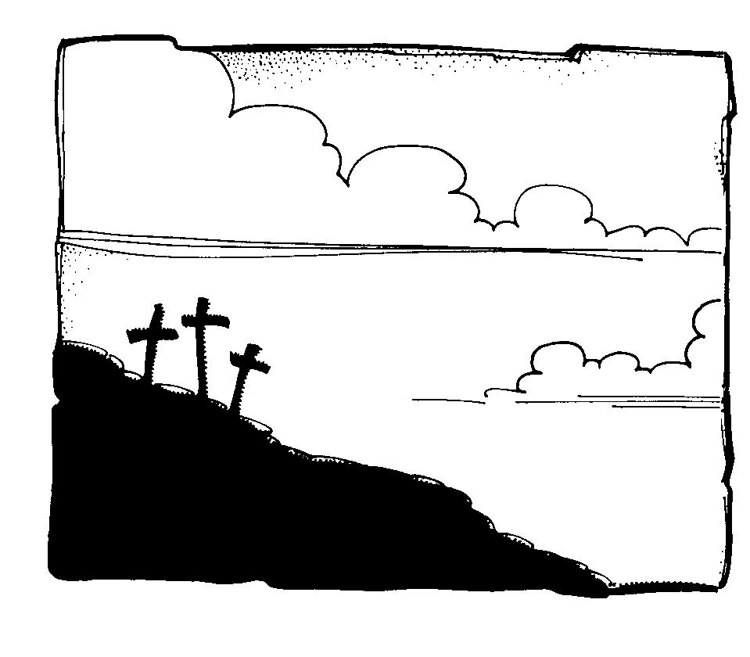
Conflict can lead all involved to a clearer understanding of the will of God and a more effective life.

Slide 18
A biblical approach to resolving conflict requires all parties involved to actively work for solutions that are filled with hope for all.

Slide 19
A. Three common causes of conflict
A struggle to understand God’s direction for the ministry.
Acts 10:9-11:18
Acts 15:1-35

Slide 20
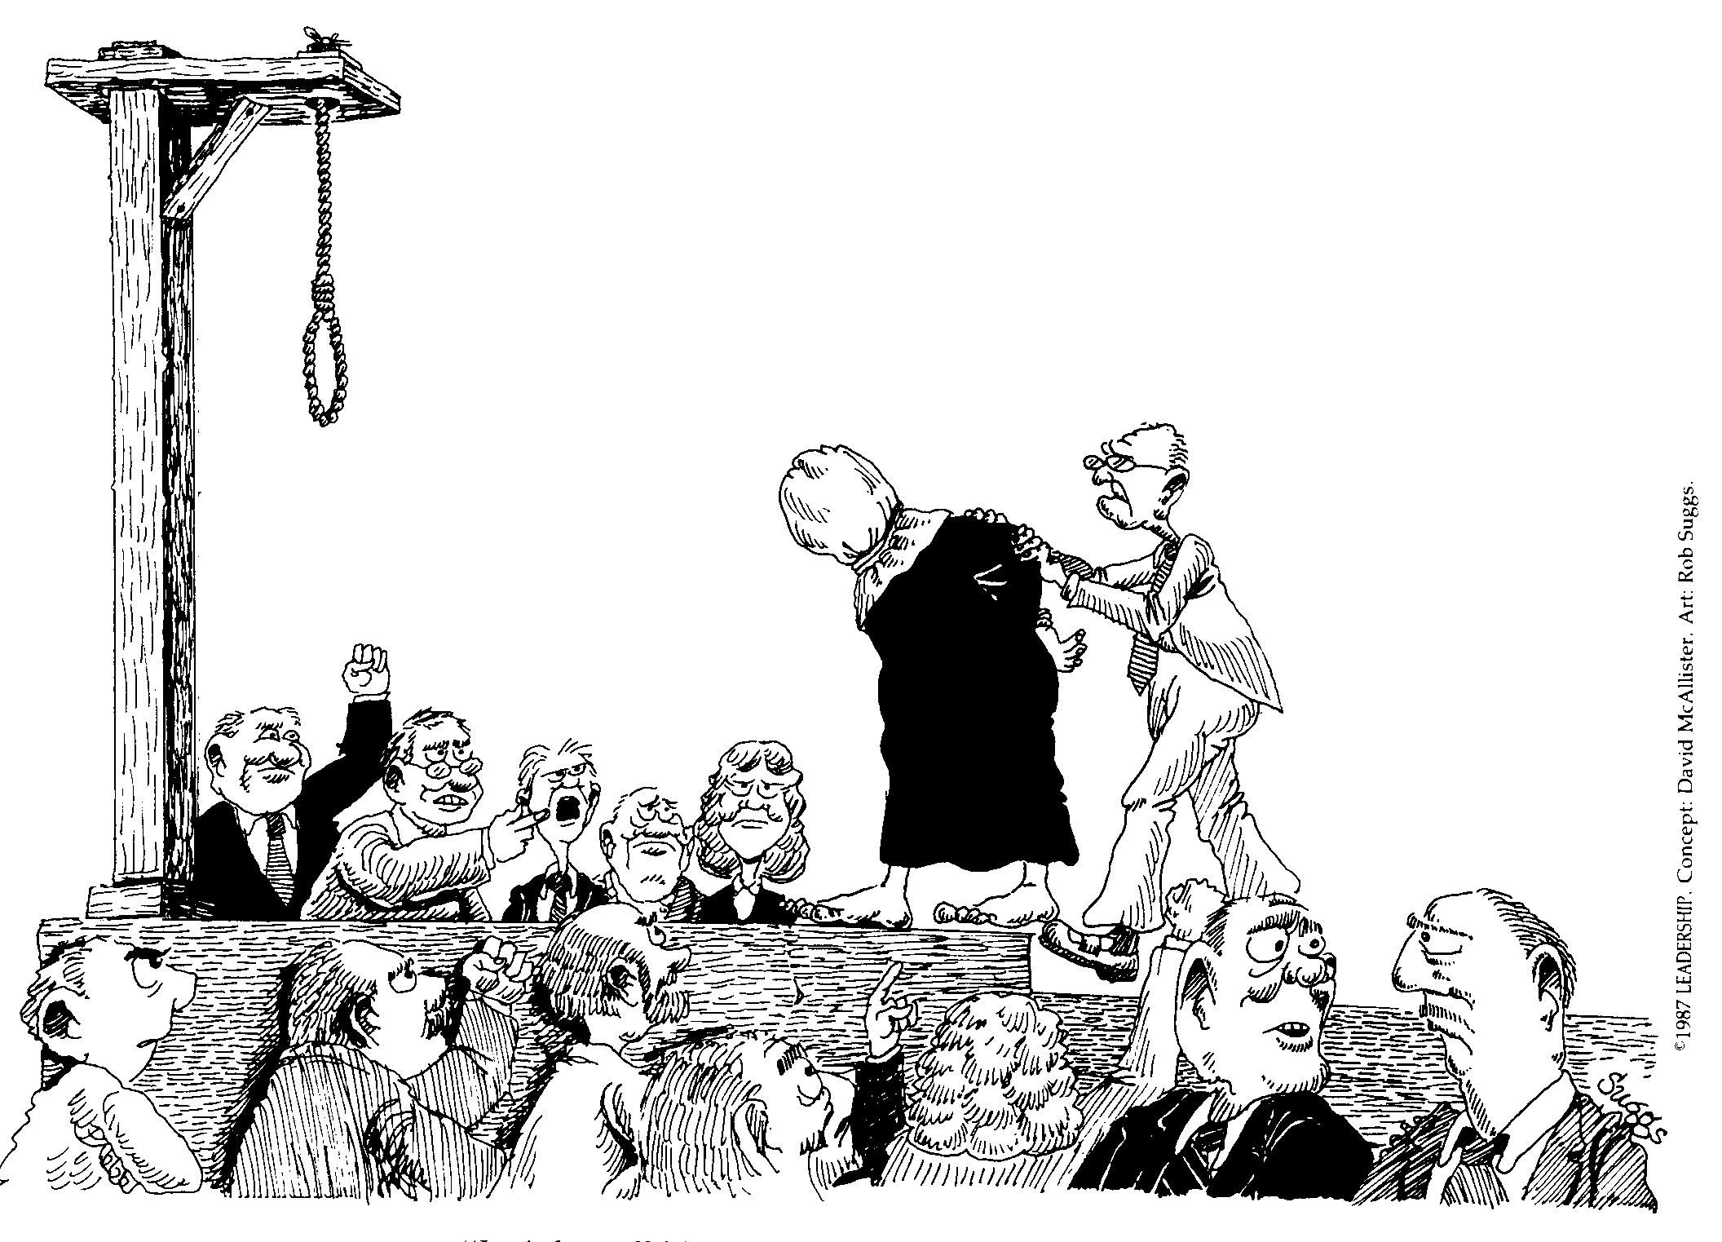
“I tried to tell him not to change to order of the Sunday morning service.”

Slide 21
Differences between persons.
Acts 15:36-41
1 Corinthians 1:10-12,
1 Corinthians 3:4 – 4:6
Sinful motives
2 Samuel 11
Matthew 21:12-16

Slide 22
B. Healthy areas where conflict occurs
Over purposes and goals.
Why are we here?
What will we do?
Over programs and methods .
How will we do it?
Who will do it? When?

Slide 23
Over values and traditions.
Any organization over
5 years old has
traditions

Slide 24
How do you respond to conflict?
How does your spouse respond to conflict?
How does your teen respond to conflict?
What are some of the typical ways people respond to conflict?

Slide 25
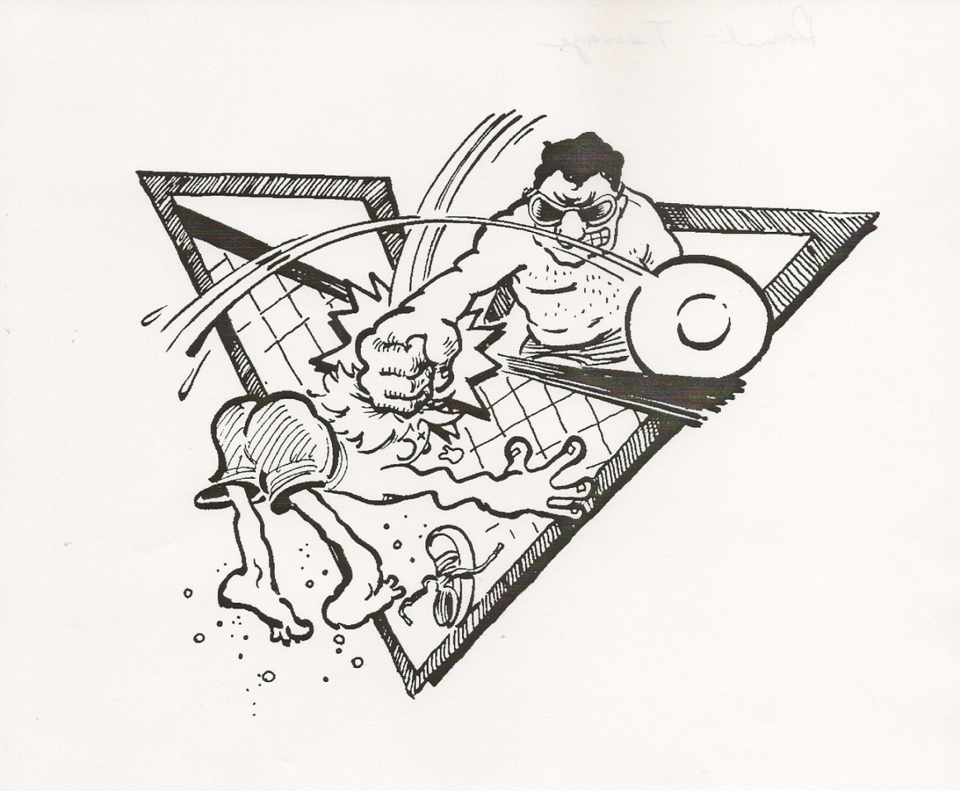
Five Options for Dealing with Conflict
1. Competing: I win—you lose

Slide 26
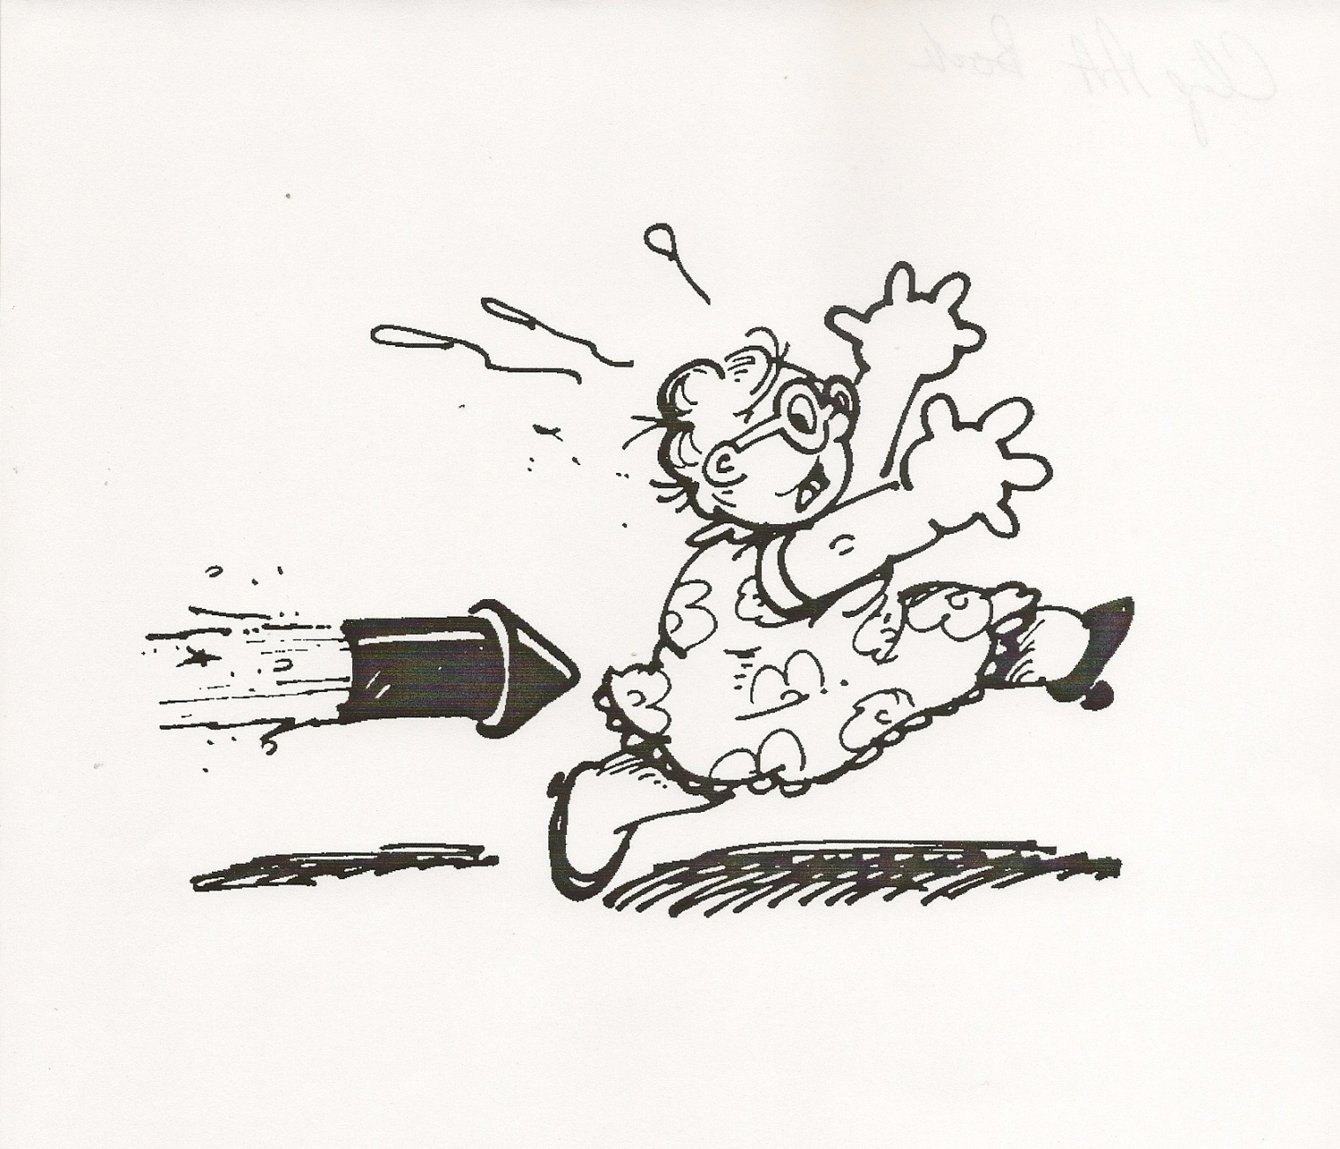
2. Avoiding: I want out

Slide 27
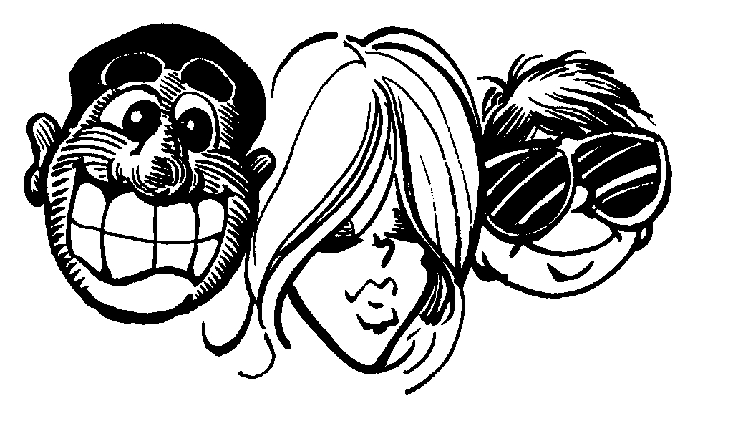
3. Accommodating
– I will give in for good relations

Slide 28
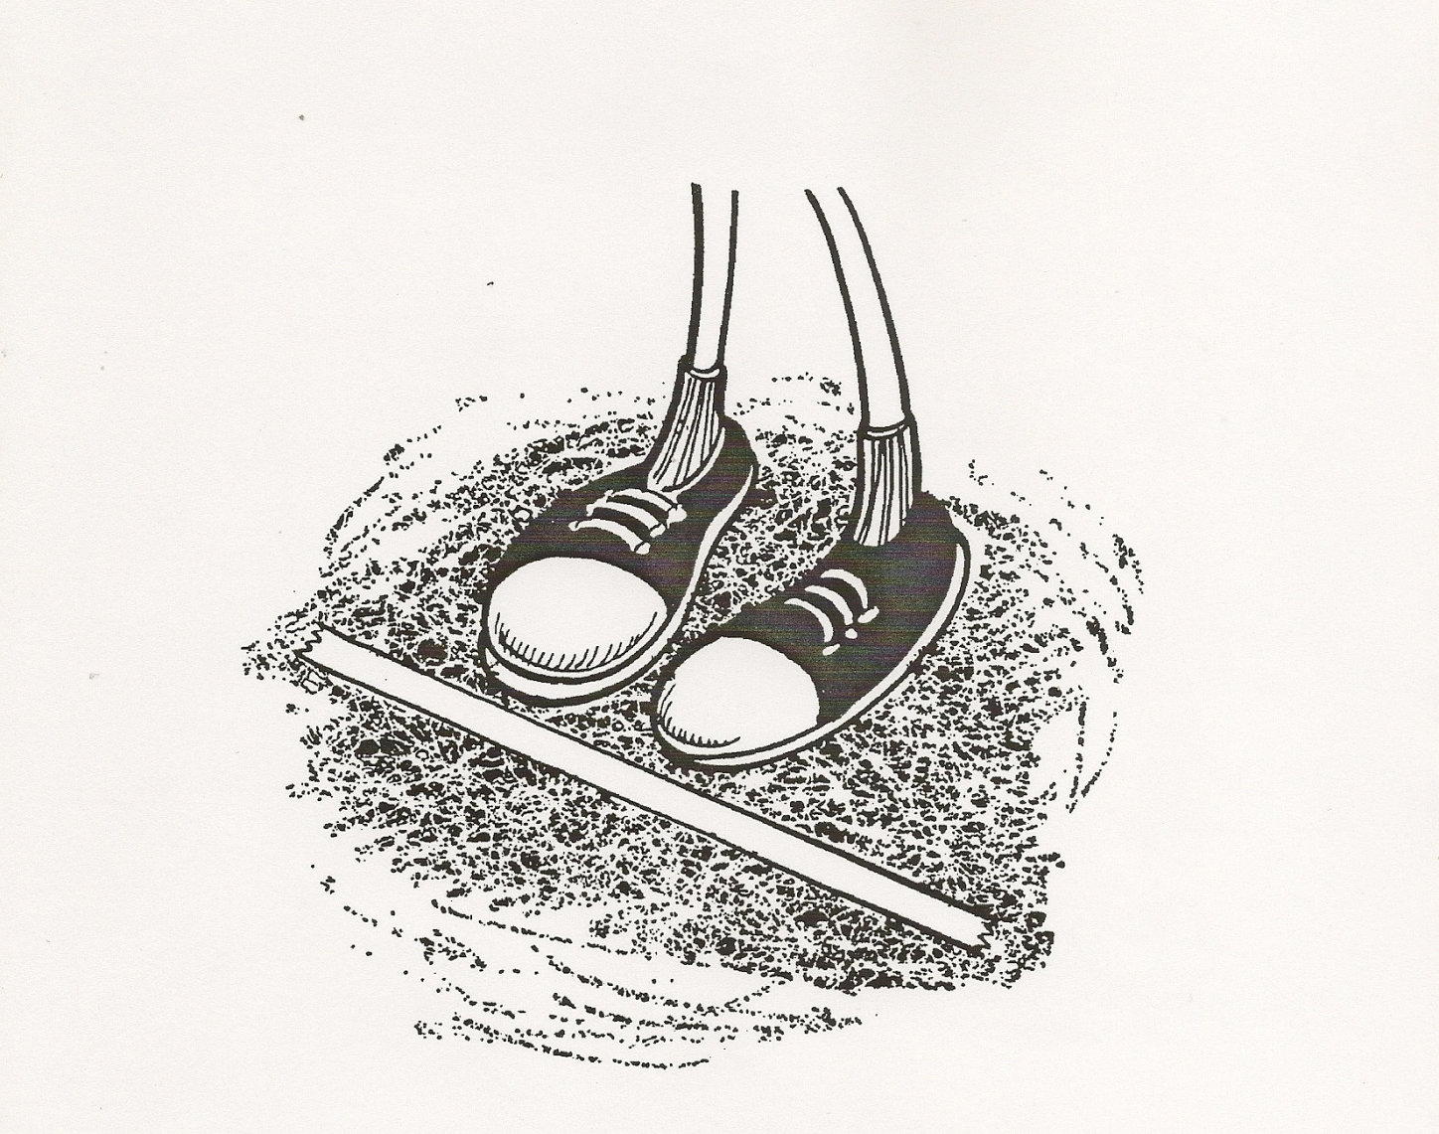
4. Compromising
– I will meet you half way

Slide 29
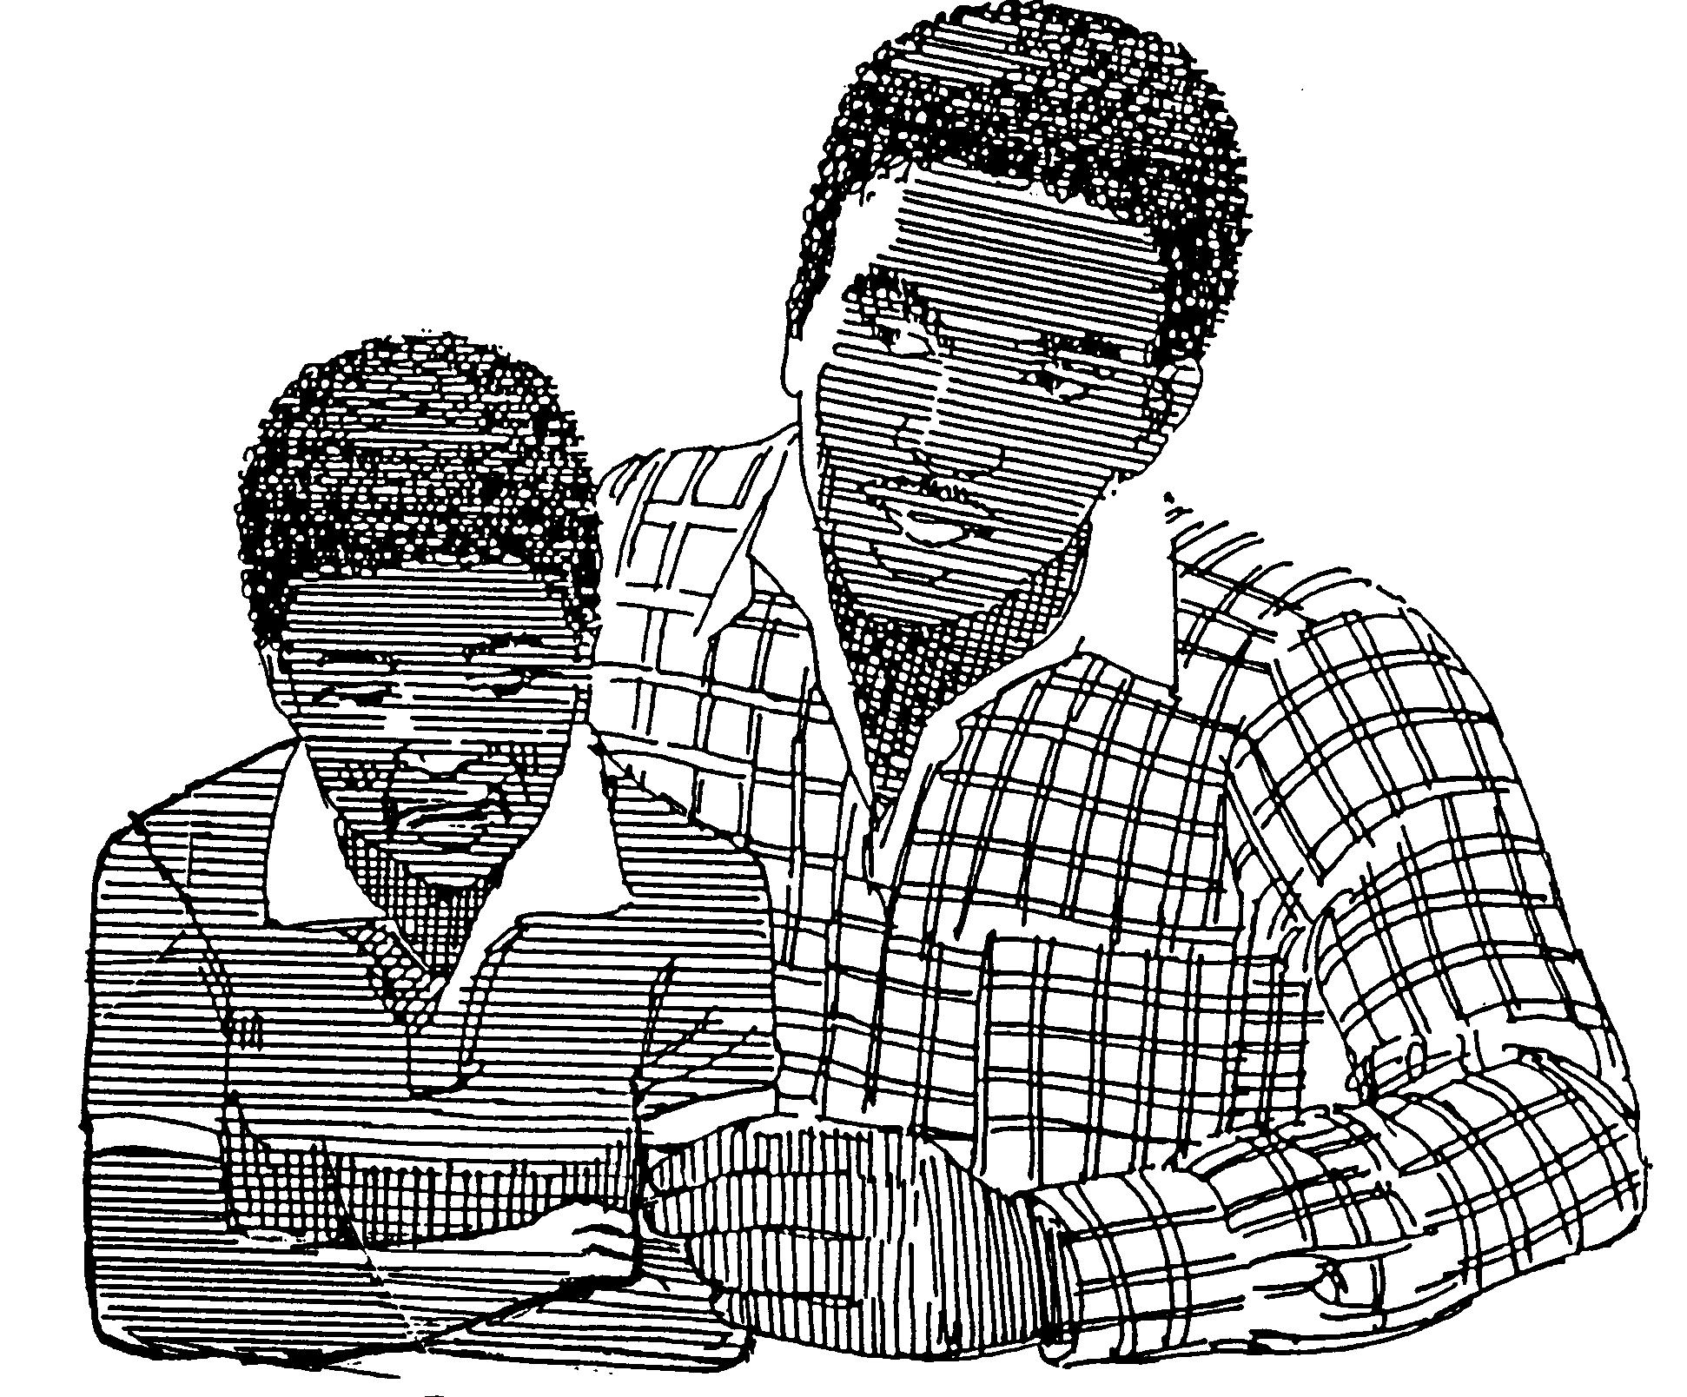
5. Collaborating
—I can care and confront

Slide 30
Key truth
We are most useful in confronting conflict when we are not so much trying to change another person as we are trying to help them see themselves more accurately.

Slide 31
Five Options for Dealing with Conflict
Competing: I win—you lose
Mark 3:1-6 Matthew 21:12-13
Avoiding: I want out, I’ll withdraw
John 6:1-15
Accommodating: I’ll give in for good relations Mark 5:1-20 John 4:1-38
Compromising: I’ll meet you halfway
Matthew 21:23-27
Collaborating: I can care and confront
John 8:1-11

Slide 32
Personal assessment of your past experiences with conflict

Slide 33
Your past experiences with conflict
____1. How big of a problem has conflict been in your life?
1=small problem 10=big problem
____2. Growing up as a child & teen, how often was conflict a part of your life?
1=conflict was rare 10=lots of conflict
____3. How much pain did conflict cause in your life?
1=little pain 10=lots of pain
____4. How much damage did conflict cause in your life?
1=very little damage 10=lots of damage

Slide 34
Some people use different conflict management styles at home than at work.
--or with those under their authority vs. peers and superiors.

Slide 35
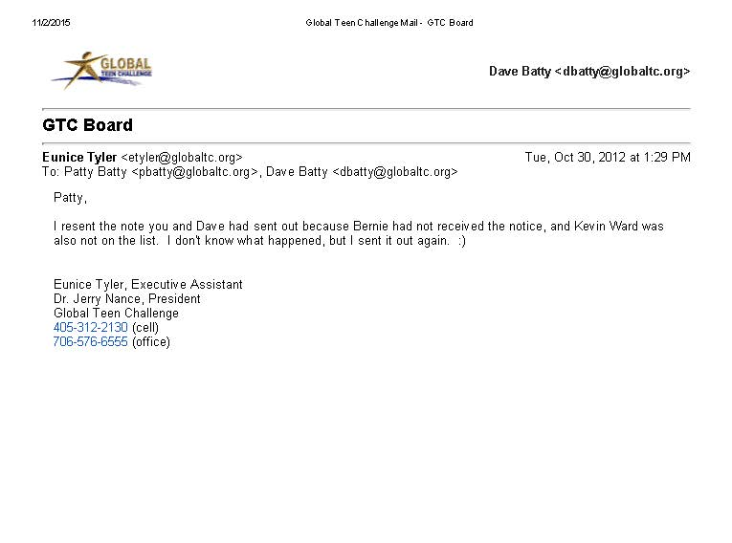

Slide 36
Patty,
I resent the note you and Dave had sent out because Bob had not received the notice, and Kevin was also not on the list.
I don't know what happened, but I sent it out again. :)

Slide 37
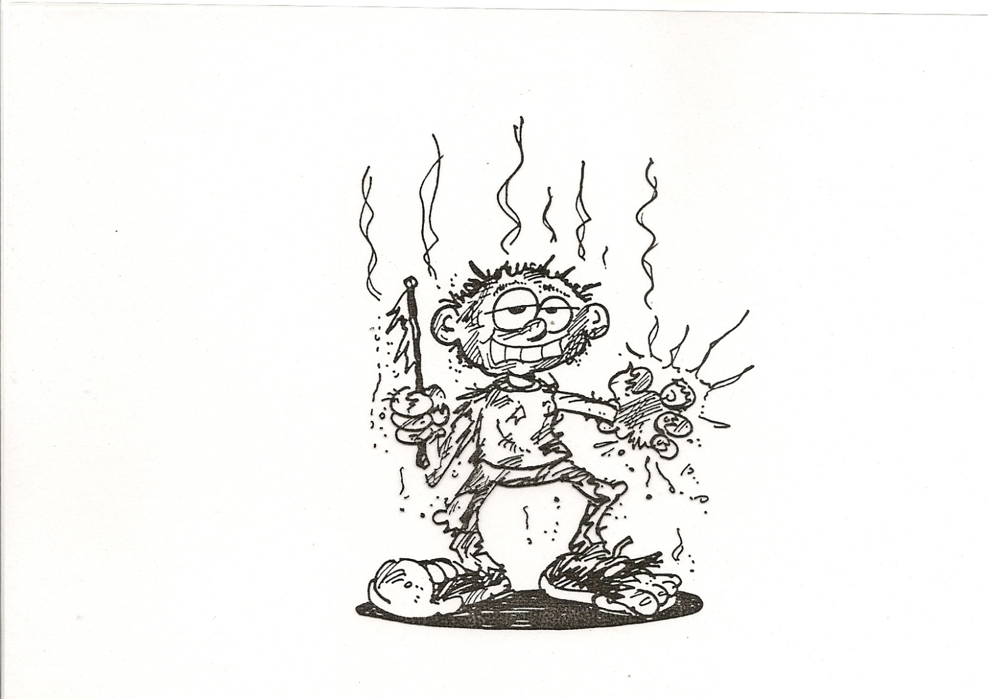
It can be dangerous to try to resolve a conflict with a person who uses the
“I win—you lose” approach.

Slide 38
#2

Slide 39
Basic tools for handling Conflict
“I” messages vs. “You” messages

Slide 40

B. What is your level of listening?

Slide 41
Level 1: Focused on myself
a. Internal
b. My thoughts
c. My judgments
d. My filters
e. How it relates to me
f. My interests
g. My agenda

Slide 42
Level 2: Focused on other person
a. Their feelings
b. Their thoughts
c. Their conclusions
d. Their filters
e. How it relates to the person I am listening to
f. Their interests

Slide 43
C. Ways of confronting conflict without being judgmental
Focus your feedback on actions, not the actor.
When you leave dirty clothes laying on the floor, I feel frustrated. Would you please put your dirty clothes in the basket in the closet.

Slide 44
C. Ways of confronting conflict without being judgmental
Focus your feedback on observations, not your conclusions.
You are not looking at me and not answering when I speak. Please give me both attention and answer.

Slide 45
C. Ways of confronting conflict without being judgmental
Focus your feedback on descriptions, not judgments.
Focus your feedback on ideas, information, and alternatives, not on advice and answers .

Slide 46
C. Ways of confronting conflict without being judgmental
Focus your feedback on what and how, not why .
What did you do?
How did it affect others?

Slide 47
Key truth
We are most useful in confronting conflict when we are not so much trying to change another person as we are trying to help them see themselves more accurately.

Slide 48
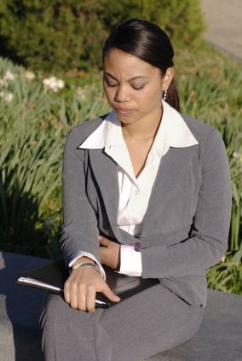
Where do I need to start in changing the way I respond to conflict?

Slide 51
Biblical view on blessing and cursing
God’s promise to Abraham
--Those who bless you, I will bless
--Those who curse you, I will curse
Teachings of Jesus on blessing and cursing
--Bless those who curse you
Luke 6:27-28

Slide 52
Second look at
Your attitude toward conflict
Embrace conflict
My eyes are toward growth
The essential need for respect

Slide 53
How abuse in your background affects how you handle conflict today
God values your life
God has harsh words for abusers
Matthew 18:6
Principle of safe boundaries
“Tough love”
Can you separate the truth from the lies?

Slide 54
7. How to respond to “Bullies”
Rudy Giuliani’s book Leadership has chapter on bullies
Some bullies are sweet and charming, but they are still bullies.
Only interested in what they want.
Issue of fear in dealing with bullies
Issues of revenge & forgiveness

Slide 55
Conflict
Healthy person vs. dysfunctional person
You-healthy vs s/he-healthy
You-healthy vs s/he-unhealthy
You-unhealthy vs s/he-healthy
You-unhealthy vs s/he-unhealthy

Slide 56
Unhealthy Healthy
Focuses on whose 1. Focuses on how we
fault is it. can solve things.
Blames others 2. Find acceptance
and love in your weaknesses and failures.
You need to change! 3. Take ownership of
your own failures.

Slide 57
Unhealthy Healthy
Makes excuses 4. Takes responsibility
for the situation.
I see myself as good 5. Give up on being
perfect & work hard to improve.
Denial 6. Honest—not taking
more or less. Only
taking the truth.

Slide 58
Unhealthy Healthy
I care about me 7. I care about you
The bully and me.

Slide 59
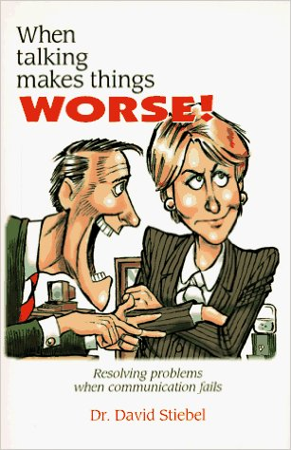

Slide 60
The Myth of
Hidden Harmony
Deep down, we all agree. There is no conflict, only poor under-standing. If only we understand each other, we will agree.
—real cause —misunderstanding?
—real cause —real disagreement?

Slide 61
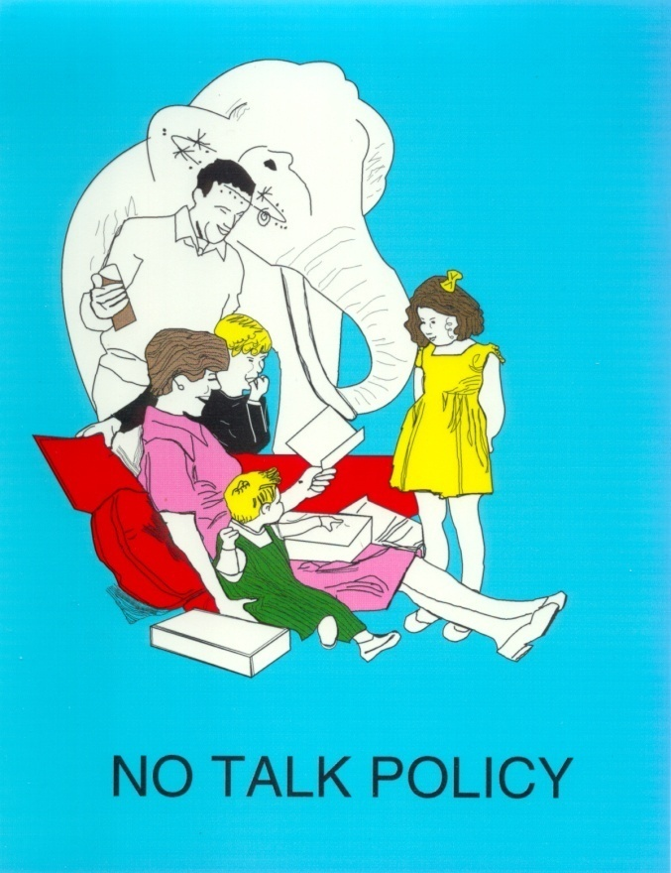
How to confront conflict in a productive manner
Are you ignoring the white elephant in your living room?

Slide 62
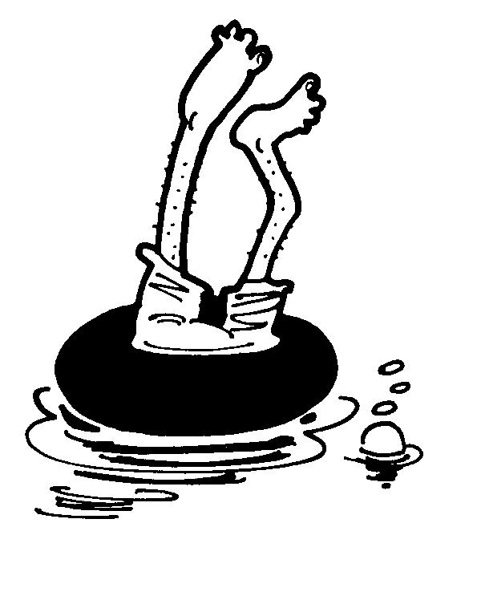
You get what you tolerate
If you do not confront conflict, and tolerate problems—that’s what you will get—more problems.

Slide 63
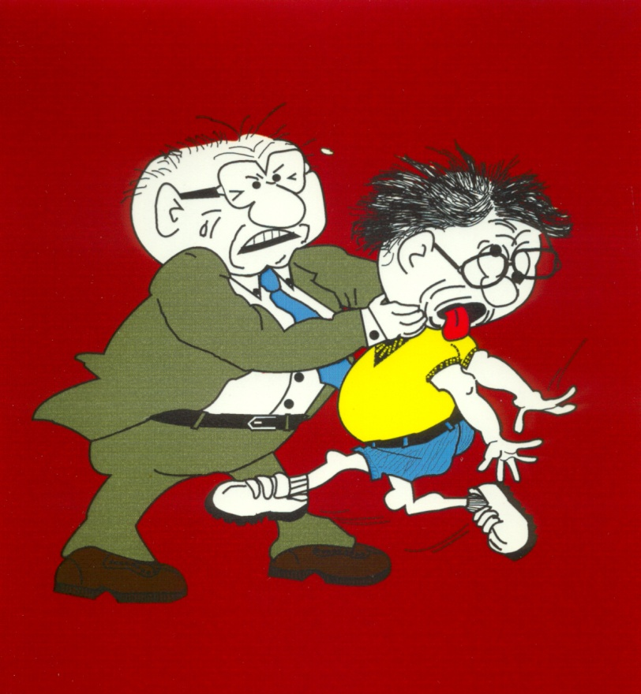
You can confront well or you can confront poorly.
If you fail to confront, you lose.
If you confront poorly, you also lose.

Slide 64
Confront in such a way as to preserve the relationship with the other person.
Stay connected with the person—conflict resolution is a process.
--solve the problem
--focus on healthy living
6. Forgiveness

Slide 65
Key truth
We are most useful in confronting conflict when we are not so much trying to change another person as we are trying to help them see themselves more accurately.

Slide 66
Where do I need to start in changing the way I respond to conflict?

Slide 67
Dbattytc@gmail.com
Text & WhatsApp: +1-706-536-5813
Web: www.iteenchallenge.org

