Slide 1
Compassion Fatigue
Cynthia Nicholson

Slide 2
Self-Assessment for Compassion Fatigue
Personal concerns commonly intrude on my professional role
My colleagues seem to lack understanding.
I find even small changes enormously draining.
I can't seem to recover quickly after association with trauma.
Association with trauma affects me very deeply.
My parishioners' stress affects me deeply.
I have lost my sense of hopefulness.
I feel vulnerable all the time.
I feel overwhelmed by unfinished personal business.

Slide 3
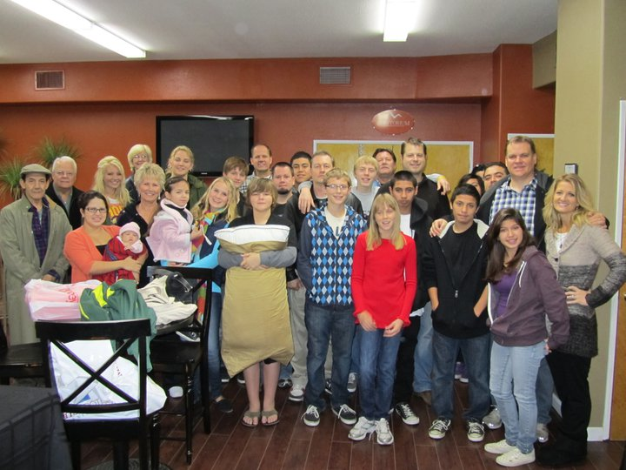
Our default wiring is to help

Slide 4
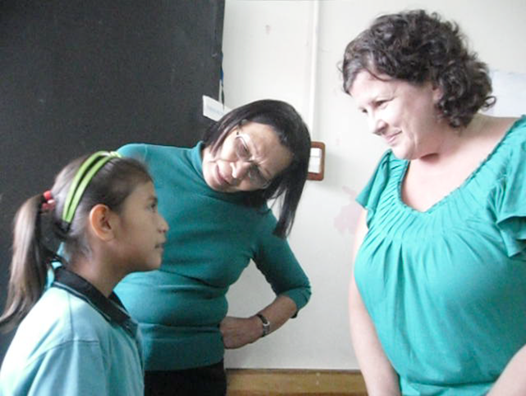
Ministers as Caregivers
Hurting people surround us

Slide 5
Compassion Fatigue
Definition: Compassion Fatigue is a state of exhaustion and dysfunction – biologically, psychologically, socially, and spiritually – as a result of working with victims of traumatic events. Prolonged exposure to someone else’s struggle results in PTSD-like symptoms in the caregiver.

Slide 7
Trauma, Posttraumatic Stress Disorder, and Secondary Traumatic Stress
Trauma
Definition
Reactions
Risk factors
Posttraumatic Stress Disorder (PTSD)
Factors
Secondary Traumatic Stress (STS), or Compassion Fatigue

Slide 8
Compassion Fatigue versus Burnout
Mixing of Terms: STS, Vicarious Traumatization, Burnout
Burnout defined
Compassion Fatigue’s Empathy factor

Slide 9
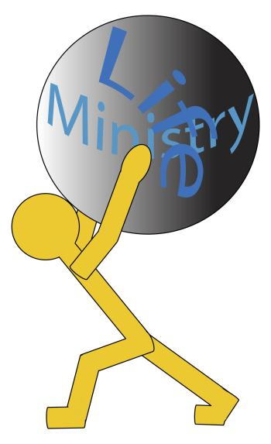
The Minister Distinctives
Characteristics of caregivers: Medical, Mental health, Social Workers, Clergy
Calling, Preparation, Foreign context
Field experience: uniqueness of life (family involvement, schedule, time off, expectations)
Vulnerable personalities

Slide 10
The Downward Spiral
“Tired me . . . poor me . . . shame on me . . . hate me . . . hate others . . . hate God for doing this to me.”

Slide 11
Recognition, Prevention, and Treatment
Recognition
Indicators and cognitive shifts
From dependence/trust → chronic suspicion
From safety → heightened sense of vulnerability
From power → sense of helplessness
From independence → loss of personal control and freedom
Others’ evaluation, intervention
Prior coping strategies

Slide 12
Recognition, Prevention, and Treatment
Prevention
1. Education and training
2. Self-Care practices build resilience
3. Establish boundaries
4. Social support

Slide 13
7 Components of Resilience
Insight - asking tough questions and giving honest answers.
Independence - distancing emotionally and physically from the sources of trouble in one's life.
Relationships - making fulfilling connections to other people.
Initiative - taking charge of problems.
Creativity - using imagination and expressing oneself in art forms.
Humor - finding the comic in the tragic.
Morality – acting on the basis of informed conscience

Slide 14
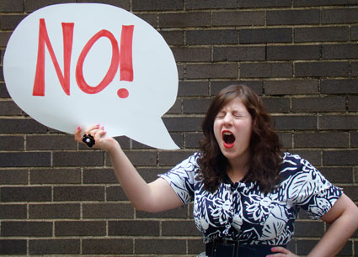
Recognition, Prevention, and Treatment
Treatment
Proactive steps:
Learn to say “no”
Personal mission statement
Healing Activities
Do’s
Don’ts

Slide 15
Do:
Relax and rest
Eat nutritiously (avoid sugar)
Get more than enough sleep
Talk about what happened (to God and others)
Write about what happened (journaling, letters, emails)
Laugh when you can
Set small goals
Keep some sort of routine
If safe, stay in familiar environment
Spend time with those who are supportive and helpful
Cry if you can
Pray, reflect in the Word
Sing or listen to music
Educate yourself about traumatic reactions
Know that the intensity of the pain will not last forever
Anticipate difficult times to come
Search and find perspective and meaning in the event
Ask for help and let others help you

Slide 16
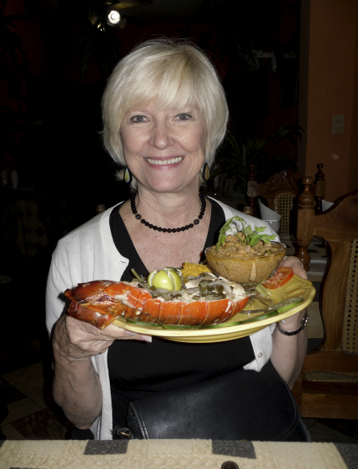
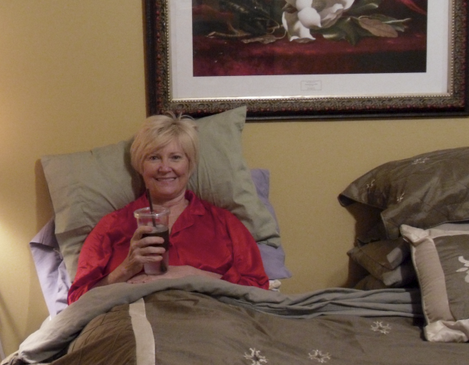
Do:
1. Relax and rest
2. Eat nutritiously (avoid sugar)
3. Get more than enough sleep

Slide 17
Do:
4. Talk about what happened (to God and others)
5. Write about what happened (journaling, letters, emails)
6. Laugh when you can

Slide 18
Do:
7.Set small goals
8. Keep some sort of routine
9. Exercise

Slide 19
Do:
10. Spend time with those who are supportive and helpful
11. Cry if you can
12. Pray, reflect in the Word

Slide 20
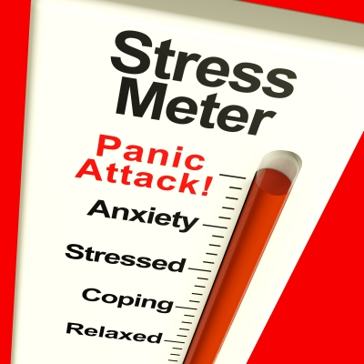
Do:
13. Sing or listen to music
14. Educate yourself about traumatic reactions
15. Know that the intensity of the pain will not last forever

Slide 21
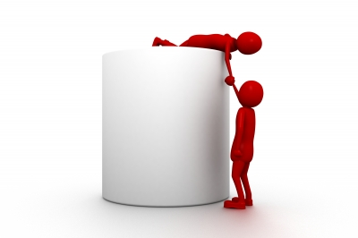
Do:
16.Anticipate difficult times to come
17. Search and find perspective and meaning in the event
18. Ask for help and let others help you

Slide 22
Don’t
Don’t make big decisions
Don’t look for a new job, buy a new car, get a divorce or have an affair.
Don’t blame others (being adversarial will only exhaust you further)
Don’t spend your energy complaining (avoid commiserating with discontented colleagues).
Don’t work harder and longer
Don’t try a quick fix (CF can make you vulnerable to addictive behaviors and substance abuse).

Slide 23
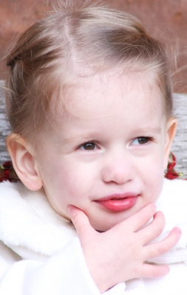
Don’t
1. Don’t make big decisions

Slide 24
Don’t:
2. Don’t look for a new job, buy a new car, get a divorce or have an affair.

Slide 25
Don’t
3. Don’t blame others (being adversarial will only exhaust you further)

Slide 26
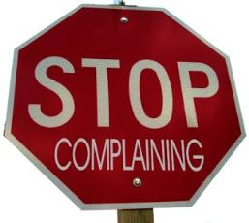
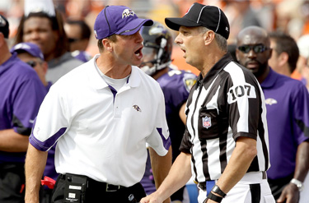
Don’t:
4. Don’t spend your energy complaining (avoid commiserating with discontented colleagues).

Slide 27
Don’t:
5. Don’t work harder and longer

Slide 28
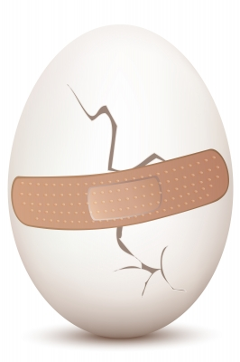
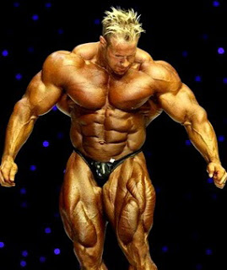
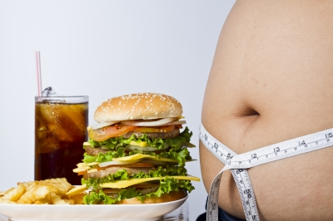
Don’t:
6. Don’t try a quick fix (CF can make you vulnerable to addictive behaviors and substance abuse).

Slide 29
Systems Involvement
What the organization can do:
Realistic work schedules
Unrealistic expectations with too little support
Inadequate or abusive supervision
Responsibility without authority
Lack of positive feedback
Limited incentives for rewards

Slide 30
Functions of Support Systems
Active listening
Acknowledgement of good work
Training (conferences, workshops)
Emotional support (accountability partners, prayer, retreats, counselors)
Reality testing (objectives, expectations, feedback)

Slide 31
Organizational factors that help members cope with work stress
Staff-client ratios
Limit hours of stressful work
balance with pleasurable assignments
rotate stressful jobs)
Offer training
Provide positive and constructive feedback
Extrinsic rewards: benefits and perks
Intrinsic rewards: appreciation and recognition

Slide 32
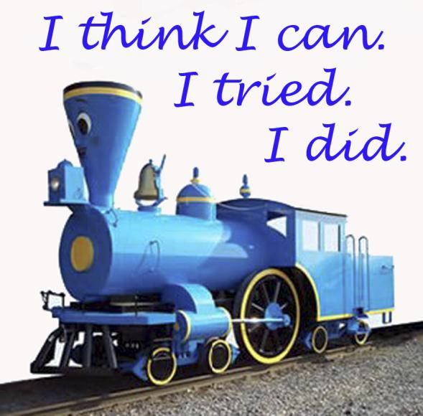
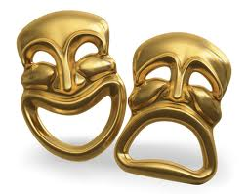
Post Traumatic Growth
Recovered survivors of trauma can find themselves stronger than before.
Positive psychological changes
Paradoxes

Slide 33
The Serenity Prayer
God grant me the serenity to accept the things I cannot change; courage to change the things I can; and wisdom to know the difference.
(Reinhold Niebuhr)

Slide 34
Conclusion
Compassion is not ours; it emanates from God through us. It is renewable!
“God’s compassions fail not. They are new every morning.”
Lamentations 3:22, 23

Slide 35
Additional resources for this teaching are available at iteenchallenge.org course # T313.01

