Slide 1
Christian Practices

Slide 2
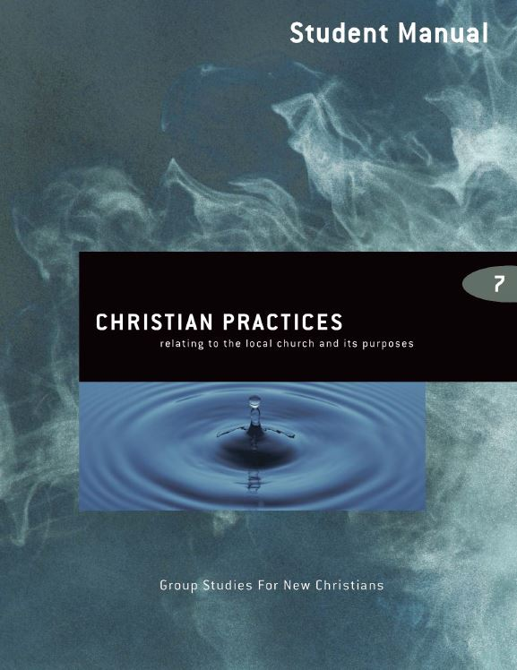
Christian Practices 5th edition By Dave Batty
This PowerPoint is designed to be used with the Group Studies for New Christians Course, Christian Practices, by Dave Batty.
Other Materials available include:
Teacher's Manual
Student Manual
Study Guide
Exam
Course Certificate
For Information on obtaining these materials see iteenchallenge.org

Slide 3
Christian Practices
Quizzes: Verses to Memorize To be done with:
1. Ephesians 4:29 Lesson 2
2. 2 Corinthians 9:7 New Life Bible Lesson 3
3. Colossians 3:23 Lesson 4
Study Guide Projects:
Project # To be done before or with:
1 Lesson 1
2 Lesson 3
3 Lesson 3
4 Lesson 4
5 Lesson 4
6 Lesson 5
Test: Lesson 7

Slide 4
The Local Church
Chapter 1

Slide 5
The Local Church
Key Biblical Truth
I can enjoy church by getting involved in sharing with the people at the church.
Key Verse: Ephesians 4:16 (New Life Bible)
“Christ has put each part of the Church in its right place. Each part helps other parts. This is what is needed to keep the whole body together. In this way, the whole body grows strong in love.”

Slide 6
Introduction – Lesson Warm-up
Share your very first memory of going inside a church. You may have been raised in a family that regularly attended church.
How many of you became a Christian as a teenager or an adult? What are your memories of church before you became a Christian?

Slide 7
A. What Does the Word “Church” Mean?
Modern definitions.
A building.
A congregation, a group of people who share similar beliefs and meet together on a regular basis.
A denomination. Some examples are Roman Catholics and Lutherans.

Slide 8
What Does the Word “Church” Mean?
Modern definitions.
All Christians in the world.
A religious service.

Slide 9
What Does the Word “Church” Mean?
Church in the Bible.
All the Christians in the world.
A congregation, a group of people who share similar beliefs and meet on a regular basis.

Slide 10
A. What Does the Word “Church” Mean?
Bible pictures of the church.
A building – with Christ as the foundation.
A body – with Christ as the head.
A bride – with Christ as the husband.

Slide 11
Why Do We Have the Local Church?
To help Christians grow stronger spiritually.
To share Christ with those who are not Christians.

Slide 12
How Can I Enjoy Church?
If you can begin doing the following four things in your local church, you may find it easy to enjoy church.

Slide 13
C. How Can I Enjoy Church?
We come together for fellowship.
Fellowship: Sharing, discussing beliefs, developing friendships, showing interest and concern for others.

Slide 14
C. How Can I Enjoy Church?
We come together for fellowship.
Helps us to know other Christians
Gives us opportunities to discuss our beliefs
Teaches us how to learn to love others

Slide 15
C. How Can I Enjoy Church?
We come together for fellowship.
Helps us discover ways of helping each other
Helps us pray for each other

Slide 16
How Can I Enjoy Church?
We come together to worship God and pray.
Worship: To tell someone he is worth something to you; to praise; to admire; to honor; to reverence.

Slide 17
How Can I Enjoy Church?
We come together to listen to God. There are many ways God speaks to us:
Through the Bible.
Through prayer
Through the gifts of the Holy Spirit.
Through other godly Christians
Through circumstances

Slide 18
C. How Can I Enjoy Church?
We come together to help each other. God has promised to give each Christian special abilities and gifts to carry out His work.

Slide 19
Personal Application…
It is important that you set a goal to choose a church to attend after graduation.
Apply the four key points to the church you are attending now while in the program.
Apply these four key points to your relationships with those you live with in the program now.

Slide 20
How to Give a Testimony
Chapter 2

Slide 21
How to Give a Testimony
Key Biblical Truth
When I give a testimony, I can share with others how God is helping me to grow.
Key Verse: Ephesians 4:29 (New Life Bible)
“Watch your talk! No bad words should be coming from your mouth. Say what is good. Your words should help others grow as Christians.”

Slide 22
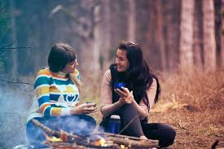
Introduction – Lesson Warm-up
Share how someone’s testimony had a personal impact on their life.

Slide 23
A. What is a Testimony?
A testimony is first hand facts told by a witness.
A testimony is sharing with others what Christ has done and is doing in your life.

Slide 24
B. Why Should I Testify?
It gives me a way to obey Christ. (Matthew 28:19-20).
It gives me an opportunity to strengthen my belief and confidence in God. It helps be become a stronger Christian.

Slide 25
B. Why Should I Testify?
It gives me an opportunity to take an open stand for God.(Acts 5:29)
It gives me an opportunity to help others. It can help others relate God to their lives.

Slide 26
B. Why Should I Testify?
It gives me an opportunity to bring glory to God, so He gets the credit for the changes in my life.
It gives me an opportunity to defeat Satan (Revelation 12:11).

Slide 27
C. Main Points of a Good Testimony
Tell of one area in your life where God is helping you grow.
Give one verse that has helped you grow in this area of your life.
Explain in a very simple, practical way how this verse helped you.
Give one specific example from the past few days to illustrate how you used this verse.

Slide 28
Life-to-Life Learning Pattern
List stress situations List the situations where I find it easy to get uptight, frustrated, angry, irritated, discouraged, or when I feel under pressure.
Ask God this question: —“God, what are you trying to teach me to do today?” Try to look at this situation from God’s point of view.

Slide 29
Life-to-Life Learning Pattern
Find one area in my daily life where I want to grow Take a look at some of the things you listed under step #1. If you have a hard time thinking of possible areas to work on, look at the list of things in 1 Corinthians 13:4-8.

Slide 30
Life-to-Life Learning Pattern
Relate this to my Bible study What does the Bible have to say about this area of my life where I want to grow?
List things I can finish today Set goals. Make a list of things you can do to personally apply what the verse tells you to do. Choose one goal and do it today.

Slide 31
Life-to-Life Learning Pattern
Evaluate the results Later the same day or the next day, review what happened when you tried to reach the goal you set. Describe the situation and explain how your goal helped you (or did not help you) apply this verse to your life.

Slide 32
D. Additional Helps…
Keep your testimony shorter than five minutes.
Plan what you are going to say in your testimony.
Make sure all your testimony brings glory to God.
Ask the Holy Spirit to help you say the right things.

Slide 33
E. Giving Your Life Testimony
Tell the results of sin.
Tell how you came here and how you became a Christian.
Tell how your life has changed since you have become a Christian.
Tell them your future plans and goals.

Slide 34
Personal Application…
Give a testimony in church, in small group devotions, or one-on-one to another person in the next few days.

Slide 35
How to be a Manager for God
Chapter 3

Slide 36
Key Biblical Truth
As a manager for God, I need to do my best in everything I do.
Key Verse: Romans 12:11 (New Life Bible)
Do not be lazy but always work hard. Work for the Lord with a heart full of love for him.

Slide 37
Introduction – Lesson Warm-up
Skit: Pearl of Great Price
(see Teacher’s manual for script for this skit)

Slide 38
A. What is a manager?
1. A manager is a person who is employed to take care of someone else’s property or money.
2. The manager is not the owner. The manager works for the owner.

Slide 39
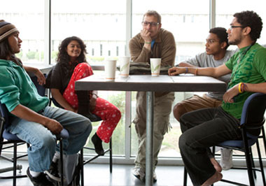
A. What is a manager?
3. Each Christian is a manager for God. Being a Christian means that God is the Leader of my life. He is my owner, but I am not a puppet or a robot. He expects me to function as a Christian in society.

Slide 40
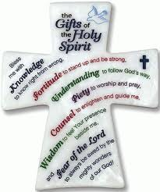
B. What has God given me to manage?
Time
Money
Gifts of the Holy Spirit
Family and relationships
Job

Slide 41
C. What makes a person a good manager for God?
1. Balanced growth
2. A good manager learns to delegate responsibilities
3. Who is my owner—my leader? God is!
Love is a very big part of being an excellent manager for God
5. Faithfulness
6. Obedience

Slide 42
D. How can I show that I’m being a good manager for God?
1. My time
a. Make Sunday a special day. Give one day a week to worship God and fellowship with other Christians at your church (Exodus 20:8-10).
b. Have personal devotions every day. Take time to read the Bible and pray

Slide 43
D. How can I show that I’m being a good manager for God?
1. My time
c. Give time for Christian work. Matthew 25:31-46 lists several ways you can get involved in Christian work.
d. Take time to witness to others. Tell them about the new life you have.

Slide 44
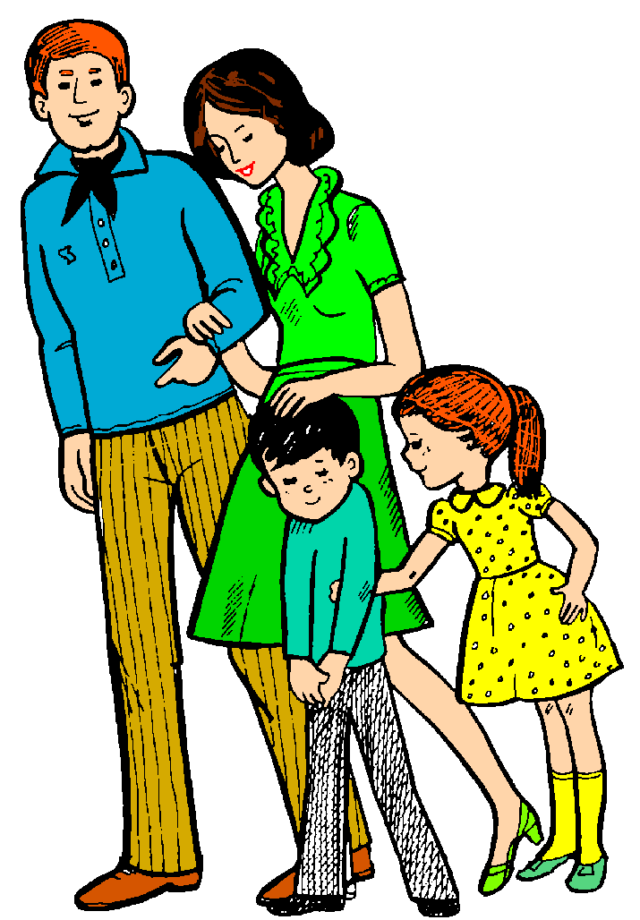
D. How can I show that I’m being a good manager for God?
My work
a. Work to support yourself and your family
b. Work at home

Slide 45
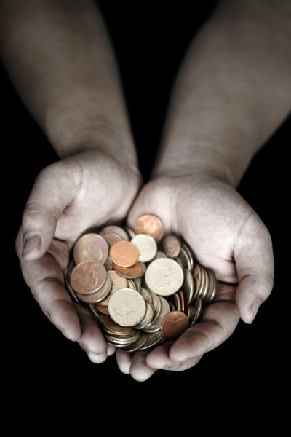
D. How can I show that I’m being a good manager for God?
3. My possessions (money and things I own)
a. Give to God
b. Give to others in need
c. Give ownership of everything else to God

Slide 46
E. My attitude determines if I am working as a manager for God
1. Is love your motive?
2. Do you want to be a manager for God?
3. What about God’s laws?

Slide 47
F. Results of being a manager for God
1. God will give you all you need (not all you want). Luke 6:38, 2 Corinthians 9:8
Philippians 4:19
2. God will give you eternal life.
Matthew 25:31-46
3. God will give you more responsibilities. Luke 16:10

Slide 48
Personal Application…
Review the things God has given you to manage.
Write down one thing you can do in the next class session which will show that you are a good manager for God.
If you have a current source of income give at least 10% as a tithe to God.

Slide 49
Communion
Chapter 4

Slide 50
Communion
Key Biblical Truth
The communion service becomes a service for growth when I meditate on God’s reasons for having this service.
Key Verse: Acts 2:42 New Life Bible
“They were faithful in listening to the teaching of the missionaries. They worshiped and prayed and ate the Lord’s supper together.”

Slide 51
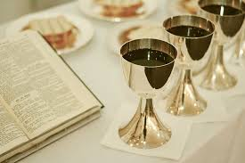
Introduction – Lesson Warm-up

Slide 52
A. What Does “Communion” Mean?
To share.
A special service in churches. This special service has been given different names:
Holy Communion.
Eucharist.
The Lord’s Supper.
Communion Service.

Slide 53
B. What Special Things Are Used in the Communion Service?
Bread. The bread represents the body of Jesus.
(1 Corinthians 11:23-24)
Wine. The wine represents the blood of Jesus.
(1 Corinthians 11:25)

Slide 54
C. Why Do We Use Bread and Wine in the Communion Service?
To help make the death of Jesus more real to us.
The bread and wine are object lessons for us.

Slide 55
D. What is the purpose of communion?
To worship God.
(1 Corinthians 11:24-26)
To remember that Jesus died for us.
(1 Corinthians 11:24-25)
To remind us to look ahead to Jesus coming again.
(1 Corinthians 11:26)

Slide 56
D. What is the purpose of communion?
To give us the opportunity to look inside ourselves (to examine our lives).
(1 Corinthians 11:27-32)
a. We can confess our sins to God.
b. We can see if we have reached our goals

Slide 57
D. What is the purpose of communion?
5. To help us look at our relationships with others. (1 Corinthians 11:29)
a. We can ask forgiveness if we have offended or hurt someone.
b. We can encourage someone.
c. We can thank others for something they have done.

Slide 58
Personal Application…
Copy the five reasons on why we have communion inside the cover of your Bible.
Review these reasons when you have communion at church to receive more out of the service.
Think about these reasons when you are in a church service.

Slide 59
Water Baptism
Chapter 5

Slide 60
Water Baptism
Key Biblical Truth
Each water baptism service provides me with an opportunity to look at my own relationship with God.
Key Verse: Romans 6:3 New Life Bible
“All of us were baptized to show we belong to Christ. We were baptized first of all to show His death.”

Slide 61
Water Baptism

Slide 62
A. The Spiritual Meaning of Water Baptism.
I identify with Christ in His crucifixion.
I identify with Christ in His death.
I identify with Christ in His burial.

Slide 63
A. The Spiritual Meaning of Water Baptism.
I identify with Christ in His resurrection.
I identify with Christ in His new way of living.

Slide 64
B. Why Should I Get Baptized in Water?
It is one way to obey God.
Matthew 28:10-20
It’s a public testimony that I have become a Christian.
It is another step in my spiritual growth.

Slide 65
C. When Should I Get Baptized in Water?
After I become a Christian I should be baptized in water.
The Bible does not put any time on how long you should wait after becoming a Christian before you are baptized in water.

Slide 66
D. The Results of Water Baptism.
Water baptism by itself will not make any spiritual change in you.
Expect temptation after you are baptized in water.
Satan will not be happy. He will do everything in his power to discourage you and get you to turn your back on God.

Slide 67
Personal Application…
Focus on making sure your relationship with God is right. Your spiritual relationship with Jesus is far more important than the act of water baptism.
Follow through by arranging to be baptized in water.

Slide 68
Prayer
Chapter 6

Slide 69
Prayer
Key Biblical Truth
Christians need to make prayer a meaningful part of each day.
Key Verse: Philippians 4:6 New Life Bible
“Do not worry. Learn to pray about everything. Give thanks to God as you ask Him for what you need.”

Slide 70
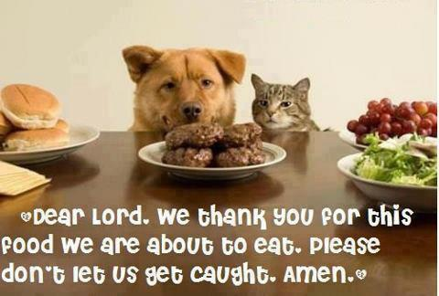
Prayer

Slide 71
A. What is Prayer?
1. Definition
Prayer is talking with God. You talk to God and God talks to you. Prayer should not be a one sided conversation with only you talking to God. Let God talk to you.

Slide 72
A. What is Prayer?
2. Why should I pray?
a. To receive help from God. (Matthew 7:7-8)
b. To have fellowship with God. (Proverbs 15:8)
c. To tell God I love Him.

Slide 73
A. What is Prayer?
2. Why should I pray?
d. To obey God’s command to pray. (1 Thessalonians 5:17)
e. To draw closer to God.
To follow the example of Jesus.
(Hebrews 5:7)

Slide 74
A. What is Prayer?
3. Who do I pray to?
When Jesus was here on earth, He prayed to God the Father. The example of Jesus is a good one to follow.

Slide 75
A. What is Prayer?
3. Who do I pray to? You pray to God the Father, in the name of Jesus, through the power of the Holy Spirit.

Slide 76
B. How Should I Pray
Use common language.
Be honest with God.
Be specific – to the point.
The position of your body is not important.

Slide 77
C. What Should I Say When I Pray?
Worship God.
Ask God to forgive my sins.
Thank God.
Pray for everything.
Pray as the Holy Spirit leads you to pray

Slide 78
D. What are the benefits of praying?
1. Prayer helps you discover more about your Heavenly Father
Matthew 6:9 (The Message)

Slide 79
D. What are the benefits of praying?
2. Prayer helps you find God’s help in times of need
Hebrews 4:16
(New Living Translation)

Slide 80
D. What are the benefits of praying?
3. Prayer helps you find God’s peace and freedom in the middle of problems
Philippians 4:6-7
(New Living Translation)

Slide 81
D. What are the benefits of praying?
4. Prayer helps you to receive the Holy Spirit
Luke 11:13 (New Living Translation)

Slide 82
D. What are the benefits of praying?
5. Prayer helps you find God’s will for your life
Luke 22:41-43
(New Living Translation)

Slide 83
D. What are the benefits of praying?
6. Prayer helps you to be prepared for the return of Jesus
Luke 21:36 (New Living Translation)

Slide 84
E. How can I get answers to my prayers?
1. Expect God to answer
1 John 5:14-15
2. Receive God’s answer
2 Corinthians 12:7-10

Slide 85
F. Why don’t I get answers to my prayers?
1. Are you asking God for the wrong thing?
James 4:14-15
(New Living Translation)
James 4:3
(New Living Translation)

Slide 86
F. Why don’t I get answers to my prayers?
2. Are you holding on to sin in your life?
Psalm 66:18
(New Living Translation)
Proverbs 28:13
(New Living Translation)

Slide 87
F. Why don’t I get answers to my prayers?
3. Are you refusing to listen to God?
Proverbs 28:9 (The Message)

Slide 88
F. Why don’t I get answers to my prayers?
4. Some prayers are conditional
1 John 3:22-24
(New Living Translation)

Slide 89
Here are some conditions that may affect our prayers
1. You must confess your sins.
2. You must keep your conscience clean.
3. You must always show love to others.
(1 Corinthians 13)
4. You must forgive others who may have hurt you.

Slide 90
F. Why don’t I get answers to my prayers?
5. Are you living with doubt?
Hebrews 11:6
(New Living Translation)
James 1:6-7
(New Living Translation)

Slide 91
G. When should I pray?
1. Never stop praying
1 Thessalonians 5:17 in the New Life Bible says, “Never stop praying.”

Slide 92
G. When should I pray?
2. Have a regular quiet time to pray
Try to plan a regular time each day when you can be alone for a few minutes to pray. Matthew 6:6

Slide 93
G. When should I pray?
3. Group prayer
There are many opportunities for praying with other people—chapel services, churches, small groups, family meetings, etc.

Slide 94
H. Why is prayer so difficult?
1. Are you angry with God?
Because of hurtful experiences from their past, many times Christians struggle with anger towards God.
Job 21:15

Slide 95
H. Why is prayer so difficult?
2. Are you convinced that God hears your prayers?
. You may ask, “How do I know God is really listening to me?
Mark 11:24 (New Living Translation)

Slide 96
H. Why is prayer so difficult?
3. Are you facing a lot of problems in your life?
Luke 18:1
(New Living Translation)
James 5:13
(New Living Translation)

Slide 97
H. Why is prayer so difficult?
4. Are you facing persecution?
Jesus had some very specific advice to give us on how we should pray when people make life hard for us.
Matt 5:44
(New International Version)

Slide 98
Personal Application…
Think of a specific situation and write a prayer about it using the information discussed in class today.
Take the challenge to make prayer a practical part of your everyday living.

Slide 99
In Conclusion…
As you seek to make God the most important part of your life, He will help you. He will give you power and wisdom and love for each situation you face. Just keep talking to Him—every day!

Slide 100
Christian Practices
Developed by TC Farm London Ontario Canada
Edited by Global Teen Challenge

