Slide 1


Anger and Personal Rights
Developed by TC Farm London Ontario Canada
Edited by Global Teen Challenge

Slide 2

Anger and Personal Rights
5th edition
By Dave Batty
This PowerPoint is designed to be used with the
Group Studies for New Christians Course,
Anger and Personal Rights, by Dave Batty.
Other Materials available include:
Teacher's Manual
Student Manual
Study Guide
Exam
Course Certificate
For Information on obtaining these materials see iteenchallenge.org

Slide 3

Anger and Personal Rights Assignment list
Quizzes: Verses to Memorize To be done with:
1. Ephesians 4:26-27 Lesson 2
2. James 1:19-20 Lesson 4
3. Proverbs 15:1 Lesson 7
Study Guide Projects:
Project # To be done with or before
1 Lesson 1
2 Lesson 2
3 Lesson 3
4 Optional (Lesson 2 followup)
5 Lesson 4
6 Lesson 4
7 Lesson 5
8 Lesson 6 or 7
9 Lesson 8 or 9
10 Lesson 9
Test: Lesson 10

Slide 4
Lesson 1 - How have I used anger in my life?
Key Biblical Truth:
I need to take a careful look at how anger has affected my life.
Key verse: Ephesians 4:26-27
And “don’t sin by letting anger gain control over you.” Don’t let the sun go down while you are still angry, 27 for anger gives a mighty foothold to the Devil.

Slide 5


Slide 6
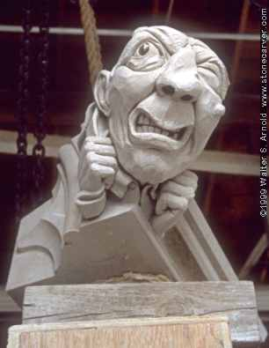
How have I used anger in my life?
What does anger look like in my life?
  Angry words
  The look
  Let’s fight!
  Scream
  Revenge
  Silence
  Hold it in
  Turning anger toward yourself
  Humor—sarcasm

Slide 7
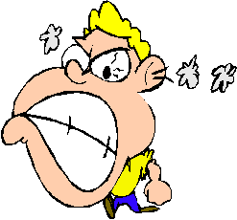
What gives anger so much power in my life?
  Fear
  Hurt
  Frustration
  Is anger a bully in your life?

Slide 8
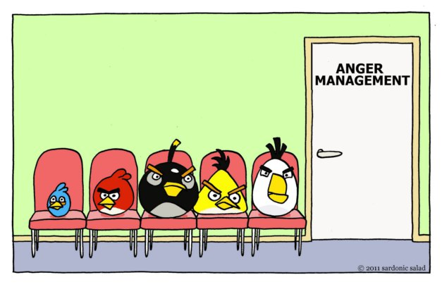
How did anger come to have such a place in my life?
  You learned how to use your anger
  You must take responsibility for your anger
  Anger can become addictive

Slide 9
Personal Application
Write down how anger has been a destructive power in your life.
  What damage has anger brought into your life or the lives of your loved ones?
Pray asking for God’s help to begin to change the way we use our anger.
Notes:
Personal Application Lesson 1, Option 1

Slide 10
Personal Application
  Reflect on the question: “Is anger a bully in your life?”
  Reflect on what goes on inside when you are angry.
  Write down your personal observations
Notes:
Personal Application Lesson 1, Option 2

Slide 11
Personal Application
Begin to keep a journal this week of the different situations where you get angry.
  Try to identify what triggered your anger in each situation.
  We’ll use these examples in the remaining class sessions as we look for new ways to handle our anger
Notes:
Personal Application Lesson 1, Option 3

Slide 12
Lesson 2 - How do I break the destructive power of anger in my life?
Key Biblical Truth:
As a Christian, I need to give my personal rights to God.
Key verse: 2 Corinthians 9:7 New Life Bible
Each man should give as he has decided in his heart. He should not give, wishing he could keep it. Or he should not give if he feels he has to give. God loves a man who gives because he wants to give.

Slide 13

The destructive power of anger
In the news….
School Shootings
An illustration of the destructive power of anger.
Notes:
Ch 2: Lesson Warm Up: Current News Story

Slide 14
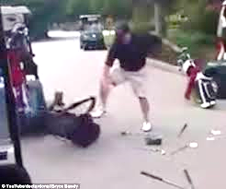
The destructive power of anger
“An example of how anger has brought destruction into my life…”
Notes:
Ch 2:Lesson Warm Up: “How anger has brought destruction into my life….”

Slide 15

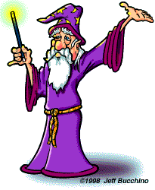
How do I break the destructive power of anger in my life?
There are no “magic wand” solutions

Slide 16

How do I break the destructive power of anger in my life?
Start with the end.
  Where do you want to be?
  Where does God want you to be?
  Where are you at today?
  Step one—have you become a Christian?

Slide 17
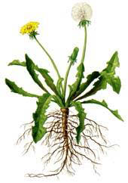
Anger is like a weed
The plant that is above ground represents our anger. The roots below the ground represent what feeds our anger. As you can see, the main root is strong and goes deep.
With the dandelion weed, if you simply cut off the leaves above ground, you will not kill it. It will simply grow new leaves. If you want to kill it, you have to kill the roots.
The leaves above ground represent our anger, and the main root underground represents our personal rights. That is what feeds our anger and gives it so much power.

Slide 18
How do my personal rights connect to my anger?
  What are personal rights?
    A personal right is a rule I have made up for myself which I expect others to obey.
  How do personal rights feed my anger?
  How do I give my personal rights to God?

Slide 19
Examples of Personal Rights
You have no right to be disrespectful to me.
You should always be kind when speaking to me.
You should not interrupt me when I am talking.
You should do what I tell you to do.
You should not accuse me of doing something wrong.
You should not take my things without first asking permission.
You should not ignore me.
You should not get angry at me.
I have the right to wear whatever I want to.
My computer should always do what I want it to do—immediately!
I have the right to listen to any kind of music I want to listen to.
I have the right to my free time/ personal time.

Slide 20

Why should I give my personal rights to God?
Because God loves me
To show God I love him
Personal rights go with ownership
God is the leader of my life
So I will not get angry

Slide 21

  How do I give my personal rights to God?
  List the things which make you get angry, uptight, upset, irritated, or cause worry
  Make a list of all your personal rights
  Pray and give your personal rights to God
  Make a decision to thank God for whatever happens

Slide 22
Personal Application
Carefully consider giving your personal rights to God.
Use project 3 “My Personal Rights Commitment,” as a means of reflecting on this decision and following it through.
Pray and ask God to help you give these personal rights over to Him.
Notes:
Personal Application Chapter 2; Lesson 2

Slide 23
Lesson 3 - A closer look at giving my personal rights to God
Key Biblical Truth:
Giving my personal rights to God puts me on a path to being able to break the destructive power of anger in my life.
Key verse: Luke 9:23-24 New Living Translation
“Then he said to the crowd, “If any of you wants to be my follower, you must turn from your selfish ways, take up your cross daily, and follow me. ²⁴ If you try to hang on to your life, you will lose it. But if you give up your life for my sake, you will save it.”

Slide 24

A closer look at giving my personal rights to God
“A personal right that I’ve observed in my life…”
Notes:
Ch 3: Lesson Warm Up: A personal right that’s been observed in life.

Slide 25
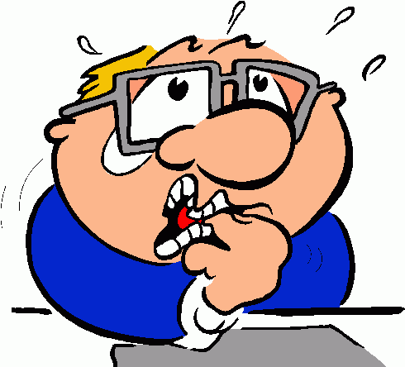
What happens if I do not give my personal rights to God?
  You disobey God
  You will get angry when someone breaks one of your personal rights
  You will worry
  You provide Satan a foothold in your life

Slide 26
What will happen when I give my personal rights to God?
“I will get killed!”
  An unreasonable but common fear. God is ready to help when you give your personal rights to Him.
  You will still get angry
    God is not looking for us to stop getting angry –
    He is looking for us to stop using anger in a destructive way in our lives.
  Expect God to test you
    God will allow other people to violate your personal rights to help you learn to live without your personal rights.

Slide 27

What will happen when I give my personal rights to God?
You must develop new response patterns to the situations that easily make you angry.
Recognize the need for change.
Embrace the change process one step at a time
    Change may include a lot of failures as you move toward growth and victory in this area of your life. Keep looking to Jesus for strength to help in this process of change.

Slide 28
GROWING THROUGH FAILURE
5
I see the problem before I fail, and avoid or solve it.
4
I see the problem before I fail, but I still fail.
3
I see my failure right when it is happening but I still fail.
2
I see the failure after it is past.
1
I don’t see the problem, I fail, and even then I don’t see it.

Slide 29

What are the benefits of giving my personal rights to God?
  You can be at peace
  You can focus on developing new patterns of response that will honor God
  God will help you
  You can become a role model to others

Slide 30
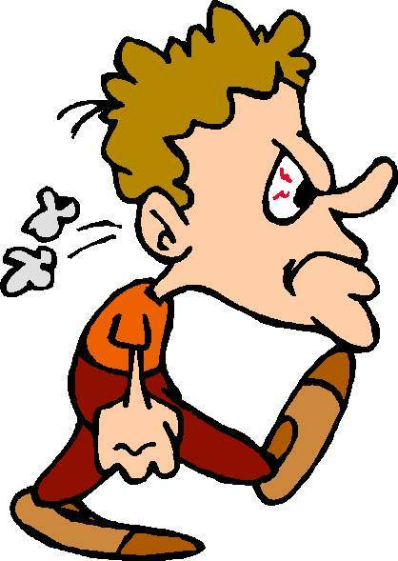
What else besides personal rights feeds my anger problem?
  Unresolved hurts from the past
  Un-forgiveness and bitterness
  Your anger in conflict situations
  Family traditions -
  ”Hand-me-downs”
  Your attitudes and habits

Slide 31
Personal Application
Give your personal rights to God if you have not done so yet.
If you already have done this, thoughtfully review the benefits of giving your rights to God, and look to see those benefits in your own experiences.
Fill out Study Guide Project 4, “My First Test Without My Personal Rights.” (Optional)
Notes:
Personal Application Lesson 3

Slide 32
Lesson 4 - What does God say about anger?
Key Biblical Truth:
The Bible gives us God’s truth about anger and how we can use it in a positive way in our life.
Key verse: Philippians 2:5 New Living Translation
You must have the same attitude that Christ Jesus had.

Slide 33
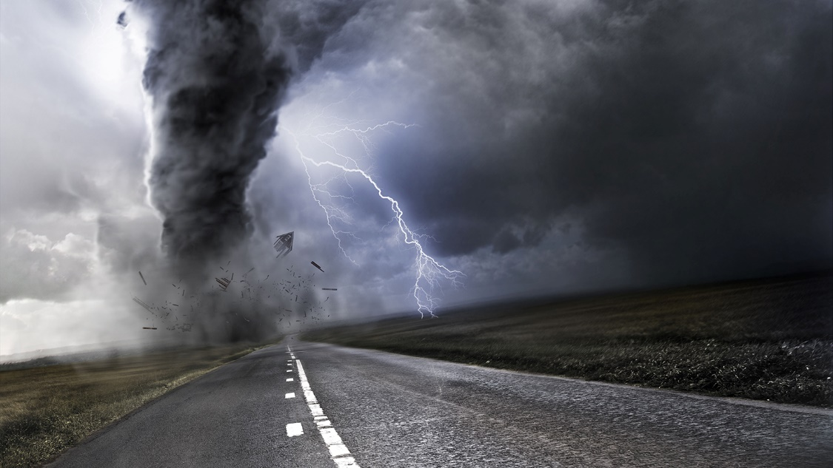
What does God say about anger?
How do you describe God and His anger toward people?
iteenchallenge.org02/2016
Notes:
Lesson Warm Up: Ch 3, Lesson 4

Slide 34
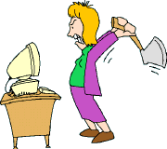
What does God say about anger?
Is anger a sin?
  God created you with the ability to experience anger
  The Bible tells you how to be angry without sinning
  Jesus and anger

Slide 35
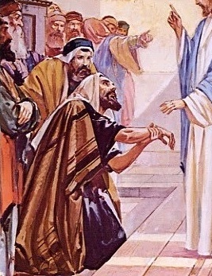
Jesus and anger
Mark 3:1-6
What made Jesus angry?
How did Jesus show He was angry?
What did Jesus do with His anger?
How did other people react to His anger?
What lessons can you learn from Jesus on how to use anger in your life?
iteenchallenge.org02/2016

Slide 36

What makes God angry?
  Jonah 4:2 (NIV)
  I knew that you are a gracious and compassionate God, slow to anger and abounding in love, a God who relents from sending calamity.
- Make sure to see the heart of God, and that he does not have an anger problem.
iteenchallenge.org02/2016
Notes:
In student manual, this comes after lesson 5, How people in the Bible used their anger

Slide 37
Personal Application
Revisit the Key Biblical Truth and the Key Verse. Take a careful honest look at your own life and how you use anger.
Be honest with yourselves about what place anger has in your life.
Select one lesson you learned from the life of Jesus that you can apply to your life this week.
Notes:
Personal Application Lesson 4

Slide 38
Lesson 5 - How people in the Bible used their anger
Key Biblical Truth:
The Bible is filled with positive and negative examples of how we can use anger in our life.
Key Verse:
1 Corinthians 10:11 New Living Translation
These things happened to them as examples for us. They were written down to warn us who live at the end of the age.

Slide 39

How people in the Bible used their anger
Current news and the ways that people in the Bible used their anger…
iteenchallenge.org02/2016
Notes:
Lesson Warm Up Lesson 5

Slide 40
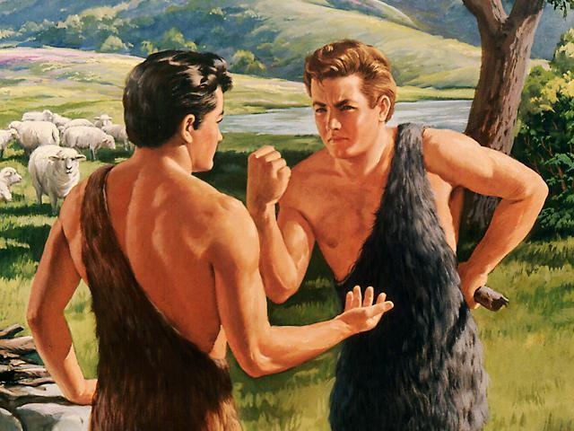
How people in the Bible used anger
Cain
Genesis 4:3-8

Slide 41
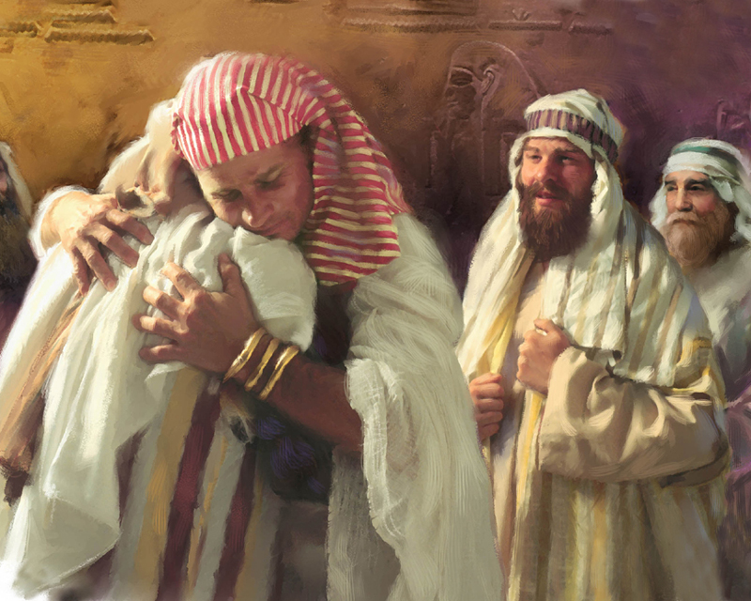
How people in the Bible used anger
Joseph
Genesis 50:19-21

Slide 42
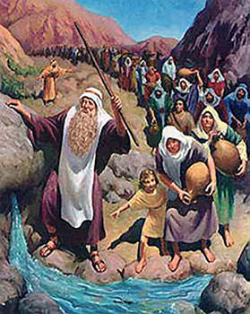
How people in the Bible used anger
Moses
Numbers 20:7-12

Slide 43

How people in the Bible used anger
David
1 Samuel 25 & 2 Samuel 16:5-15

Slide 44
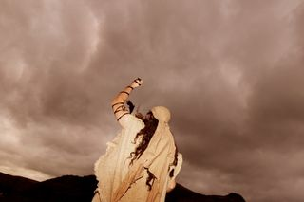
How people in the Bible used anger
Jonah
Jonah 4:1-4

Slide 45

Personal Application
Take a careful and honest look at your own life and how you use anger.
Consider what place anger has in your life.
Select one lesson you learned from the Bible characters discussed that you can apply to your life this week.
Notes:
Personal Application Lesson 5

Slide 46
Chapter 4
How can I use my anger in a way that pleases God?

Slide 47
Lesson 6
First Steps to New Growth
iteenchallenge.org02/2016
Notes:
Lesson 6

Slide 48
Lesson 6 - First steps to new growth
Key Biblical Truth:
I need to learn new ways of responding which I can use in situations where my former personal rights are being violated.
Key Verse:
James 1:19 New Living Translation
Understand this, my dear brothers and sisters: You must all be quick to listen, slow to speak, and slow to get angry.

Slide 49

First steps to new growth
How have personal rights fed anger in my life?
iteenchallenge.org02/2016
Notes:
Lesson Warm Up Lesson 6

Slide 50

Prepare for problems with this new decision to give your personal rights to God
  Win the battle with fear
  Don’t condemn yourself every time you fail
  You will still feel anger
  You will see others with their anger problem
  Don’t “over-spiritualize” your anger
iteenchallenge.org09/2012

Slide 51
How can I use my anger in a way that pleases God?
Prepare for problems with this new decision to give your personal rights to God
  Win the battle with fear
  Don’t condemn yourself every time you fail
  You will still feel anger
  You will see others with their anger problem
  Don’t “over-spiritualize” your anger

Slide 52

First steps to new growth
  Fill your mind with God’s truth on anger
  Daily commitment to lay down your personal rights
  Decide to stop allowing anger to control you

Slide 53

First steps to new growth
  4) Set as your goal to be slow to become angry
Everyone should be quick to listen
Everyone should be slow to speak
Everyone should be slow to become angry

Slide 54
5. Develop new skills for responding to situations where you used anger in the past
You need to develop a whole new way of living when it comes to anger in your life.
1. New thought responses
2. New emotional responses
3. New action responses
4. New speaking responses
5. New looks—not the anger look of “I could kill you!” but a different look.

Slide 55
First steps to new growth
It takes lots of hard work to develop new response patterns
See every life situation as a part of God’s plan for your day.

Slide 56
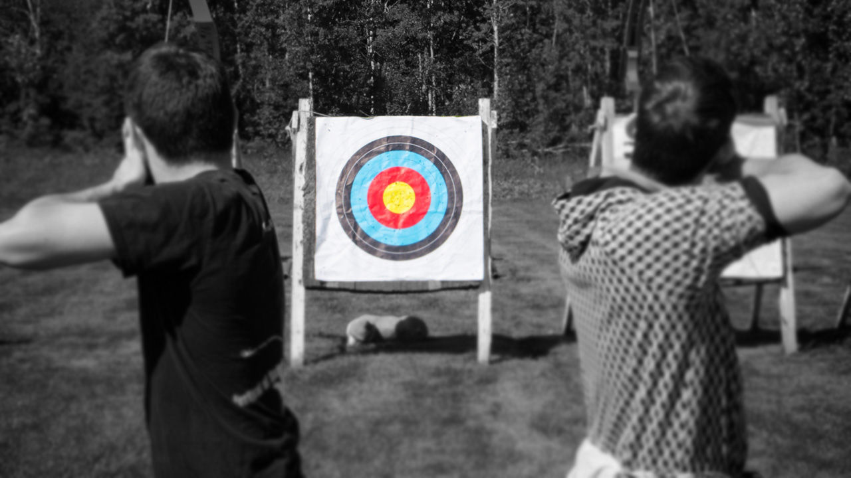
Personal Application
Pick one type of situation where you are likely to encounter a problem that will be easy to react with anger.
Set a goal to respond in a new way to that situation
Pair off with each other and pray for each other, ask God to help you use these new response patterns when tempted.
Notes:
Personal Application Lesson 6

Slide 57
Lesson 7 - New ways of responding to situations where anger was used in the past
Key Biblical Truth:
I need to learn new ways of responding which I can use in situations where my former personal rights are being violated.
Key Verse:
Colossians 3:8 & 10 New Living Translation
8 But now is the time to get rid of anger, rage, malicious behavior, slander, and dirty language. 10 Put on your new nature, and be renewed as you learn to know your Creator and become like him.

Slide 58

New ways of responding to situations where anger was used in the past
Examples of an opportunity to respond in a new way instead of getting angry
iteenchallenge.org02/2016
Notes:
Lesson Warm Up Lesson 7

Slide 59
First steps to new growth
(review)
  Fill your mind with God’s truth on anger
  Daily commitment to lay down your personal rights
  Decide to stop allowing anger to control you

Slide 60
First steps to new growth
(review)
  4) Set as your goal to be slow to become angry
  5) Develop new skills for responding to situations where you used anger in the past

Slide 61

First steps to new growth
  Develop new patterns of responding to conflict
  Celebrate small victories
  Use anger as your “alarm clock”
  Choose new rules for living your life

Slide 62

Personal Application
Pick one type of situation where you are likely to encounter a problem that will be easy to react with anger.
Set a goal to respond in a new way to that situation.
Notes:
Personal Application Lesson 7

Slide 63
Lesson 8 - Three major growth areas for dealing with anger
Key Biblical Truth:
I need to develop positive inward qualities to use when responding to situations where my former personal rights are being violated.
Key Verse:
Ephesians 4:31-32 New Living Translation
Get rid of all bitterness, rage, anger, harsh words, and slander, as well as all types of evil behavior. 32 Instead, be kind to each other, tenderhearted, forgiving one another, just as God through Christ has forgiven you.

Slide 64
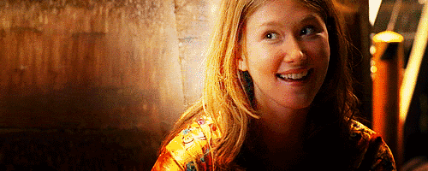
Three major growth areas for dealing with anger
Share an example of how you responded to a situation using a new response pattern instead of anger.
iteenchallenge.org02/2016
Notes:
Lesson warm up 8

Slide 65

Develop positive character qualities in your life

Slide 66

Learn the difference between personal responsibilities and personal rights
  What is a personal responsibility?
  Do I have the right to protect myself and others from danger and abuse?

Slide 67

Develop boundaries
Personal rights are rules that I make which I want you to obey.
Boundaries are rules that I make for myself to obey.

Slide 68
Personal Application
CHOOSE ONE
Develop positive character qualities in your life.
Learn the difference between personal responsibilities and personal rights
Develop boundaries in your life
Set a goal to begin to take steps in applying this in your life as it relates to situations where you are likely to react with anger.
Notes:
Personal Application Lesson 8

Slide 69
Lesson 9 - How can I use my anger in a way that pleases God?
Key Biblical Truth:
I need to be careful to express my anger only in ways that will please God.
Key Verse:
Colossians 3:17 New Living Translation
And whatever you do or say, do it as a representative of the Lord Jesus, giving thanks through him to God the Father.

Slide 70

How can I use my anger in a way that pleases God?
The right way to use anger
iteenchallenge.org02/2016
Notes:
Lesson warm up 9

Slide 71
Use your anger in a way that pleases God
  Learn how to respond with anger instead of reacting with anger
  When you do become angry, don’t hold grudges
  Channel your anger into something positive
  Bring God into your stressful situations
  Become a peace-maker for others who are angry

Slide 72

God may give some of your personal rights back to you—but now they are privileges
A privilege is a gift, a surprise, something you do not deserve or expect, something you cannot demand, an honor, something special.

Slide 73
How can I use my anger in a way that pleases God?
Pick one of the six issues discussed. Set a goal to respond in a new way using that truth in each situation.
Continue to use anger as an alarm clock in your daily activities; an alert to the prospect that you may still be holding on to a personal right that you need to give to God.
iteenchallenge.org02/2016
Notes:
Personal Application Lesson 9

Slide 74
Anger and Personal Rights
Verses

Slide 75
Ephesians 4:26-27 NIV
26 "In your anger do not sin" : Do not let the sun go down while you are still angry, 27 and do not give the devil a foothold.

Slide 76
James 1:19-20 NIV
19 My dear brothers, take note of this: Everyone should be quick to listen, slow to speak and slow to become angry, 20 for man's anger does not bring about the righteous life that God desires.

Slide 77
Proverbs 15:1 NIV
A gentle answer turns away wrath, but a harsh word stirs up anger.

Slide 78
Mark 3:1-5
Jesus went into the synagogue again and noticed a man with a deformed hand. 2 Since it was the Sabbath, Jesus’ enemies watched him closely. Would he heal the man’s hand on the Sabbath? If he did, they planned to condemn him. 3 Jesus said to the man, “Come and stand in front of everyone.”

Slide 79
Mark 3:1-5
4 Then he turned to his critics and asked, “Is it legal to do good deeds on the Sabbath, or is it a day for doing harm? Is this a day to save life or to destroy it?” But they wouldn’t answer him. 5 He looked around at them angrily, because he was deeply disturbed by their hard hearts. Then he said to the man, “Reach out your hand.” The man reached out his hand, and it became normal again! 6 At once the Pharisees went away and met with the supporters of Herod to discuss plans for killing Jesus.

Slide 80
Mark 12:30
Jesus replied, “The most important commandment is this: ‘Hear, O Israel! The Lord our God is the one and only Lord. 30 And you must love the Lord your God with all your heart, all your soul, all your mind, and all your strength.’ 31 The second is equally important: ‘Love your neighbor as yourself.’ No other commandment is greater than these.”

Slide 81
1 Corinthians 6:19-20
Or don’t you know that your body is the temple of the Holy Spirit, who lives in you and was given to you by God? You do not belong to yourself, 20 for God bought you with a high price. So you must honor God with your body.

Slide 82
Matthew 11:28-30
Then Jesus said, “Come to me, all of you who are weary and carry heavy burdens, and I will give you rest. 29 Take my yoke upon you. Let me teach you, because I am humble and gentle, and you will find rest for your souls. 30 For my yoke fits perfectly, and the burden I give you is light.”

Slide 83
Matthew 16:24-26
Then Jesus said to the disciples, “If any of you wants to be my follower, you must put aside your selfish ambition, shoulder your cross, and follow me. 25 If you try to keep your life for yourself, you will lose it. But if you give up your life for me, you will find true life. 26 And how do you benefit if you gain the whole world but lose your own soul in the process? Is anything worth more than your soul?

Slide 84
Anger and Personal Rights
5th edition
By Dave Batty
This PowerPoint is designed to be used with the
Group Studies for New Christians Course,
Anger and Personal Rights, by Dave Batty.
Other Materials available include:
Teacher's Manual
Student Manual
Study Guide
Exam
Course Certificate
For Information on obtaining these materials see iteenchallenge.org

Slide 85
Anger and Personal Rights
Developed by TC Farm London Ontario Canada
Edited by Global Teen Challenge
Anger and Personal Rights 5th Edition

