Slide 1
Addiction Basics
By Dave Batty
Teen Challenge Staff Training Course T507.02
iTeenChallenge.org

Slide 2
1. Teen Challenge history on dealing with addictions
Drug treatment 50 years ago when TC started—not much hope for a cure
Faith-based solution not widely accepted by treatment professionals

Slide 3
2. Definition of addiction
Chemical dependency (addiction) is the process of increasingly turning to chemical use to meet life’s needs. –Jeffrey VanVonderan
“I will not be mastered by anything.” 1 Corinthians 6:12

Slide 4
3. Life-controlling problems, not just drug addiction, cause damage
False beliefs/delusion/denial
Parallel addictions
Symptoms vs root problems
Deep damage from abuse and neglect

Slide 5
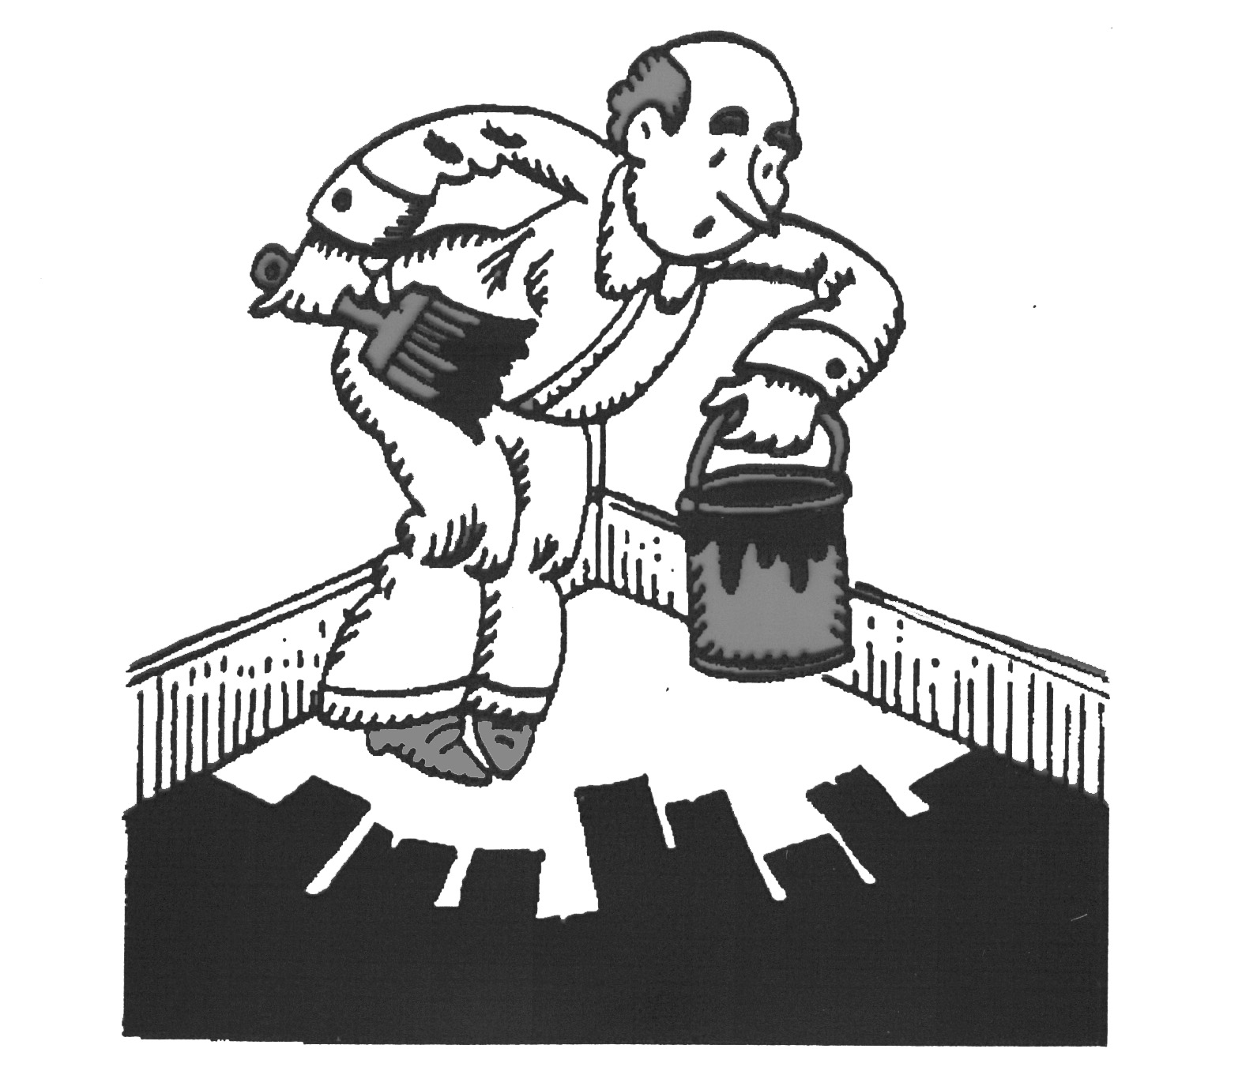
How does one get caught in an addiction?

Slide 6
4. Four stages of addiction
Experimentation
High
Normal
Low

Slide 7
4. Four stages of addiction
Social Use
High
Normal
Low

Slide 8
4. Four stages of addiction
Harmful Abuse (Daily Preoccupation)
High
Normal
Low

Slide 9
4. Four stages of addiction
Uses to feel normal
High
Normal
Low

Slide 10
4. Four stages of addiction
Experimentation
Social Use
Harmful Abuse (Daily Preoccupation)
Uses to feel normal

Slide 11
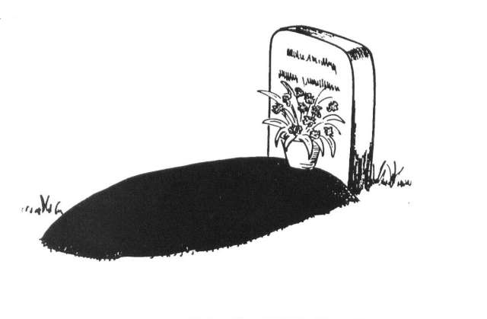
5. Addiction is death on the installment plan

Slide 12
6. What is the process of real change?
addict
>> ex-addict
>> non-addict
Real change involves transformation of your whole life, not just to get off drugs.

Slide 13
7. What are the keys to overcoming addiction?
Relationship with Jesus
Renewing your mind
“Put off” old way of living and “put on” new way of living

Slide 14
7. What are the keys to overcoming addiction?
God dependency is the process of increasingly turning to God to meet life’s needs.

Slide 15
8. Questions for discussion

Slide 16
www.Globaltc.org www.iTeenChallenge.org

