Slide 1
A Quick Look at the Bible
Introducing the Word of God

Slide 2
A Quick Look at the Bible
5th edition
By David Batty
This PowerPoint is designed to be used with the
Group Studies for New Christians Course,
A Quick Look at the Bible, by David Batty
Other materials available include:
Teacher’s Manual
Student Manual
Study Guide
Know Your Bible (Supplementary reading)
Exam
Course Certificate
For Information on obtaining these materials see iteenchallenge.org
Iteenchallenge.org 01/2018

Slide 3
A Quick Look at the Bible
Quizzes: See Chapter 4, Student Manual
Division Name & Book Names to Memorize To be done with:
1. Gospels and Church History Lesson 1
2. Letters by Paul Lesson 2
3. General Letters and Book of Prophecy Lesson 3
Iteenchallenge.org 01/2018

Slide 4
A Quick Look at the Bible
Optional Quizzes for both OT & NT: See Chapter 4, Student Manual
Division Name & Book Names to Memorize To be done with:
1. Books of Moses Lesson 1
Books of History
2. Books of Poetry Lesson 2
Major Prophets
3. Minor Prophets Lesson 3
Gospels
Church History
4. Letters by Paul Lesson 4
5. General Letters Lesson 5
Book of Prophecy
Iteenchallenge.org 01/2018

Slide 5
A Quick Look at the Bible
Projects:
Project # To be done before or with
1. Lesson 1
2. Lesson 2
3. Lesson 2 (Extra Credit)
4. Lesson 3 (Extra credit)
5. Lesson 3
6. Lesson 4
7. Lesson 4(Extra credit)
8. Lesson 5
Extra Reading from Know Your Bible
Pages 1, 4 – 7 Lesson 1
Pages 8 – 11 Lesson 2
Test Date: Lesson 5
Iteenchallenge.org 01/2018

Slide 6
A Quick Look at the Bible
Introducing the Word of God
Chapter 1 General Information About the Bible.

Slide 7
A Quick Look at the Bible
Introducing the Word of God
Lesson 1 Why we have the Bible

Slide 8
Lesson 1
Key Biblical Truth
I need to have a clear understanding of why we have the Bible.
Key Verse
As new babies, you should want to drink the pure milk which is God’s Word so you will grow up and be saved from the penalty of sin.
1 Peter 2:2 NLB
Iteenchallenge.org 01/2018

Slide 9
Lesson Warmup
“If you were God, and wanted to have a book written for people on this earth, what do you think would be the most important thing to put in this book?”
What childhood experiences do you remember about the Bible?

Slide 10
A. Basic facts about the Bible
1. How many books are in the Bible?
Books in the Old Testament?
Books in the New Testament?
Books in the whole Bible?
39
27
66

Slide 11
A. Basic facts about the Bible
2. How many people wrote the 66 books in the Bible?
About 40 people wrote the books of the Bible.

Slide 12
A. Basic facts about the Bible
3. How long did it take to write the Bible?
The Bible was written over a period of about 1500 years.

Slide 13
A. Basic facts about the Bible
In what languages was the Bible originally written?
The Old Testament was written in Hebrew.
A few parts of the Old Testament were written in Aramaic.
The New Testament was written in Greek.

Slide 14
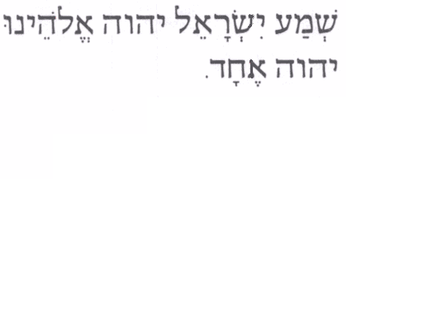
Hebrew
Hebrew was many times was written with all capital letters, all consonants with no spaces between words
English Equivalent- All caps, consonants only, no spaces between words
HRSRLTHLRDRGDTHLRDSN
Hear, O Israel: The LORD our God, the LORD is one. “Deut. 6:4 NIV “

Slide 15
Greek

Slide 16
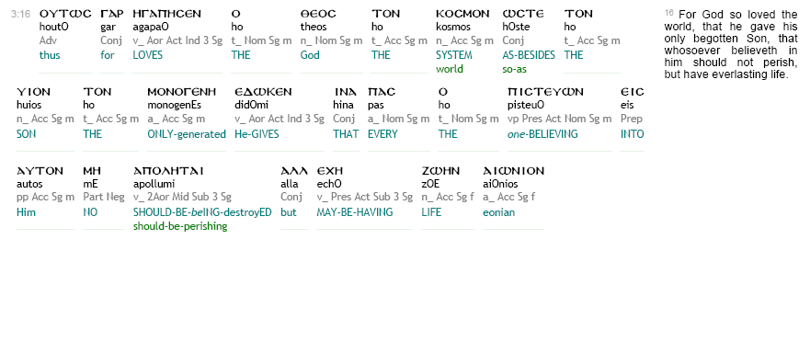
Greek Interlinear

Slide 17
B. The unity of the Bible
One of the amazing things about the Bible is how all 66 books fit together–the material all “hangs together.”
The unity of the Bible can best be explained by looking at the author–God.

Slide 18
C. Getting the whole picture (progressive revelation)
If you want to get a proper understanding of what the Bible teaches, you need to get the whole picture.
We must be careful to find out all the Bible says about a particular subject before making our final conclusions. It is important to see each book, each chapter, and each verse in relation to the whole Bible.

Slide 19
D. How does Christ fit into the whole Bible?
Jesus Christ is the main person in the Bible.
The Old Testament looks forward to the coming of Jesus.
The New Testament books were all written after Jesus returned to heaven.
The New Testament tells of the time Jesus spent here on earth. It also tells us how to prepare for the second coming of Christ.

Slide 20
E. How the years are numbered
When the Bible was being written the people did not number their years the same way we do today.
Many countries counted their years beginning with the rule of a new king.
Another method was to number the years beginning with some major event

Slide 21
How Years are Numbered Today
B.C. means ?

Slide 22
How Years are Numbered Today
B.C. Before Christ

Slide 23
How Years are Numbered Today
B.C. Before Christ
A.D. means?

Slide 24
How Years are Numbered Today
B.C. Before Christ
A.D. Anno Domini

Slide 25
How Years are Numbered Today
B.C. Before Christ
A.D. Anno Domini
Latin for “The Year of our Lord”

Slide 26
How Years are Numbered Today
B.C. Before Christ
BCE Before Common Era
A.D. Anno Domini
“The Year of our Lord”
CE Common Era

Slide 27
Personal Application…
Reflect on the following questions:
Why did God give us the Bible?
Why do I want to have the Bible?
How do I plan to use the Bible in my life?
How will I respond to the teachings in the Bible?

Slide 28
Bonus information
Old Testament
Hebrew
New Testament
Greek

Slide 29
History’s Effect on Bible Languages
Hebrew- was the ancient language of the Patriarchs-
Abraham, Isaac & Jacob
Moses
Aramaic Persian Rule
In 538 BC the Jews were taken into captivity into Persia. Upon their return to Israel the common language in Israel became Aramaic

Slide 30
History’s Effect on Bible Languages
Greek In 333 BC Alexander the Great conquered the then known world. To unify his empire the Hellenistic (Greek) culture was imposed on all subjects.
The Greek language became the main language for commerce and culture.

Slide 31
History’s Effect on Bible Languages
Latin- In 63 BC the Roman general Pompey conquers Jerusalem.
Judea is now ruled by the Roman government. The language of Rome is Latin.

Slide 32
History’s Effect on Bible Languages
At the time of Christ, three languages were used in Israel.
Aramaic- the every day language of the people, including Jesus.
Greek- the language used most widely in commerce and trade.
Latin- the language of the Romans

Slide 33
History’s Effect on Bible Languages
In John 19:19 Pontius Pilate orders an inscription be placed over the head of Jesus on the cross. It is to be written in Aramaic, Greek and Latin.
The common depiction of this in artwork is INRI. This is from the Latin-
“Iesvs Nazarenvs Rex Ivdaeorvm”
Jesus of Nazereth, king of the Jews

Slide 34
History’s Effect on Bible Languages
Latin- though not an original Bible language was used extensively in the Christian Church for nearly 2,000 years.
In 70 AD Jerusalem was destroyed by the Romans. The leadership of the church moved from Jerusalem to Rome. Thus the extensive use of Latin. The Roman Catholic Church continues to use Latin as it’s official language even today. Latin fell from common use in the 9th century AD.

Slide 35
??????????????????
PATER noster, qui es in caelis, sanctificetur nomen tuum. Adveniat regnum tuum. Fiat voluntas tua, sicut in caelo et in terra. Panem nostrum quotidianum da nobis hodie, et dimitte nobis debita nostra sicut et nos dimittimus debitoribus nostris. Et ne nos inducas in tentationem, sed libera nos a malo. Amen.

Slide 36
The Lord’s Prayer in Latin
PATER noster, qui es in caelis, sanctificetur nomen tuum. Adveniat regnum tuum. Fiat voluntas tua, sicut in caelo et in terra. Panem nostrum quotidianum da nobis hodie, et dimitte nobis debita nostra sicut et nos dimittimus debitoribus nostris. Et ne nos inducas in tentationem, sed libera nos a malo. Amen.

Slide 37
A Quick Look at the Bible
Introducing the Word of God
Chapter 2 How was the Bible written?

Slide 38
A Quick Look at the Bible
Introducing the Word of God
Lesson 2 The Bible is Inspired

Slide 39
Lesson 2
Key Biblical Truth
Because the Bible is inspired by God, I need to use the Bible today the way God tells me to.
Key Verse
2 Timothy 3:16 All scripture is inspired by God and is useful for teaching the faith and correcting error, for re-setting the direction of a man's life and training him in good living.
Iteenchallenge.org 01/2018

Slide 40
A. Inspiration–What does it mean?
Inspire (Webster’s Intermediate Dictionary)
(1) to move, guide, or communicate by divine or supernatural influence <prophets inspired by God> <thoughts inspired by God>
(2a) to exert an animating, enlivening, or exalting influence on <inspired by his mother>
(2b) affect <a childhood that inspired him with a desire for education>
(2c) to infuse or introduce into the mind: arouse <inspires confidence in his followers>.Give several illustrations of how we use this word in our normal conversations today.

Slide 41
2 Timothy 3:16 King James Version “All scripture is given by inspiration of God... ”

Slide 42
This verse shows us that “inspired by God” means:
1. God gave us the Bible.
2. The scriptures are “God-breathed,” and “made alive by Him.” They are not just dead words in a book. When you take God’s Word, and put it to practice in your life, it works! God’s Word comes to life and God begins to change your life!

Slide 43
2 Peter 1:20-21 New International Version 20Above all, you must understand that no prophecy of Scripture came about by the prophet’s own interpretation. 21For prophecy never had its origin in the will of man, but men spoke from God as they were carried along by the Holy Spirit.

Slide 44
2 Peter 1:20-21 tells us two more things which help us to understand the meaning of the words, “the Bible is inspired by God.”
3. No part of the Bible was made up by man.
4. These writers spoke (and wrote down) what the Holy Spirit told them.

Slide 45
A. Inspiration–What does it mean?
When we say that “the Bible is inspired by God,” we mean:
The Holy Spirit guided the thoughts of the writers so they wrote what God wanted them to write.
It is important to understand that all the Bible is inspired by God.

Slide 46
B. How did God inspire the people to write the books of the Bible?
God did not tell them the exact words to write down (in most cases)
God did not move their hands mechanically
The Holy Spirit gave them thoughts which the writers expressed in their own ways

Slide 47
C. How the Bible has been passed down to us
How were the books first written?
How were the books of the Bible copied?

Slide 48
C. How the Bible has been passed down to us
In order to see the uniqueness of the Scripture in its reliability, one needs to examine the extreme care in which the copyists transcribed the O.T. Manuscripts.
THE TALMUDISTS (A.D.100-500)
During this period a great deal of time was spent in cataloging Hebrew civil and canonical law. The Talmudists had quite an intricate system for transcribing synagogue scrolls.
Samuel Davidson describes some of the disciplines of the Talmudists in regard to the Scriptures. These minute regulations... are as follows:

Slide 49
Rules for Copying Scripture

Slide 50
Rules for Copying Scripture
A synagogue roll must be written on the skins of clean animals,
Prepared for use by a Jew
Must be fastened together with strings from clean animals
Every skin must contain a certain number of columns, equal through the entire codex,

Slide 51
Rules for Copying Scripture
5) The length of each column must not extend over less than 48 or more than 60 lines. And the breadth must consist of 30 letters.
6)The whole copy must be first lined; and if three words be written without a line it is worthless.

Slide 52
Rules for Copying Scripture
7)The ink should be black, not red, green, nor any other color and prepared according to a definite recipe.
8)An authentic copy must be the exemplar, from which the transcriber ought not in the least deviate.

Slide 53
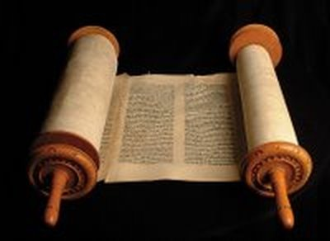
Rules for Copying Scripture
9) No word or letter, not even a yod, must be written from memory, the scribe not having looked at the codex before him…

Slide 54
Rules for Copying Scripture
10) Between every consonant the space of a hair or thread must intervene; between every word, the breadth of a narrow consonant;
11) between every new section, the breadth of nine consonants;
12) between every book, three lines.
13) The fifth book of Moses must terminate exactly with a line, but the rest need not do so.

Slide 55
Rules for Copying Scripture
14) Besides this, the copyist must sit in full Jewish dress,
15) wash his whole body,
16) Not begin to write the name of God with a pen newly dipped in ink,
17)and should a king address him while writing that name he must take no notice of him….

Slide 56
Rules for Copying Scripture
In addition…The rolls in which these regulations are not observed are condemned to be buried in the ground or burned; or they are banished to the schools, to be used as reading books.
From Sir Frederic Kenyon, Our Bible and the Ancient Manuscripts (Harper and Brothers,
New York, 1958) pp. 78-79.

Slide 57
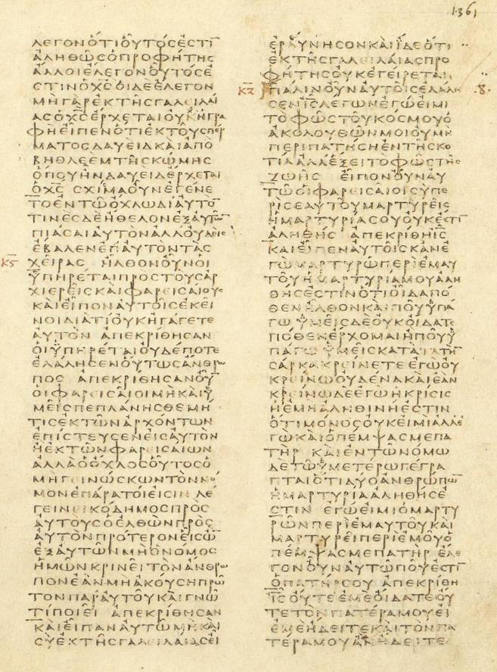
Codex Vaticanus
One of the oldest and most valuable extant manuscripts of the Greek Bible.

Slide 58
Personal Application…
Make a commitment to trust the Bible and accept it as God’s Word, not just the good ideas of the Jewish people who wrote it.
Look for practical ways to begin using the Bible teachings in their lives each day.

Slide 59
A Quick Look at the Bible
Introducing the Word of God
Chapter 3 How can I know the Bible is accurate (true)?

Slide 60
A Quick Look at the Bible
Introducing the Word of God
Lesson 3 Is the Bible Accurate?

Slide 61
Lesson 3
Key Biblical Truth
I need to prove in my own daily life that the teachings of the Bible are true.
Key Verse
And be sure to put into practice what you hear. The more you do this, the more you will understand what I tell you. Mark 4:24 TLB
Iteenchallenge.org 01/2018

Slide 62
A. All prophecies have been true and correct
The word “prophecy” has two common definitions.
(1)A message from God spoken by a Christian.
(2)A prediction–A message from God telling what will happen in the future.

Slide 63
B. The Bible says it is God’s Word
The people who wrote the Bible clearly speak out and say it is God’s Word.
God guided them and told them what to write.
The writers give credit to God for what they write.

Slide 64
C. Jesus said the Bible is God’s Word
Several times in His life Jesus clearly states that the Bible is true, that it is the Word of God.
Jesus showed His firm belief in the Bible by daily applying its teachings to all areas of His life.

Slide 65
Prophecies are accurate
Alfred Edersheim in studying the Bible, found 456 specific prophecies related to the life of Christ.
What is the chance that these prophecies can be fulfilled in the life of just one person?
Prof. Peter Stoner calculated the probability of just eight of these prophecies coming true in one person.

Slide 66
Probability of 8 prophecies
In the book, Science Speaks, mathematician and scientist, Peter Stoner, applies the rules of probability to these prophecies. The chances of just eight of these 456 prophecies being fulfilled are one in 10 to the 17th power - that's 1 in 100,000,000,000,000,000! In the book, Professor Stoner, illustrates:

Slide 67
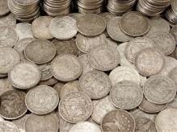
Probability of 8 prophecies
Let us try to visualize this chance. . . Suppose that we take 10 to the 17th power silver dollars and lay them on the face of Texas. They will cover all of the state two feet deep.
1/2

Slide 68
Probability of 8 prophecies
Now mark one of these silver dollars and stir the whole mass thoroughly. . . Blindfold a man and tell him. . . he must pick up one silver dollar . . . What chance would he have of getting the right one? Just the same chance that the prophets would have had of writing these eight prophecies and having them all come true in any one man. (Science Speaks, pp. 106 - 107)

Slide 69
Probability of 8 prophecies

Slide 70
Probability of 48 prophecies
Professor Stoner, then took 48 of these 456 fulfilled prophecies. The chances of 48 being fulfilled are 1 in 10 to the 157 power - that's 1 in 10 with 157 zeros!

Slide 71
Probability of 48 prophecies
Let us try to visualize it. . . The electron is about as small an object as we know of. It is so small that it will take 2.5 x 10 to the 15th power of them laid side by side to make a line, single file, one inch long. If we were going to count the electrons in this line one inch long, and counted 250 each minute, and if we counted day and night, it would take us 19,000,000 years to count just the one-inch line of electrons. . . With this introduction, let us go back to our chance of 1 in 10 to the 157th power. . . Let us make a solid ball of electrons, extending in all directions from the earth to the distance of six billion light-years (the distance that light will travel at 186,000 miles a second in 6,000,000,000 years). Have we used up our 10 to the 157th power electrons? No, we have made such a small hole in the mass that we cannot see it. Now, one of these electrons was marked and thoroughly stirred into the whole mass; blindfold your man and ask him to find the marked electron. (The electron, in fact, is so small that it cannot be seen with a powerful microscope.) To the extent, then, that we know this blindfolded man cannot pick out the marked electron, we know that the Bible is inspired. (Science Speaks, pp 109 - 111)

Slide 72
C. Jesus said the Bible is God’s Word
If the Bible is not the Word of God, and if the Bible is not true, then Jesus lied in John 17:17.
If Jesus lied, that means He sinned.
If Jesus sinned, then His death on the cross cannot in any way pay the penalty for our sins.

Slide 73
C. Jesus said the Bible is God’s Word
Read these scriptures and see what they say about the life of Jesus.
Hebrews 4:15
Hebrews 5:8-9
1 Peter 3:18

Slide 74
D. There are no contradictions in the Bible
What is a contradiction?
It is when two different statements both claim to be true, but yet they are completely opposite each other.
The Bible does not contradict itself. It does not say in one place that something is true, and then say in another place that the opposite thing is true.

Slide 75
E. Archaeology proves the Bible is accurate
Archaeologists have spent many years digging up and studying old cities that existed when the Bible was written.
The noted Jewish archaeologist Nelson Glueck summed it up very well:
“It may be stated categorically that no archeological discovery has ever controverted a single biblical reference. Scores of archeological findings have been made which confirm in clear outline or in exact detail historical statements in the Bible.” Nelson Glueck, Rivers in the Desert, 1960, pg 31

Slide 76
E. Archaeology proves the Bible is accurate
2. The Dead Sea Scrolls prove the Bible is accurate.
1,000 years older than any previous manuscripts

Slide 77
F. Medical Practices in the Bible Prove it is Accurate
The medical instructions in the Bible have been proven (some only recently) to be completely accurate according to present day medical knowledge.
Additional Information
Sanitary Practices Numbers 19:3-22, Lev. 11:1-47; 15:1-33, Deut 23:12).

Slide 78
F. Medical Practices in the Bible Prove it is Accurate
The Israelites were instructed to wash themselves and their clothes in running water if they had a bodily discharge, if they came in contact with another person’s discharge, or if they had touched a dead human or animal carcass. They were also instructed to wash any uncovered vessels that were in the vicinity of a dead body, and if a dead carcass touched a vessel it was to be destroyed. Items recovered during war were also to be purified through either fire or running water. In addition, the Israelites were instructed to bury their human waste outside of camp, and to burn the waste of their animals. These sanitary practices without question saved countless lives in the Israelite camps by protecting them against infection caused by unseen germs. Meanwhile, their Egyptian peers were dying by the thousands due to “remedies” that almost always consisted of some amount of human or animal dung.
For centuries doctors denied the possibility that disease could be transmitted by invisible agents. However, in the late 19th century Louis Pasteur demonstrated in his Germ Theory of Disease that most infectious diseases were caused by microorganisms originating from outside the body. This new understanding of germs and their means of transmission led to improved sanitary standards that resulted in an enormous drop in the mortality rate. Yet these core principles of sanitation were being practiced by the Israelites thousands of years earlier.
Source: https://bibleevidences.com/medical-evidence/

Slide 79
G. Prove to yourself that the Bible is true by testing its teachings in your own life
If the teachings of the Bible are true, then as you begin to practice them in your daily life, changes will begin to take place.
If the teachings of the Bible are not true, then nothing will happen in your life when you begin to apply them.

Slide 80
Personal Application…
How should the accuracy of the Bible affect my life today? Here are three thoughts that can be a response to this question:
I can trust the Bible and believe that it really is God’s Word.
I can trust that what the Bible says today is the same as what God told the men who first wrote the Bible.
I need to be careful to accurately use the teachings of the Bible in my life today.

Slide 81
Life-to-Life Learning Bible Study Pattern
List stress situations —situations where I find it easy to get uptight, frustrated, angry, irritated, discouraged, or when I feel under pressure.
Ask God this question: —“God, what are you trying to teach me to do today?”
Find one area in my daily life where I want to grow —use 1 Corinthians 13:4-8 to identify possible areas where I need to grow.

Slide 82
Life-to-Life Learning Bible Study Pattern
Relate this to my Bible study —what does the Bible have to say about this area of my life where I want to grow?
List things I can finish today —in other words, set goals —choose one goal and do it today
Evaluate the results —later the same day or the next day, review what happened when you tried to reach the goal you set.

Slide 83
A Quick Look at the Bible
Introducing the Word of God
Lesson 4 Old and New Testament Overview

Slide 84
A Quick Look at the Bible
Introducing the Word of God
Chapter 4 A quick look at the Old Testament

Slide 85
Lesson 4
Key Biblical Truth
I need to use the Bible in all my daily experiences.
Key Verse
The scriptures are the comprehensive equipment of the man of God, and fit him fully for all branches of his work. 2 Timothy 3:17 Phillips NT
Iteenchallenge.org 01/2018

Slide 87
A Quick Look at the Old Testament
The Bible is divided into two sections called testaments. A testament is a pact, treaty, or covenant.
The Old Testament was given to the Jews.
It covers time from the creation of the world to about 400 years before the birth of Jesus.
It tells of God’s relationship with people before Jesus came.

Slide 88
A Quick Look at the Old Testament
Three-fourths of the Bible is the Old Testament.
It was originally written in the Hebrew language.
A few parts of the Old Testament were written in the Aramaic language.

Slide 89
Five Divisions in the Old Testament
Books of Moses
Genesis
Exodus
Leviticus
Numbers
Deuteronomy
Books of History
Joshua 2 Kings
Judges 1 Chronicles
Ruth 2 Chronicles
1 Samuel Ezra
2 Samuel Nehemiah 1 Kings Esther

Slide 90
Five Divisions in the Old Testament
Books of Poetry
Job
Psalms
Proverbs
Ecclesiastes
Song of Solomon
Major Prophets
Isaiah
Jeremiah
Lamentations
Ezekiel
Daniel

Slide 91
Five Divisions in the Old Testament
Minor Prophets
Hosea Habakkuk
Joel Zephaniah
Amos Haggai
Obadiah Zechariah
Jonah Malachi
Micah
Nahum

Slide 92
A Quick Look at the Bible
Introducing the Word of God
Chapter 5 A Quick look at the New Testament

Slide 93
A Quick Look at the New Testament
The twenty-seven books of the New Testament tell about the life of Jesus and what happened after He went back to heaven.
Many of the books tell about the ministry of Jesus’ disciples and Paul.

Slide 94
Five Divisions in the New Testament
Gospels
Matthew
Mark
Luke
John
Church History
The Acts of the Apostles

Slide 95
Five Divisions in the New Testament
Letters by Paul
Romans 1 Thessalonians
1 Corinthians 2 Thessalonians
2 Corinthians 1 Timothy
Galatians 2 Timothy
Ephesians Titus
Philippians Philemon
Colossians

Slide 96
Five Divisions in the New Testament
General Letters Book of Prophecy
Hebrews Revelation
James
1 Peter
2 Peter
1 John
2 John
3John
Jude

Slide 97
The Role of Prophecy in the Bible
God put prophecy in the Bible for these reasons:
To demonstrate the accuracy of the Bible.
To give Christians hope in the future. Romans 15:4
To motivate people to draw closer to God.
It is not to be used to predict the future.

Slide 98
Personal Application…
Use the Key Biblical Truth from this lesson as a reminder of the need each of us have to carefully use God’s Word as a guide in our daily living.
Key Biblical Truth: I need to use the Bible in all my daily experiences.

Slide 99
In Conclusion…
The Bible is filled with encouragement, direction, and warnings. If we will respect it and obey it, we will find our relationship with God will grow deeper.

Slide 100
A Quick Look at the Bible
5th edition
By David Batty
This PowerPoint is designed to be used with the
Group Studies for New Christians Course,
A Quick Look at the Bible, by David Batty
Other materials available include:
Teacher’s Manual
Student Manual
Study Guide
Know Your Bible (Supplementary reading)
Exam
Course Certificate
For Information on obtaining these materials see iteenchallenge.org
Iteenchallenge.org 01/2018

Slide 101
Contact Info
Global Teen Challenge
globaltc.org
iteenchallenge.org
gtc@globaltc.org

