Slide 1
Counseling in the PSNC Classes
By Dave Batty

Slide 2
Conversations with great value!

Slide 3
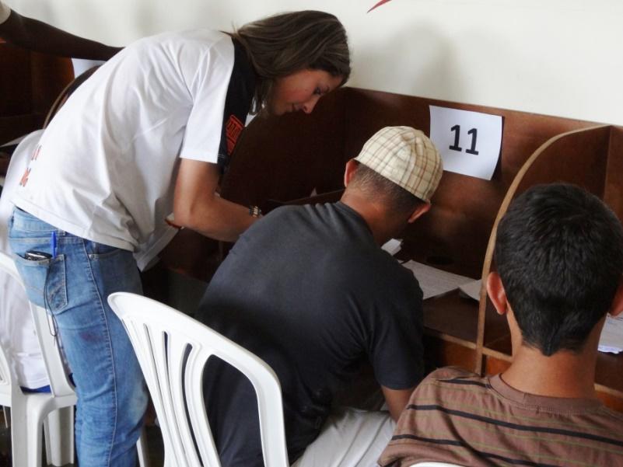
A. The role of the teacher in the PSNC classroom
Every interaction with the students in the PSNC classes provides an opportunity to counsel them.

Slide 4
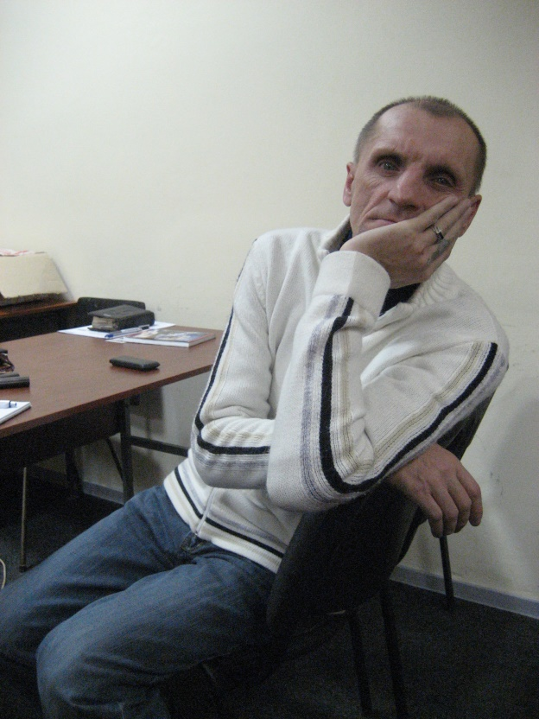
A. The role of the teacher in the PSNC classroom
The teacher is not just “baby-sitting” watching the students as they do their work.

Slide 5
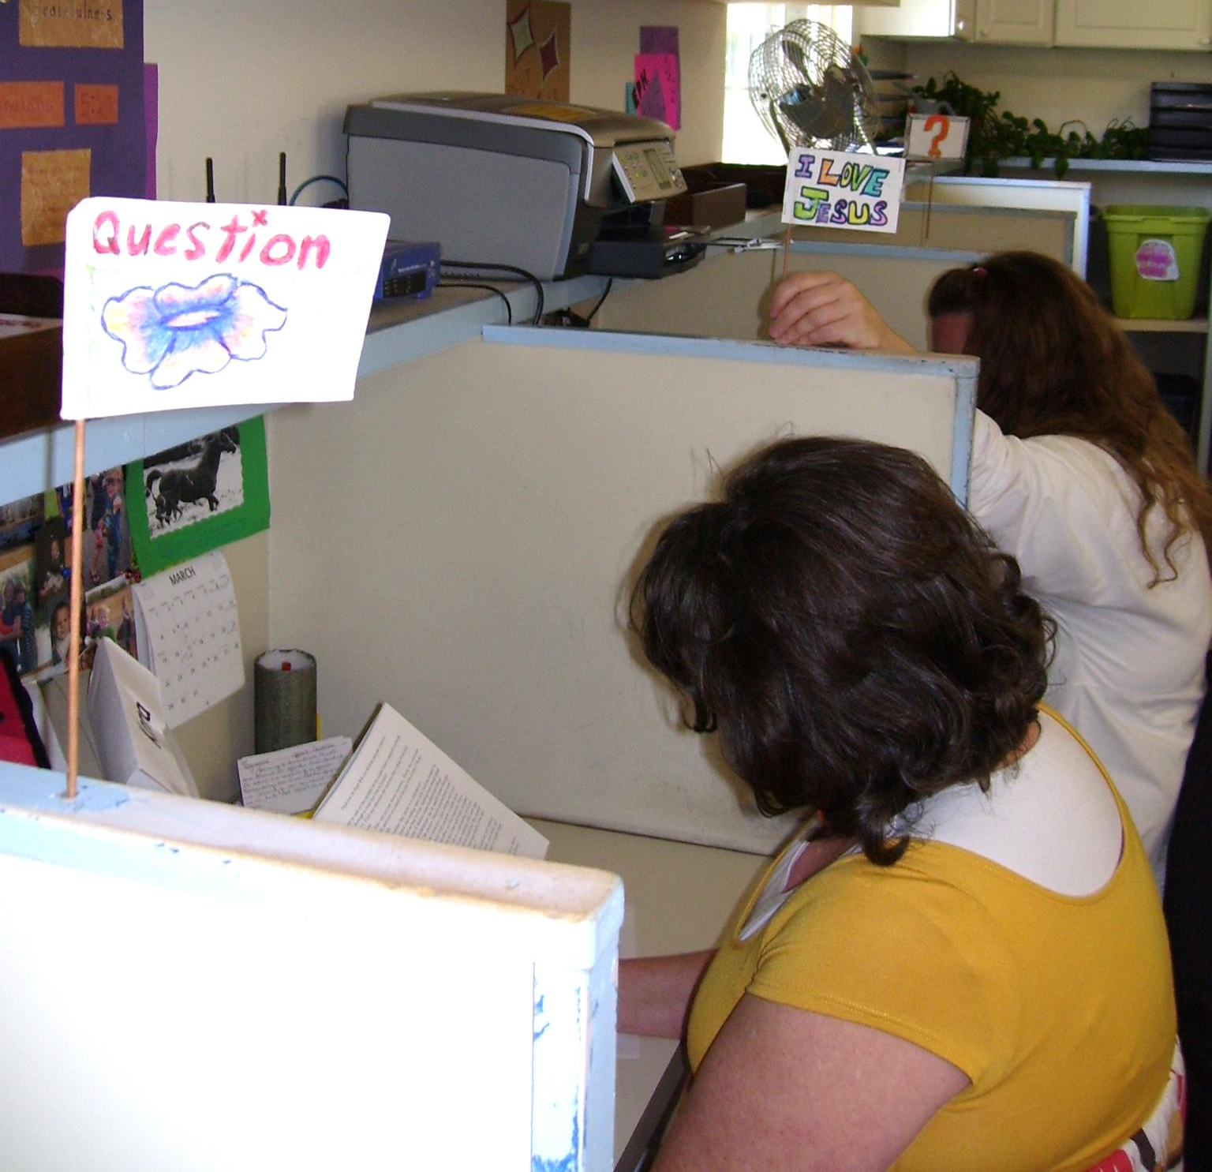
B. When does counseling take place in the PSNC classroom?
Each student works at his own desk.
Each student has a flag to put up when they need to talk to the teacher.

Slide 6
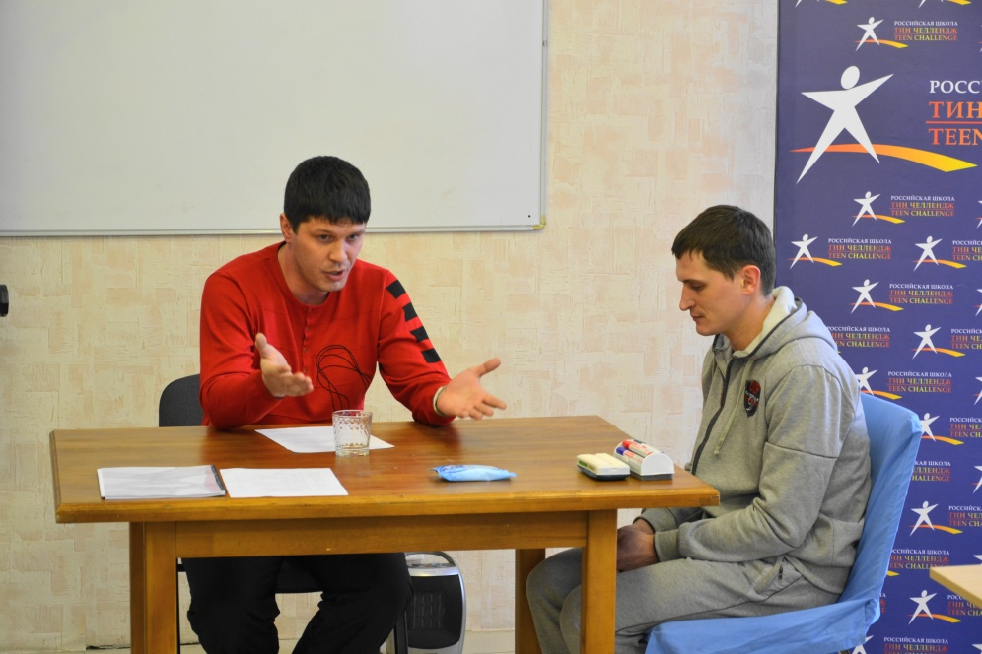
B. When does counseling take place in the PSNC classroom?
We need to see counseling as much bigger than just a formal “sit down” counseling session.

Slide 7
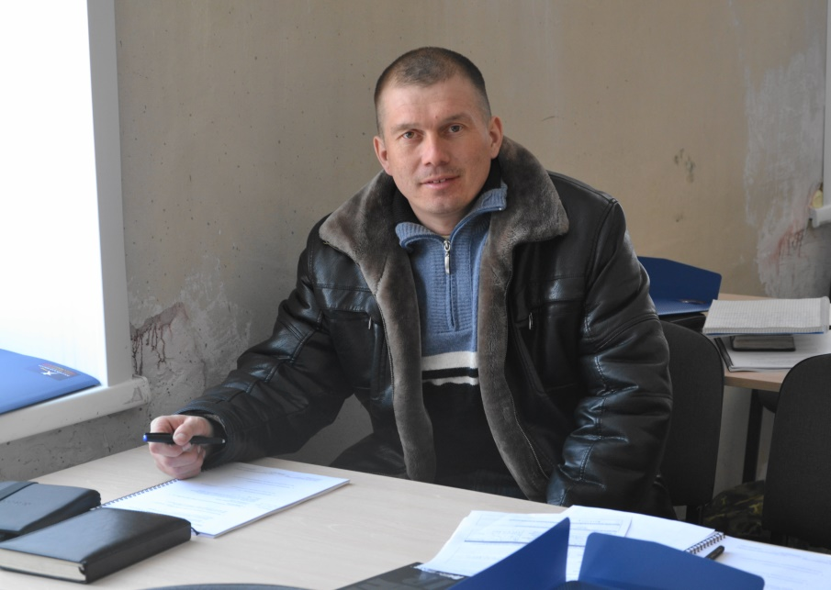
B. When does counseling take place in the PSNC classroom?
How can we guide them into God’s truth in their lives? —all day long
How can we help them in their personal search for a closer relationship with Jesus?

Slide 8
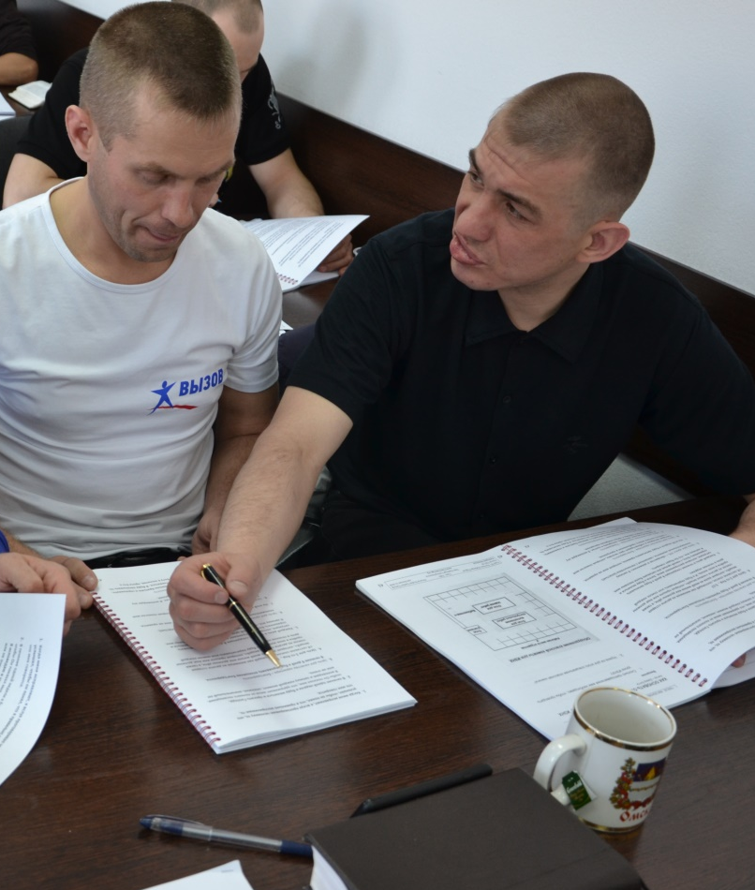
B. When does counseling take place in the PSNC classroom?
Remember the 3 Steps to learning 1. Know the facts 2. Relate it to their life 3. Personal application
Remember you are a guide, not God.

Slide 9
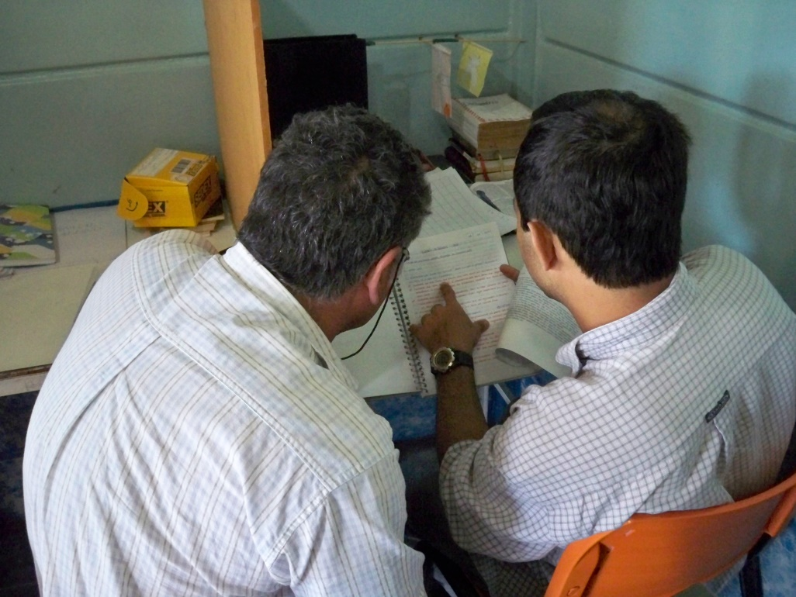
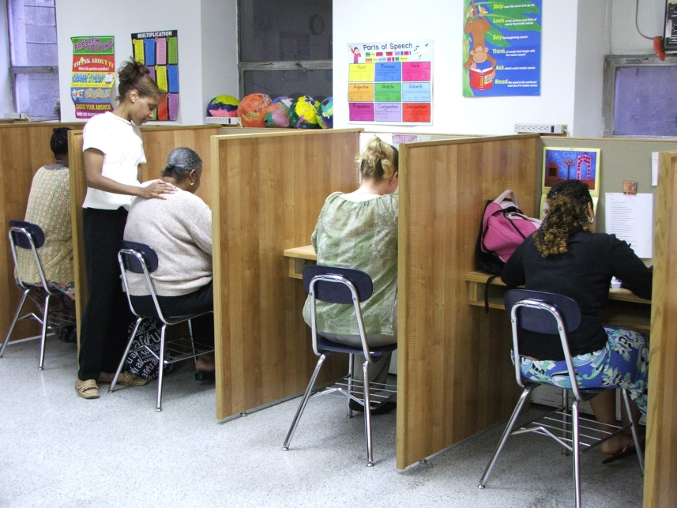
C. How should you interact with the student in the classroom?
Get on their eye level, kneel down or pull up a chair.

Slide 10
C. How should you interact with the student in the classroom?
Ask questions that allow them to open up.
Listen carefully

Slide 11
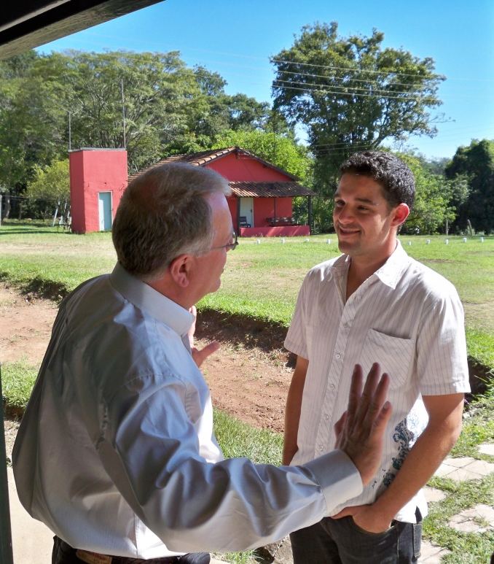
C. How should you interact with the student in the classroom?
Speak softly —allow limited noise in the classroom
If conversation turns to very private issues, you may need to go outside the classroom.

Slide 12
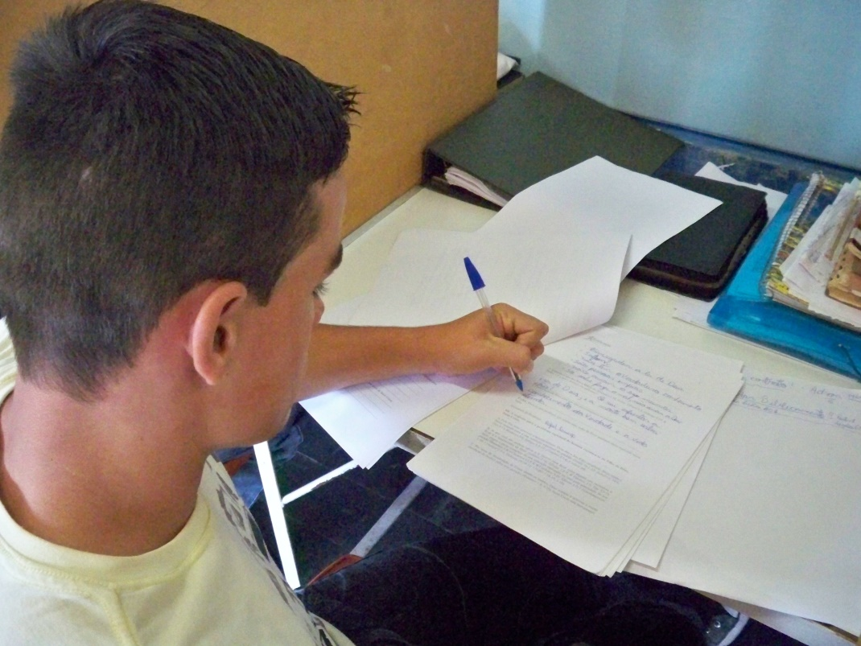
D. What am I attempting to accomplish in the counseling?
I want to point them to Jesus as their real Source of help.

Slide 13
D. What am I attempting to accomplish in the counseling?
Don’t push for them to give you the “right answers.”
Help them move toward personal application of God’s truths.

Slide 14
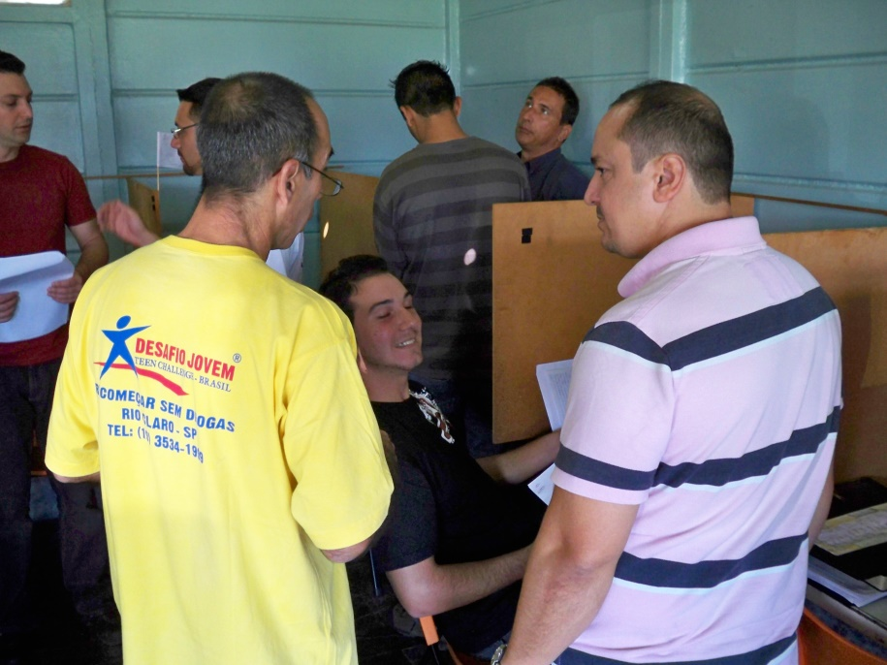
E. Documenting your counseling in the PSNC classes
Some of these conversations may be very brief, but if done carefully, you can have a great impact in a short time.

Slide 15
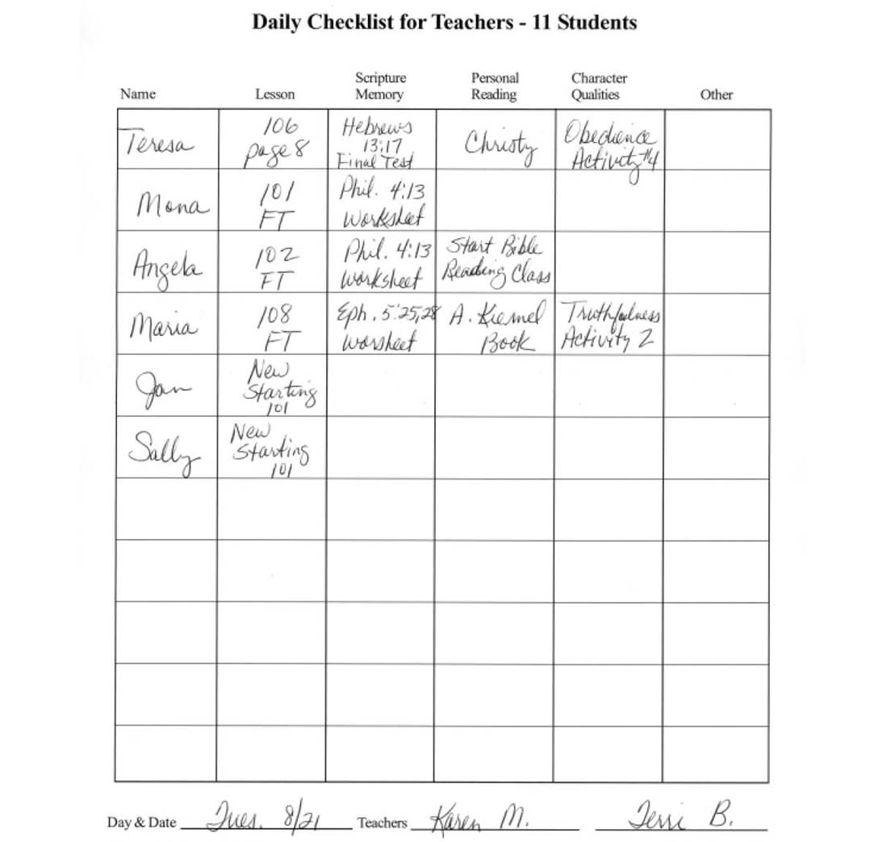
E. Documenting your counseling in the PSNC classes
Either make a note on the Daily Checklist for Teachers, or write a separate note to follow up on after class is done.

Slide 16
E. Documenting your counseling in the PSNC classes
Even if the issue is not related to the major theme of what they are studying, make a note if a significant issue surfaces in your conversations.
Put these notes in that student’s PSNC class file, and it can be used when you prepare your next contract for that student.

Slide 17
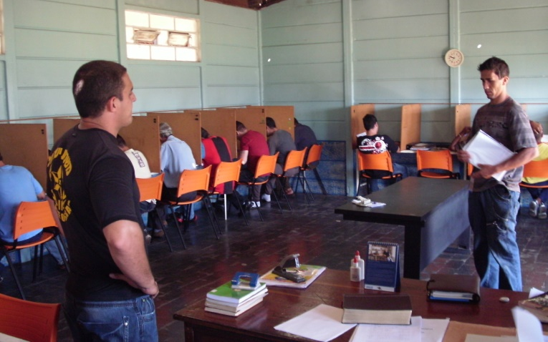
E. Documenting your counseling in the PSNC classes
If the student has another staff assigned as his counselor, you may find it helpful to pass on to that counselor some of these issues that surface in the PSNC classes.

Slide 18
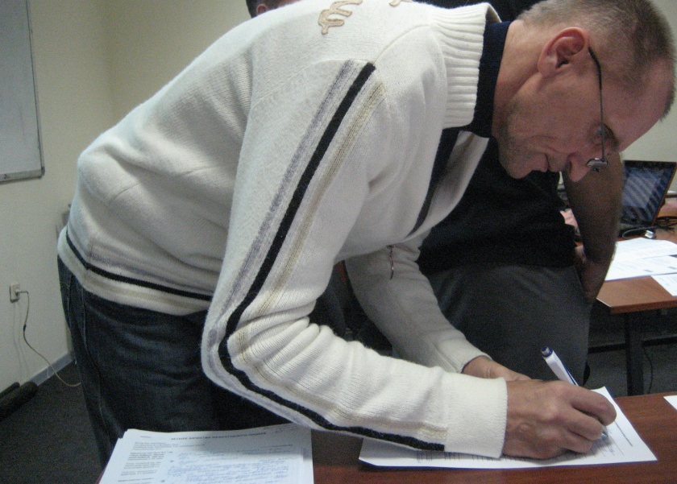
E. Documenting your counseling in the PSNC classes
When going over the student’s papers that have come to you for grading, you may find other issues that need to be addressed.

Slide 19
F. Elements of effective counseling
Teaches them to depend on God
Breaks through delusion Helps people see themselves accurately.

Slide 20
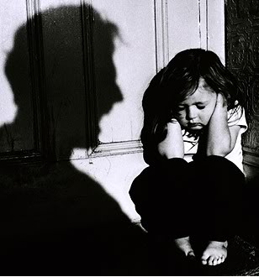
F. Elements of effective counseling
Identifies problems and hurts from the past that are still affecting them today.

Slide 21
F. Elements of effective counseling
Helps the person take responsibility for own responses—past, present & future.
Helps the person discover God’s resolution to past hurts and problems.

Slide 22
F. Elements of effective counseling
Counselor does not make decisions for the person.
Involves person in community of healing—the body of Christ. James 5:16

Slide 23
For Further Study

Slide 24
Conversations with great value!

Slide 25
Questions for Discussion

Slide 26
Contact information
Global Teen Challenge
706-576-6555
www.GlobalTC.org
www.iTeenChallenge.org

