Slide 1
Operating the PSNC Classes
By Dave Batty

Slide 2
Your PSNC gift

Slide 3
A. What does the PSNC classroom look like?
Each student works at his own desk.
Each student office has a small bulletin board in it for the student papers.
Each student has a flag to put up when they need to talk to the teacher.
Table in the middle of the classroom for taking tests and grading lessons.

Slide 4
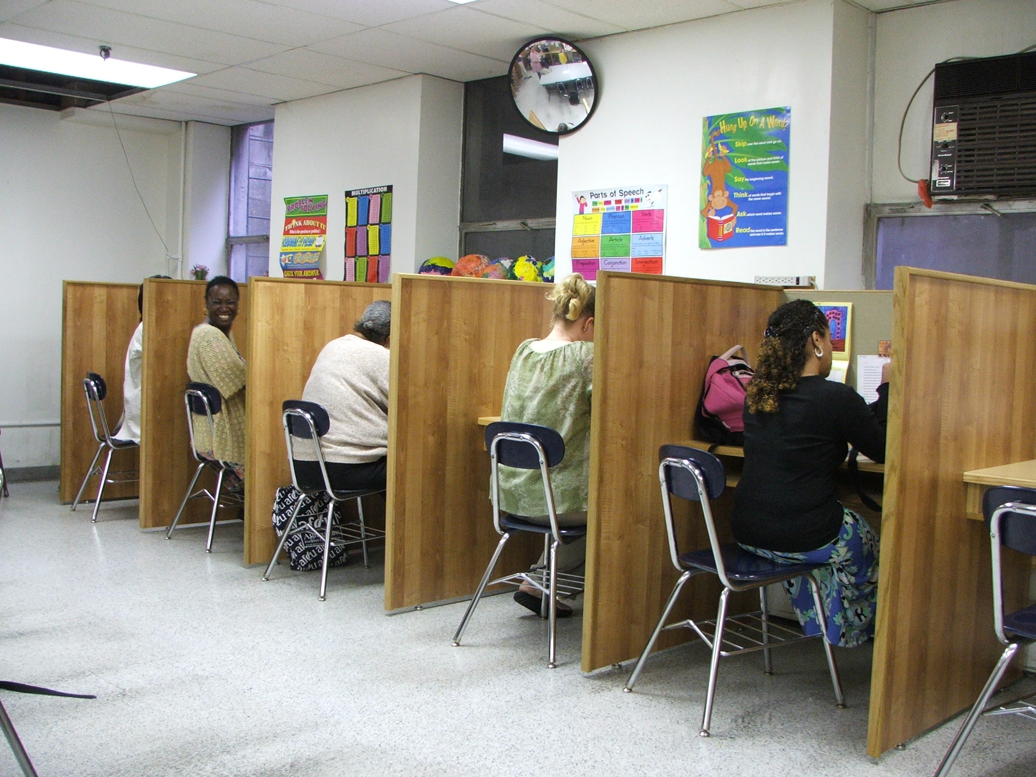

Slide 5
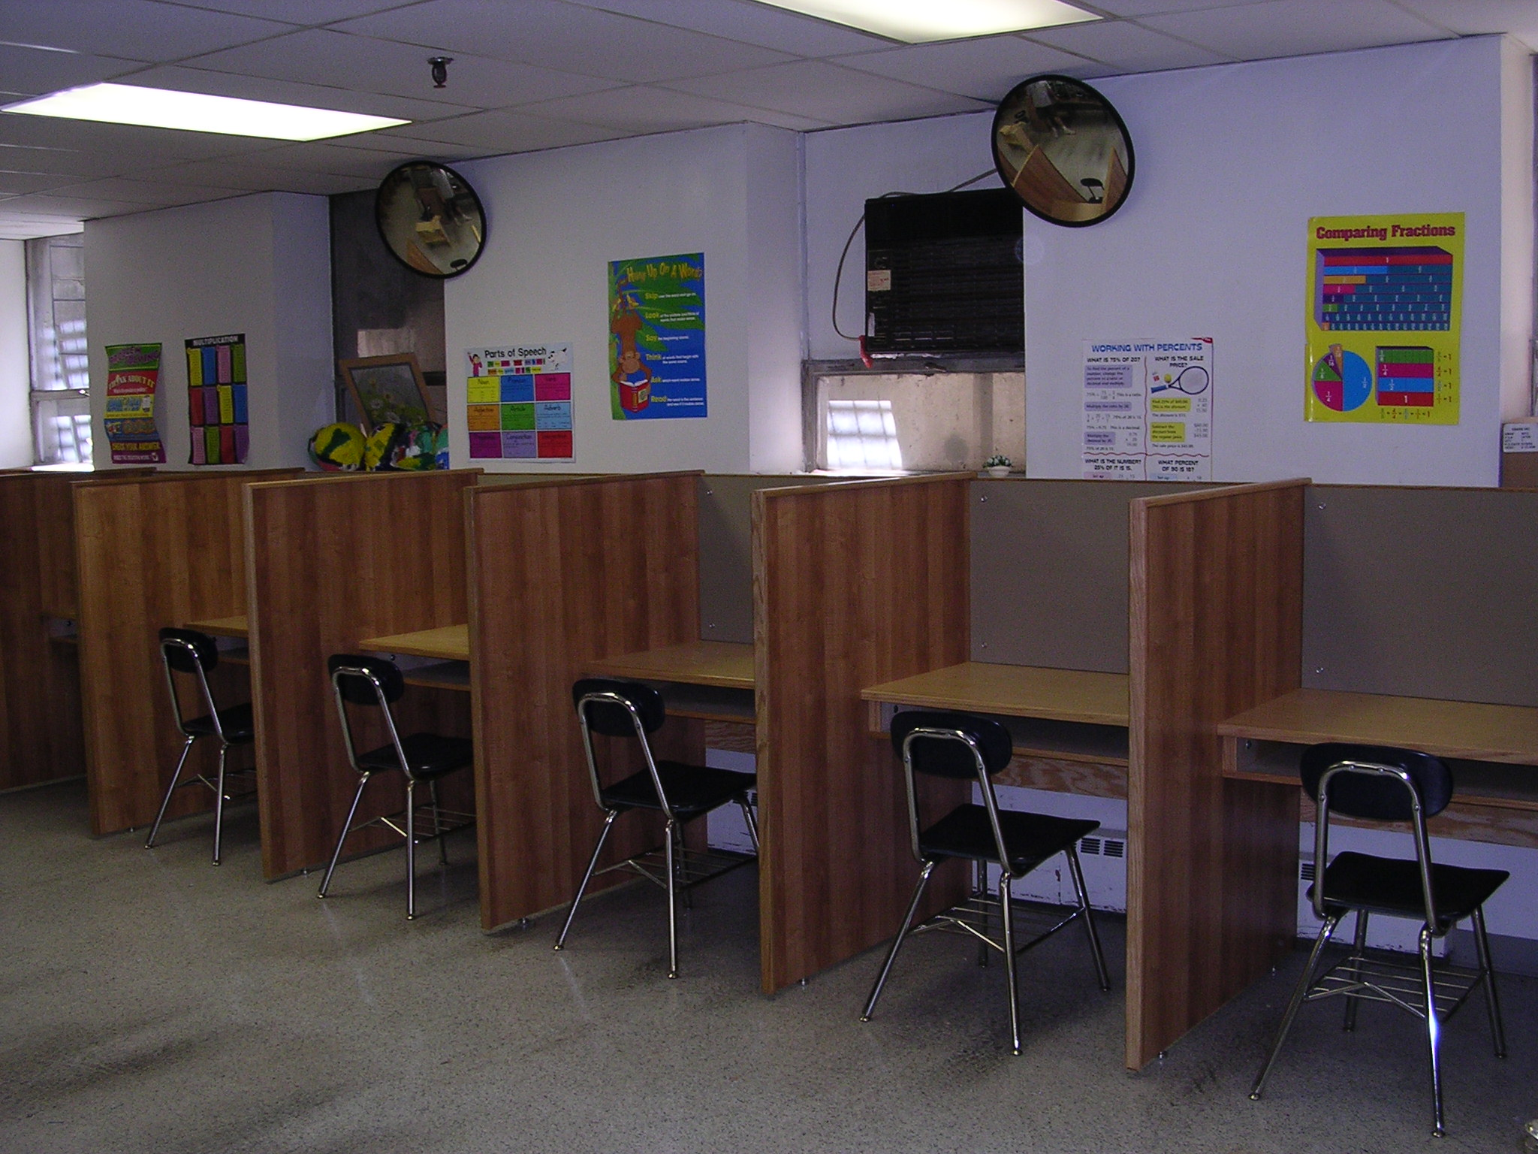

Slide 6
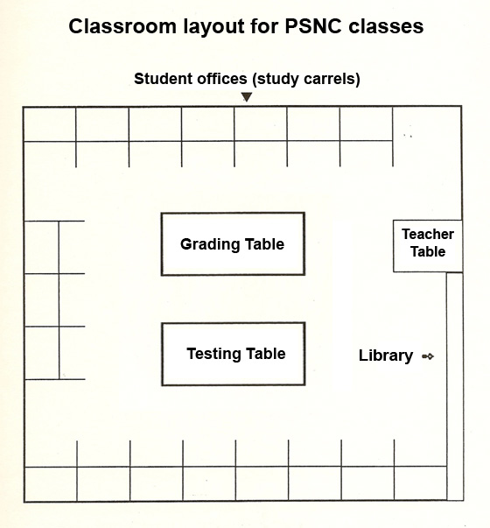

Slide 7
A. What does the PSNC classroom look like?
Library book shelves
File cabinet for student materials

Slide 8
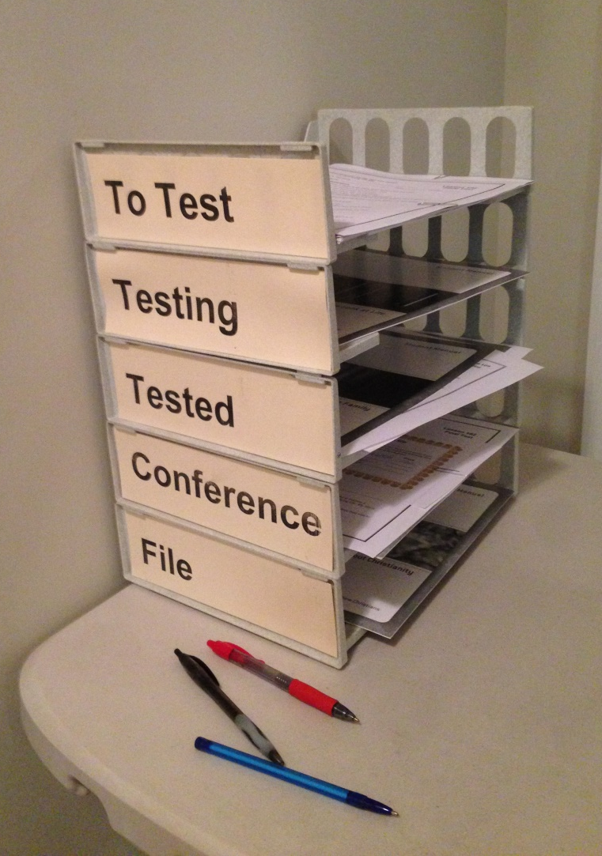
A. What does the PSNC classroom look like?
Five stack trays for student papers 1. To Test 2. Testing 3. Tested 4. Conference 5. File

Slide 9
B. How does the PSNC class start each day?
Each day starts with “Opening Exercises” which is the only group activity in the PSNC classes.
Introduce new students.
Quote the scripture of the month.

Slide 10
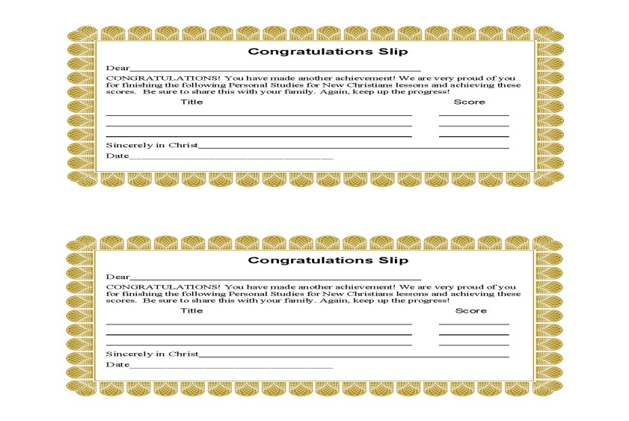
B. How does the PSNC class start each day?
Hand out Congratulations Slips.
Student book reports
Announcements

Slide 11
C. Regular activities in the PSNC class time
Give final tests on lessons or scriptures they have memorized.
Hold conferences with any students who need to revise their daily goals.
Hold conferences with any students who have papers in the stack tray labeled “Conferences.” --After having that conference, put the papers in the tray labeled “File”

Slide 12
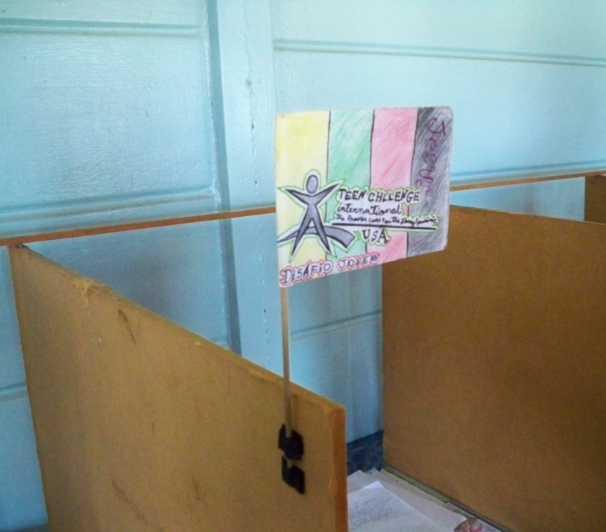
C. Regular activities in the PSNC classtime
Talk with any student who has their flag up.

Slide 13
C. Regular activities in the PSNC classtime
Make notes on your Daily Checklist for Teachers regarding the progress of each student.
Pray for students
Before the end of class, check the daily goals of each student. (For tomorrow)

Slide 14
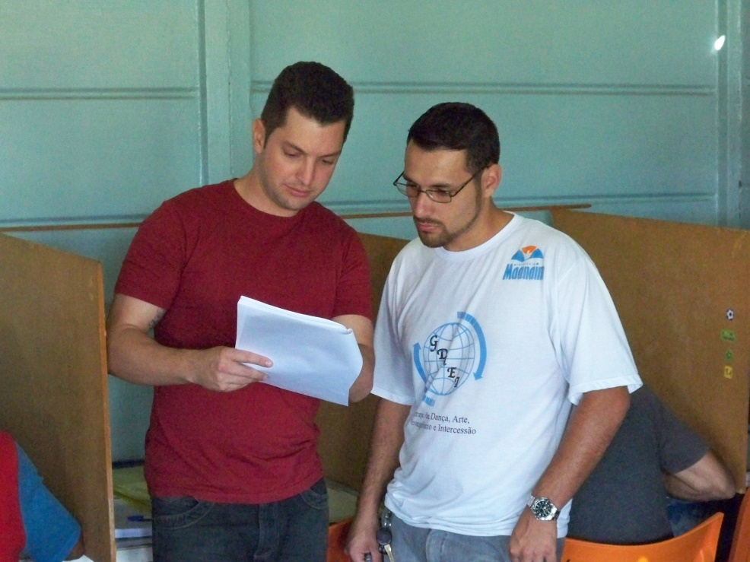
D. First day in the PSNC classroom for a new student
Introduce yourself to the student. Learn his full name.
Assign the student to their student desk.

Slide 15
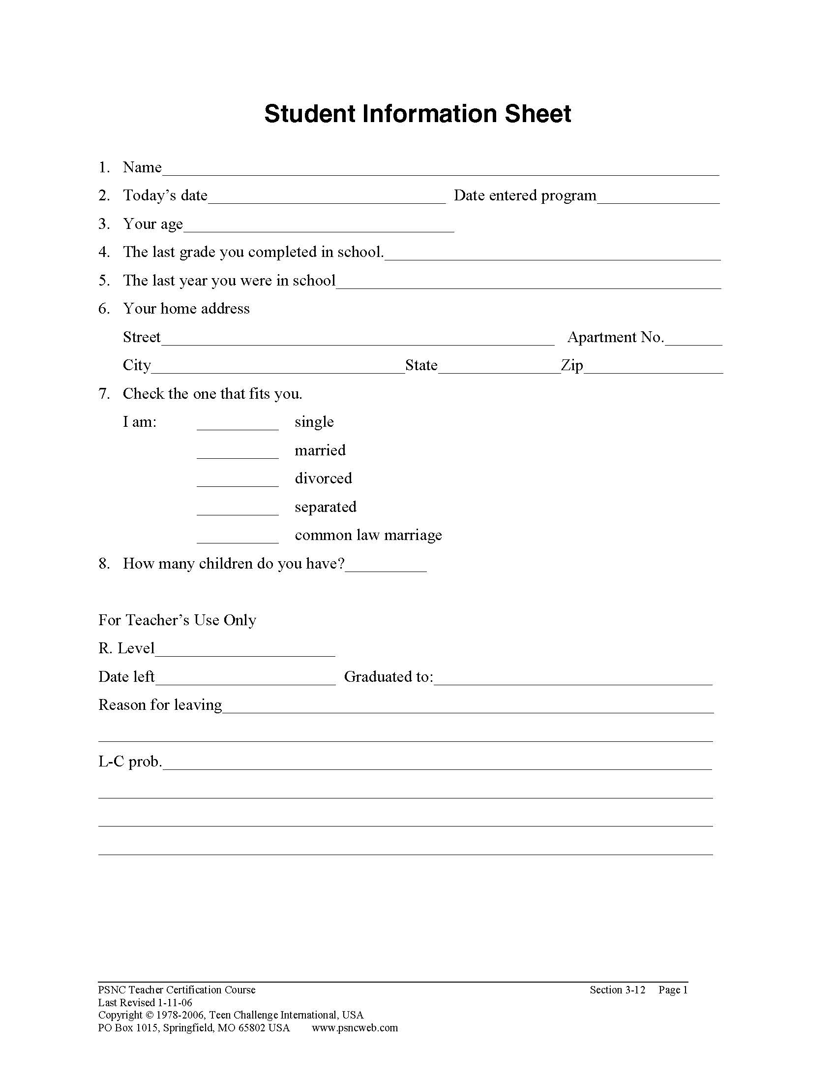
D. First day in the PSNC classroom for a new student
Have them fill out the Student Information Sheet.
Briefly go over the information they put on this sheet.

Slide 16
D. First day in the PSNC classroom for a new student
Briefly explain how the PSNC class functions.
Optional—give a reading placement test.
Give the student a Bible and any other class papers needed to start their work.

Slide 17
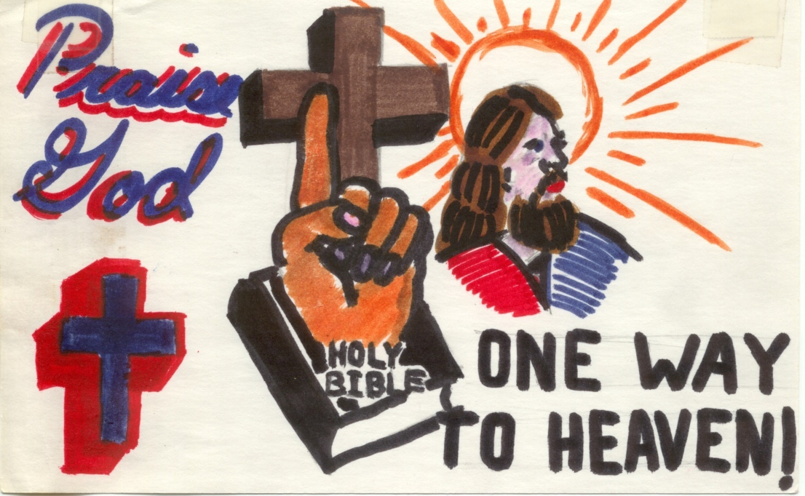
Explain how the flags are used in the classroom. Have the student make one.

Slide 19
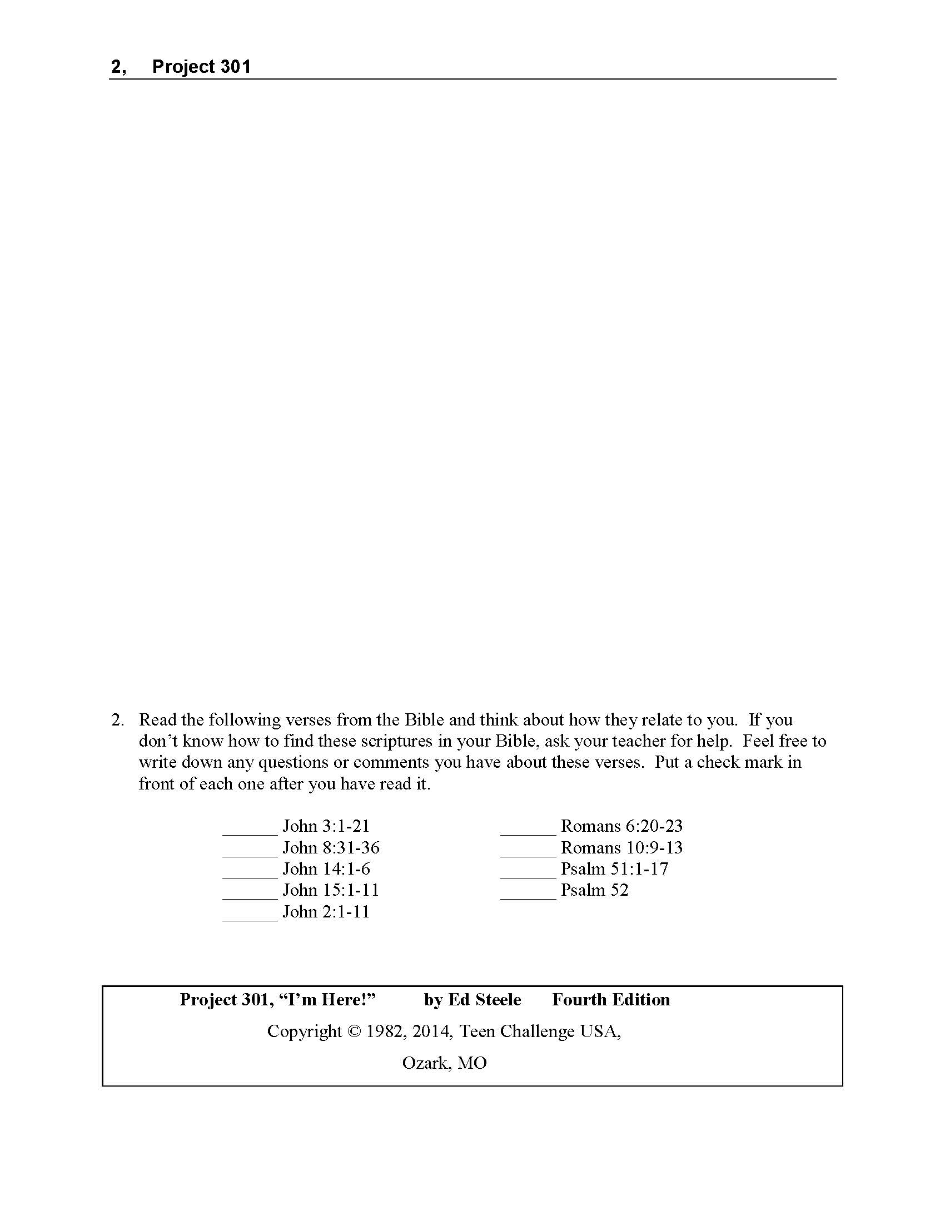
D. First day in the PSNC classroom for a new student
Give them Project 301, “I’m Here!” Explain that any time they need help to put up their flag.

Slide 20
D. First day in the PSNC classroom for a new student
Give them Lesson 101, and explain what needs to be done, especially at each stop point.

Slide 21
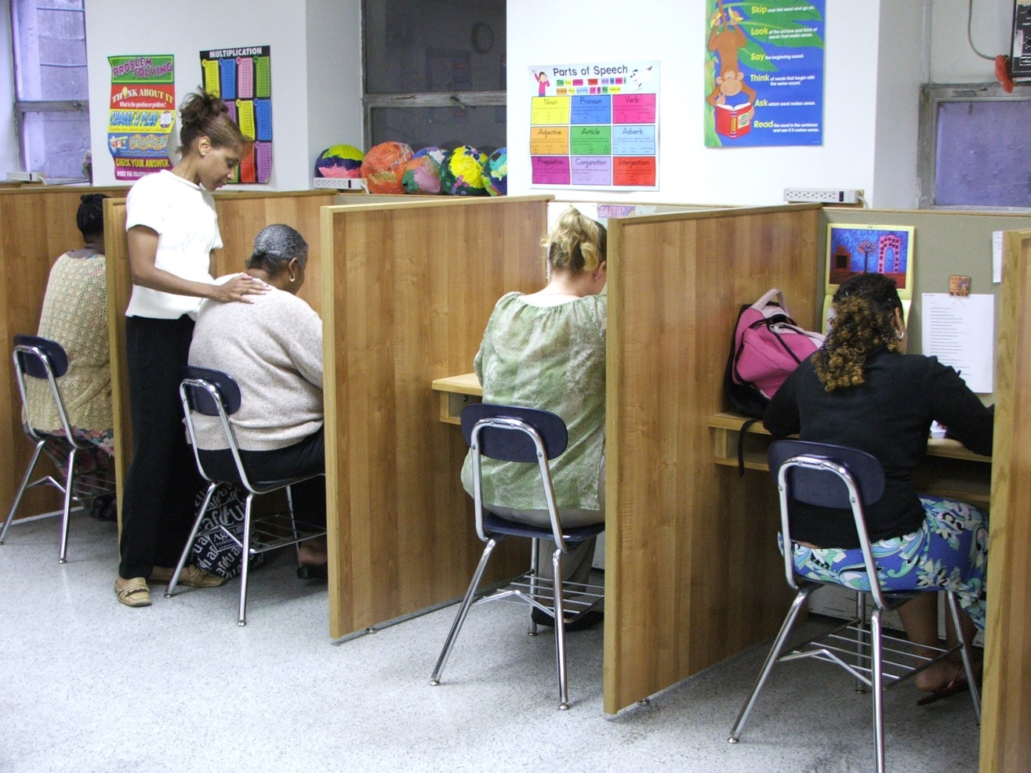
D. First day in the PSNC classroom for a new student
Regularly check with this student, even if they do not have their flag up.

Slide 23
E. Next days in the PSNC classroom for a new student
It may take more than one day, but when the new student finishes Lesson 101, then you have them complete the Scripture Memorization Class Student Manual, and then do their first Scripture Memory Verse.

Slide 24
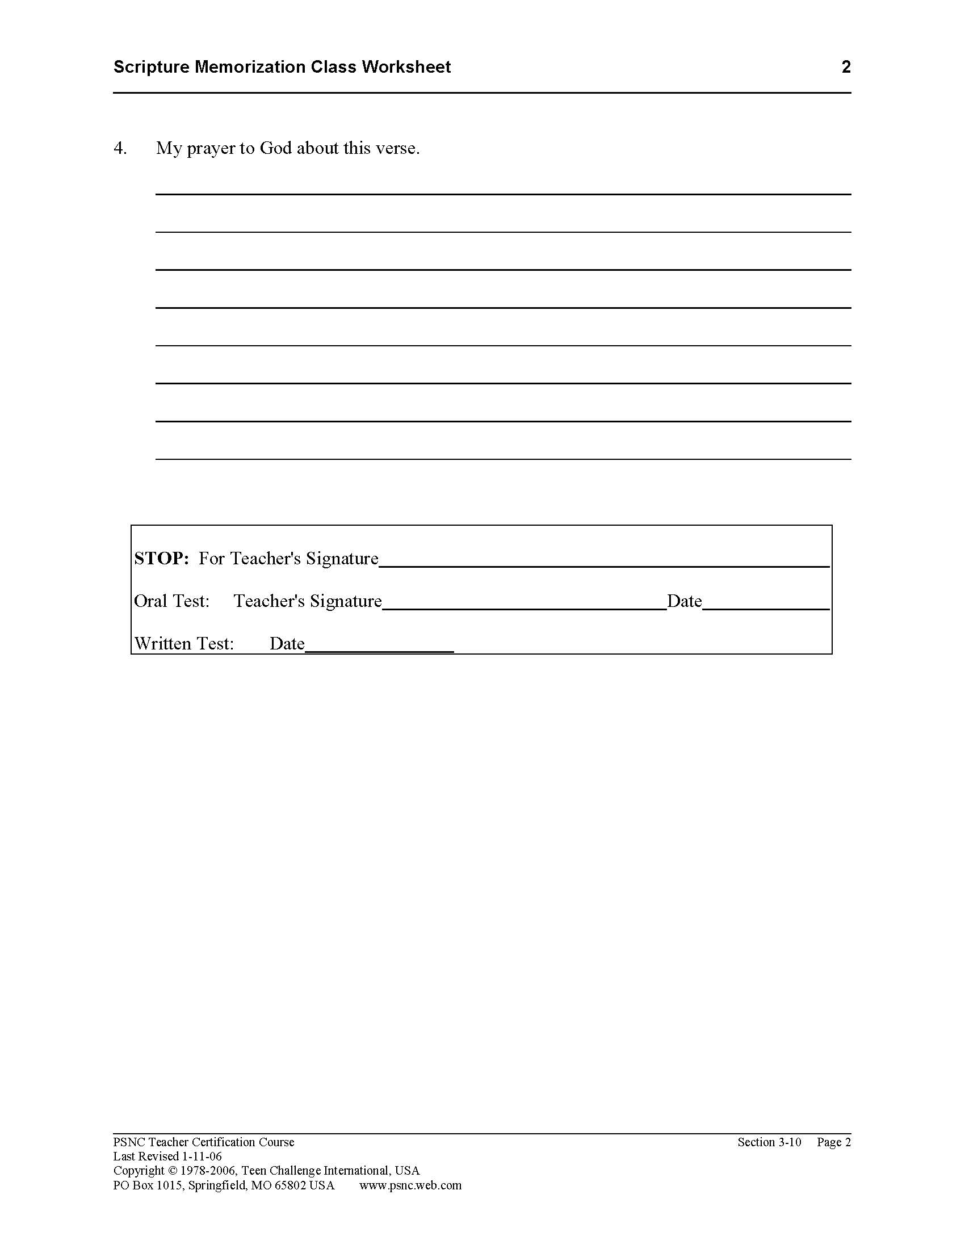

Slide 25
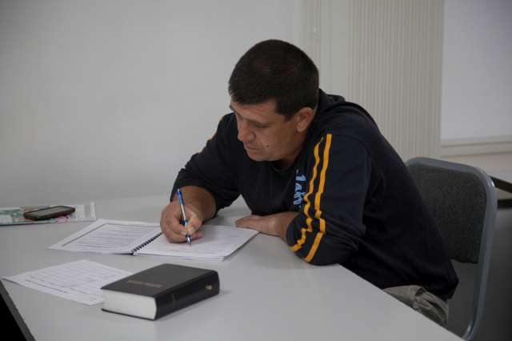
E. Next days in the PSNC classroom for a new student
It may take more than one day, but when the new student finishes Lesson 101, then you have them complete the Scripture Memorization Class Student Manual, and then do their first Scripture Memory Verse.

Slide 26
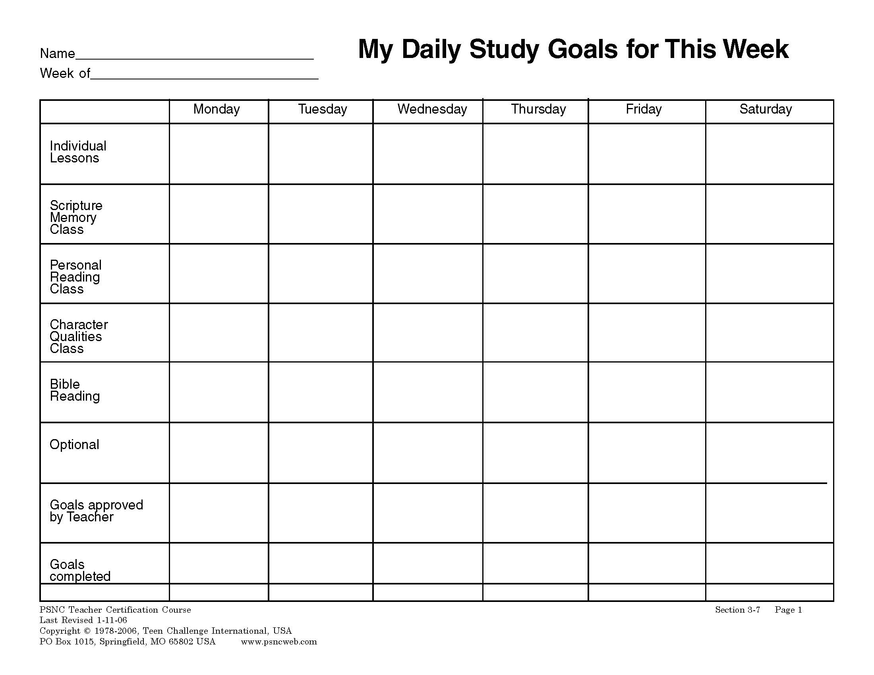
E. Next days in the PSNC classroom for a new student
After they complete their first Scripture Memory Verse, then you will give them 2 new things—Lesson 102 and a new Scripture Verse. Introduce the Daily Goal Sheet.

Slide 27
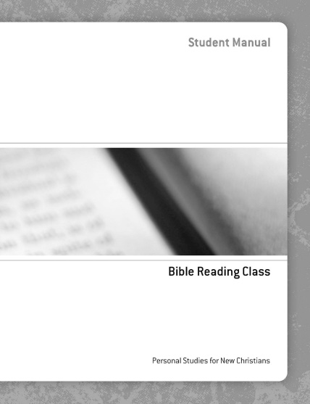
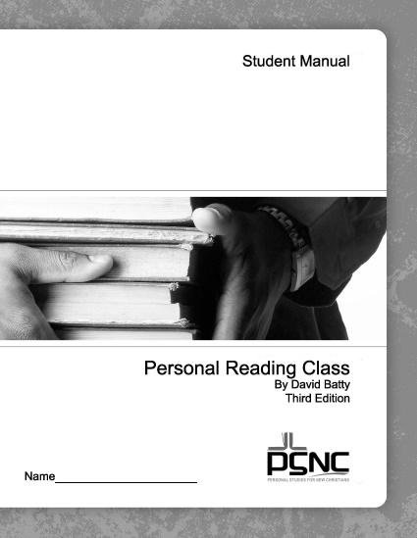
E. Next days in the PSNC classroom for a new student
After a few days, get them started on the Bible Reading Class.
After a few more days, get them started on the Personal Reading Class.

Slide 28
E. Next days in the PSNC classroom for a new student
After a few more days, get them started on the Character Qualities Class.

Slide 29
F. Teacher’s work after PSNC class each day
Take all the lessons out of the top stack tray labeled “To Test.”
Attach the Final Test to the lesson and put it back in the “To Test” tray.
Take all the papers out of the “File” stack tray. File them in the appropriate place.

Slide 30
F. Teacher’s work after PSNC class each day
Take all the papers out of the stack tray labeled “Tested.”
Grade all papers and tests. Record scores on the Student Record Sheet.

Slide 32
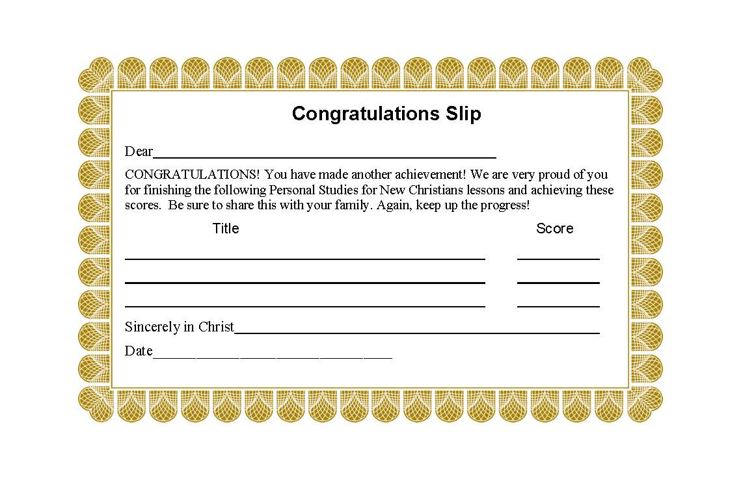
Put the graded papers in the tray labeled “Conference.” These are ready for class for tomorrow.
Create a Congratulations Slip for each student who completed a Lesson, etc.

Slide 33
F. Teacher’s work after PSNC class each day
Plan your agenda for the next class session, especially the opening exercises.
Check the new goals on the Daily Goal Sheet for each student if you did not do this during class time.

Slide 34
10. Make every effort to get all grading of student papers completed before the next class session. Immediate feedback is very helpful to the students.

Slide 35
For more information on the daily work of the teacher in the PSNC
The PSNC website has free downloads at www.iTeenChallenge.org
Section One of the PSNC teacher training materials.

Slide 36
Your PSNC gift to your students

Slide 37
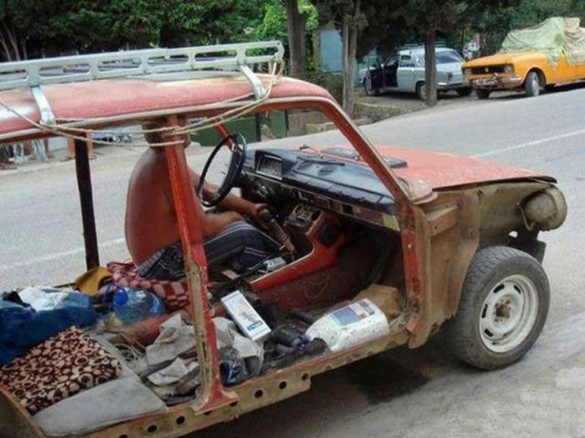
Not this PSNC!

Slide 38
Questions for discussion

Slide 39
CONTACT INFORMATION
Global Teen Challenge
www.GlobalTC.org
www.iTeenChallenge.org

