Slide 1
Achievement, Grading & Testing
By Dave Batty

Slide 2
Positive Reward -- Gas

Slide 3
A. Achievement in the PSNC classes
We are more than an academic school.
Most important lessons learned must change the life of the student.
What are God’s achievement standards for each student?
How can we influence each student to become a life-long learner?

Slide 4
Tests & Grading -- Mirrors

Slide 5
B. A close look at the grading procedures in the PSNC
Each student works at his own desk, at his own speed.
STOP POINTS—At certain points in his daily studies he must stop and discuss his progress with his teacher.

Slide 6
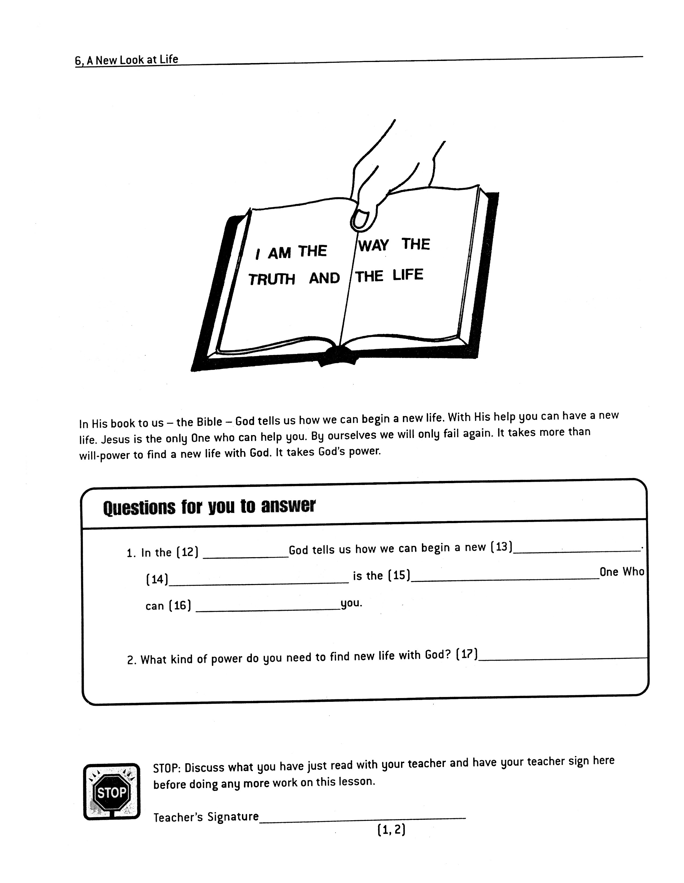

Slide 7
(1)

Slide 8
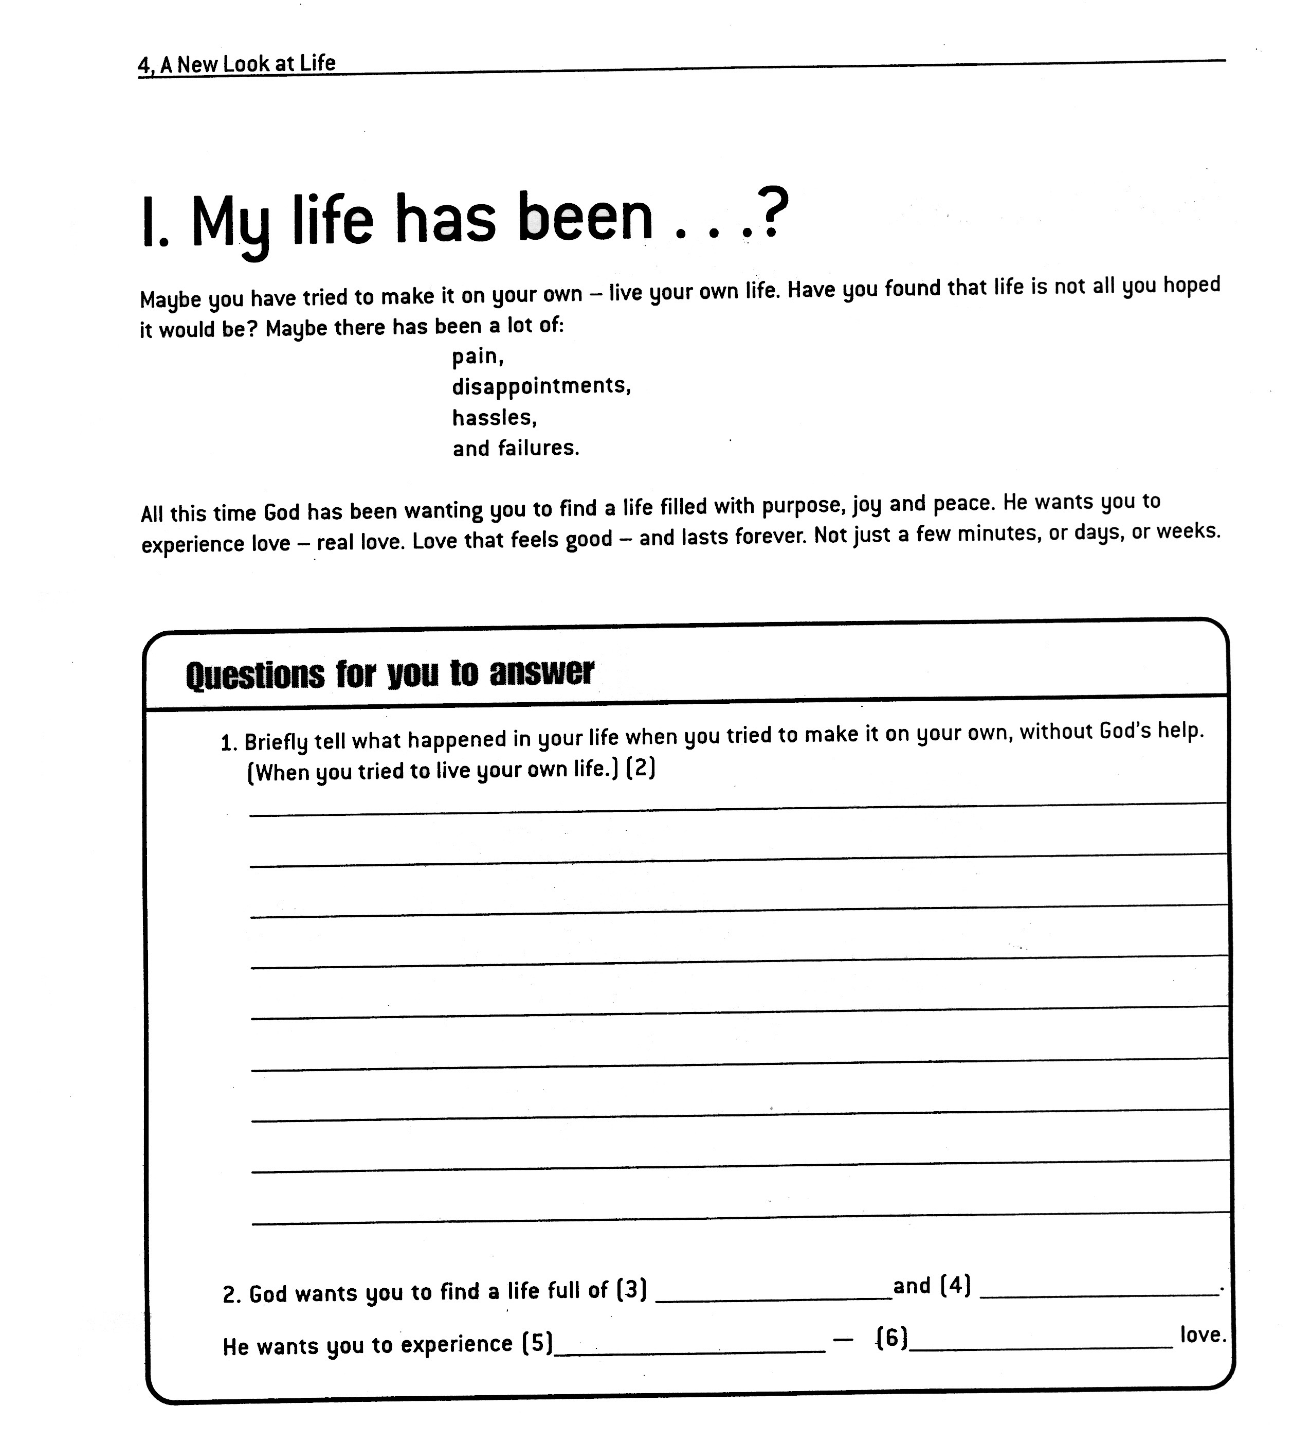

Slide 9
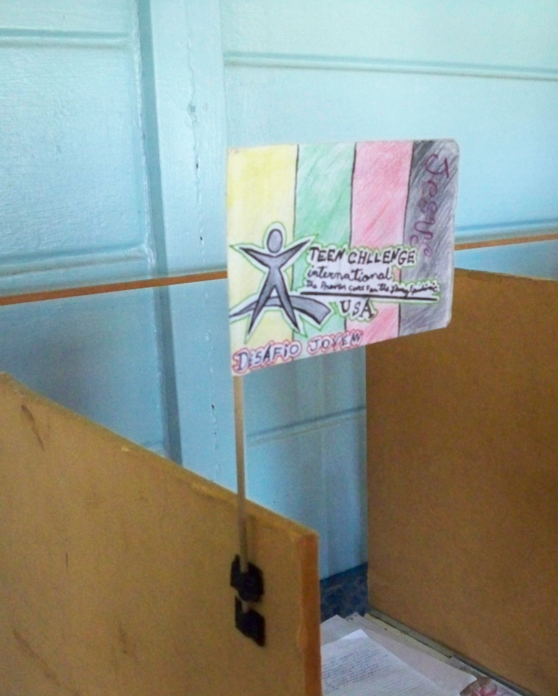
B. A close look at the grading procedures in the PSNC
The student uses his flag to let the teacher know he is needing to talk.

Slide 10
C. Teacher responsibilities at each STOP POINT
Check to make sure they have completed all questions. --one word in each answer—fill-ins
Questions which require a personal answer --numbers under teacher signature at STOP POINT.

Slide 12
D. Teacher responsibilities at each STOP POINT for the Personal answer questions
“Would you read your answer out loud to me and then explain it in a little more detail?”
Especially for new students, give them time to share.
Don’t try to get them to give you “right” personal answers.

Slide 13
E. More Teacher responsibilities at each STOP POINT
Give the student your full attention.
After you have discussed their answers, sign the line at the STOP POINT and allow them to continue their work.
At the next STOP POINT, cover the new material covered since the last STOP POINT.

Slide 14
F. At the end of the lesson
Discuss the last section of the lesson they have completed. Then sign the line for “Lesson Completed.”

Slide 15
At the end of the lesson—cont.
Next have the student grade the whole lesson—using the Student Lesson Answer Key book.

Slide 17
At the end of the lesson—cont.
Then sign the “Grading Completed” line and explain the tests to be taken.

Slide 18
G. The tests for each lesson
The SELF TEST is a trial run for the student.
The FINAL TEST should be taken the next day.
The teacher will grade the FINAL TEST and discuss the results with the student, especially the personal answers.

Slide 19
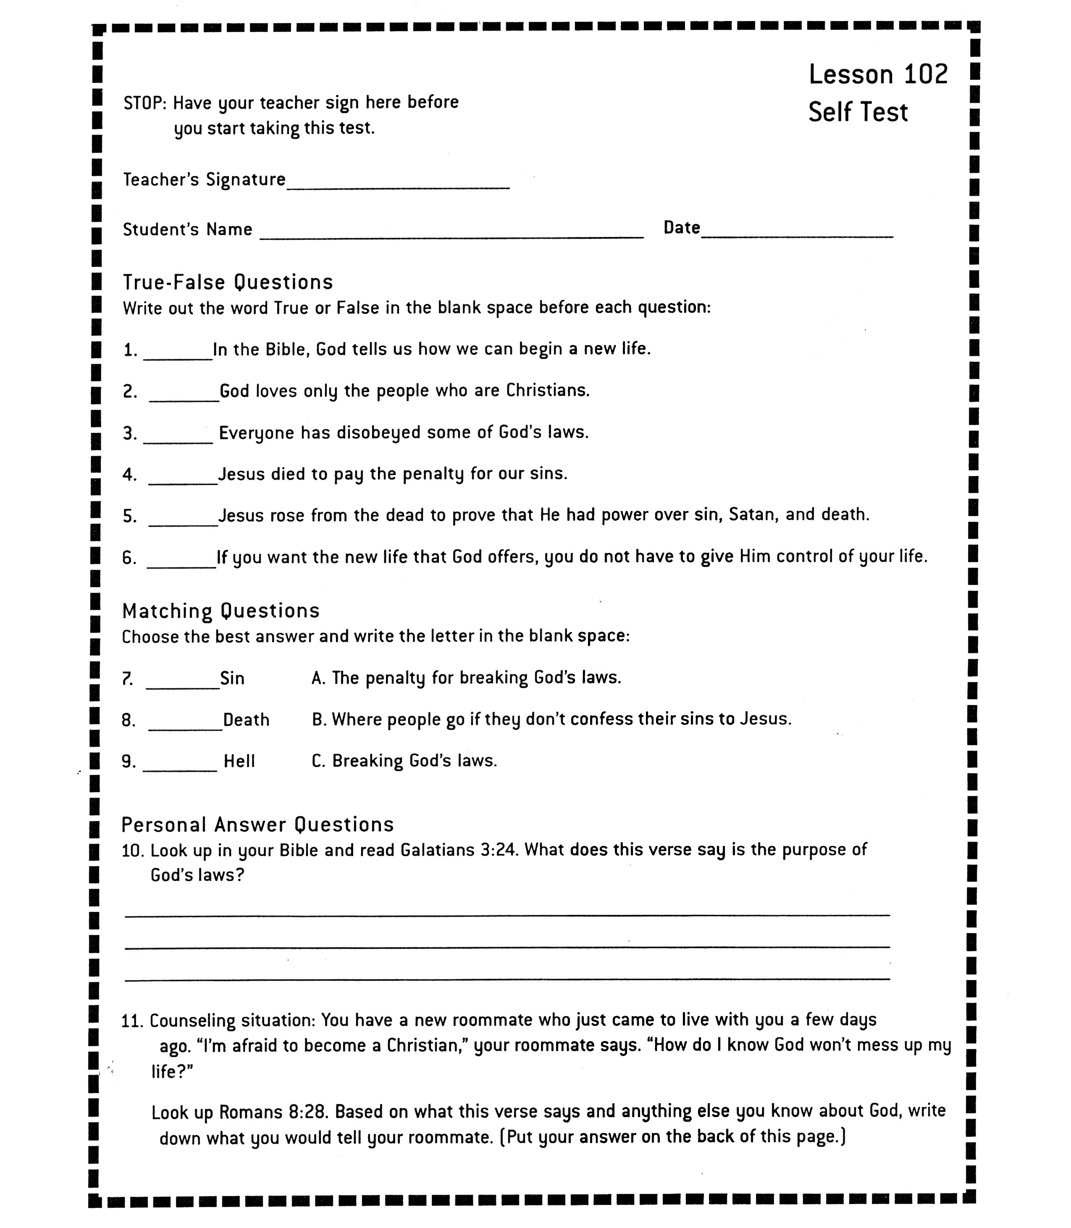

Slide 20
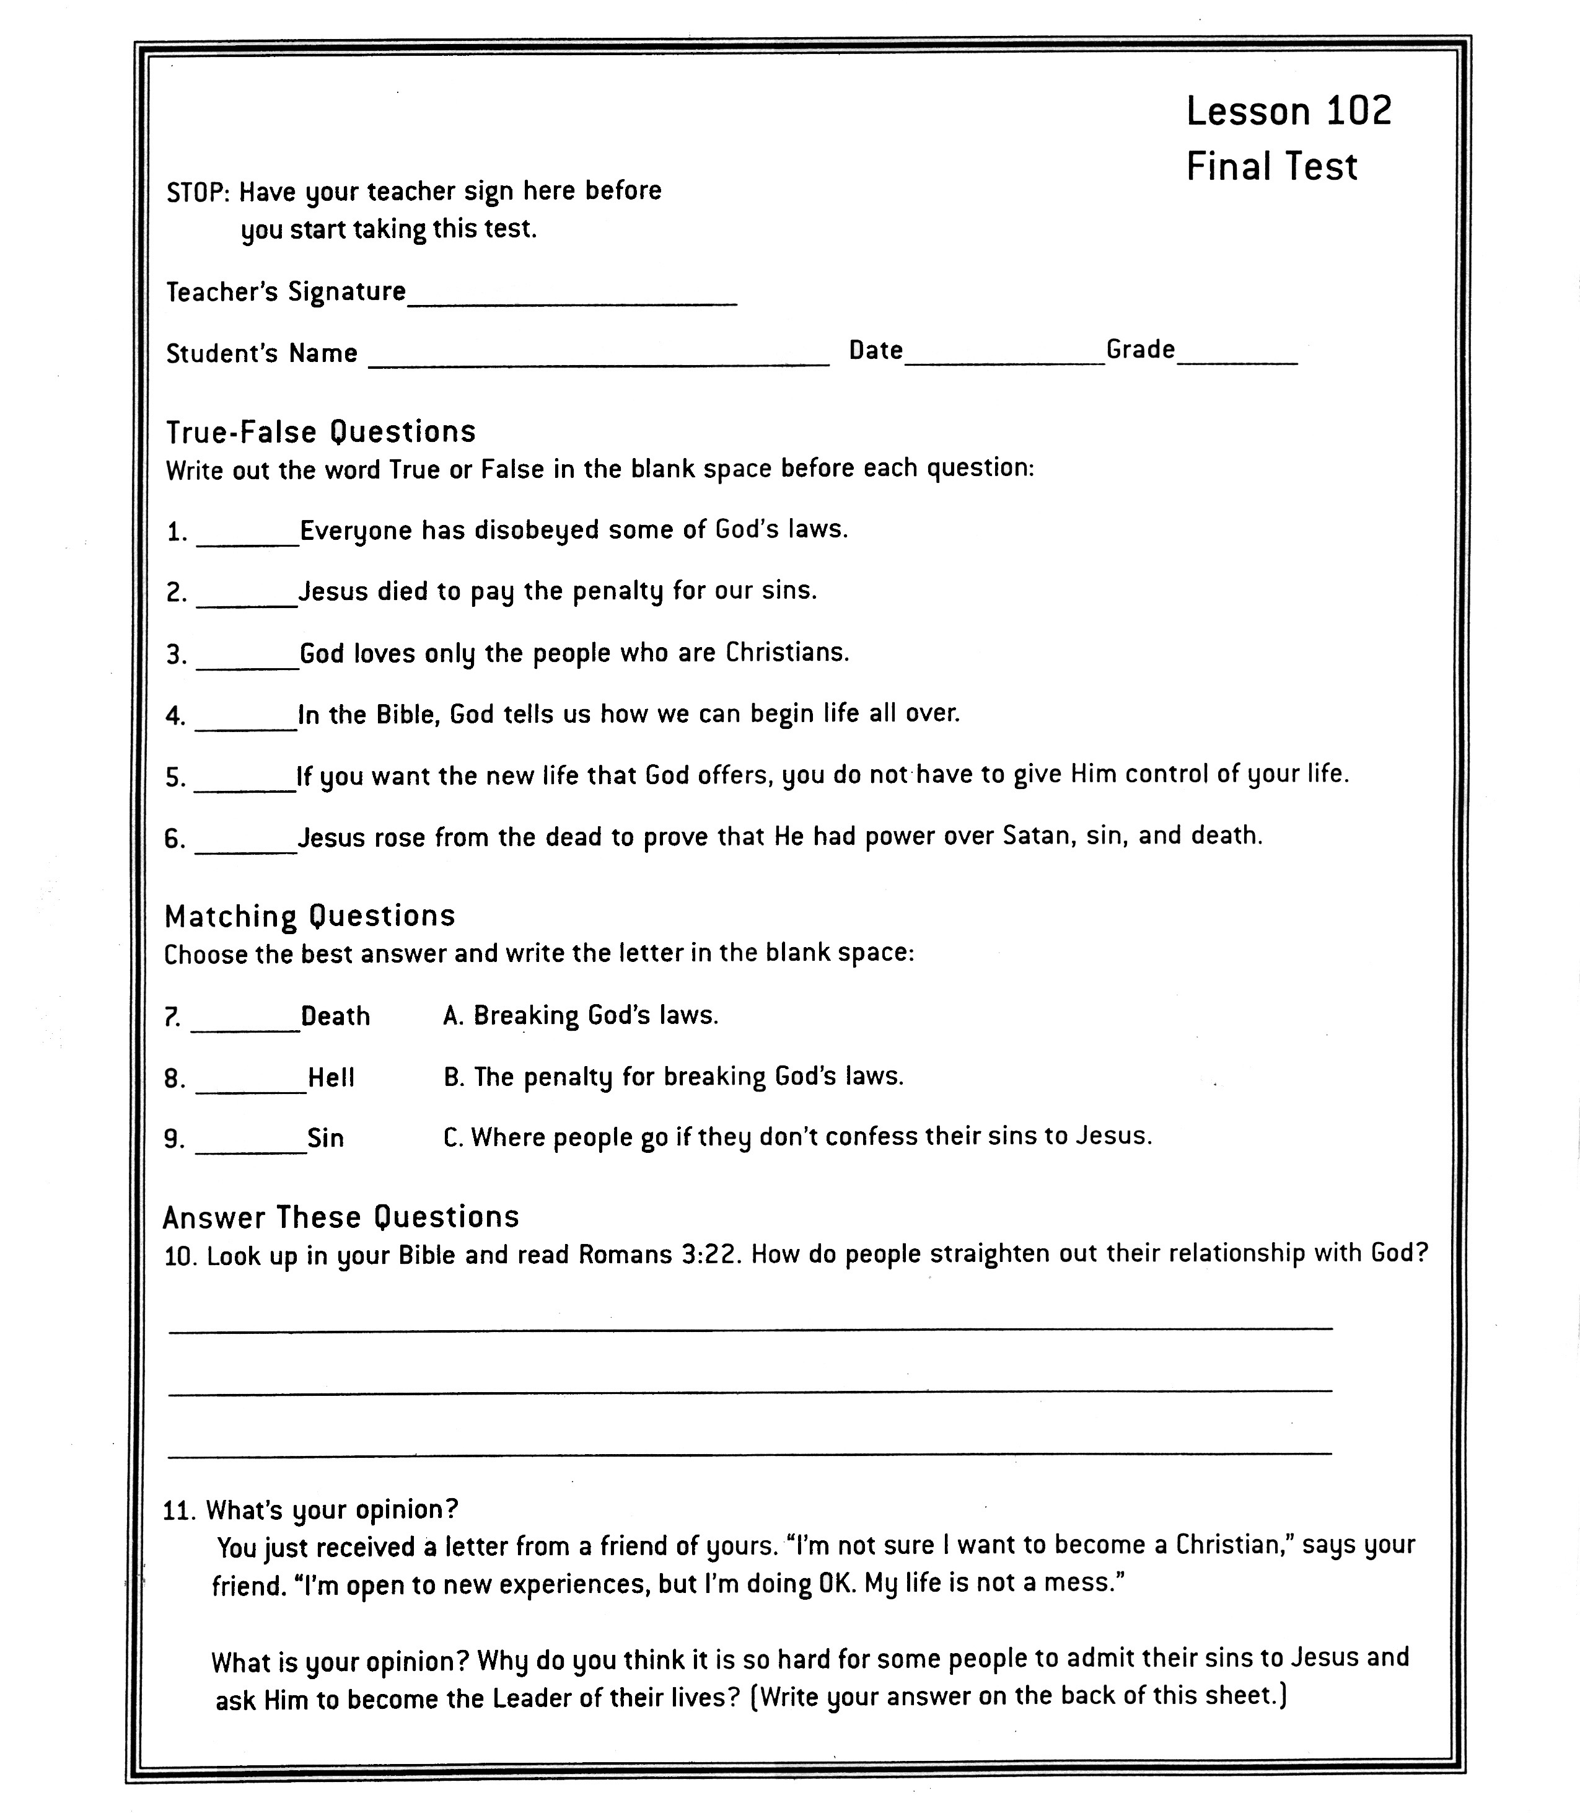

Slide 21
Positive Reward -- Gas

Slide 22
H. The recognition for each lesson successfully completed
Give the student words of encouragement when discussing the final test results.
Give the student a “Congratulations Slip.”

Slide 23
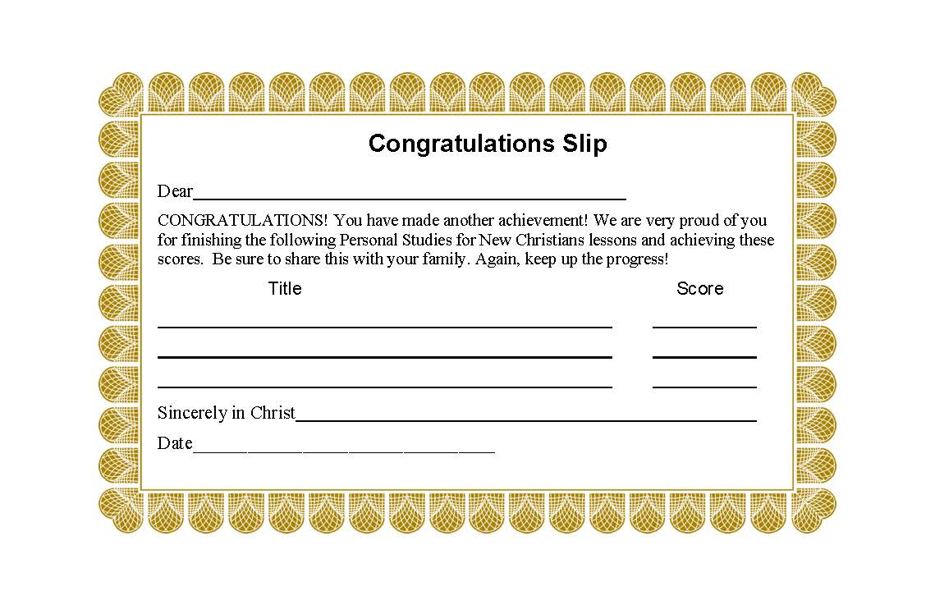
H. The recognition for each lesson successfully completed

Slide 24
H. The recognition for each lesson successfully completed
Give the student words of encouragement when discussing the final test results.
Give the student a “Congratulations Slip.”
Have the student record their grade on their “Achievement Record.”

Slide 25
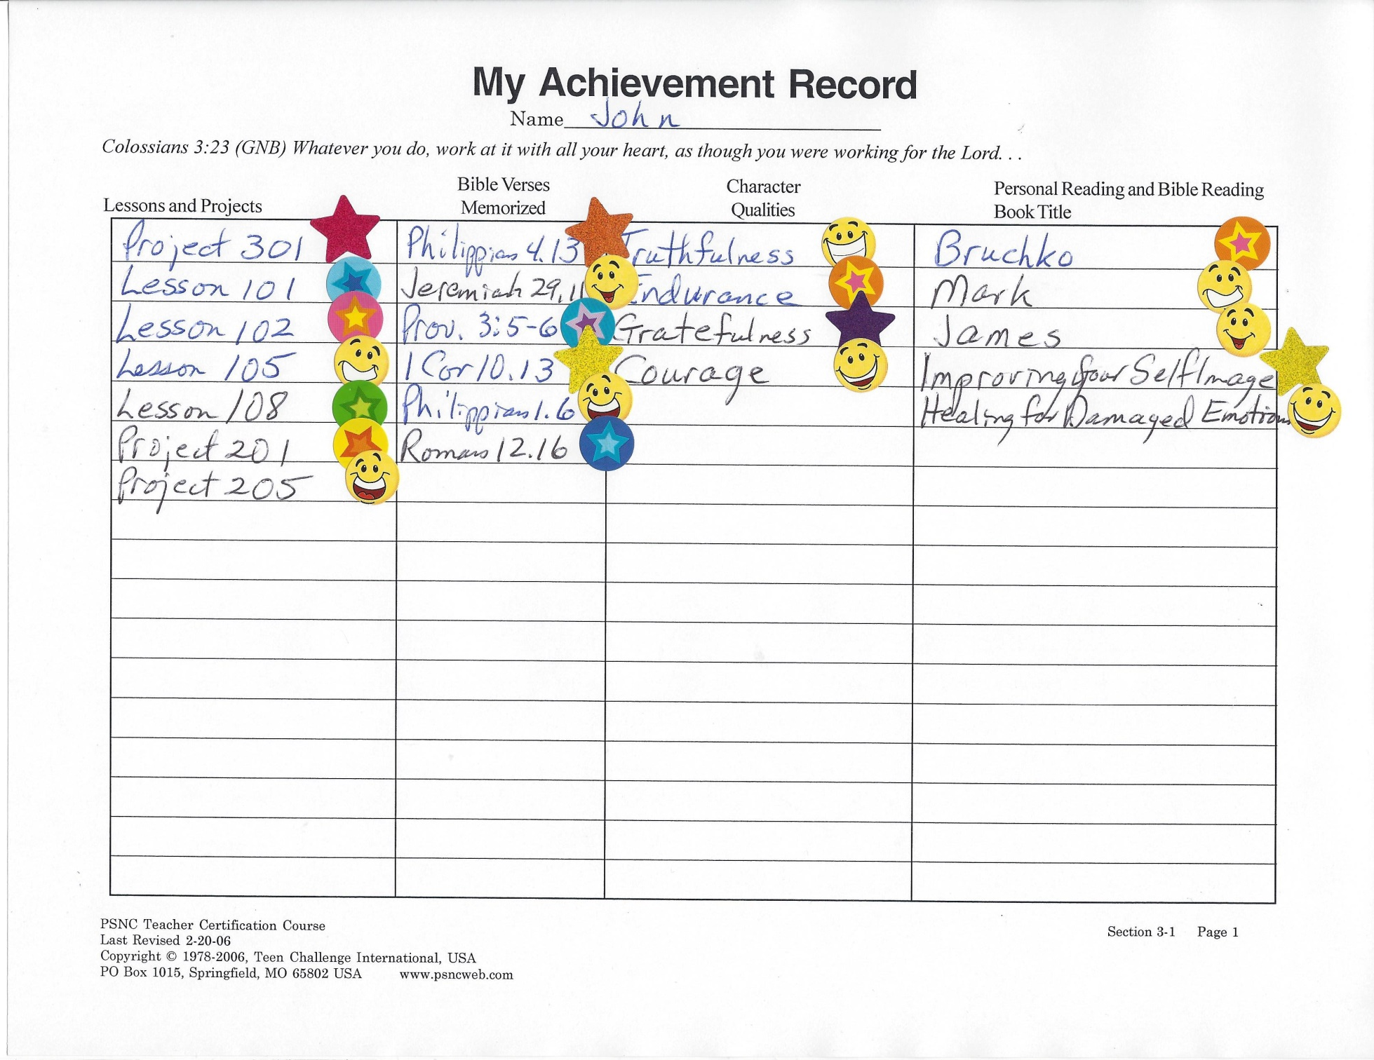

Slide 26
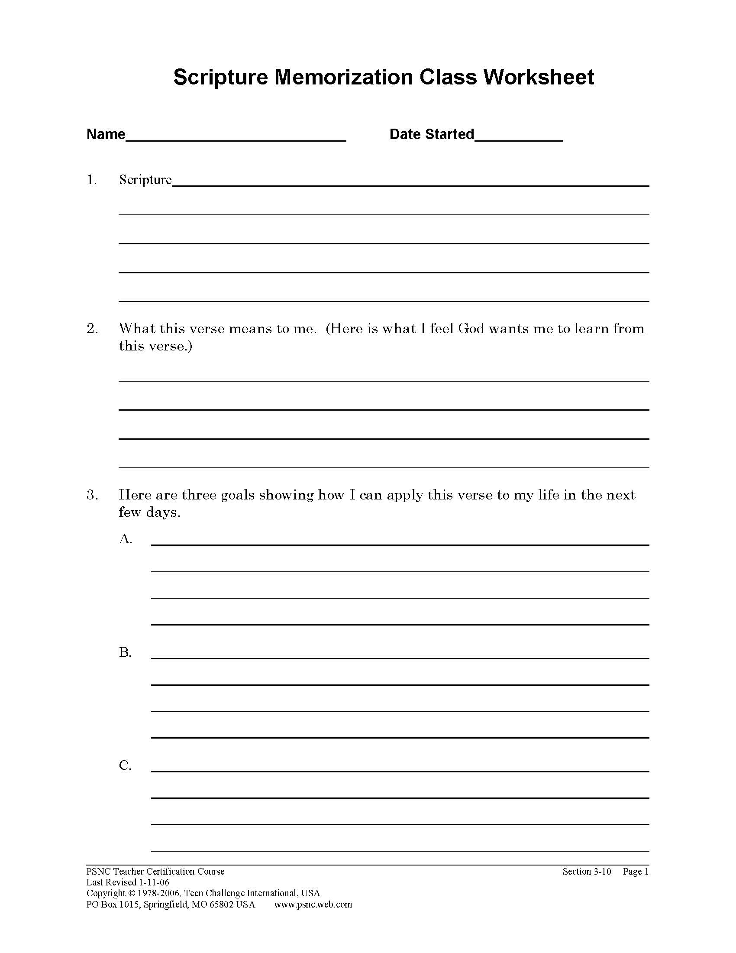
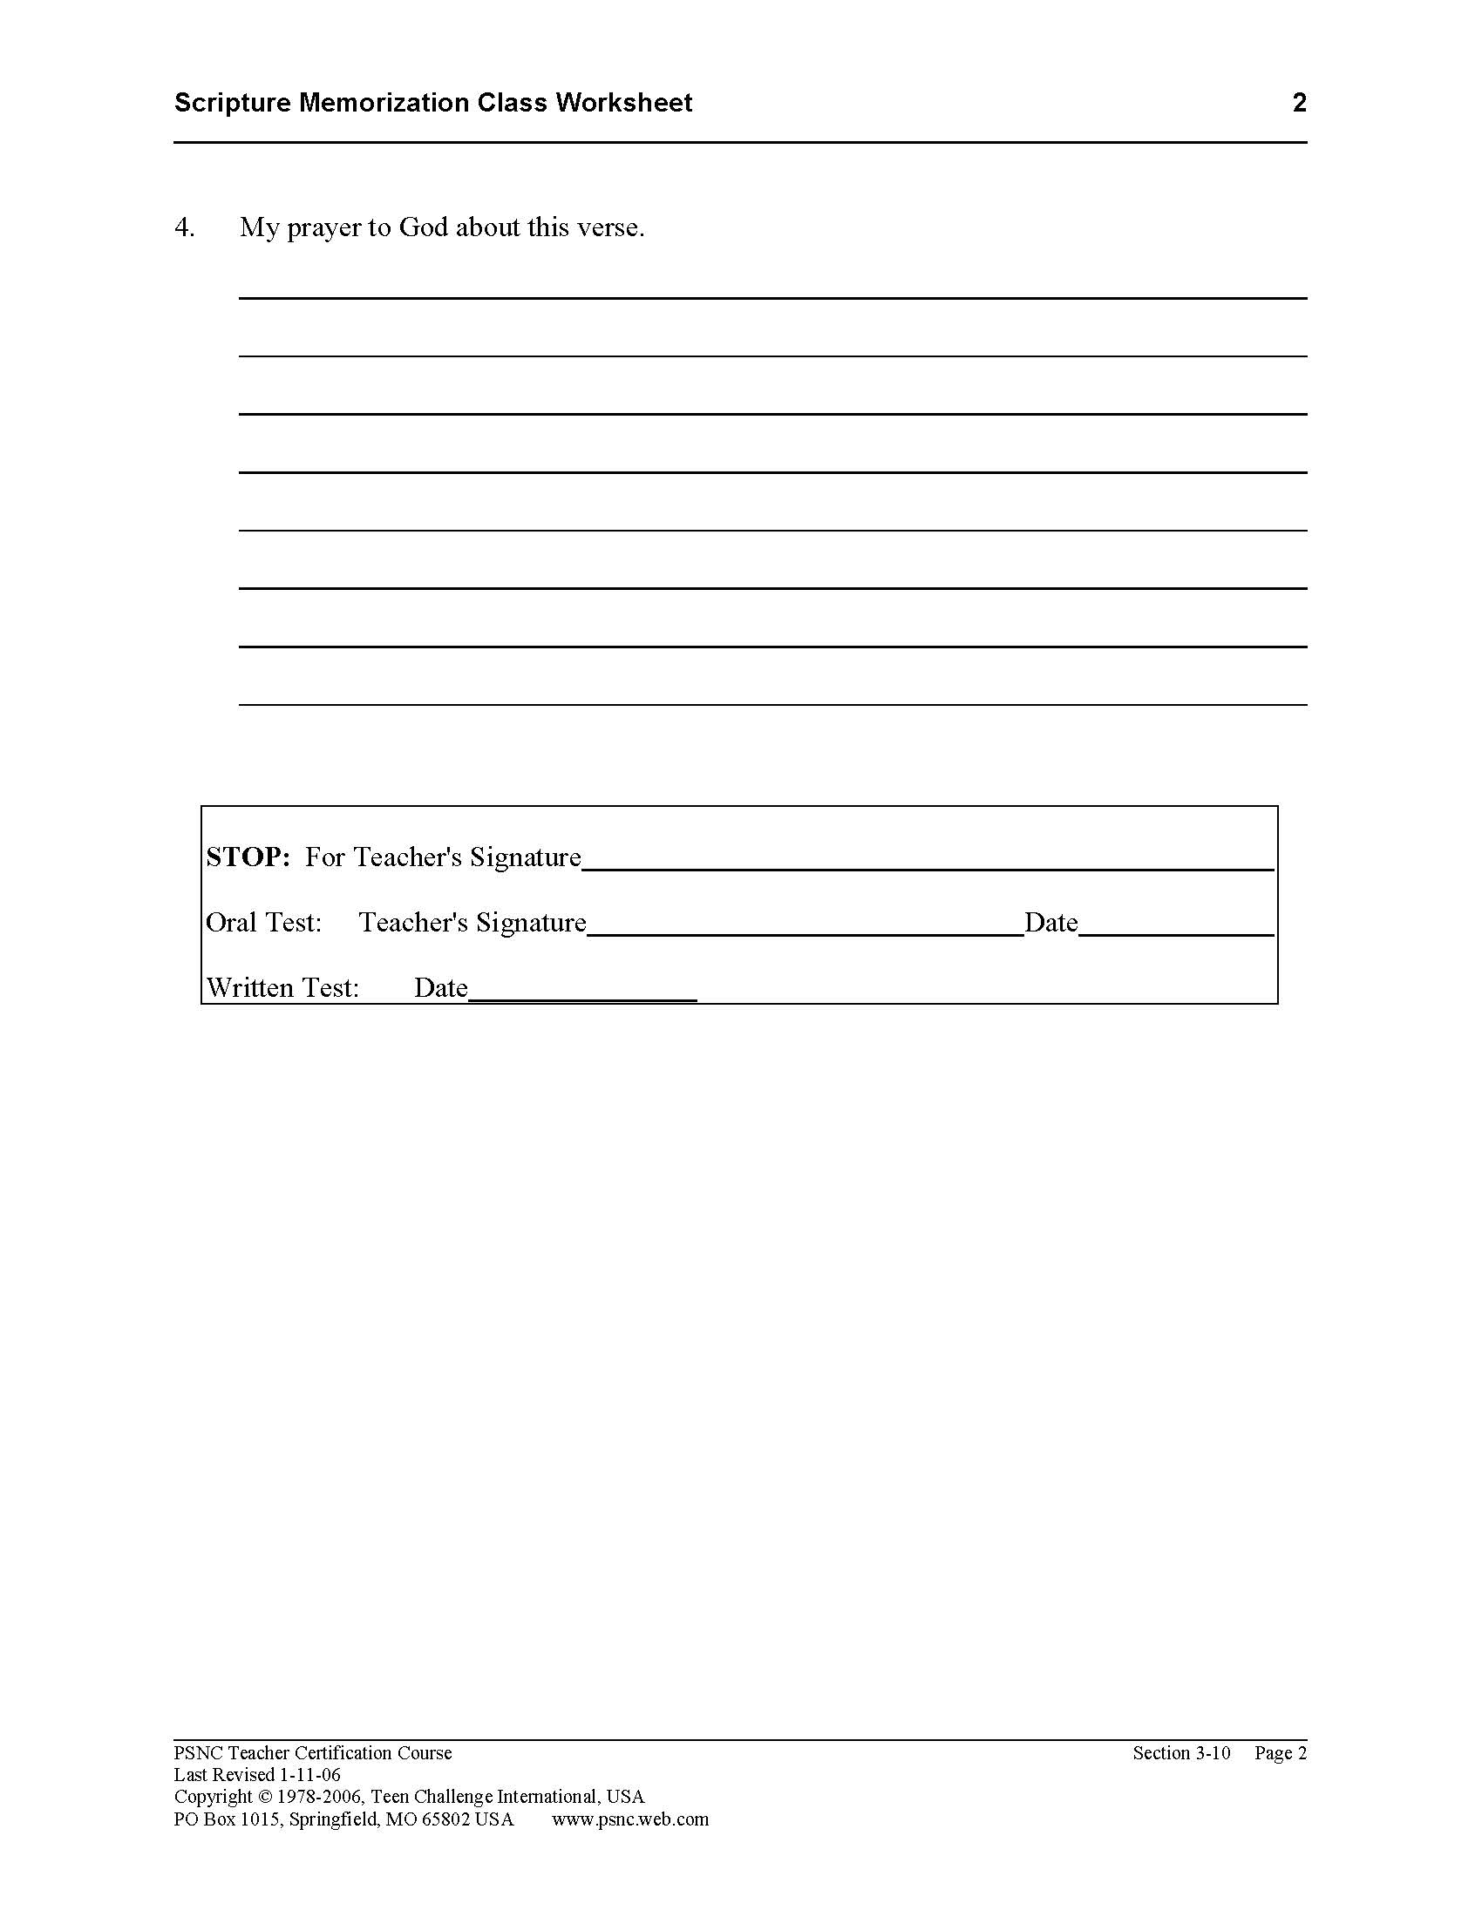
I. Grading their Scripture Memorization work
Each student fills out the Scripture Memorization Worksheet.

Slide 27
I. Grading their Scripture Memorization work
When he has memorized the verse, he first does an oral test, and quotes it to the teacher.
The student takes the written test on the verse the day after completing the oral test. Use the SMC Final Test Form.

Slide 28
I. Grading their Scripture Memorization work
The final test includes writing the verse from memory and giving a written evaluation of how they have put at least one of their goals into action.

Slide 29
I. Grading their Scripture Memorization work
The student receives a Congratulations Slip after successfully completing the verse.
The student enters this verse on his Achievement Record.

Slide 30
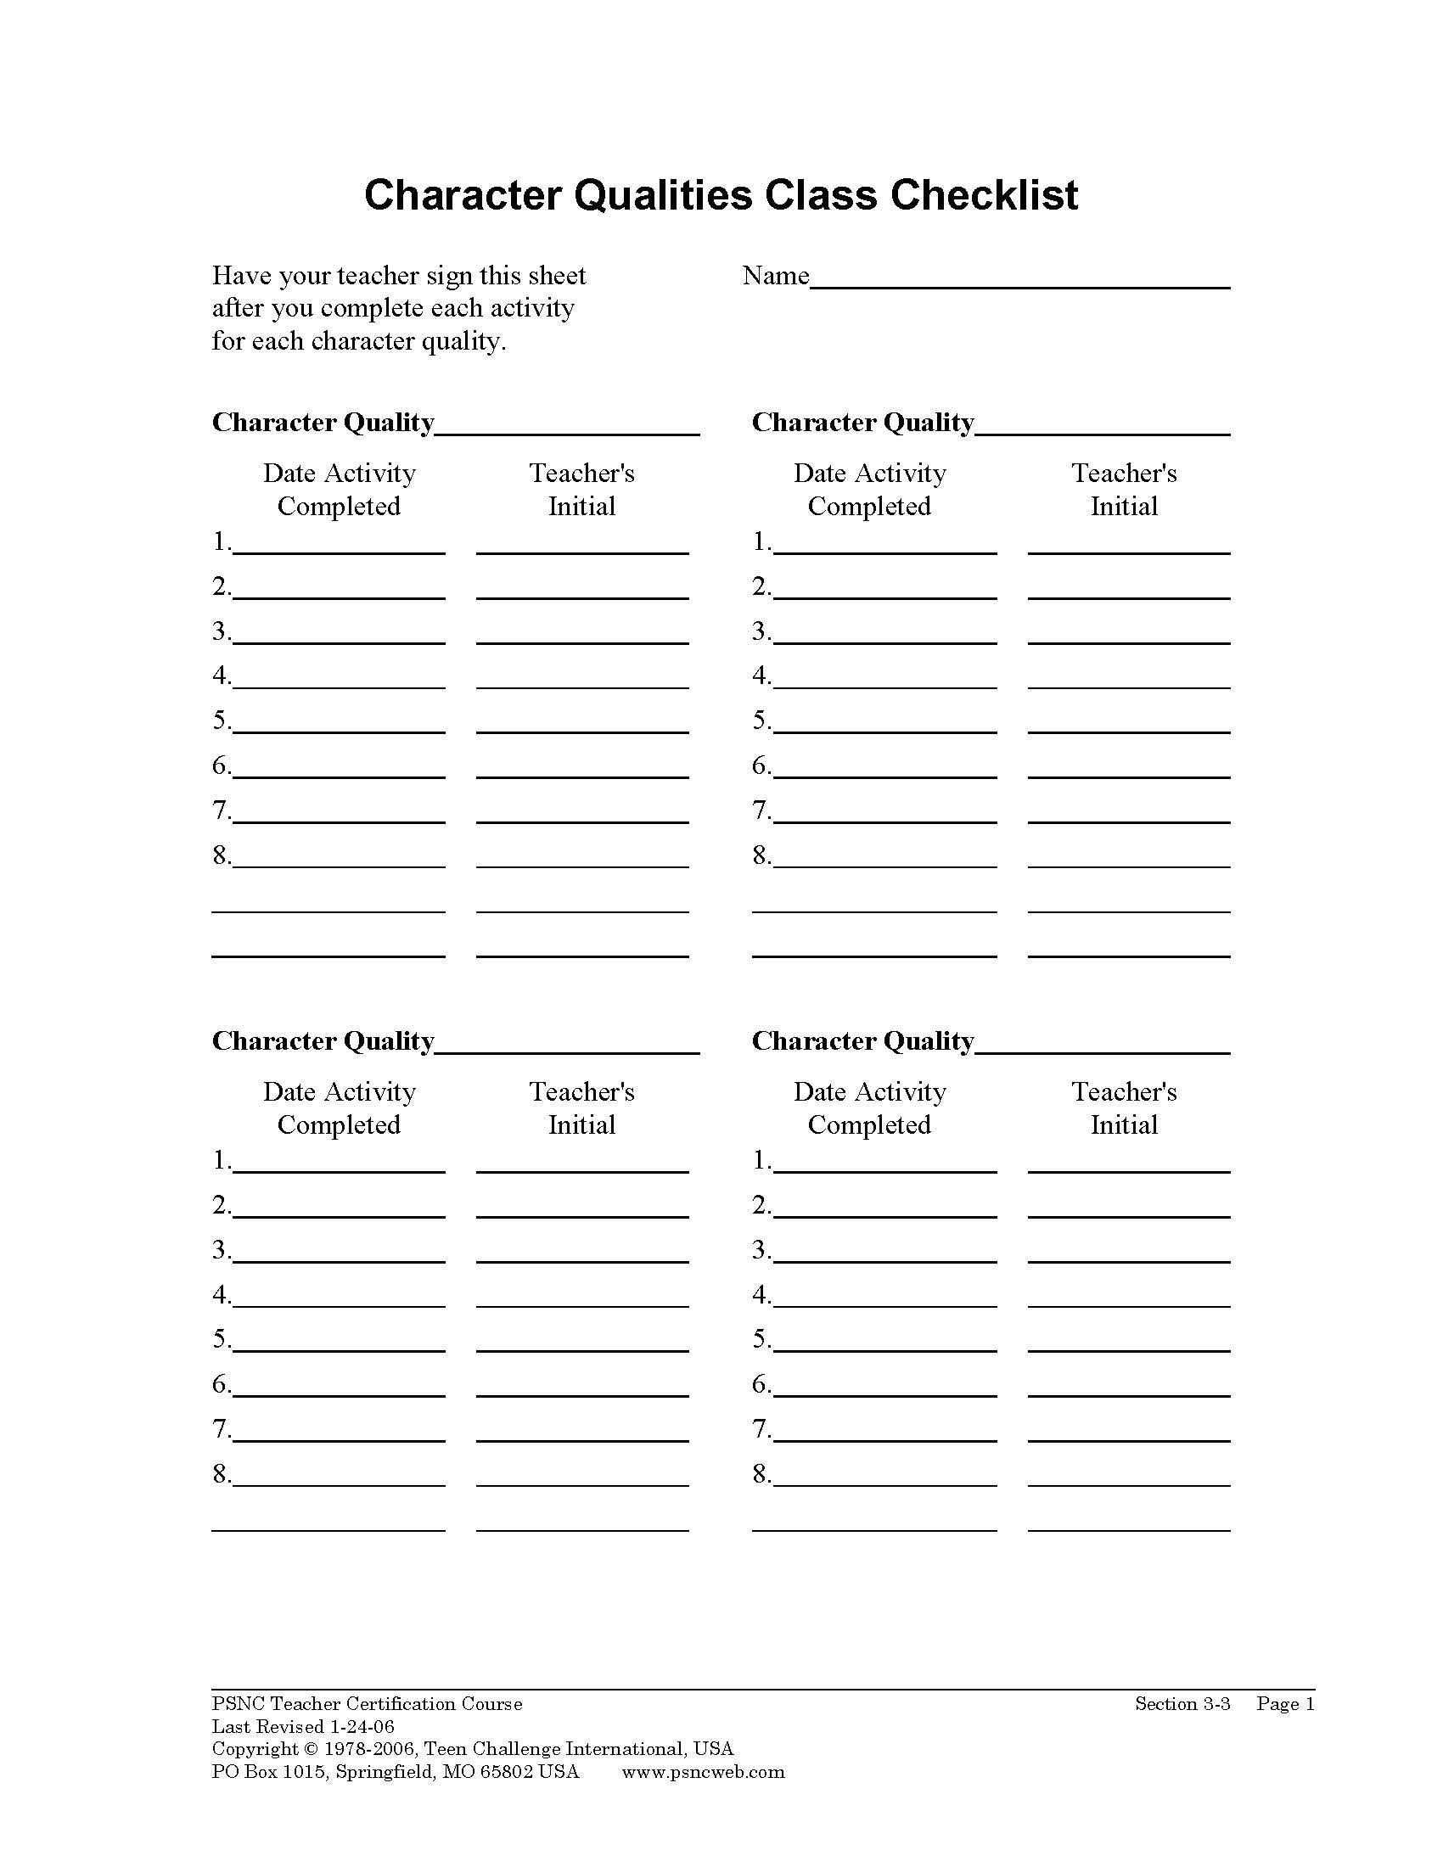
J. Grading their Character Qualities classwork
Each student completes the 8 required learning activities for the character quality.

Slide 31
J. Grading their Character Qualities classwork
When he has memorized the definition of the character quality, he takes a quiz.
The three tests related to each character quality cannot be taken the same day.

Slide 32
J. Grading their Character Qualities classwork
Take time to discuss with the student their answers on the final test, stressing the need to continue to use this character quality in their daily living.

Slide 33
J. Grading their Character Qualities classwork
The student receives a Congratulations Slip after successfully completing the final written test.
The student also enters this character quality on his Achievement Record.

Slide 34
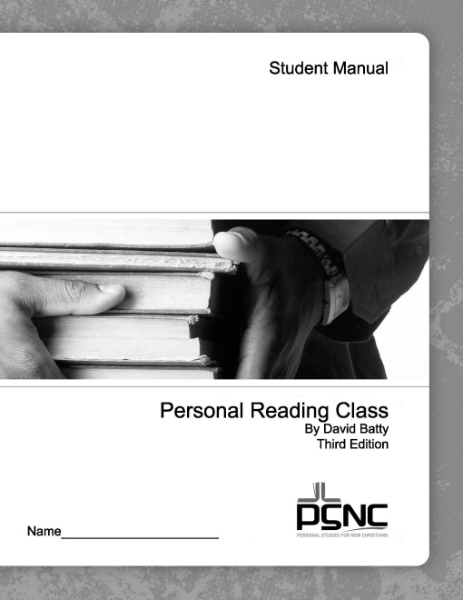
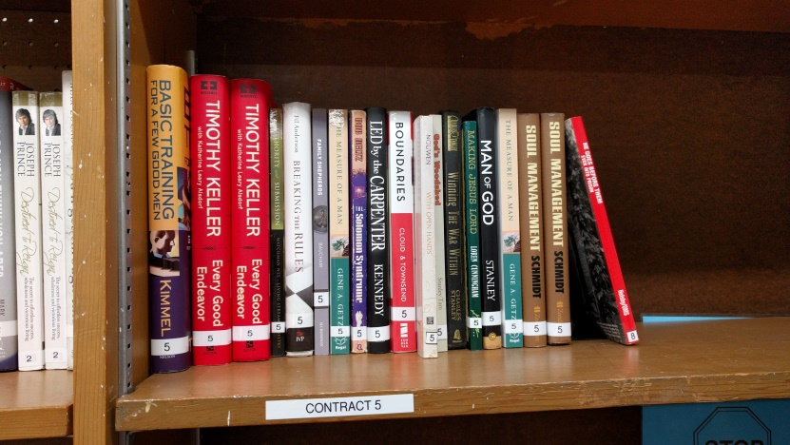
K. Grading their Personal Reading classwork
When the book is assigned to the student, there should be specific goals, questions or issues that the student will seek as he reads the book.

Slide 35
K. Grading their Personal Reading classwork
Each student completes the Daily Summaries on the book they are reading.
When he has completed the book, he writes a book report. This should address the goals identified at the beginning.
You may want to have the student give an oral report on this book to the whole class, telling what they learned from reading this book.

Slide 36
K. Grading their Personal Reading classwork
The student receives a Congratulations Slip after successfully completing the book.
The student also enters this book on his Achievement Record.

Slide 37
L. The purpose of the tests in PSNC
The test is a tool to help the student take seriously what we are expecting them to learn.
More important than the test score is that the student personally apply in his life the lessons he is studying.
The test becomes another opportunity for the teacher to discuss the progress of the student. Not spelling of words, but life issues.

Slide 38
Positive Reward -- Gas

Slide 39
M. Motivating your students to achieve through positive reward
What has been the “success factor” in the life of each student?
Your style of teaching can have a major impact on motivating your students. --Who was the worst teacher in your life? --Who was the best teacher in your life?
Take time to write encouraging comments on the work papers of your students.

Slide 40
M. Motivating your students to achieve through positive reward
Award the Congratulations Slips publicly
Give each student a star or sticker to put on their Achievement Record.
Share good examples of their work with their family and other staff.
Include excellent examples in your sample class work in a notebook in the classroom.

Slide 41
Positive Reward -- Gas

Slide 42
Tests & Grading -- Mirrors

Slide 43
Questions for discussion

Slide 44
Contact information
Global Teen Challenge
706-576-6555
www.GlobalTC.org
www.iTeenChallenge.org

