Slide 1
ЗНАКОМИМ С ИНДИВИДУАЛЬНЫМИ ЗАНЯТИЯМИ ДЛЯ НОВООБРАЩЕННЫХ ХРИСТИАН Introducing the Personal Studies for New Christians curriculum Автор Дэвид Бэтти By Dave Batty
Notes:
P3: Introducing the Personal Studies for New Christians curriculum

Slide 2
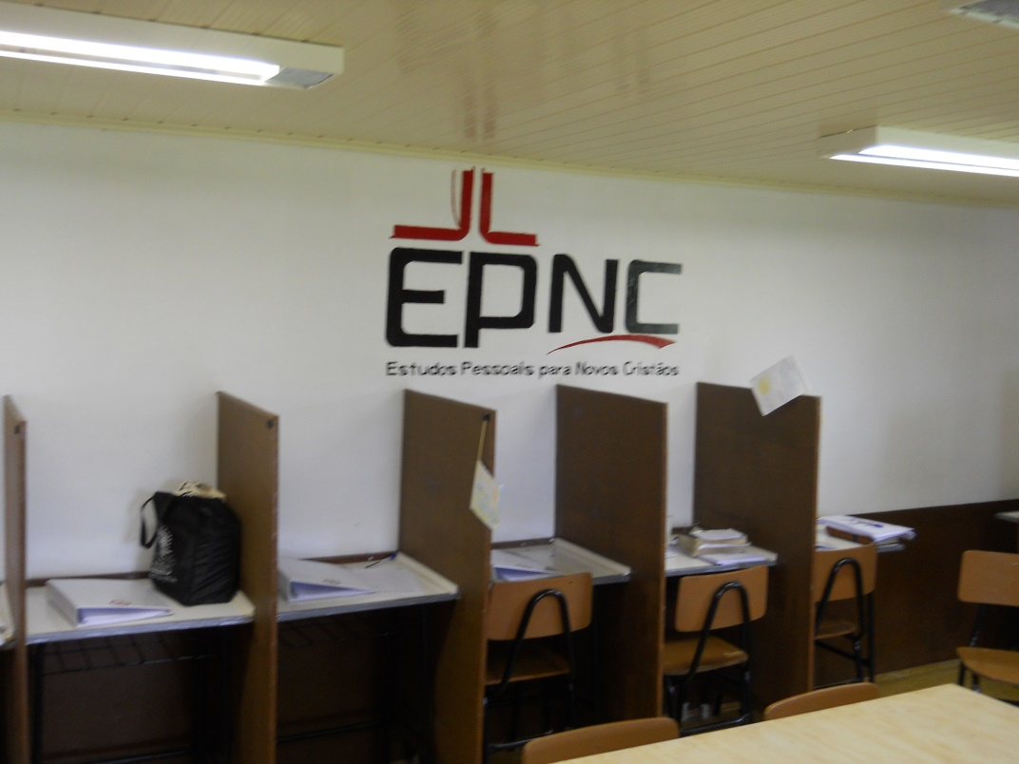
Notes:
This picture shows a chicken coop that was converted into the PSNC classroom at on TC center in Brazil.

Slide 3
Notes:
Shows teacher discussing class work with one of the students.

Slide 4
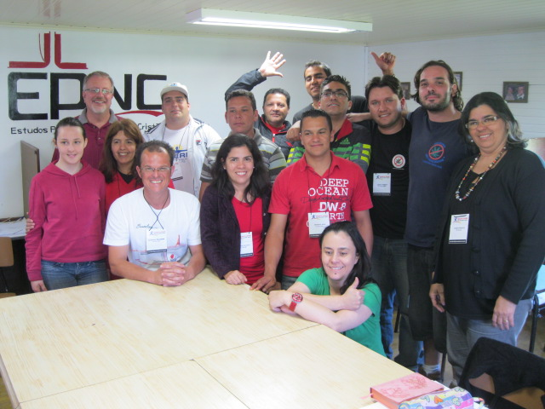
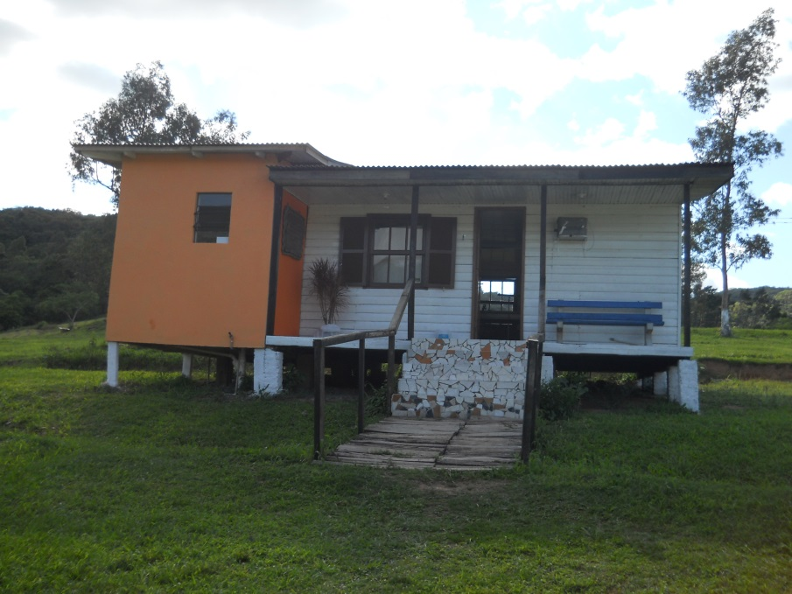
Я увидел повышение эффективности нашей программы на 80%!
In one year, I have seen an 80% increase in the effectiveness of our program after we started using the PSNC classes
Notes:
The director of that center said, “In one year, I have seen an 80% increase in the effectiveness of our program after we started using the PSNC classes!”

Slide 5
Благодаря этим занятиям существенно возрос общий уровень зрелости наших студентов и значительно уменьшилась необходимость в дисциплинарных взысканиях.
The PSNC has increased significantly the overall level of maturity of our students and significantly reduced the need for disciplinary action.
Notes:
Luiz Fernando, director of another TC center:
The PSNC has greatly raised the overall maturity level of our students and greatly reduced the need for disciplinary counseling situations

Slide 6
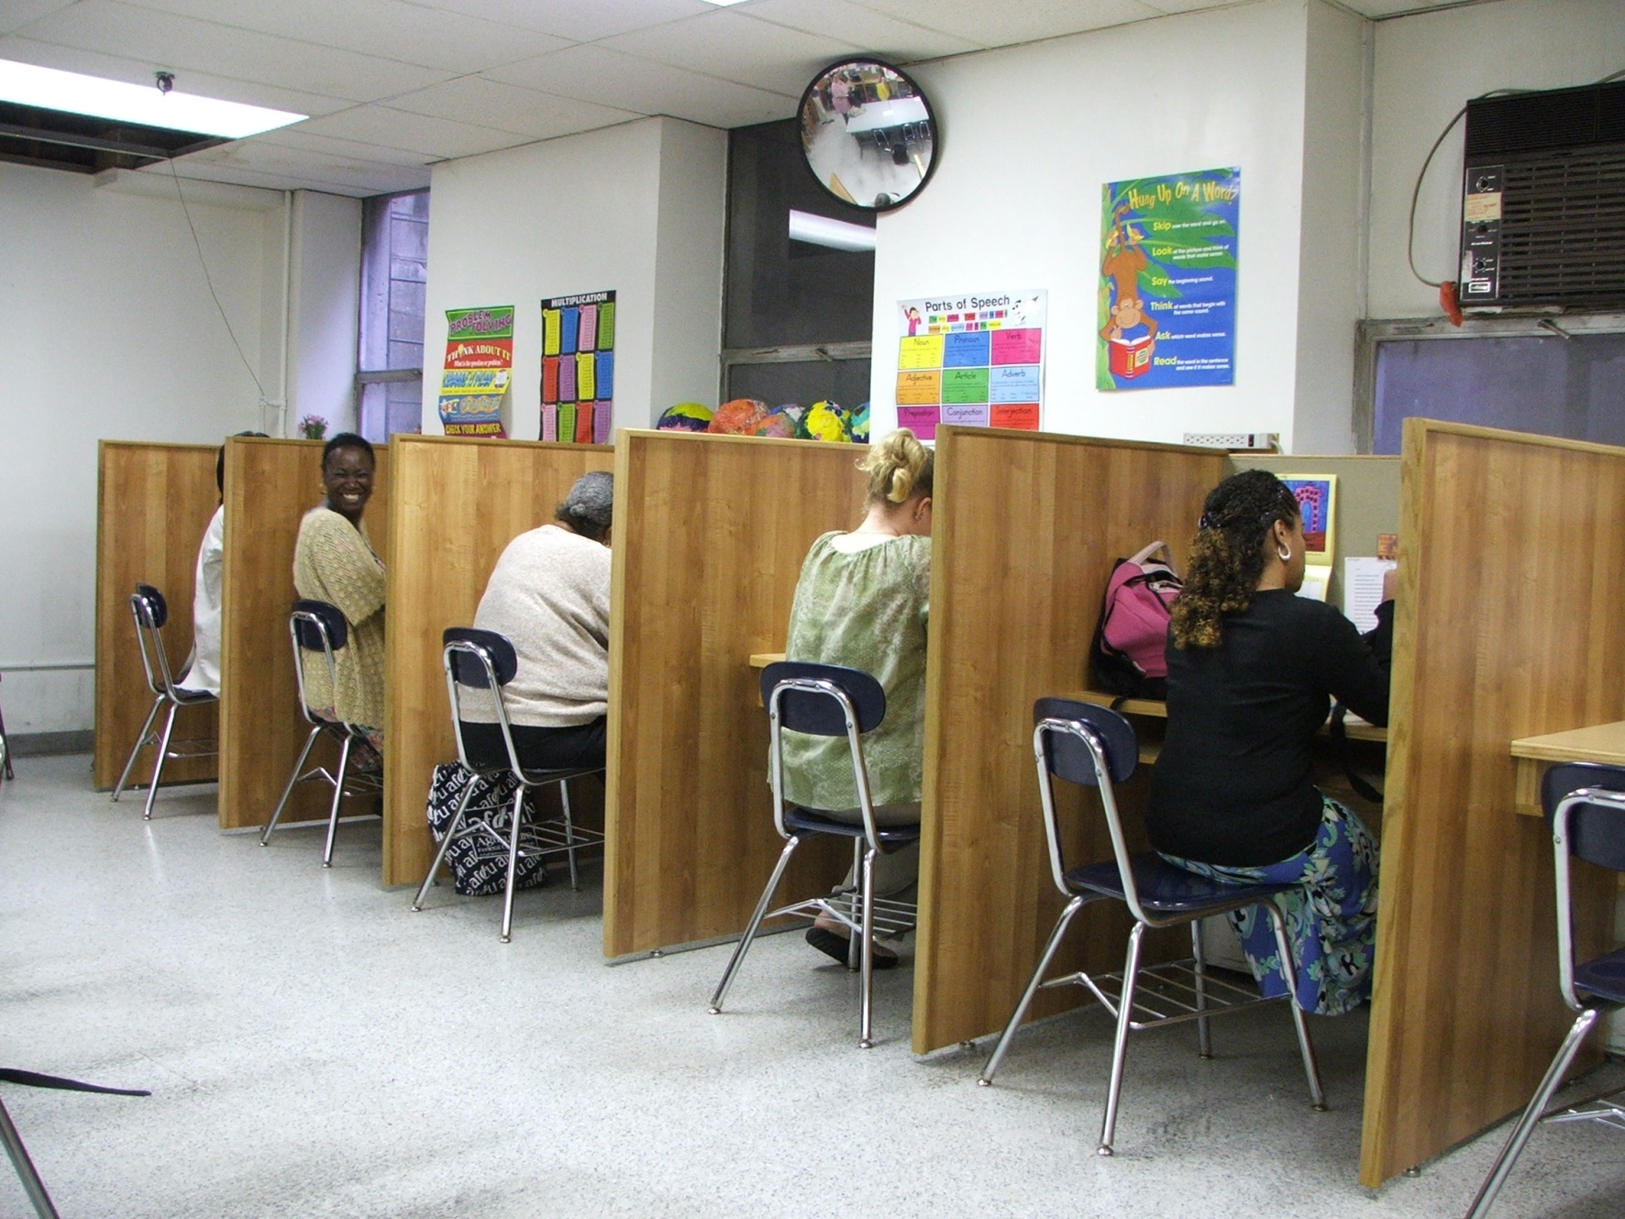

Slide 7
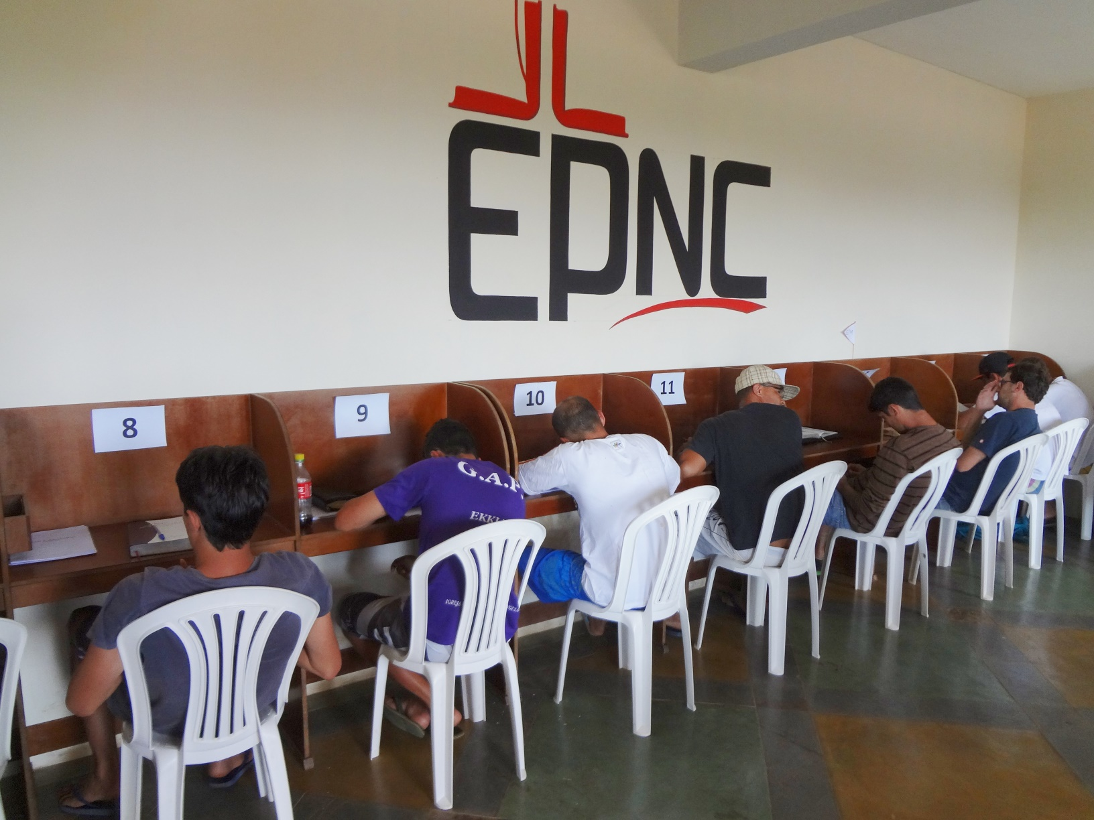
Notes:
PSNC classroom in one TC center

Slide 9
Подарок тебе – новая машина! Gift for you—a new car!

Slide 10
Твой подарок ИЗНХ Your PSNC gift

Slide 11
Б. Если правильно применять ИЗНХ, потенциал влияния на жизнь студентов просто огромен – как это и было задумано.
The potential for the impact in a student’s life is huge IF PSNC is implemented well – as intended and as designed.
Notes:
The potential for the impact in a student’s life is huge IF PSNC is implemented well. – as intended and as designed

Slide 12
B. Больше, чем определенный набор учебных планов. ИЗНХ является моделью и структурой проведения уроков, во время которых учителя обеспечивают конкретные ресурсы, отвечающие на нужду и интересы конкретного студента.
The PSNC is more than a particular set of curriculum. The PSNC is a model and structure of conducting class where the teachers provide specific resources that address the particular needs and interests of each individual student.
Notes:
The PSNC is more than a particular set of curriculum - PSNC is a model and structure of conducting class where the teachers provide specific resources that address the particular needs and interests of each individual student.

Slide 13
2. Для чего были разработаны ИЗНХ? Why PSNC was developed
A. Каждую неделю в программе появляются новые студенты New students coming in the program every week
Разный духовный уровень у студентов Different spiritual levels
Разный уровень развития Different educational levels
Разные личные нужды и проблемы Different personal needs and problems
Notes:
Why Personal Studies for New Christians (PSNC) was developed
New students coming in the program every week
Different spiritual levels
Different educational levels
Different personal needs and problems

Slide 14
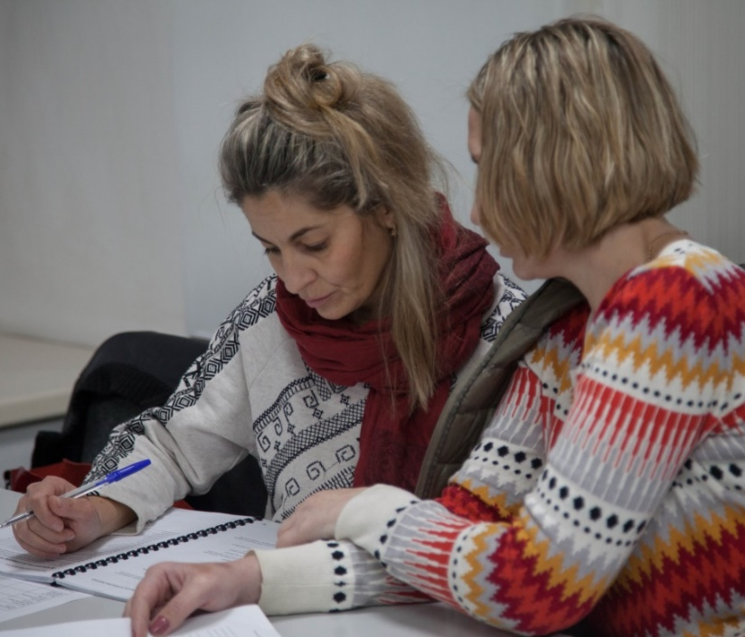
Значимые отличия Major Distinctive
Основное отличие индивидуального образования в том, что преподаватель не стоит у доски перед всем классом, читая лекцию. The major distinctive of individualized education is that the teacher is not up in front of the class lecturing the entire group.
Вместо этого преподаватель работает со студентом один на один Instead the teacher works on a one-to-one basis with the students.
Notes:
Major Distinctive
The major distinctive of individualized education is that the teacher is not up in front of the class lecturing the entire group.
Instead the teacher works on a one-to-one basis with the students.

Slide 15
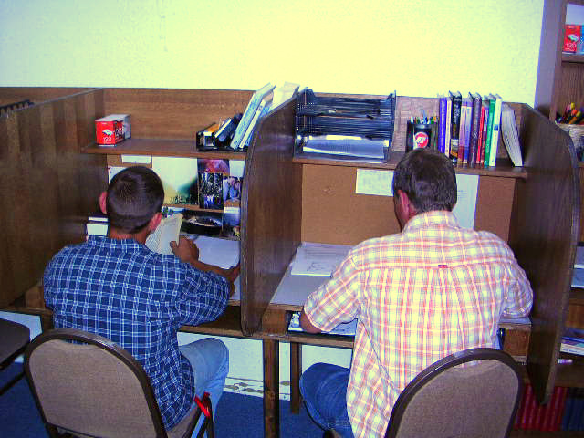
Б. У каждого студента есть свой собственный стол. Each student has their own desk
Notes:
Each student has their own desk

Slide 16
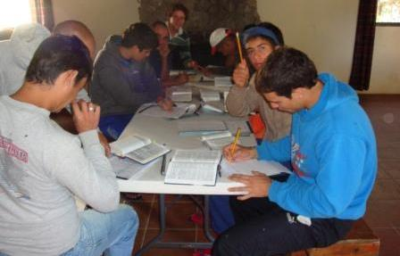
<< Идеальная организация Ideal
не идеально Not Ideal>>
Notes:
Top -- Ideal classroom
Bottom -- Not ideal

Slide 17
Кабинет ИЗНХ The PSNC Classroom
Другие факторы, создающие положительную атмосферу обучения: Other things that are important to helping to create a positive learning environment:
Качественное освещение Good lighting
Отсутствие в кабинете отвлекающих моментов Classroom free from distractions
Удобные стулья Comfortable chairs
Библиотека Library
Иллюстрации Artwork
Проветривание Airflow
Notes:
The PSNC Classroom
Other things that are important to helping to create a positive learning environment:
Good lighting
Classroom free from distractions
Comfortable chairs
Reference book library
Artwork, airflow,,, etc.

Slide 18
Занятия и изучение Библии Lessons and Bible Studies
Notes:
5 Contract Components
Lessons and Bible Studies

Slide 19
Занятие по заучиванию мест Писания Scripture Memorization Class
Notes:
Scripture Memorization Class

Slide 20
Занятие по
качествам характера Character Qualities Class
Notes:
Character Qualities Class

Slide 21
Занятие по чтению Библии Bible Reading Class
Notes:
Bible Reading Class

Slide 22
Занятие самостоятельным чтением Personal Reading Class
Notes:
Personal Reading Class

Slide 23
ЗАНЯТИЕ ПО ПРИМЕНЕНИЮ МАТЕРИАЛА ВОСКРЕСНОЙ ПРОПОВЕДИ В СВОЕЙ ЖИЗНИ
Sunday Sermon Personalization Class
Notes:
Sunday Sermon Personalization Class

Slide 24
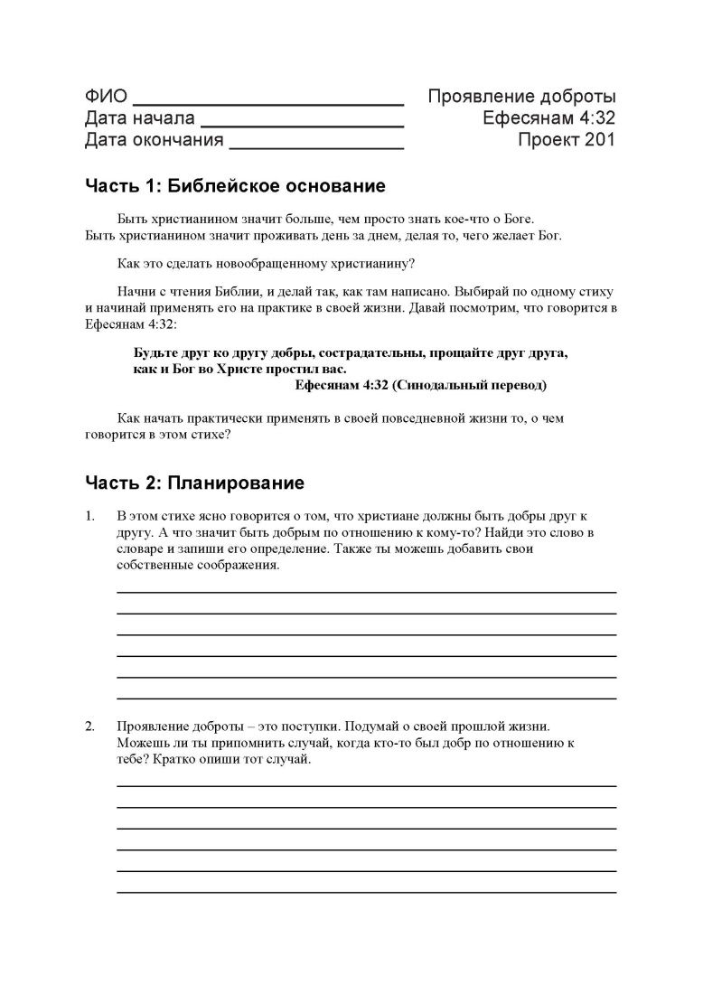
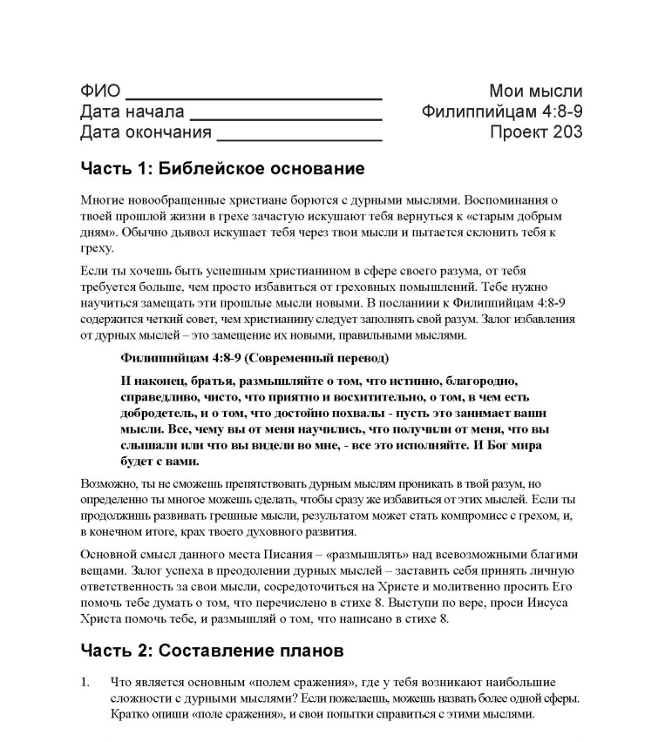
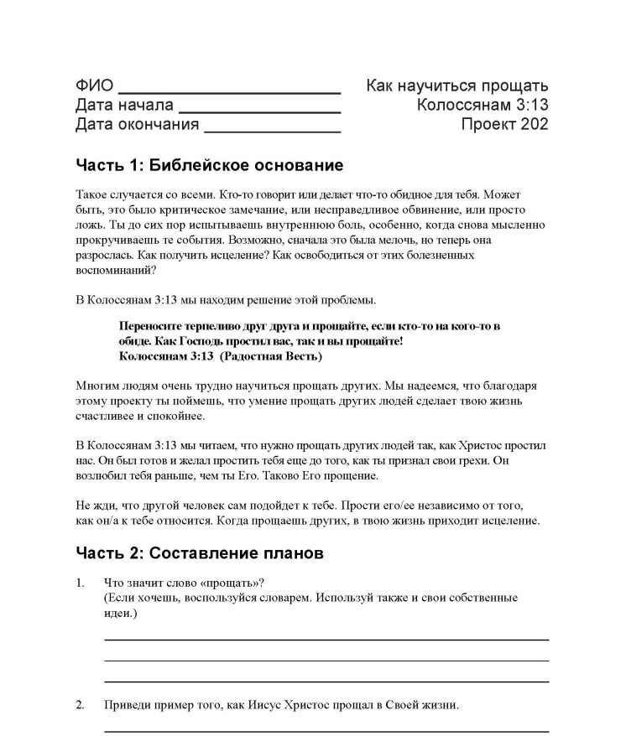
200 серий проектов 200 series of Projects
Цель этих двухсот серий проектов: Взять конкретные библейские принципы и места Писания, чтобы применять их в своей жизни на этой неделе Purpose of the 200 series projects:
To take a specific biblical principle and scripture and apply it in your life this week
Notes:
200 series of PSNC Projects
Purpose of the 200 series projects:
To take a specific biblical principle and scripture and apply it in your life this week.
Samples are shown of page one of Projects 201, 202, 203
These are the first 3 in this series. These can be used at any time in the program.

Slide 25
300 серий проектов 300 series of projects
Notes:
300 series of projects
1. These are special projects dealing with specific issues or problems in their lives.
2. Not all of these will be used by every student.
3. Some of these projects can be used at any point in the program.

Slide 26
300 серий проектов 300 series of projects
Это специальные проекты, касающиеся конкретных вопросов или проблем в жизни человека. These are special projects dealing with specific issues or problems in their lives
Не каждый из этих проектов можно использовать с любым студентом. Not all of these will be used by every student
Некоторые из этих проектов можно использовать на любом отрезке программы. Some of these projects can be used at any point in the program.
Notes:
300 series of projects
1. These are special projects dealing with specific issues or problems in their lives.
2. Not all of these will be used by every student.
3. Some of these projects can be used at any point in the program.

Slide 27
Проект 301 Я здесь! Project 301 I’m here!
Notes:
Project 301 I’m here!
This is used as the first project to have students tell what brought them to Teen Challenge. This is the only one in the 300 series that all students are required to complete. All the rest are only used as needed.

Slide 28
Проект 302 Новая надежда для жизни Project 302 New Hope for Life
Notes:
Project 302 New Hope for Life
This is a project for students who have left the program and returned to the program. They take a look at what happened the first time they were in TC, why they left, and now that they are back at TC, what do they want to see happen in their life.

Slide 29
Проект 303 На встречу с судьей Project 303 Go See the Judge
Notes:
Project 303 Go See the Judge
This is for students who have a court case coming up.
There are more projects in the 300 series, but they are not shown here in this PPT.

Slide 30
Notes:
This chart shows the overall progression of how students will come into the PSNC classes and gradually be introduced to all the different types of studies they will do. (An English copy of this chart is on the next slide.)

Slide 31
Notes:
This chart shows the overall progression of how students will come into the PSNC classes and gradually be introduced to all the different types of studies they will do. (The Russian copy of this chart is on the previous slide.)

Slide 32
Контракты Contracts
Студентам выдаются контракты, разработанные, чтобы отвечать на нужды и интересы студентов, помогая им работать на уровне их учебных способностей. Students are given contracts that are custom designed to address their needs and interests as well as it allows you to work with them within their learning abilities
Notes:
Contracts
Students are given contracts that are custom designed to address their needs and interests as well as it allows you to work with them within their learning abilities.

Slide 33
Контракты Contracts
A. Контракты разработаны на тему основных нужд или интересов студента. Student Learning Contracts are developed around a focus need or interest
Б. Учебный процесс: ЗНАТЬ – ПОНИМАТЬ – ДЕЛАТЬ Learning Process: Know – Understand – Do
Notes:
Student Learning Contracts are developed around a focus need or interest
Learning Process: Know – Understand – Do
Ideally a contract should be about one month long.
Students set daily goals as a means of helping them to develop their ability to manage their time.

Slide 34
Контракты Contracts
B. В идеале контракт должен длиться в течение одного месяца Ideally a contract should be about one month long
г. Студенты ставят ежедневные цели, чтобы научиться организовывать свое время. Students set daily goals as a means of helping them to develop their ability to manage their time
Notes:
Student Learning Contracts are developed around a focus need or interest
Learning Process: Know – Understand – Do
Ideally a contract should be about one month long.
Students set daily goals as a means of helping them to develop their ability to manage their time.

Slide 36
Каждый раз, когда студент завершает контракт, отмечайте это вручением сертификата.
Notes:
Celebrate the completion of a Contract with a certificate

Slide 37
5. Расписание по времени Time Schedule
2 часа, 5 дней в неделю 2 hours each day, 5 days a week
Notes:
How much time should we have PSNC classes per week?
2 hours each day
5 days a week

Slide 38
6. Соотношение учителей на количество студентов? Teacher to Student Ratio
1 учитель – 5 студентов 1 Teacher to 5 students
Notes:
Teacher to Student Ratio?
1 to 5

Slide 39
Заключение Conclusion
A. Правильно все организовав, вы сможете взаимодействовать со студентом на личном уровне и работать с его конкретными нуждами. Вы сможете прочитать работу студента, - пока читаете, вы слушаете их. Operating correctly you are able to interact with each student on a personal level dealing with their specific needs. You are able to read a student’s work, - when you read a student’s work you are listening to them
Notes:
Introducing the PSNC
Operating correctly you are able to interact with each student on a personal level dealing with their specific needs. You are able to read a student’s work, - when you read a student’s work you are listening to them.
How do they know you are listening - Comment in writing and in conversation –pull them to the side for a moment during class or after class.

Slide 40
Заключение Conclusion
Б. Как им понять, что вы слушаете – комментируйте письменно и устно –отведите их в сторонку во время занятия или после него. How do they know you are listening? – Comment in writing and in conversation – either during class or after class.
Notes:
Introducing the PSNC
Operating correctly you are able to interact with each student on a personal level dealing with their specific needs. You are able to read a student’s work, - when you read a student’s work you are listening to them.
How do they know you are listening - Comment in writing and in conversation –pull them to the side for a moment during class or after class.

Slide 41
Курс сертификации преподавателя ИЗНХ
PSNC Teacher Certification Course
www.iTeenChallenge.org
Notes:
PSNC Teacher Certification Course

Slide 42
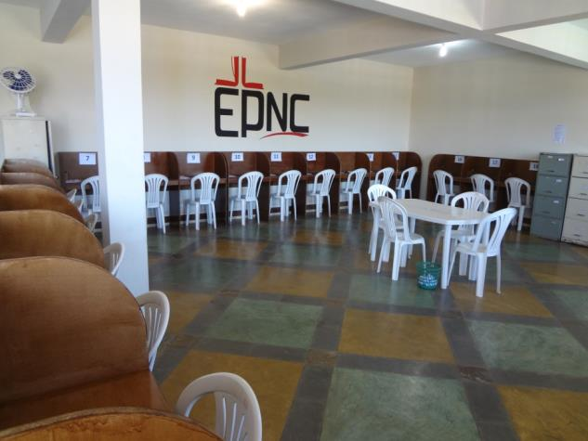
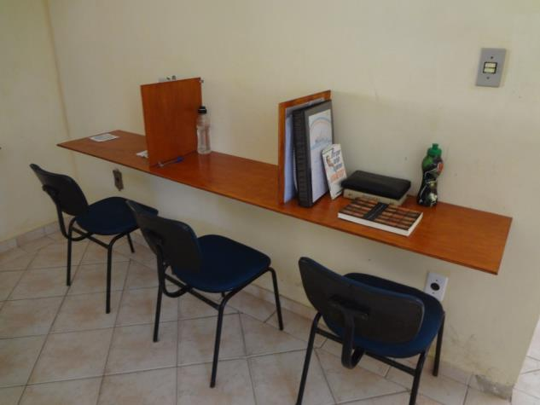
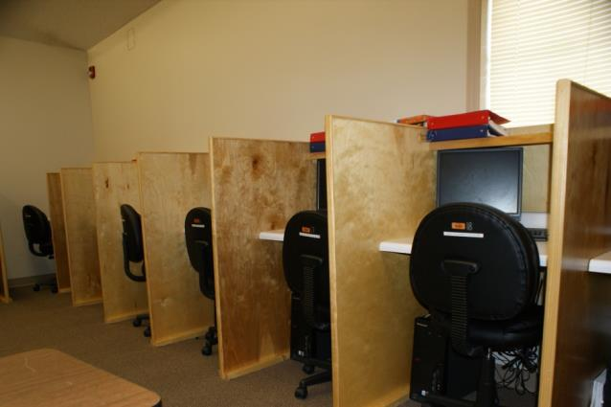
Notes:
PSNC classrooms at different TC centers

Slide 43
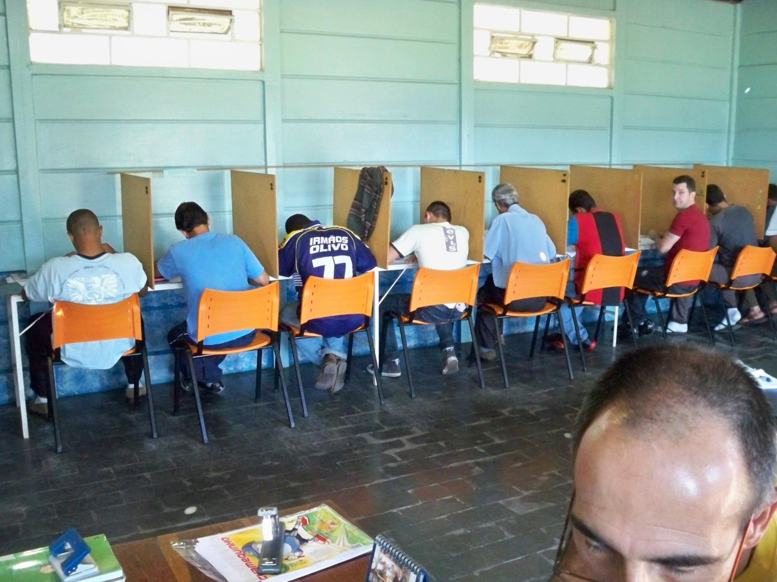

Slide 44
Твой подарок ИЗНХ Your PSNC gift

Slide 45
Вопросы для обсуждения Questions for discussion

Slide 46
Contact information
Global Teen Challenge
www.GlobalTC.org
www.iTeenChallenge.org

