Slide 1
Writing Student Learning Contracts
By Dave Batty

Slide 2
What are Contracts?
1. Contracts are a written plan for student class work
2. A plan for growth
3. Personalized outlines for study in the Personal Studies for New Christians Curriculum

Slide 3
What are Contracts?
4. A specialized tool to help each student
5. An organized plan to help students study the various units in the PSNC

Slide 4
What are Contracts?
6. A treatment plan that includes:
goals for growth
expected outcomes
time limits (3-5 weeks)

Slide 5
What are Contracts?
7. Students are given contracts that are custom designed to address their needs and interests as well as it allows you to work with them within their learning abilities.

Slide 6
Why Contracts?
1. Focused Study on Major Themes
2. Sense of Accomplishment

Slide 7
Why Contracts?
3. Contracts provide flexibility for different students
academic abilities
needs
interests
levels of spiritual growth

Slide 8
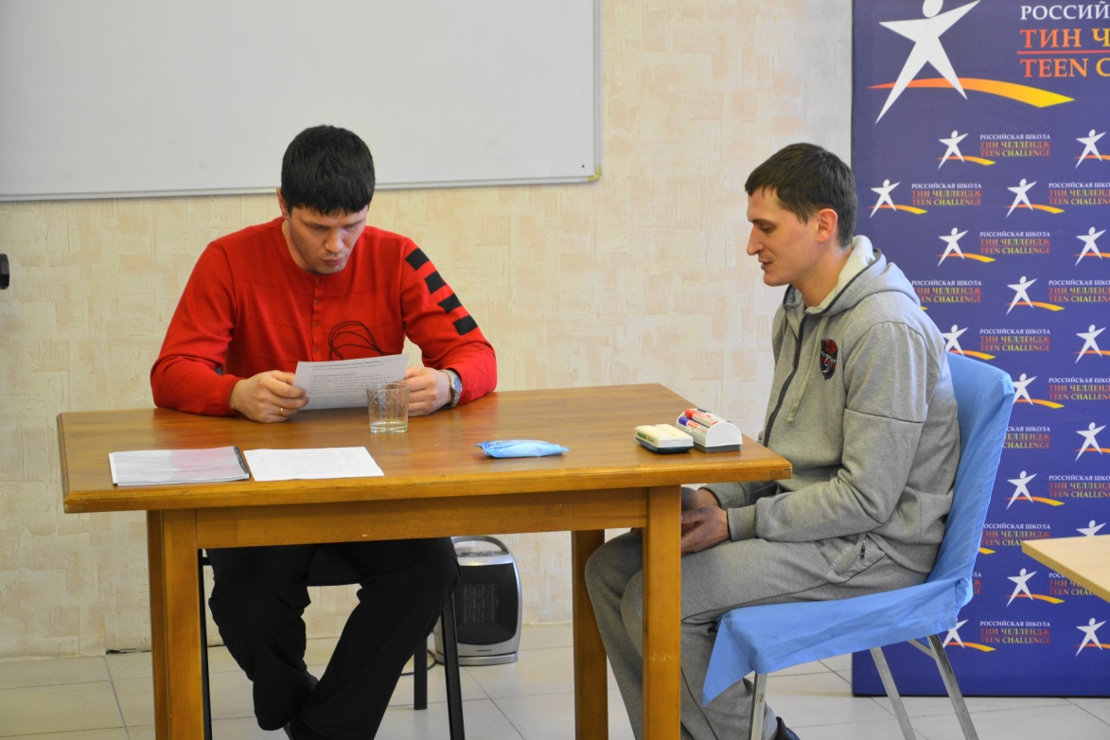
Why Contracts?
4. Complements your counseling ministry

Slide 9
What’s included in a Contract?
1. Focused Study on Major Themes
2. Goals for Growth
3. Lessons and Bible Studies
4. Scripture Memorization Class

Slide 10
What’s included in a Contract?
5. Character Qualities Class
6. Personal Reading Class
7. Bible Reading Class
8. Special Projects

Slide 11
Writing Contracts

Slide 12
A. Develop Tools
1. PSNC Library
Lessons
Books with study guides
Videos, DVD’s, Audio tapes, CD’s etc.
Tracts

Slide 13
A. Develop Tools
2. Contract Questionnaires
Use questionnaires provided or develop your own
3. Contract Writing Book

Slide 14
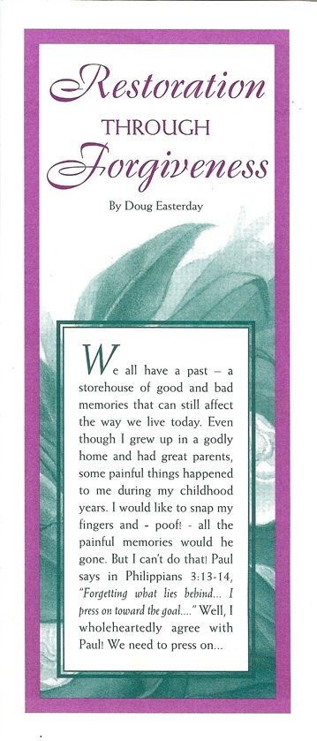
LDM
Discipleship
Teachings

Slide 15
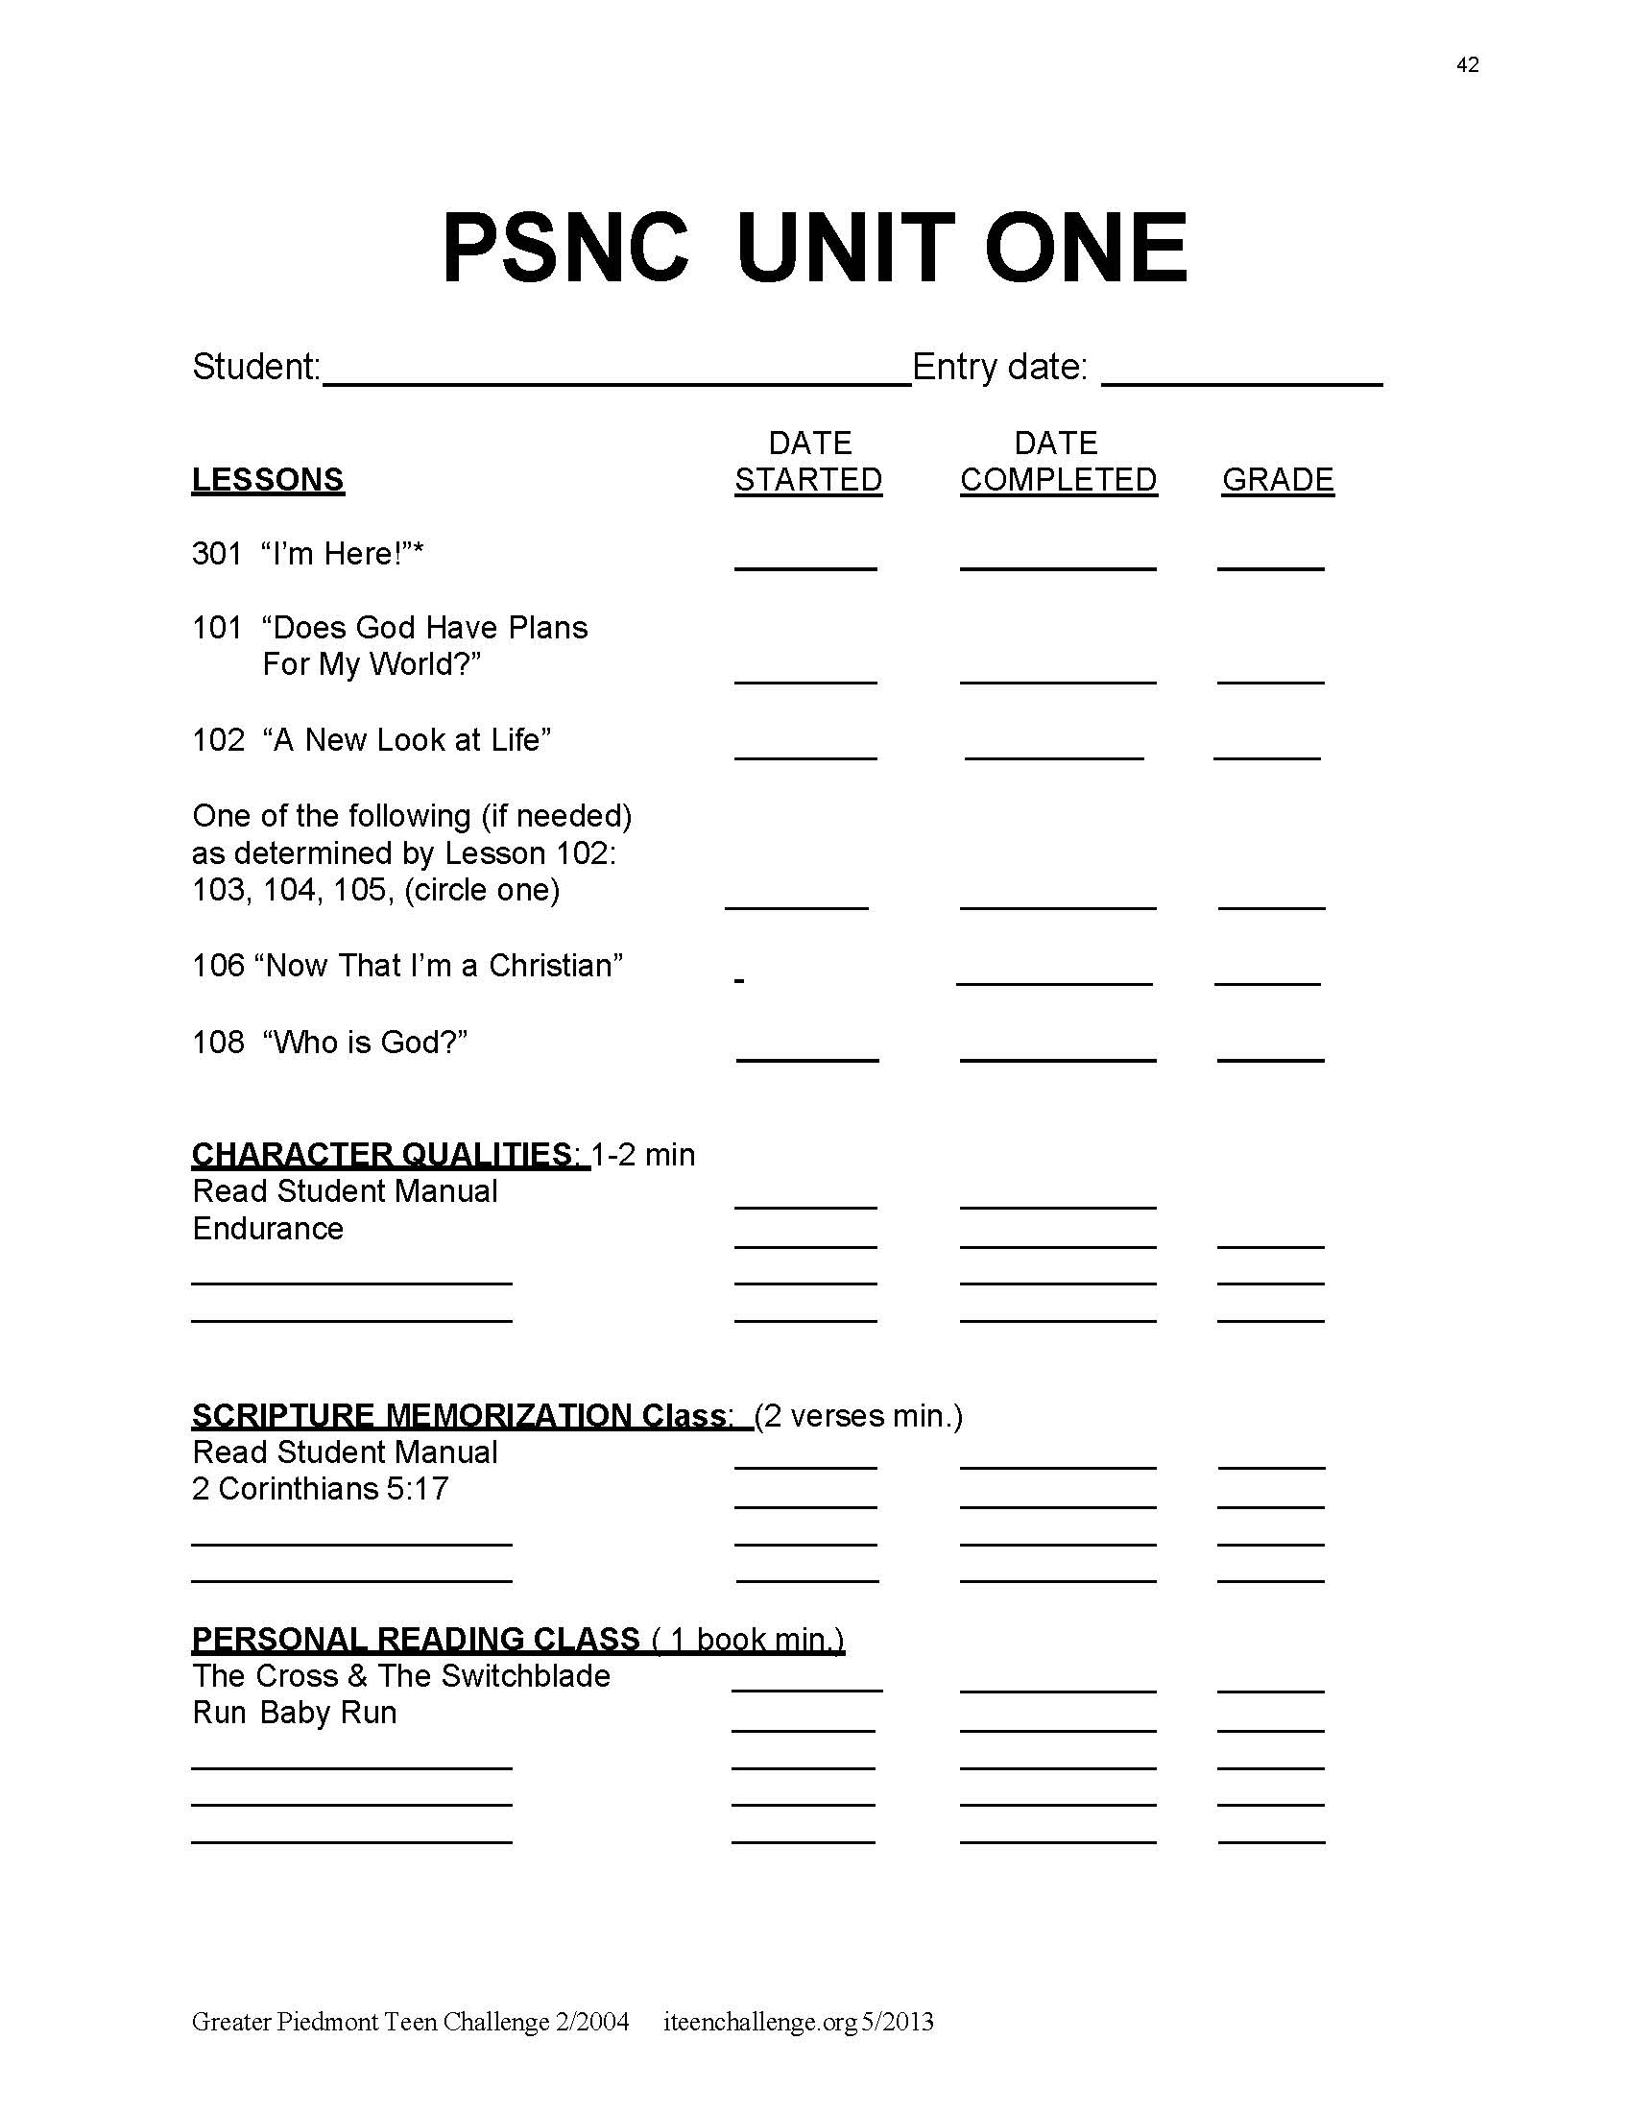
B. Unit 1 Salvation
Use Contract form or develop one
Use Project 301 to get to know the student
Is a reading test needed?

Slide 16
Б. Unit 1 Salvation
Introduce Students to the PSNC
Lessons 101, 102, 103* – 106, *(depends on answers in 102) 108
Character Qualities Class

Slide 17
B. Unit 1 Salvation
Introduce Students to the PSNC
Scripture Memorization Class
Personal Reading Class
Bible Reading Class

Slide 18
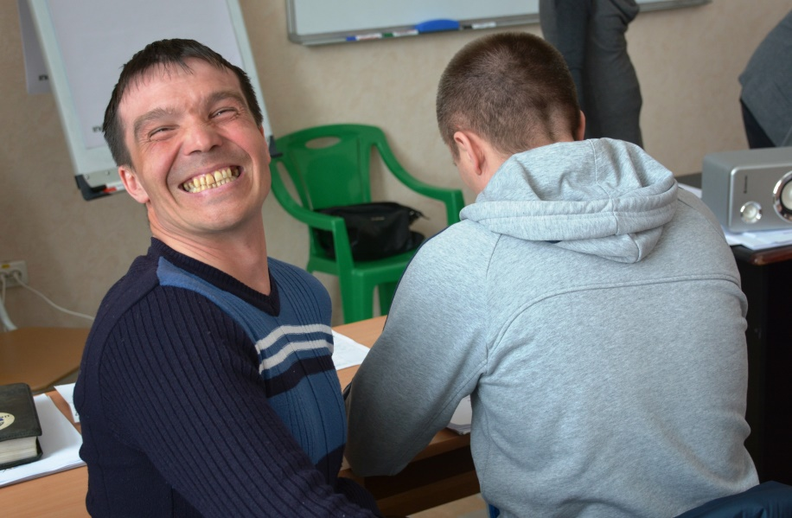
C. Units 2 & up
1. For all contracts from Unit 2 and higher, we will write a specific contract for each student

Slide 19
B. Units 2 & up
2. Gather information prior to writing contract
Use Unit Questionnaire form
feedback from dorm staff, counselors, work supervisors, & evaluations

Slide 20
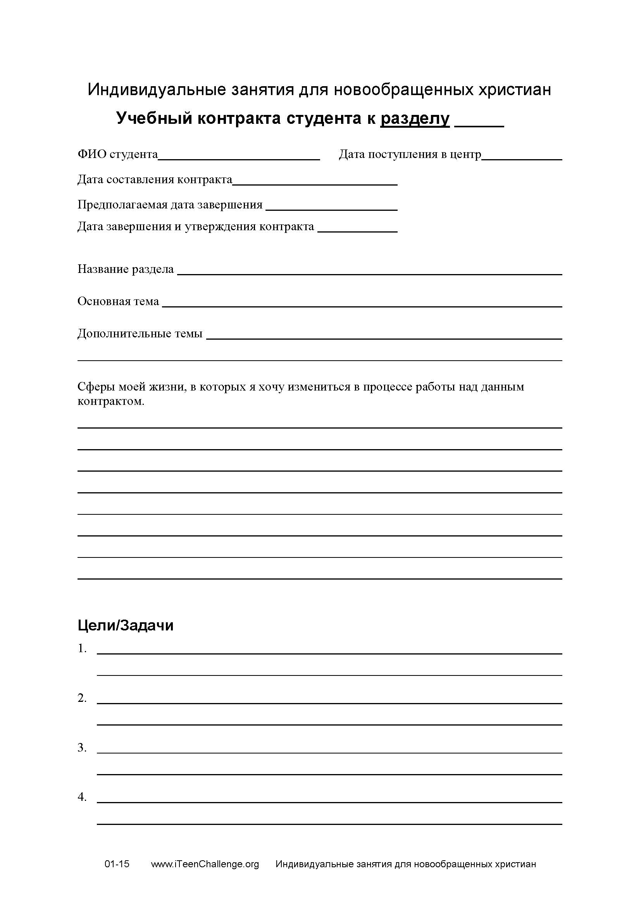
B. Units 2 & up
3. Meet with student
4. Pray
5. Write the contract

Slide 21
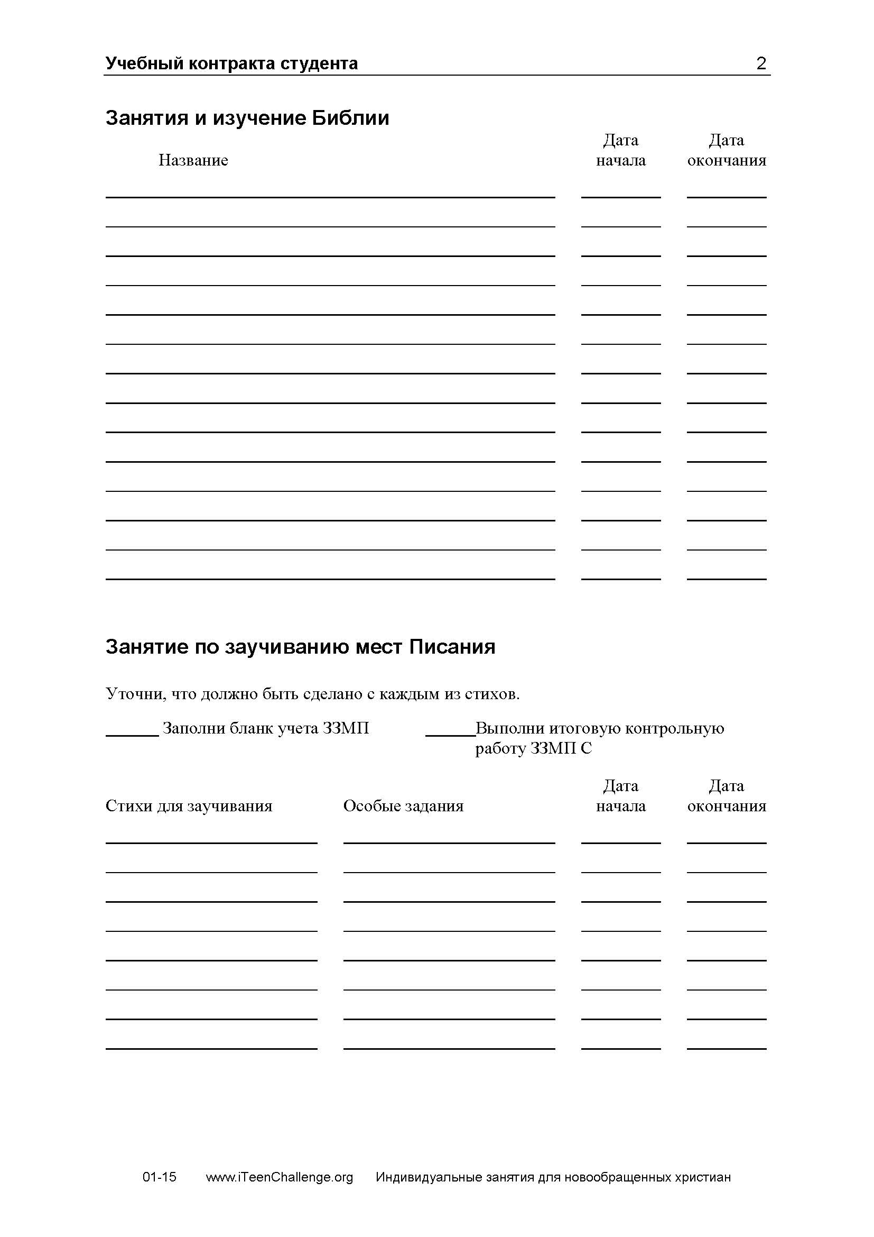
Student Learning Contract
Includes places for the students to track their progress on each assigned part of this contract

Slide 22
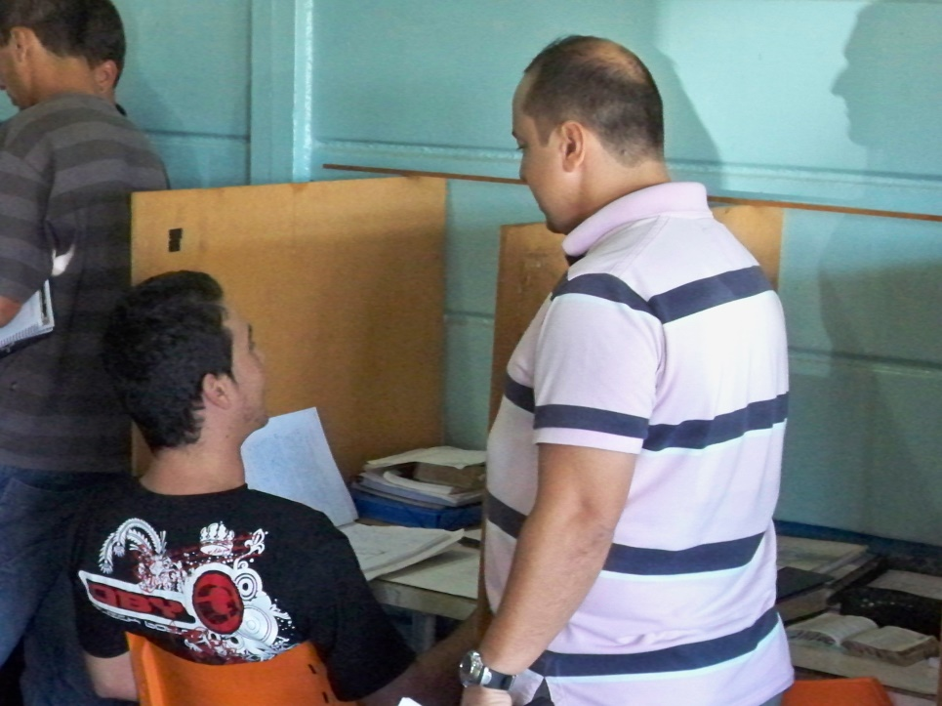
B. Units 2 & up
6. Prioritize their work
7. Track their progress as they work on their contract

Slide 23
B. Units 2 & up
8. End of contract evaluation
Write an evaluation of how this contract work helped them
Use the goals from page 1 of the Student Learning Contract

Slide 24
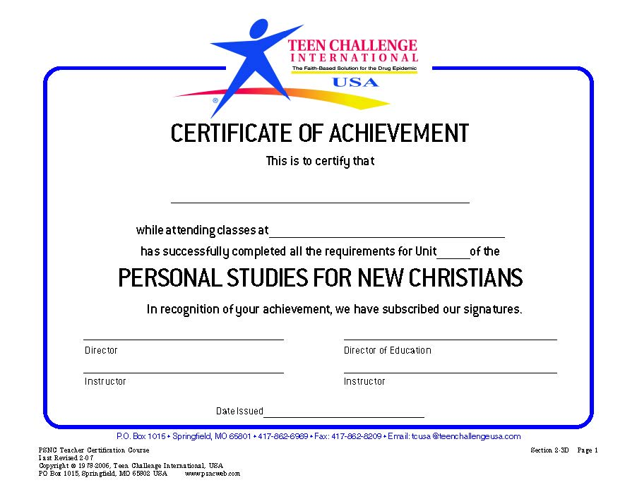
B. Units 2 & up
9. Certificate of completion
Celebrate their completion of the contract by awarding them a Certificate of Achievement

Slide 25
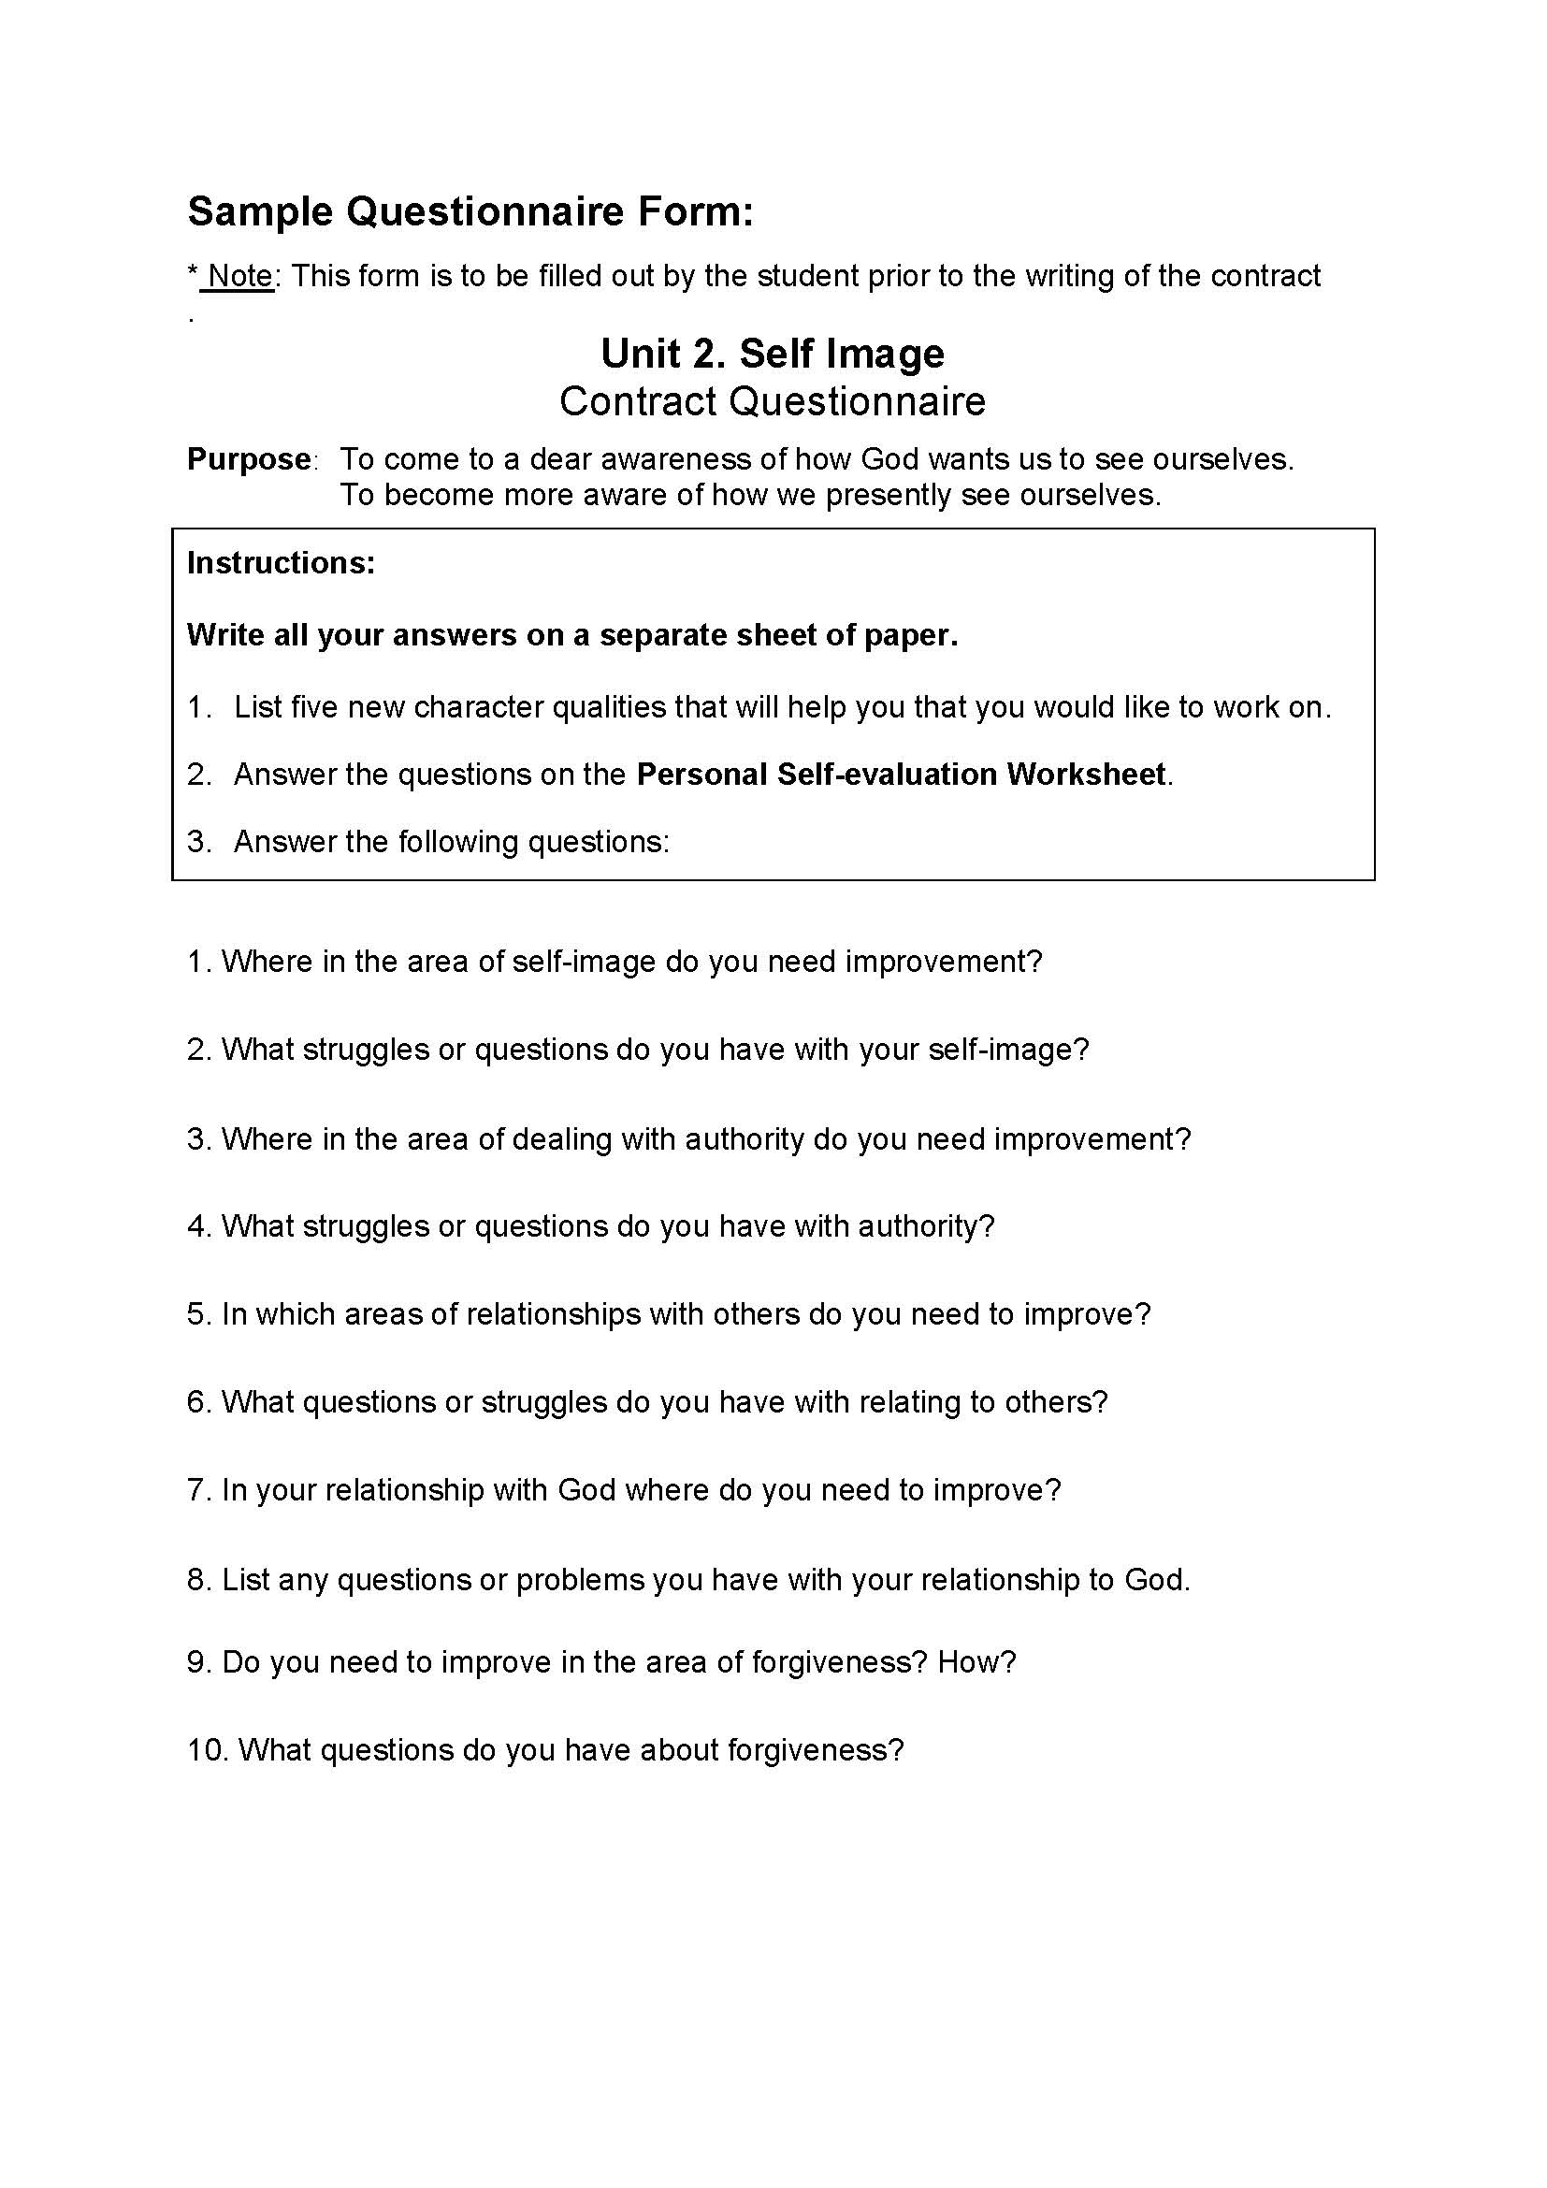
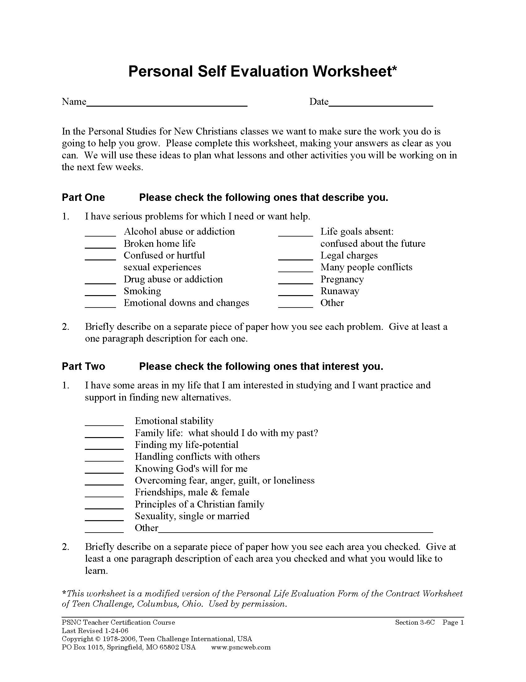
Student Learning Contract Unit 2. Self Image
1. Gather information prior to writing contract
Use Unit 2 Questionnaire form
Personal Self-evaluation Worksheet

Slide 26
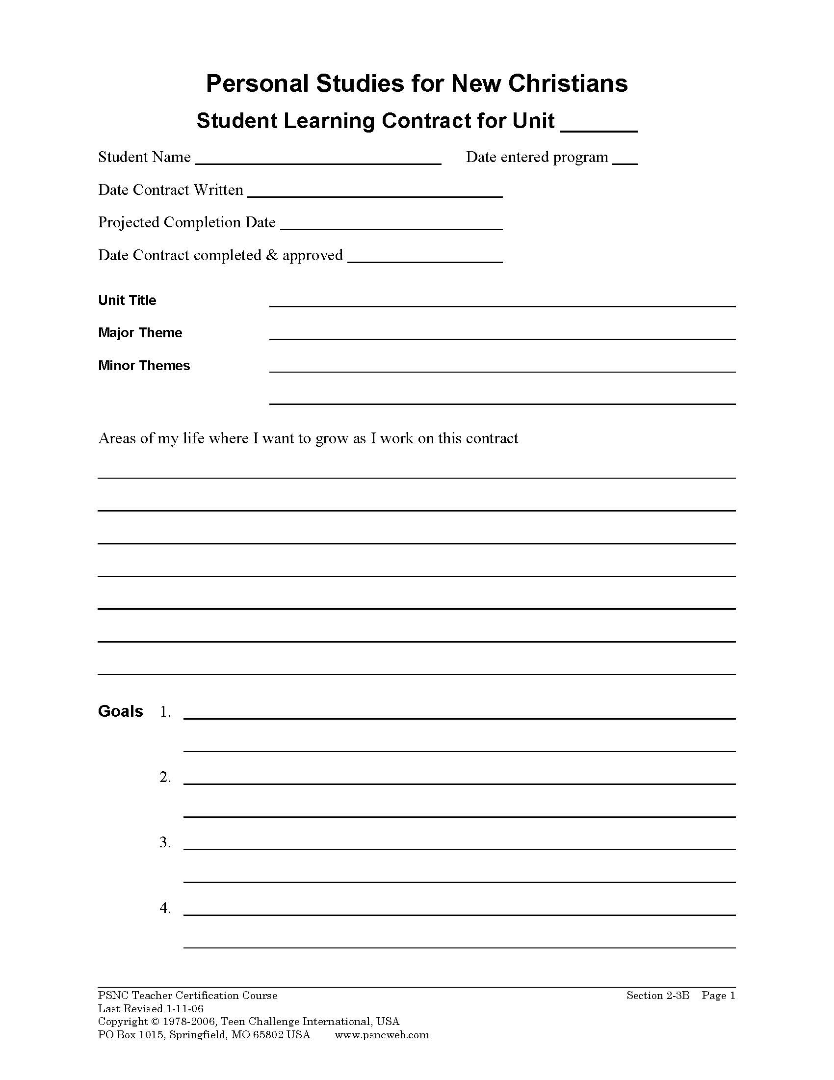

Slide 28
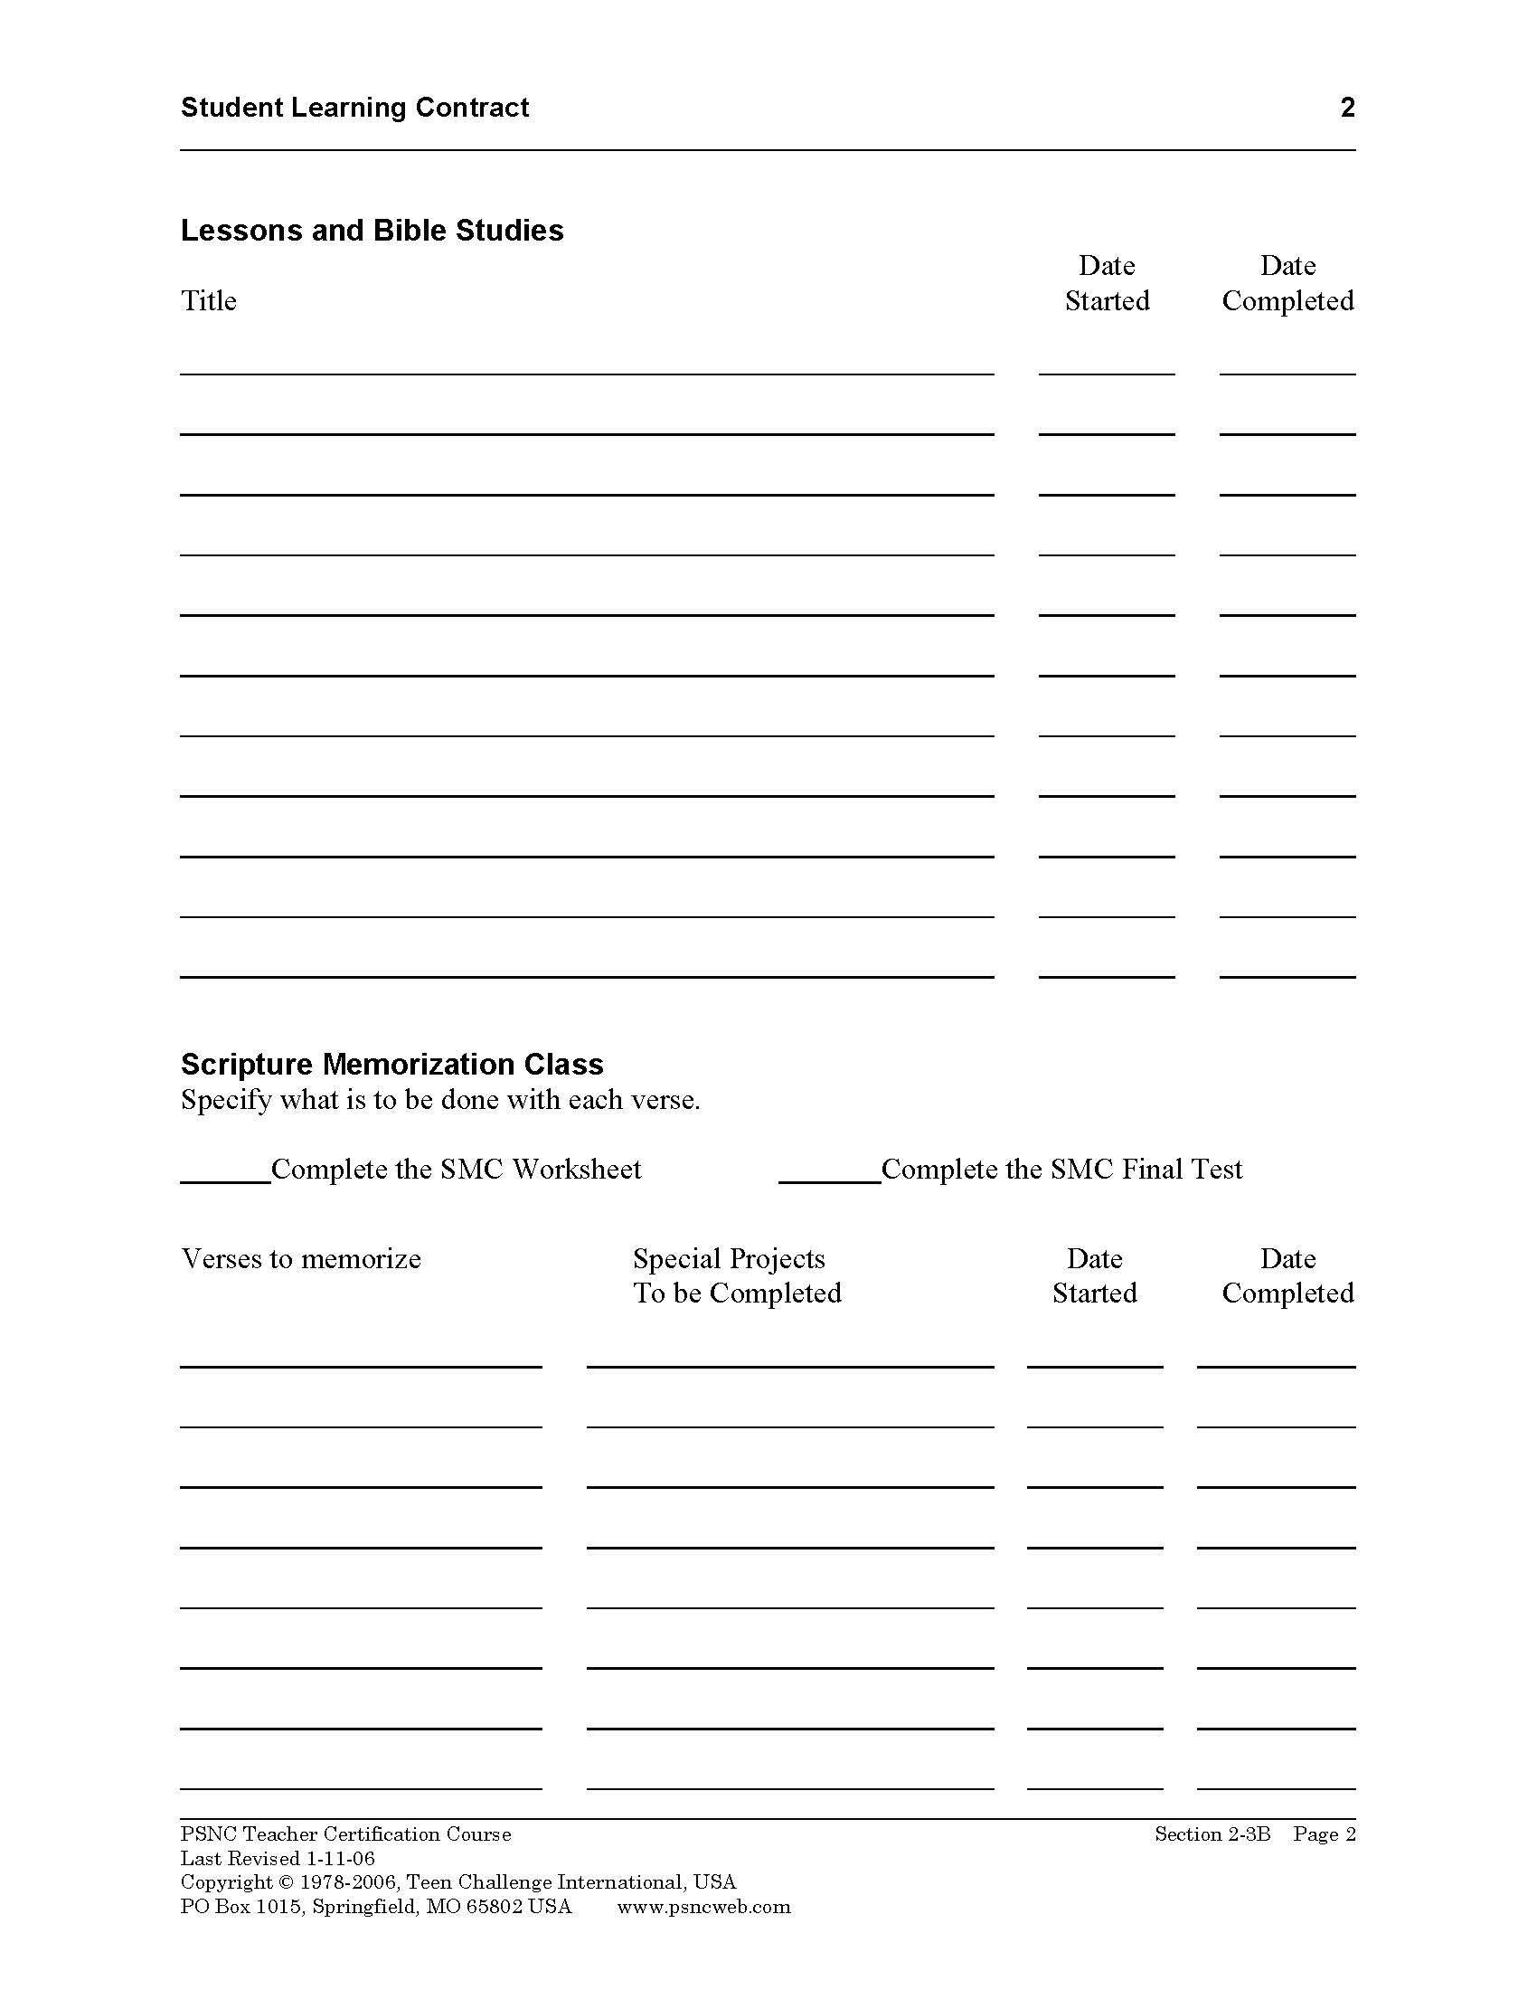
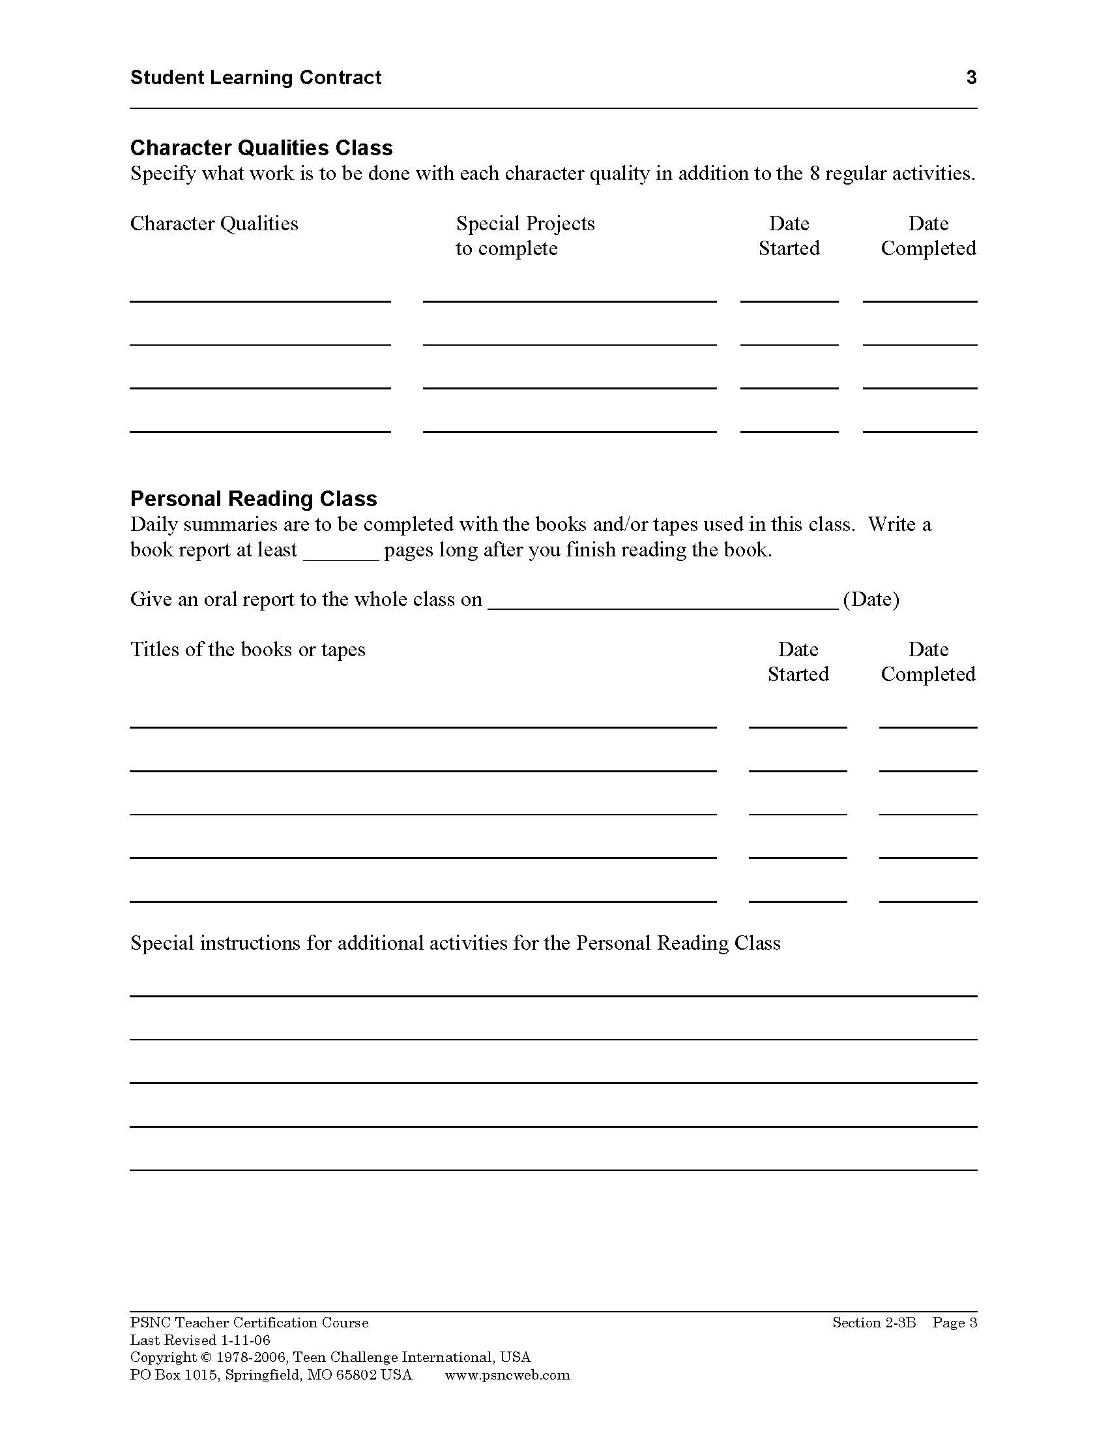

Slide 29
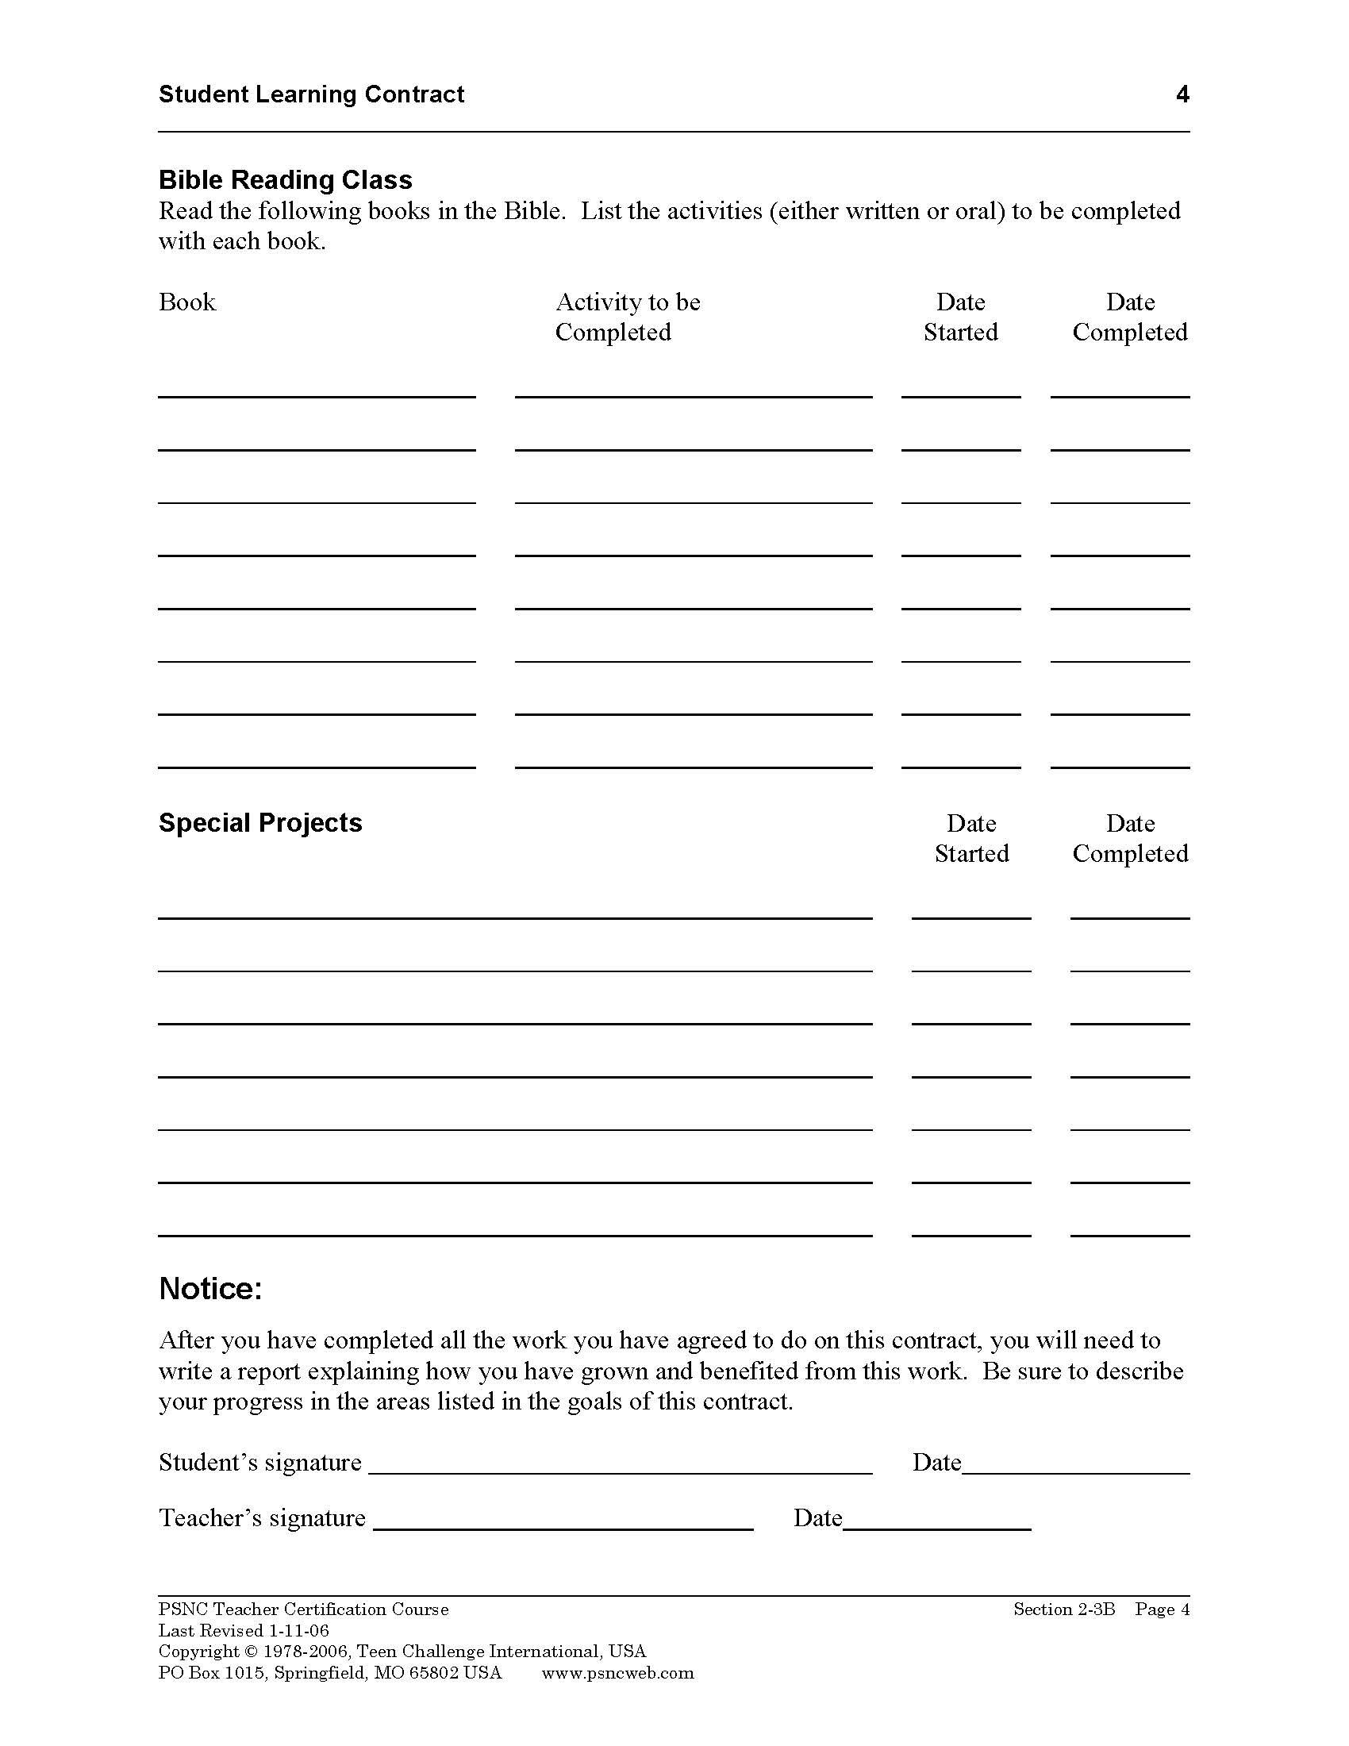

Slide 31
Questions for discussion

Slide 32
Contact information
Global Teen Challenge
www.GlobalTC.org
www.iTeenChallenge.org

